Slide 1

AWS CodePipeline
CONTINUOUS INTEGRATION AND CONTINUOS DELIVERY
By Yesid Perea Martinez https://github.com/yperea
Based on What is Continuous Delivery? - Amazon Web Services

Slide 2


AWS CodePipeline
Concepts
How it works
Demo
Questions

Slide 3
AWS CodePipeline
Concepts

Slide 4
Continuous Integration
+
=
Quality Tests
Continuous Delivery
+
Automatic Deployment
=
Continuous Deployment
Software development practice where developers FREQUENTLY merge their code changes into a central repository, after which automated builds and tests are run.
Code changes are automatically built, tested beyond unit tests - UI testing, load testing, integration testing, API reliability testing, etc.- and pushed to a non-production testing or staging environment.
With Continuous Deployment, production happens automatically without explicit approval.

Slide 5
What is Continuous Integration?
Continuous integration is a DevOps software development practice where developers regularly merge their code changes into a central repository, after which automated builds and tests are run.

Slide 6
What a Continuous Integration…
…Needs?
AUTOMATION: A continuous integration service automatically builds and runs unit tests on the new code changes to immediately surface any errors.
CULTURAL: Developers FREQUENTLY commit (and push) to a shared repository.

Slide 7
What are Continuous Integration…
…Main Goals?
Improve software quality
Reduce Time to Market

Slide 8
What are Continuous Integration…
…Benefits?
Improve Developer Productivity
Freeing developers from manual tasks (Automation).
Encouraging behaviors that improves Software Quality (Culture).
More frequent testing discovers bugs earlier.
Better response to Business Needs

Slide 9
What is Continuous Delivery?
Continuous Integration + Quality Approval
Continuous delivery is a practice where code changes are automatically built, tested beyond unit tests, and prepared for a release to production.
These tests may include UI testing, load testing, integration testing, API reliability testing, etc.
When Continuous Delivery is implemented properly, developers will always have a deployment-ready build artifact that has passed through a standardized test process

Slide 10
What is Continuous Deployment?
Continuous Delivery + Automatic Deploy to Production
With Continuous Delivery, every code change is built, tested, and then pushed to a non-production testing or staging environment.
With Continuous Deployment, production happens automatically without explicit approval.

Slide 11
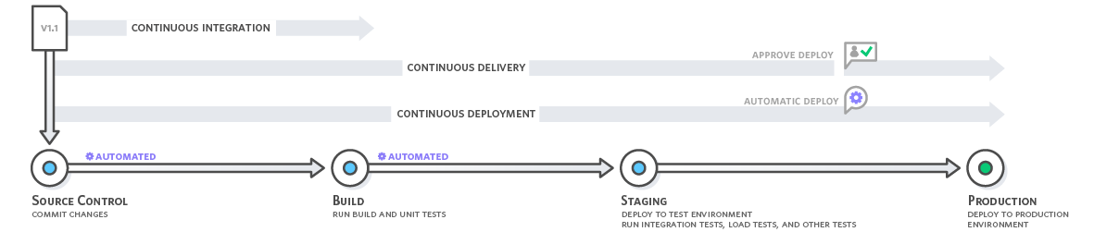
Continuous Delivery Cycle

Slide 12
What is AWS CodePipeline?
AWS CodePipeline is a fully managed Continuous Delivery service that helps to automate release pipelines for fast and reliable application and infrastructure updates.
Automates the build, test, and deploy phases of your release process every time there is a code change, based on the release model you define.

Slide 13

How AWS CodePipeline Works?

Slide 14
What is AWS CodeDeploy?
AWS CodeDeploy is a fully managed deployment service that automates software deployments across your development, test, and production environments whether deploying to Amazon EC2, AWS Lambda, and your on-premises servers.
Essential Components
Source Code
Repository
+
Appspec.yml
File
+
CodeDeploy
Agent

Slide 15
What is AWS CodeBuild?
AWS CodeBuild is a fully managed continuous integration service that compiles source code, runs tests, and produces software packages that are ready to deploy.

Slide 16
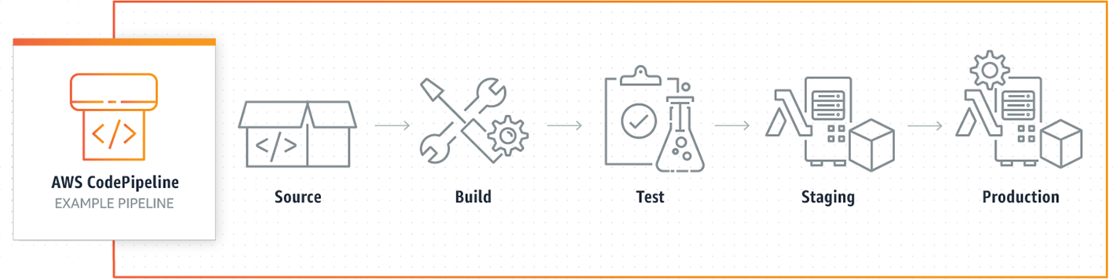
How AWS CodePipeline Works?

Slide 17
AWS CodePipeline
Demo

Slide 18
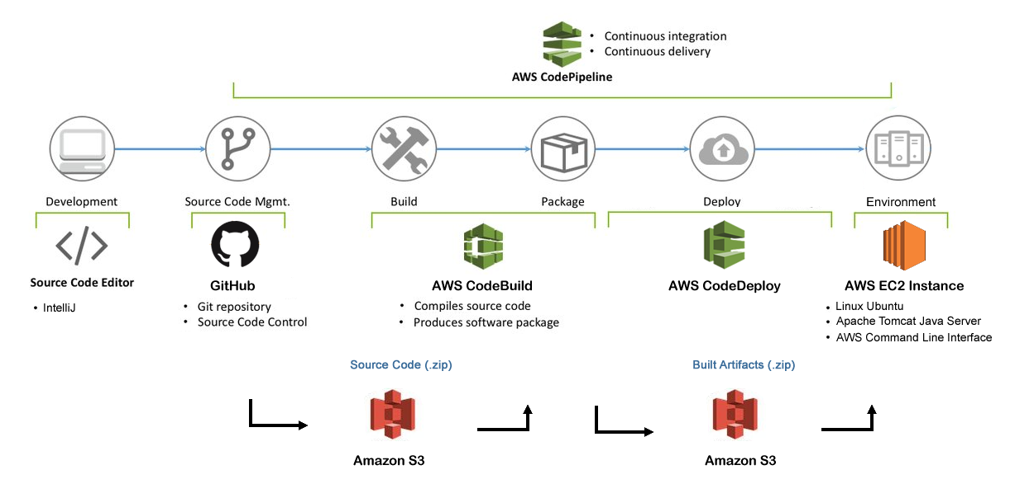
Demo Configuration

Slide 19
Demo Prerequisites
AWS Account
EC2 Instance with Linux Ubuntu 16 LTS and Apache Tomcat.
AWS CodeDeploy Agent installed.
AWS CodeDeploy Service Role to access the instances to which applications will be deployed.
GitHub Account
Repository with a Java Web Application or where you can push the sample code.
Source Code Editor
IntelliJ
Java WebApp Maven Project
Notes:
Setup tomcat7 as a Service
Modify .gitignore to push war file to GitHub
- Remember update CONTEXT_PATH in start_application script

Slide 20

AWS CodePipeline
OK… Let’s do it!

Slide 21

THANK YOU!
Questions?

