Slide 1
Office Security System using AWS Rekognition
Yashwanth Pindi
Anusha Suresh Akshintala
Under the Guidance of: Prof. Nico Schönnagel

Slide 2
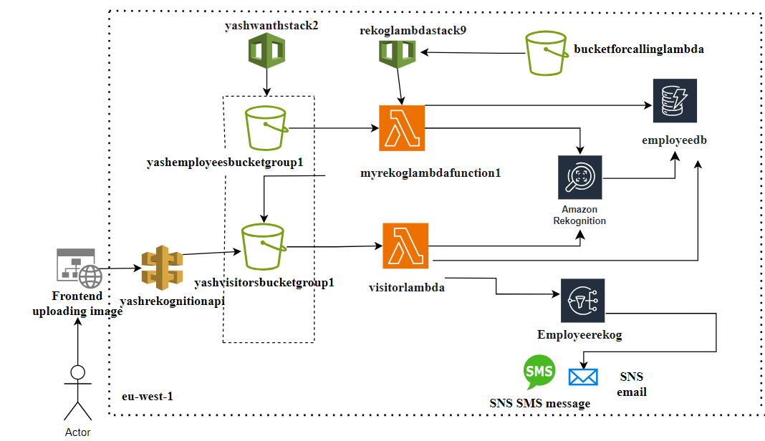

Slide 3
Contents
Employee Bucket - through Cloud Formation
Visitor Bucket - through Cloud Formation
Employee Lambda Function - through Cloud Formation
Amazon Dynamo DB
Visitor Lambda Function
Amazon Rekognition
Front-End Website
Amazon SNS
References

Slide 4

Amazon Rekognition
For image and video analysis
Compares the image present in the dynamo db table to the image just uploaded in the visitor bucket.

Slide 5
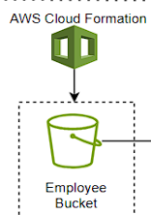
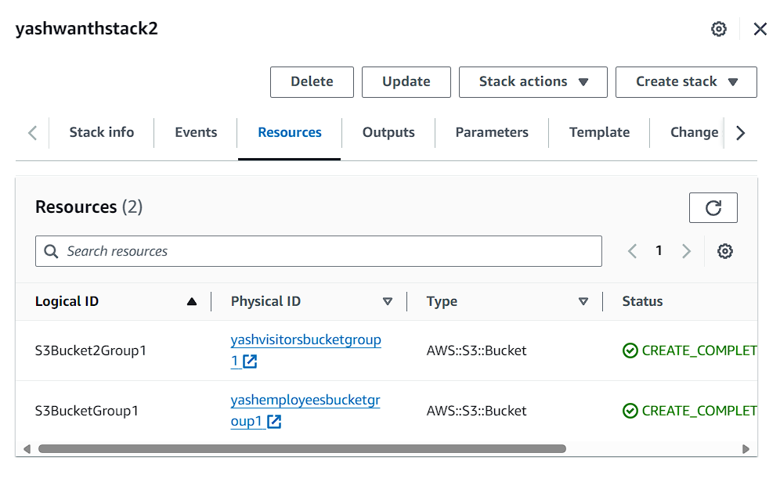
Employee and Visitor Bucket - through Cloud Formation

Slide 6
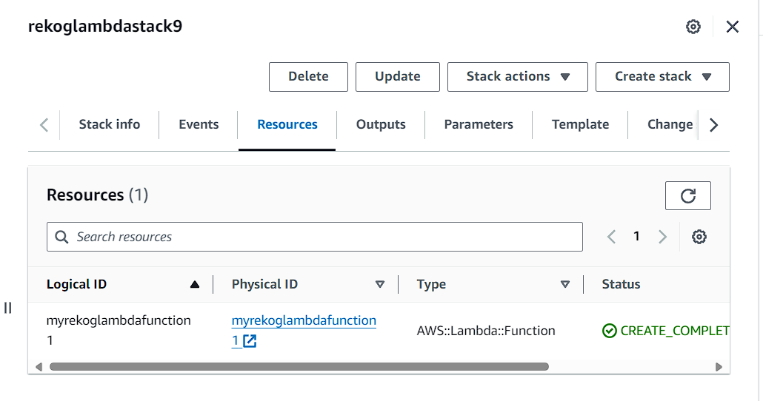
Employee Lambda through Cloud Formation

Slide 7
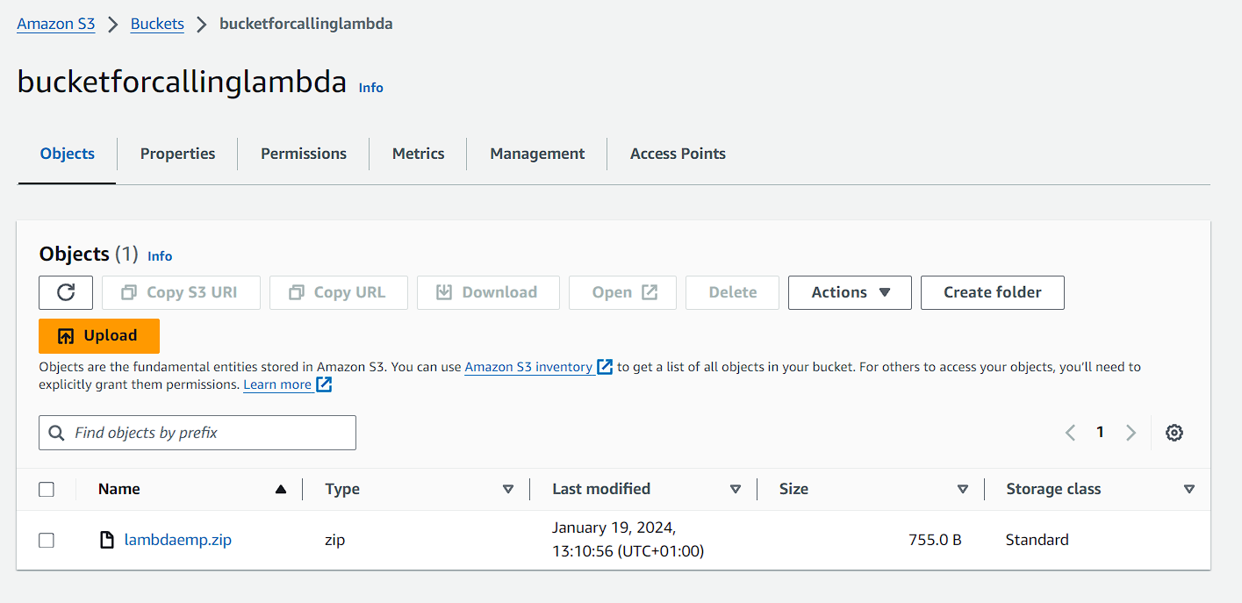
Employee Lambda through Cloud Formation whose code is stored in bucket

Slide 8
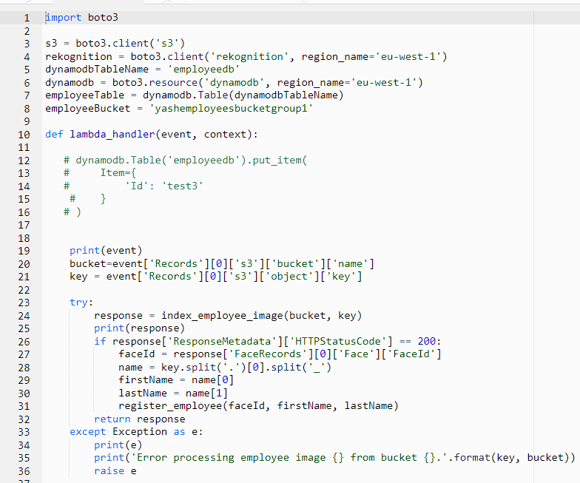
Employee Lambda - through Cloud Formation

Slide 9
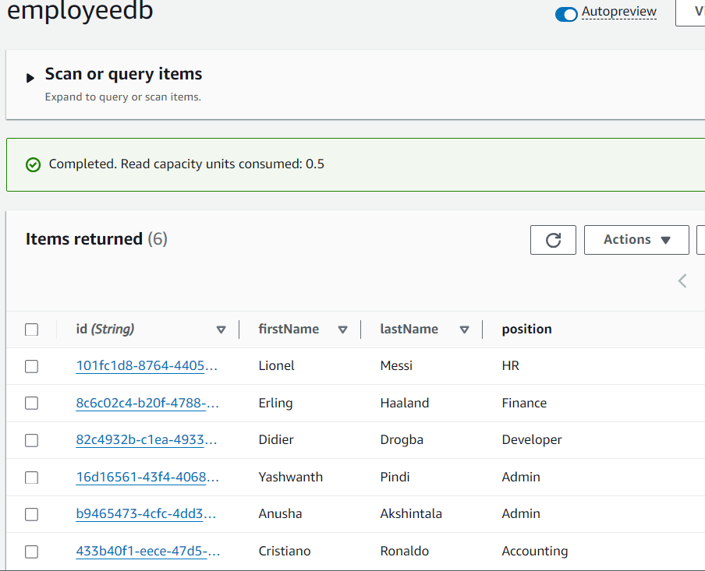
Amazon Dynamo DB

Slide 10
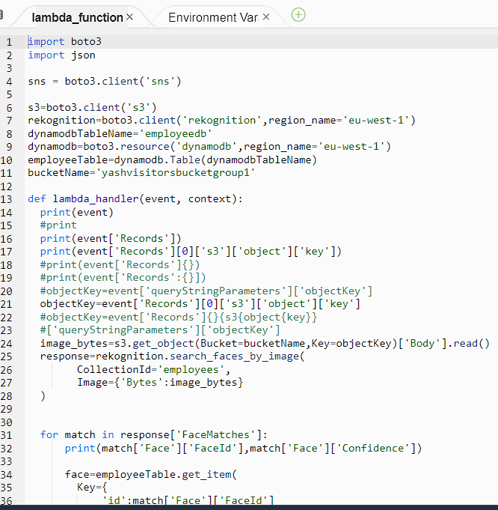
Visitor Lambda Function
Triggered when an image is uploaded into the Visitor Bucket.
Uses Amazon Rekognition in order to compare the employee (who’s information is stored in the employee dynamo db table) with the visitor.

Slide 11
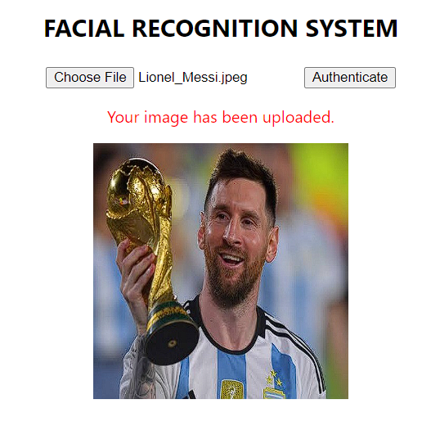
Front-End Website

Slide 12
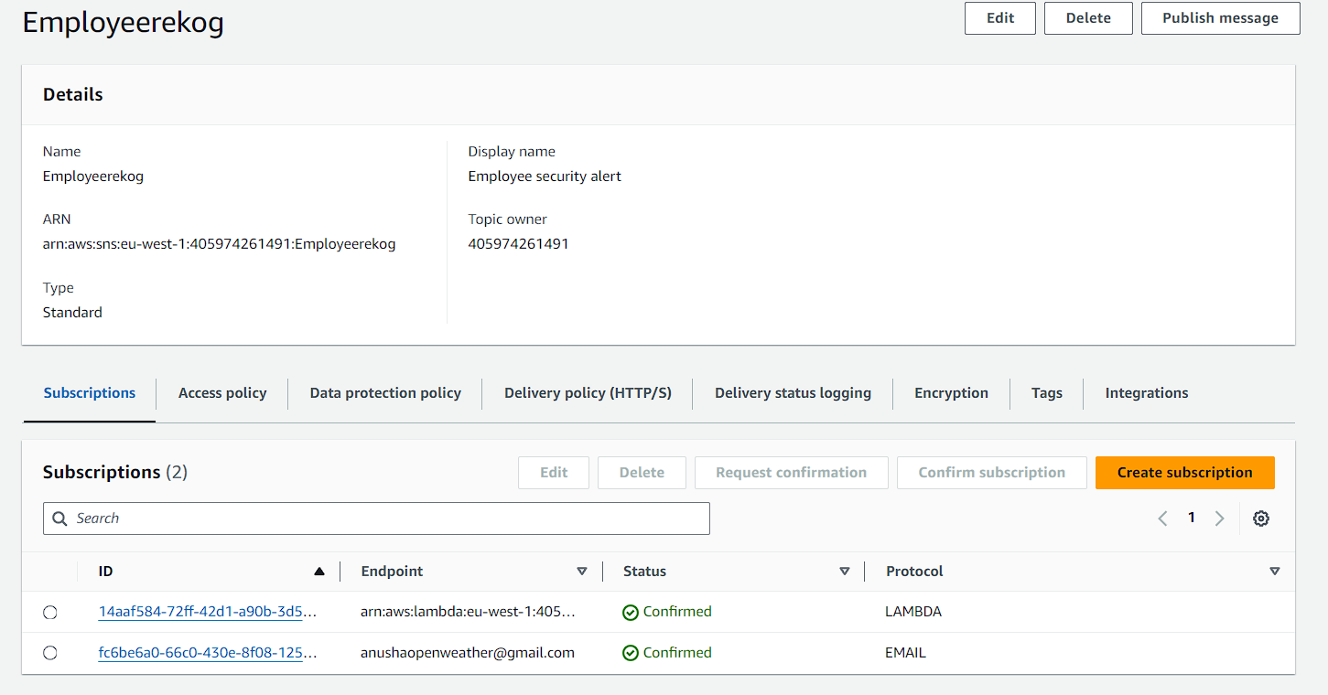
Amazon SNS

Slide 13
References
https://docs.aws.amazon.com/rekognition/latest/dg/face-feature-differences.html
https://docs.aws.amazon.com/apigateway/latest/developerguide/http-api-dynamo-db.html
https://docs.aws.amazon.com/AWSCloudFormation/latest/UserGuide/template-formats.html
https://docs.aws.amazon.com/AWSCloudFormation/latest/UserGuide/aws-resource-s3-bucket.html
https://docs.aws.amazon.com/sns/latest/dg/sns-email-notifications.html
https://eu-west-1.console.aws.amazon.com/rekognition/home?region=eu-west-1#/
https://youtu.be/vwYy8GUV8Zw?si=kYLk-l_EXzStE-hj
https://youtu.be/2k2GINpO308?si=5HTQT2Kk7Wb2oT9q
https://youtu.be/Q9YmoMwRKZQ?si=fQIix4mcTylVZgXp
https://youtu.be/FsXyfxLDDIs?si=OtWk0nJPX58RhuHt
https://youtu.be/j6pdncQiohs?si=XvQs_aWRI978yaiD
https://youtu.be/v662kWVBmdc?si=VFBPwJ2OWlTGqj3j

