Slide 1
WEB DEVELOPMENT
TEST CASE
PRESENTATION
Three HTML/CSS mini-projects
Restaurant Website • Student Profile • Ame-Tech Electronics
Prepared by: _G . Yaswanth Phani Krishna_
Course / Section: _CSM / Section-1_
Date: _25-10-26_

Slide 2
Project Overview
A summary of the three web development test cases.
01 Restaurant Website
02 Student Profile
03 Ame-Tech Electronics
A food-focused webpage with menu cards, dish imagery, About and Contact sections, and a footer.
A personal profile page presenting student details, education, hobbies, links, abbreviations, and HTML text examples.
A product showcase with electronics cards, images, prices, product search links, About and Contact sections.
Technologies represented: HTML • CSS • Images • Links • Page sections
02

Slide 3
Test Case 1 — Restaurant Website
Files: Web-dev1.html and styles13.css
• Displays a menu containing six dish cards.
• Uses external images as CSS background images.
• Includes About and Contact sections.
• Provides a footer to complete the page layout.
• Focuses on presenting restaurant food items in a visual format.
Main purpose
Help visitors browse a restaurant menu and view food options.
Screenshot evidence
Paste a browser screenshot on the next slide.
03

Slide 4
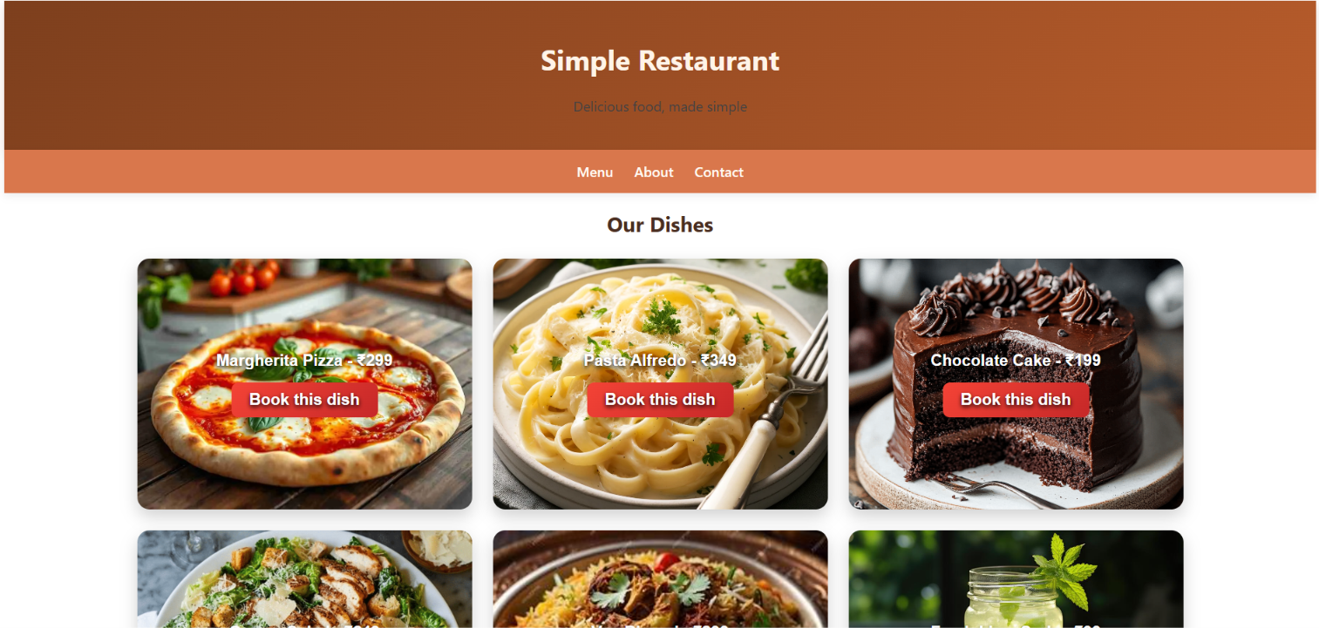
Restaurant Website — Screenshot
Paste a screenshot captured from the browser.
PASTE SCREENSHOT HERE
Test Case 1: Restaurant Website
04

Slide 5
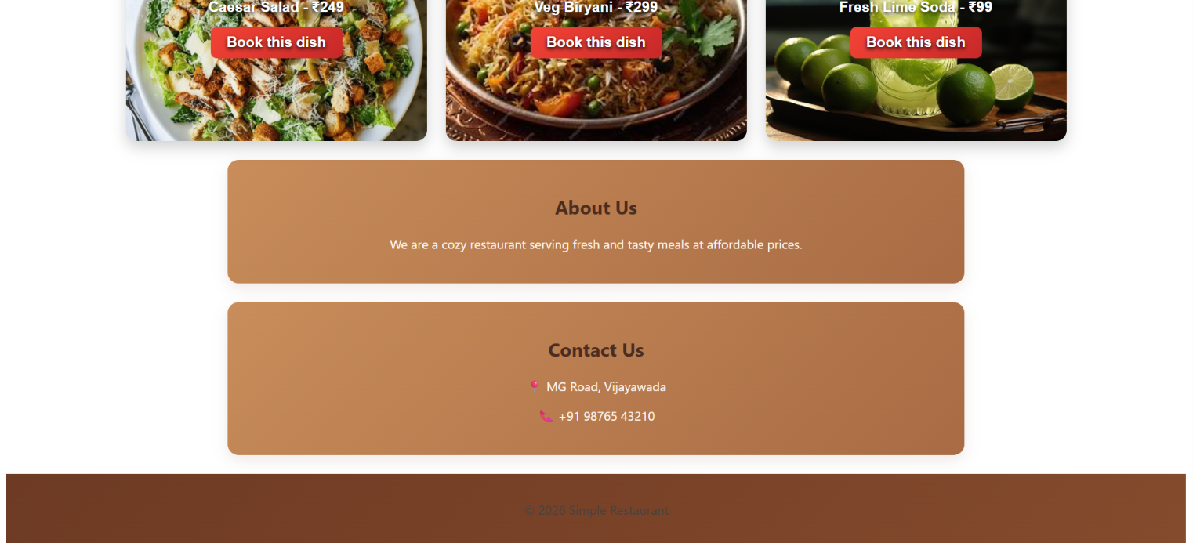
Restaurant Website — Screenshot
Paste a screenshot captured from the browser.
PASTE SCREENSHOT HERE
Test Case 1: Restaurant Website
04

Slide 6
Test Case 2 — My Student Profile
File: Web-dev2.html (internal CSS)
• Introduces the student and displays a profile image.
• Shows education details and hobbies.
• Includes favorite website links and abbreviations.
• Demonstrates bidirectional text and mathematical notation.
• Uses a marquee element as part of the HTML examples.
Purpose
Present personal and educational information in one webpage.
CSS approach
Styling is included inside the HTML file.
05

Slide 7
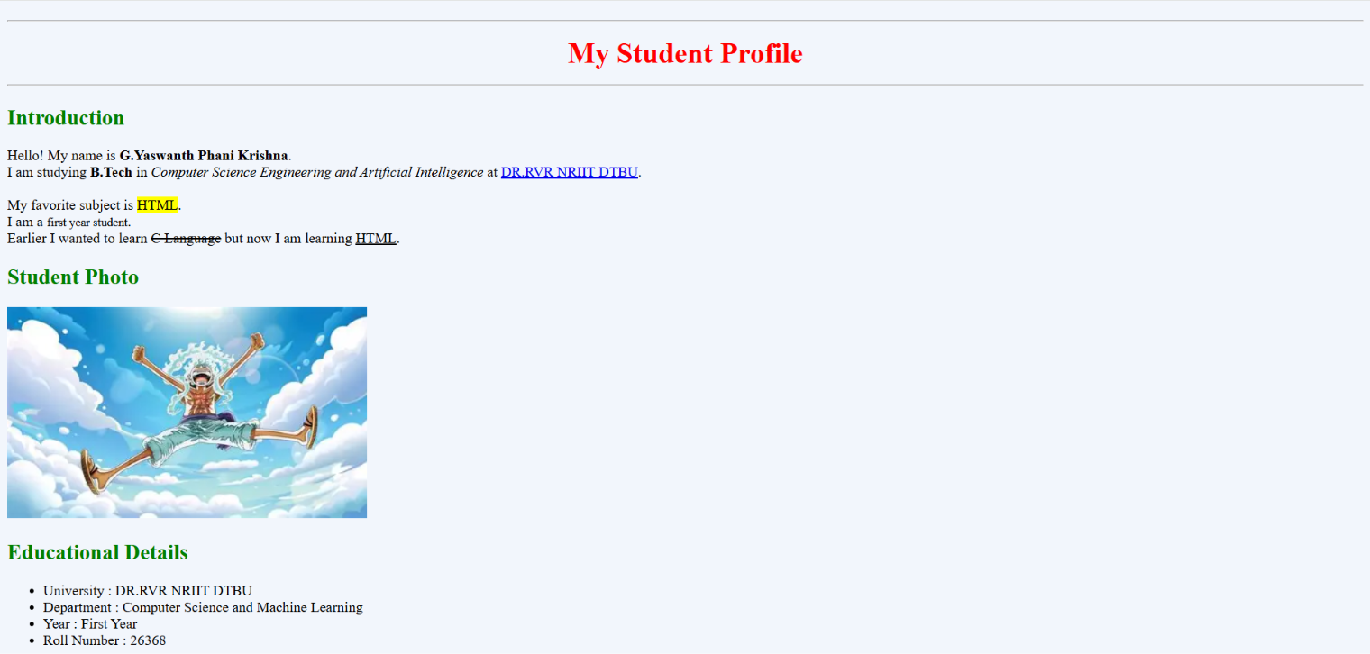
Student Profile — Screenshot
Paste a screenshot captured from the browser.
PASTE SCREENSHOT HERE
Test Case 2: My Student Profile
06

Slide 8
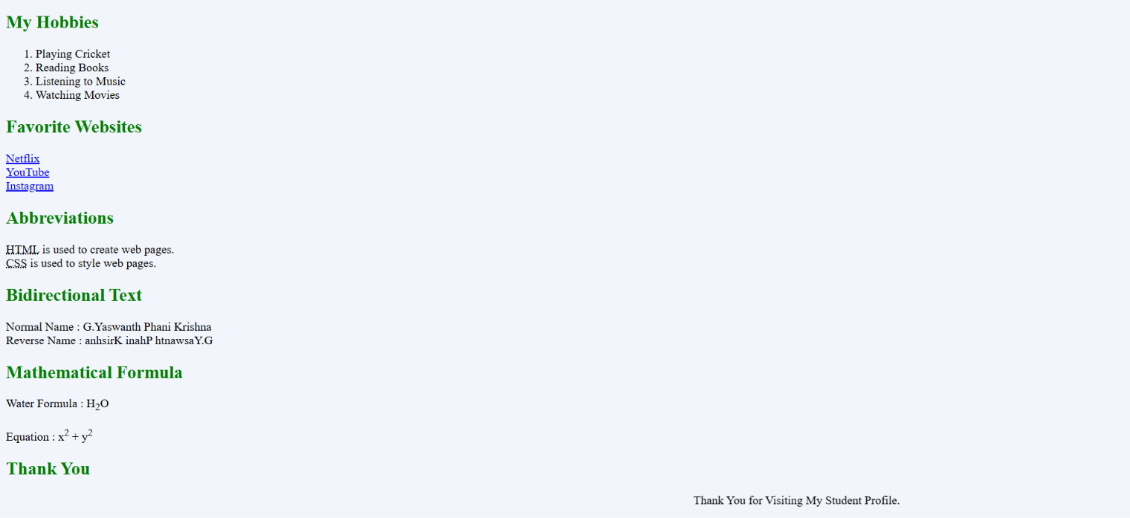
Student Profile — Screenshot
Paste a screenshot captured from the browser.
PASTE SCREENSHOT HERE
Test Case 2: My Student Profile
06

Slide 9
Test Case 3 — Ame-Tech Electronics
Files: Web-dev3.html and styles.css
• Shows six electronics product cards.
• Uses product images from Unsplash.
• Displays prices for the listed products.
• Includes Amazon search links for product discovery.
• Contains About, Contact, and footer sections.
Main purpose
Present electronics products with basic purchase research links.
Page structure
Product cards supported by common information sections.
07

Slide 10
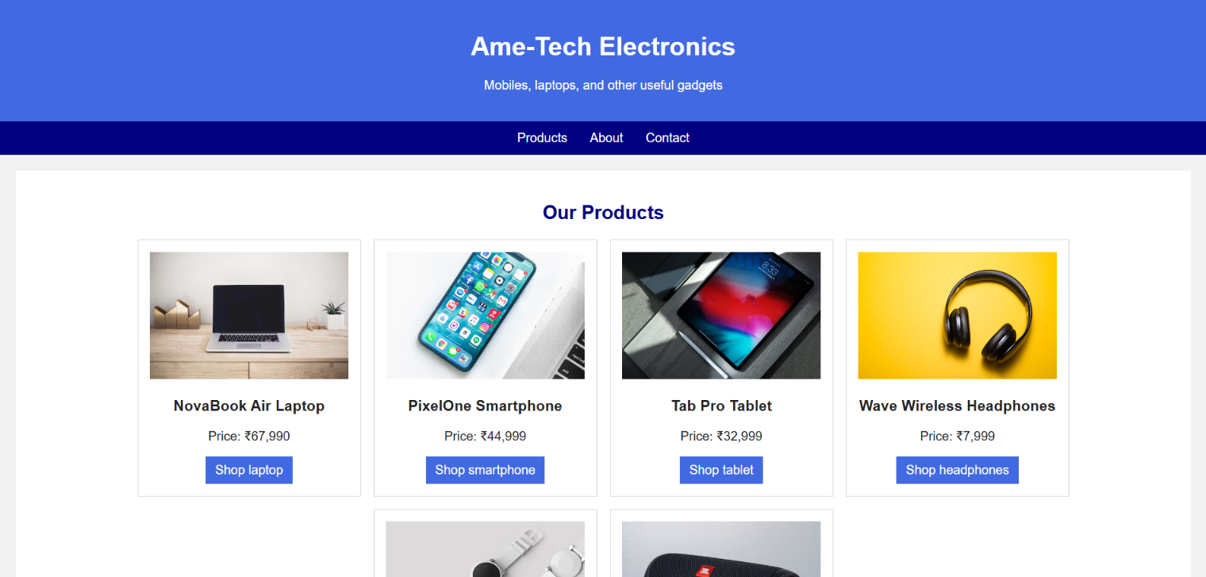
Ame-Tech Electronics — Screenshot
Paste a screenshot captured from the browser.
PASTE SCREENSHOT HERE
Test Case 3: Ame-Tech Electronics
08

Slide 11
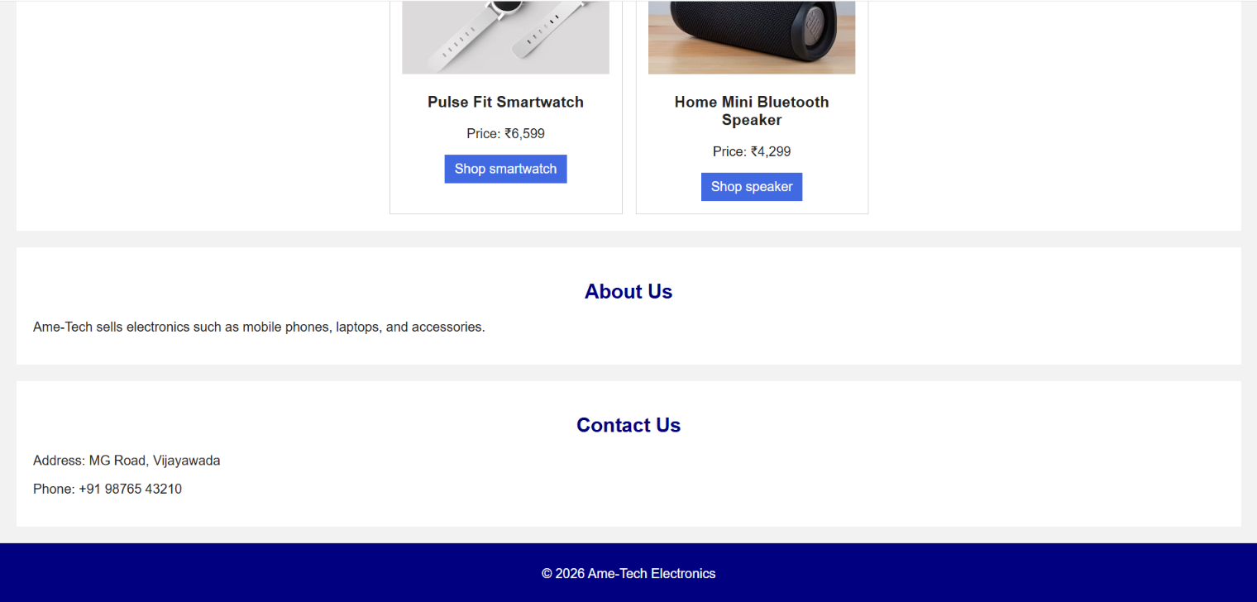
Ame-Tech Electronics — Screenshot
Paste a screenshot captured from the browser.
PASTE SCREENSHOT HERE
Test Case 3: Ame-Tech Electronics
08

Slide 12
Test Case Comparison
Different content goals using core HTML and CSS techniques.
TEST CASE
CONTENT
KEY ELEMENTS
Restaurant
Food menu
6 dish cards, CSS background images, About/Contact
Student Profile
Personal details
Profile image, education, links, HTML text examples
Ame-Tech
Electronics catalog
6 product cards, prices, product search links
09

Slide 13
Conclusion
Key takeaways from the three test cases.
Content presentation
HTML & CSS
Evidence
The projects show how webpages can organize food, personal information, and products.
The examples use page sections, images, links, cards, and styling to structure content.
Use the three screenshot slides to document how each webpage looks in a browser.
Thank you
Questions and discussion
10

