Slide 1
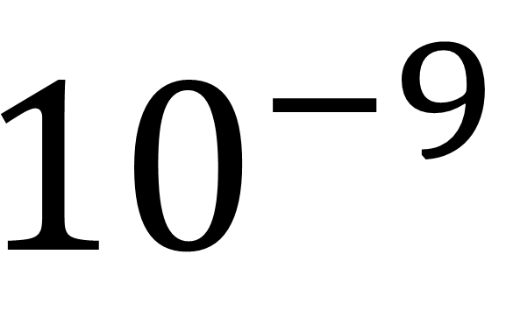
nano (n)
$${10}^{−9}$$

Slide 2
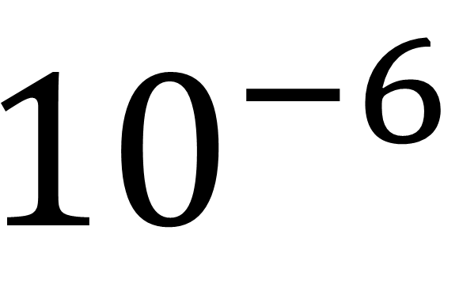
micro (µ)
$${10}^{−6}$$

Slide 3
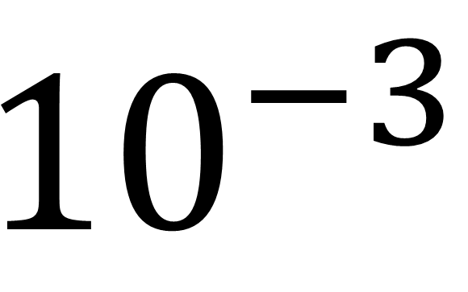
milli (m)
$${10}^{−3}$$

Slide 4
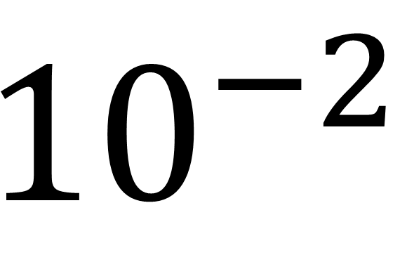
centi (c)
$${10}^{−2}$$

Slide 5
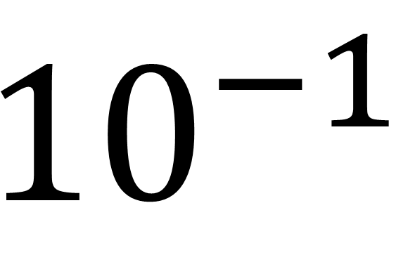
deci (d)
$${10}^{−1}$$

Slide 6
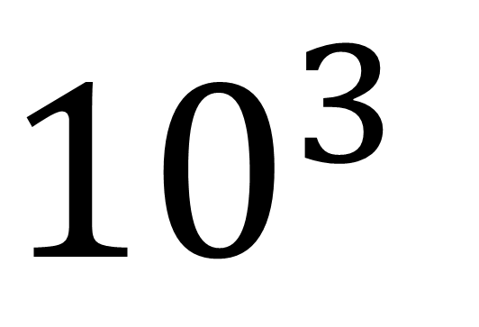
kilo (k)
$${10}^{3}$$

Slide 7
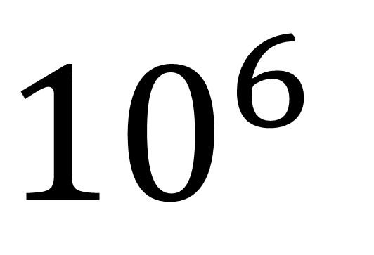
mega (M)
$${10}^{6}$$

Slide 8
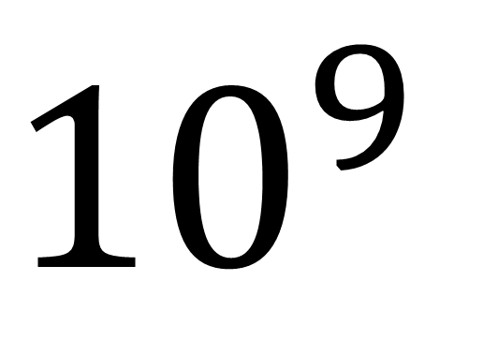
giga (G)
$${10}^{9}$$

Slide 9
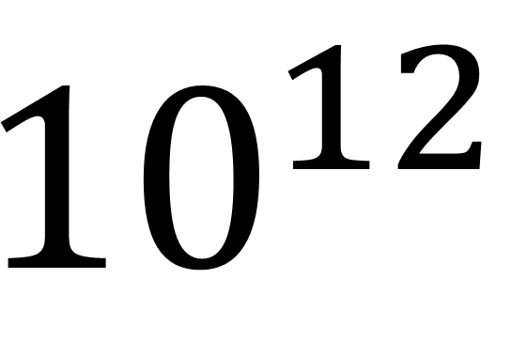
tera (T)
$${10}^{12}$$

Slide 10
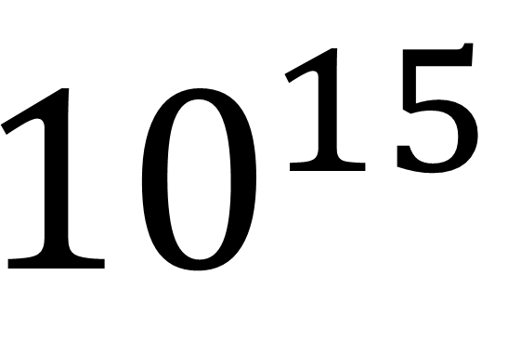
peta (P)
$${10}^{15}$$

Slide 11
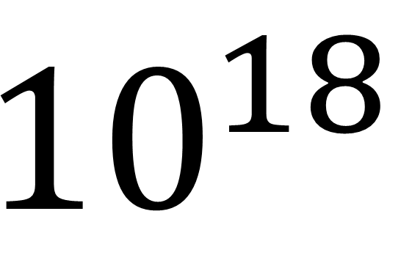
exa (E)
$${10}^{18}$$

