Slide 1
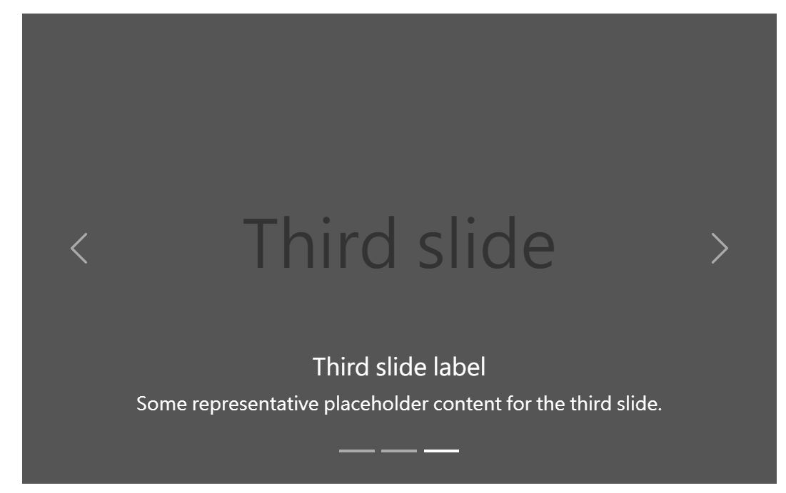
1. 找 bootstrap 下的/ docs /components/下的carousel
2. 找第四個有文字的
2. With controls
1. Slides only
4. With captions
3. With indicators

Slide 2
corousel 元件，被包在 #carouselExampleCaptions 內。
<div id="carouselExampleCaptions" class="carousel slide" data-bs-ride="carousel">
corousel 元件，被包在 #carouselExampleCaptions 內。
內有 .carousel slide
及 data-bs-ride= 自訂屬性。

Slide 3
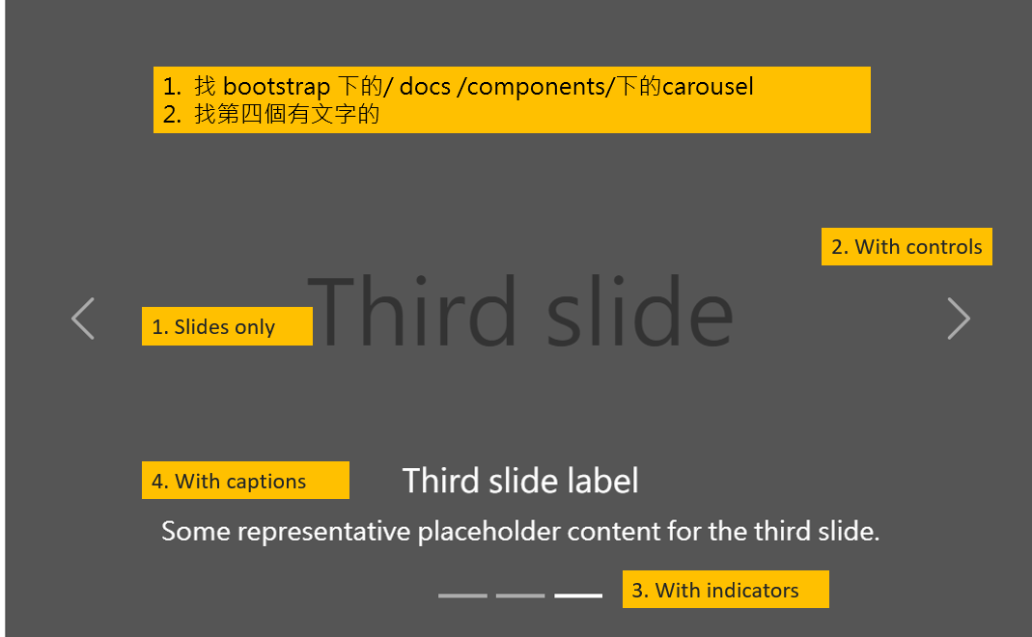
第三項在是 indicators
主體是 .carousel-indicators.
內有 <button>，有幾張照片。就要自已增加至幾個button
<button> 內有 二個bs自建的屬性
data-bs-target
data-bs-slide-to
<div class="carousel-indicators">
<button type="button" data-bs-target="#carouselExampleCaptions" data-bs-slide-to="0" class="active" aria-current="true" aria-label="Slide 1"></button>
<button type="button" data-bs-target="#carouselExampleCaptions" data-bs-slide-to="1" aria-label="Slide 2"></button>
<button type="button" data-bs-target="#carouselExampleCaptions" data-bs-slide-to="2" aria-label="Slide 3"></button>
</div>

Slide 4
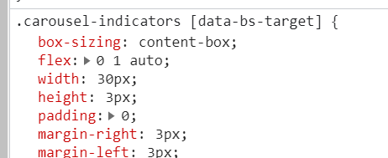
目標: 把原始的indicator 由 橫線 改成 圓線
把 width:30px
height:3px
改成
width:30px;height:30px;border radius=50%

Slide 5
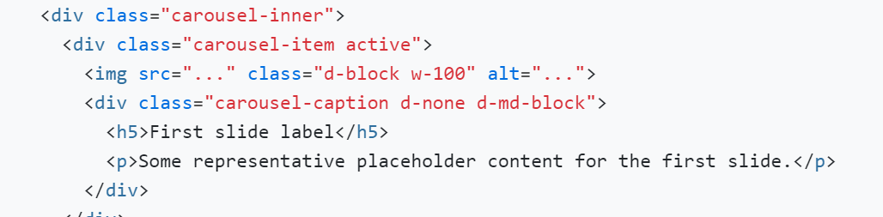
第一及第四項 在 .carousel-inner
主體是 .carousel-inner
內有 .carousel-item 可視情況加到自已要的數量
內有 img.
內有 .carousel-caption
內有 <h5> First slide label
內有 <p> representative
故，要改 文字的位置，要操縱 .carousel-caption
如。加 bottom 50%
transform: translate(0,50%) 可置中
#carouselExampleCaptions .carousel-caption {
bottom:50%;
transform: translate(0, 50%);
}

Slide 6
第四項是左右的控制器
第四項在最後的二個button.carousel-control-prev 及 button.carousel-control-next
button內有 二個bs自建的屬性
data-bs-target
data-bs-slide
左右 那邊的箭號，可用font awesome換掉。
1. 去Font Awesome 的icons 下找。 找 free / arrow 下的
caret-left 及 caret-right 。
3. 點入後copy <i class=“fas fa-caret-left”></i> ，置換掉原始的二個<span>，換成font awesomed的 <i class="fas fa-caret-left"></i>
4. 去 docs / sizeing icons 找加大icon 的方法。加入 fa-3x
<span class="carousel-control-prev-icon" aria-hidden="true"></span>
<span class="visually-hidden">Previous</span>
上面二行即為原始的箭號圖案。 把它置換成喜歡的font awesome 箭號圖案
<i class="fas fa-caret-left"></i>
<button class="carousel-control-prev" type="button" data-bs-target="#carouselExampleCaptions" data-bs-slide="prev">
<span class="carousel-control-prev-icon" aria-hidden="true"></span>
<span class="visually-hidden">Previous</span>
</button>
<button class="carousel-control-next" type="button" data-bs-target="#carouselExampleCaptions" data-bs-slide="next">
<span class="carousel-control-next-icon" aria-hidden="true"></span>
<span class="visually-hidden">Next</span>
</button>

Slide 7
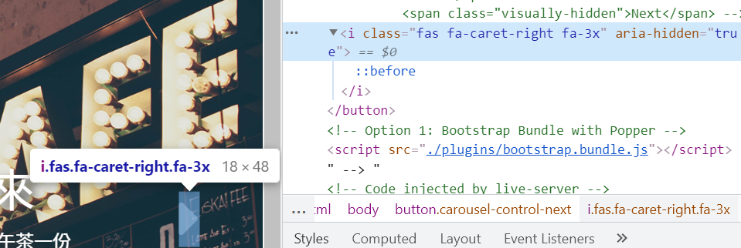
Font Awesome 算文字，故可選箭號。查出其用fas
在.fas 內加text-shadow 來做陰影

Slide 8
<div id="carouselExampleCaptions" class="carousel slide" data-bs-ride="carousel">
<div class="carousel-indicators">
<button type="button" data-bs-target="#carouselExampleCaptions" data-bs-slide-to="0" class="active" aria-current="true" aria-label="Slide 1"></button>
<button type="button" data-bs-target="#carouselExampleCaptions" data-bs-slide-to="1" aria-label="Slide 2"></button>
<button type="button" data-bs-target="#carouselExampleCaptions" data-bs-slide-to="2" aria-label="Slide 3"></button>
</div>
<div class="carousel-inner">
<div class="carousel-item active">
<img src="..." class="d-block w-100" alt="...">
<div class="carousel-caption d-none d-md-block">
<h5>First slide label</h5>
<p>Some representative placeholder content for the first slide.</p>
</div>
</div>
<div class="carousel-item">
<img src="..." class="d-block w-100" alt="...">
<div class="carousel-caption d-none d-md-block">
<h5>Second slide label</h5>
<p>Some representative placeholder content for the second slide.</p>
</div>
</div>
<div class="carousel-item">
<img src="..." class="d-block w-100" alt="...">
<div class="carousel-caption d-none d-md-block">
<h5>Third slide label</h5>
<p>Some representative placeholder content for the third slide.</p>
</div>
</div>
</div>
<button class="carousel-control-prev" type="button" data-bs-target="#carouselExampleCaptions" data-bs-slide="prev">
<span class="carousel-control-prev-icon" aria-hidden="true"></span>
<span class="visually-hidden">Previous</span>
</button>
<button class="carousel-control-next" type="button" data-bs-target="#carouselExampleCaptions" data-bs-slide="next">
<span class="carousel-control-next-icon" aria-hidden="true"></span>
<span class="visually-hidden">Next</span>

Slide 9
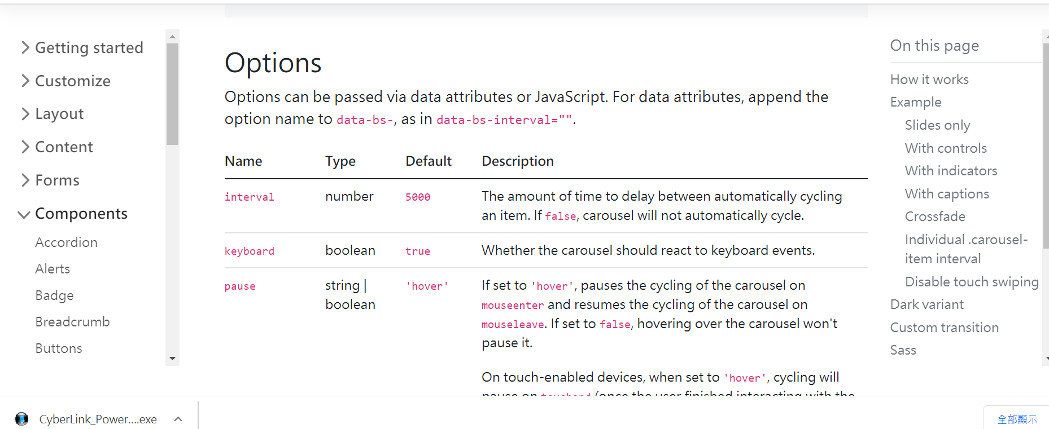
可在bootstrap 輪播的最下方的Options 找如何控製輪播的快慢等….
快慢預設是5s。
可自行改成3s .
data-bs-interval=“3000”
加 data-bs-pause=‘false’; mouse 點到不會停

