Slide 1



Rethinking Learned Cost Models: Why Start from Scratch?
Jiani Yang, Sai Wu*, Dongxiang Zhang, Jian Dai, Feifei Li, Gang Chen
Zhejiang University & Alibaba Group
Notes:
Hello everyone, my name is Jiani Yang. I am an PHD student from Zhejiang University. Today I am going to share our research presented in the paper titled "Rethinking Learned Cost Models: Why Start from Scratch?"

Slide 2
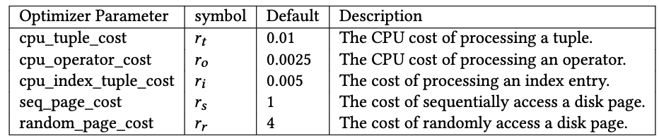
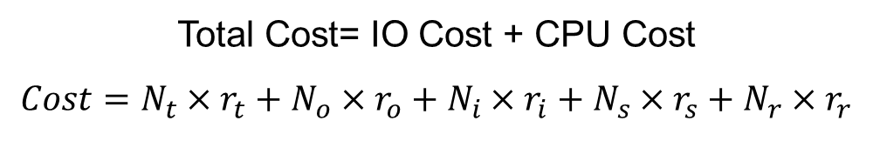
Formula-based Cost Model
SQL
Example: PostgreSQL Cost Model
Logical Optimizer
Total Cost= IO Cost + CPU Cost
$$Cost=N_{t}×r_{t}+N_{o}×r_{o}+N_{i}×r_{i}+N_{s}×r_{s}+N_{r}×r_{r}$$
Physical Optimizer
Cardinality Estimation
Cost Model
Plan Enumeration
Executor
Notes:
In the optimizer, a query first moves through the logical optimizer and then the physical optimizer before execution. The physical optimizer consists of several key modules: cardinality estimation, cost estimation, and plan enumeration. Our research focuses on enhancing the cost model within this structure.
Taking Postgres as an example, the cost model estimates operational costs using a linear formula. This includes I/O costs and CPU costs. It relies on predefined constants to compute the total cost of a query. These constants, which we describe using five examples from a table, are based on the expertise of database administrators and their understanding of the database environment. They help assign weights to different operations in calculating the total cost.

Slide 3
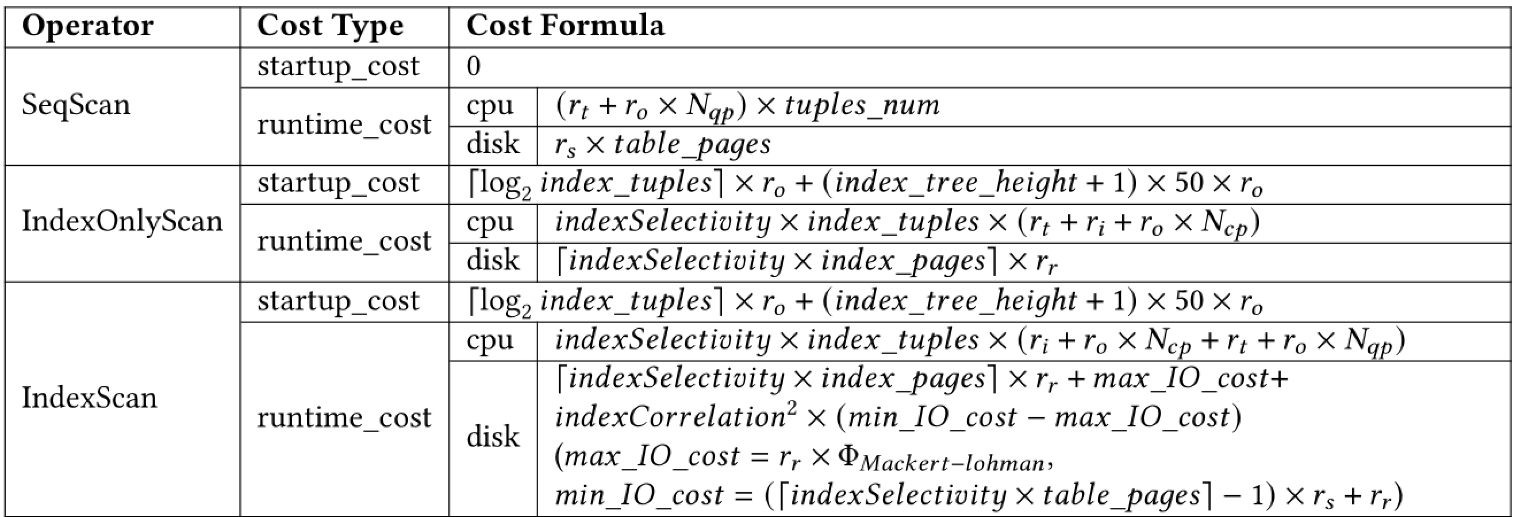
Formula-based Cost Model
Example: PostgreSQL Cost Model
$$Cost=N_{t}×r_{t}+N_{o}×r_{o}+N_{i}×r_{i}+N_{s}×r_{s}+N_{r}×r_{r}$$
Notes:
We analyzed the source code in PostgreSQL and organized the cost formulas for common physical operators, and found that they all fit the linear template mentioned above.

Slide 4
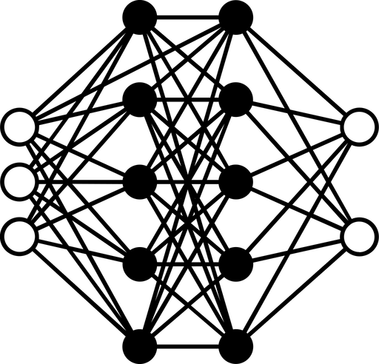
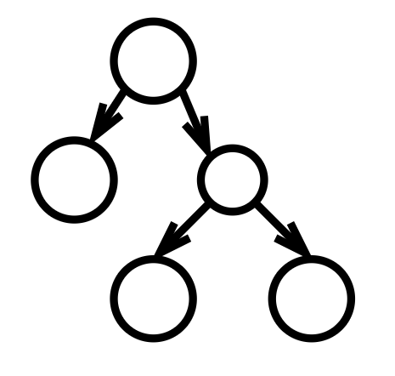
Learned Cost Model
SQL
Logical Optimizer
Cost
Physical Optimizer
Physical Plan
Cardinality Estimation
Plan Enumeration
DNN / LSTM / Tree-CNN / GNN / Transformer
Executor
Notes:
With advances in deep learning, researchers have investigated replacing traditional cost models with deep learning models. They have employed various architectures, such as DNN, LSTM, Tree-CNN, GNN, and Transformer. These approaches have demonstrated impressive results.

Slide 5

Formula-based or Learning-based ?
Formula-based
Learning-based
Advantages:
Efficient
Explainability
Easy to Tune
Disadvantages:
Low Accuracy
Advantages：
High Accuracy
Disadvantages:
Cold Start
High Training Overhead
Unexplainability
Need to Meet i.i.d. Assumption
Notes:
We compared traditional formula-based cost models with deep learning-based models. The formula-based models are efficient, explainable, and easy to tune but often lack accuracy.
In contrast, learning-based models are highly accurate. However, they face challenges such as the cold start problem, high training costs, and a lack of explainability. These models also require queries to be independent and identically distributed (i.i.d.) for optimal performance.
These differences underline the trade-offs between the two approaches.
So, we face a decision: should we stick with the traditional formula-based cost model, or switch to the more accurate learning-based model?

Slide 6
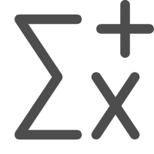



Why Start from Scratch?
$$Cost=N_{t}×r_{t}+N_{o}×r_{o}+N_{i}×r_{i}+N_{s}×r_{s}+N_{r}×r_{r}$$
Seq Scan
Index Scan
Sort
Wrong Settings for R-params
Poor Estimation Accuracy
Index Only Scan
Aggregate
Hash Join
Nested Loop
Design Principles
Fully utilize the cost formulas designed by database experts.
Adopt learning-based approaches to correct the settings for R-params.
Do not sacrifice the interpretability of the cost model.
Notes:
Before we make a decision, let's first analyze why traditional cost models often give inaccurate estimates. The cost formulas themselves are carefully designed by database experts based on the behavior of the executor, so the formulas are not the issue. In reality, the problem lies in the inaccurate settings of the cost constants, which we refer to as "R-params" in our work.
Based on this, we propose the concept of "Why start from scratch?" Instead of discarding the expert-designed cost formulas, we can fully utilize them and apply learning-based methods to refine a new cost model. Here are the design principles:
Fully utilize the cost formulas designed by database experts.
Adopt learning-based approaches to adjust and correct the settings for R-params.
Do not sacrifice the interpretability of the cost model.

Slide 7
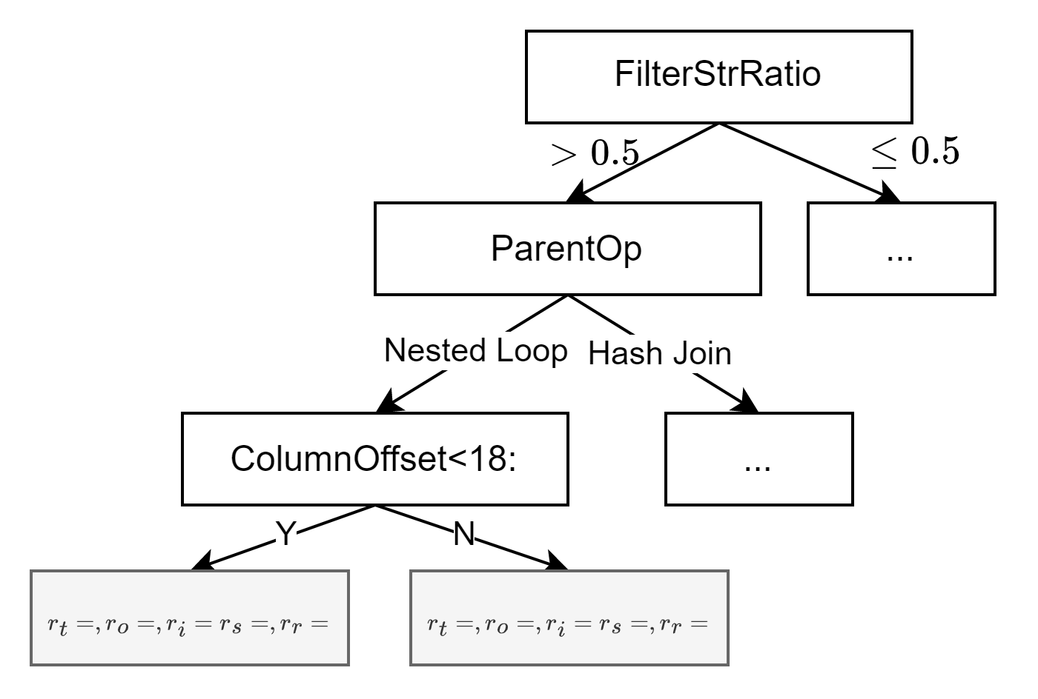
Introducing ParamTree
High Generalization
Quickly adapts to new databases or different hardware/software environments.
Maintains high prediction accuracy for unseen queries.
Low Training Overhead
Leverages existing knowledge to reduce model complexity.
Decreases the need for training samples.
High Explainability
Transparent decision-making process for estimating execution plan costs.
Facilitates DBA diagnosis of slow queries.
Notes:
Now，Let me introduce our designed model-ParamTree, which includes three key features: high generalization, low training overhead, and high explainability.
For high generalization, ParamTree quickly adapts to new databases or different hardware and software environments, maintaining high prediction accuracy for unseen queries.
For low training overhead, ParamTree leverages existing knowledge to reduce model complexity, thereby decreasing the need for extensive training samples.
For high explainability, ParamTree provides a transparent decision-making process for estimating execution plan costs, helping DBAs diagnose slow queries.

Slide 8
Introducing ParamTree
(C-params)
What Affects the Accuracy of Formula-based Cost Models? (C-params)
Static C-params
Hardware: IO read/write speed, CPU, Storage
Software: Windows/Linux/Mac, DBMS version
Configuration: shared_buffers, block_size
Dynamic C-params
Query-Related: Physical Operator, Structure
Data-Related: Data Type, Index Correlation, Column offset
Configuration: work_mem, temp_buffers
(C-params)
(C-params)
(R-params)
(R-params)
Notes:
We conducted extensive experiments to identify the environmental variables affecting R-params, which we call C-params. We divided these C-params into two types: Static and Dynamic. Static C-params include factors such as hardware specifications—like IO speed and CPU—software environments—like different operating systems—and certain configuration settings. Dynamic C-params cover query-related factors such as the type of physical operator, data-related aspects like data types and index correlation, and other configuration settings.
In our decision tree model, these C-params are used as the splitting attributes. Samples with similar R-params are grouped into the same leaf nodes based on these attributes. At each leaf node, we apply the least squares method to determine the values of the R-params.

Slide 9


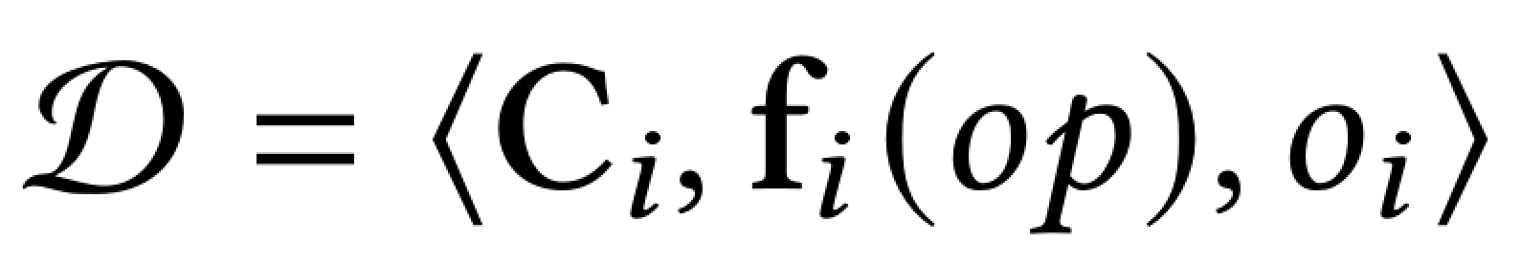



How to Train ParamTree
: represent the values of C-params when executing queries
Training Dataset
: denotes the vectorized representations of the involved cost estimation functions, containing cardinality estimation results
: denotes the real processing cost
What we have
R-params play like hidden parameters
What we want
$$C→O$$
$$C→R→O$$
$$C→R$$
Train model without any explicit label for R-params
Notes:
So How to Train ParamTree? our training dataset D consists of three main components: Ci, representing the C-params; fi(op), which are the vectorized representations of the cost estimation functions including cardinality estimation results; and Oi​, the actual processing costs.
So we only have the direct impact of C-params on exectution time. But what we want is the impact of C-params on R-params. R-params play like hidden parameters. So our objective is to train model without any explicit label for R-params, which is not a trivial task.

Slide 10
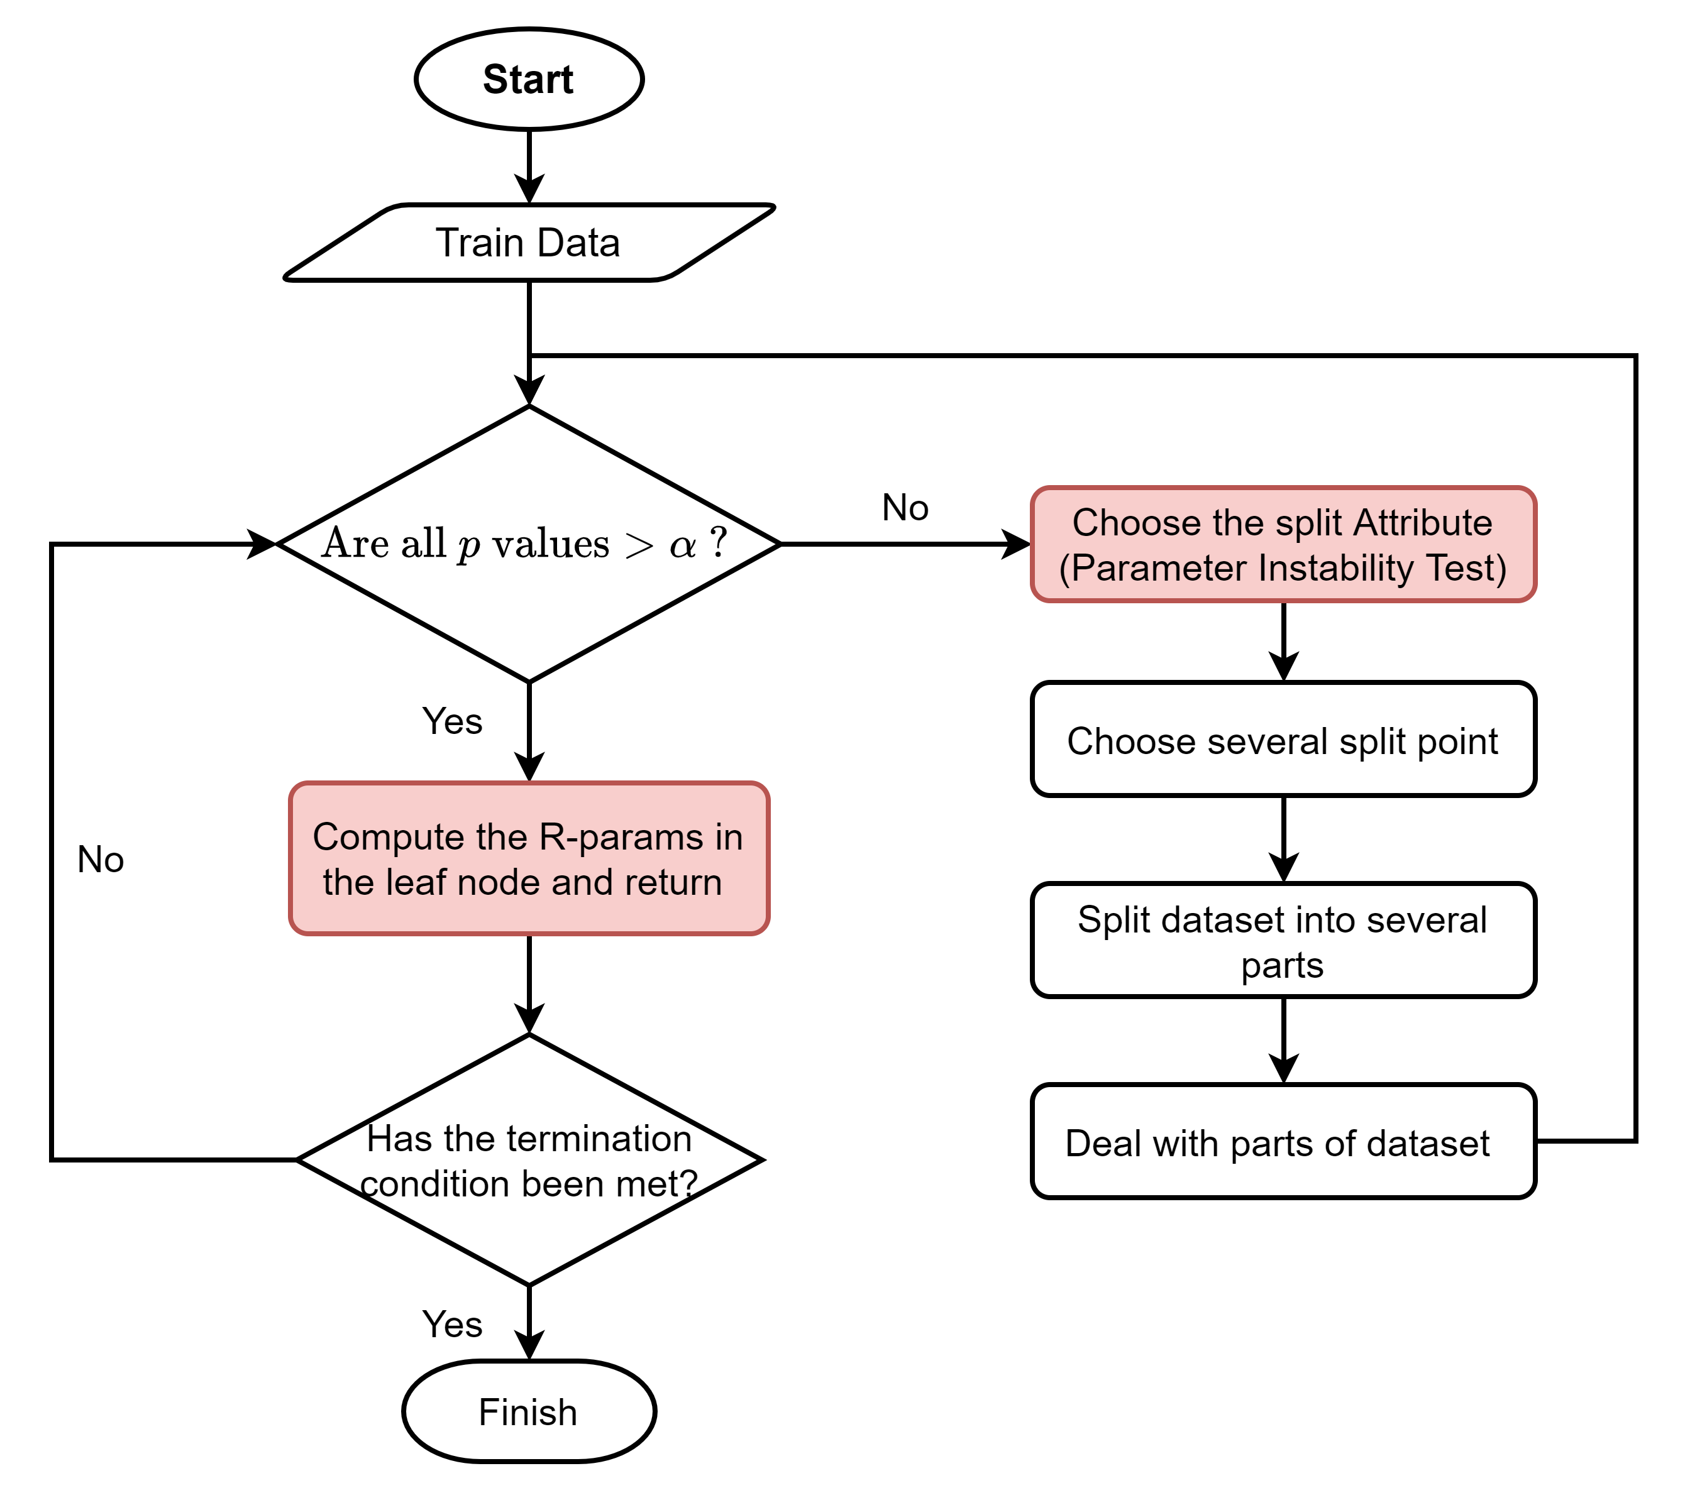
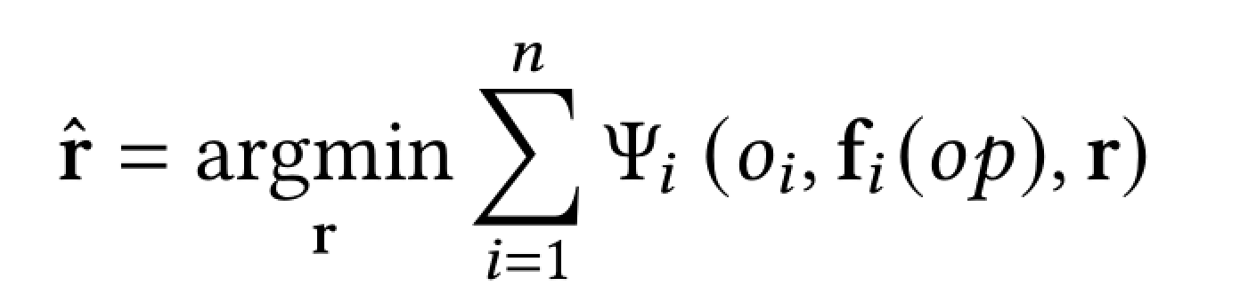
How to Train ParamTree
Parameter Instability Test
A statistical method used to assess whether the parameters of a linear model (R-params), remain stable across variations in another set of parameters (C-params).
Compute R-params
Train a linear regression model
Notes:
This is the entire training process, similar to that of a traditional decision tree.
First, we need to select the split attribute, for which we use the Parameter Instability Test. It is a statistical method used to assess whether the parameters of a linear model (R-params), remain stable across variations in another set of parameters (C-params).
Once the split attribute is chosen, we enumerate potential split values, allowing us to distribute the dataset across different nodes. This cycle continues until the criteria for further splits are no longer met, and splitting stops. For each leaf node, we calculate the values of the R-params. Using the original cost formula, we fit a linear regression model, and the coefficients obtained represent the values of the R-params.
By now, we have a basic understanding of how the model operates. Thanks to the model's interpretability, we have added two features to its foundation: one is generalization performance, and the other is active learning.

Slide 11
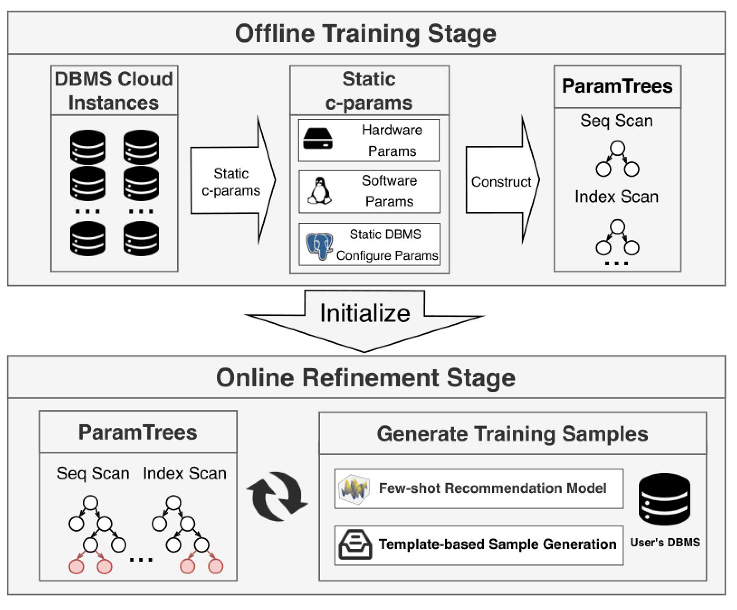
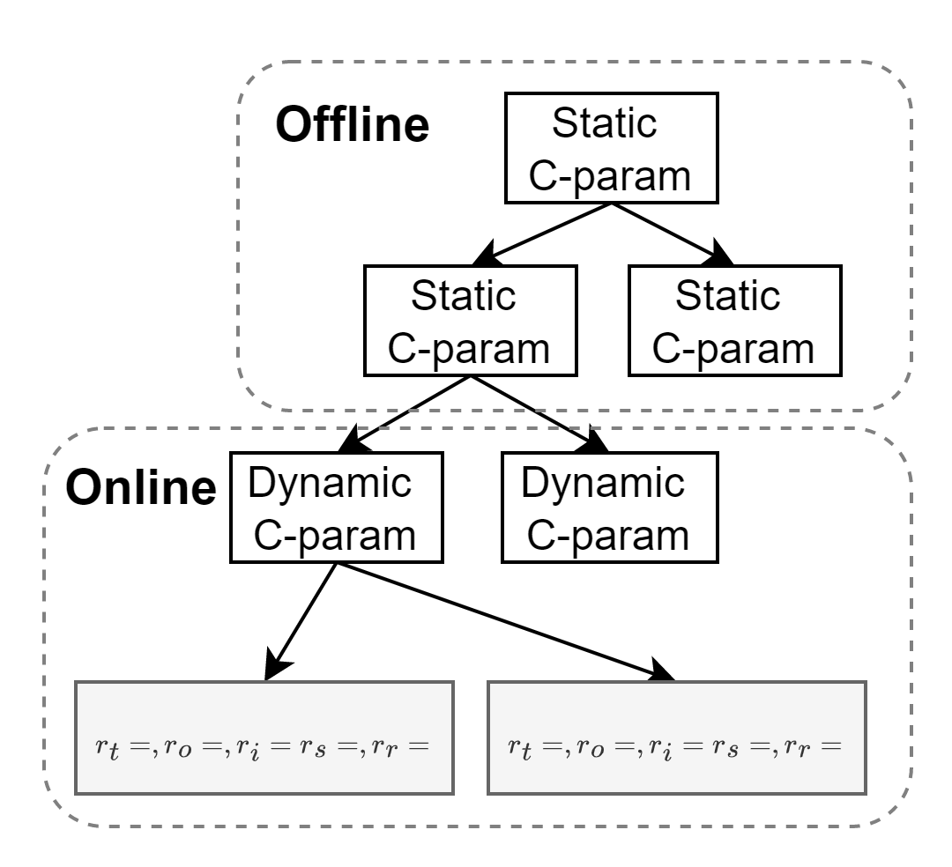
Generalization: Two-stage Training and Refinement
Notes:
We have designed a Two-stage Training and Refinement training paradigm specifically for two different types of C-params.
As mentioned earlier, C-params can be categorized into two types: Static C-params and Dynamic C-params. Static C-params generally do not change after the database is deployed, whereas Dynamic C-params change with queries and data. Based on this characteristic, in the first stage, we train on Static C-params to build a basic pre-trained decision tree. Once the database starts running, it can be refined based on specific queries, allowing the decision tree to split on dynamic C-params and continue growing.

Slide 12
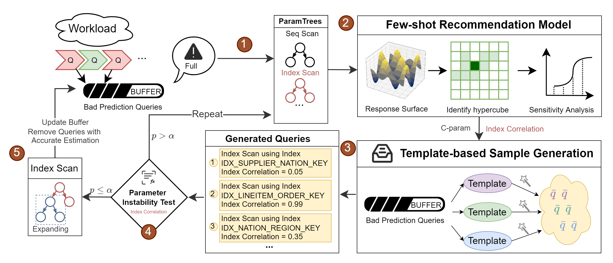
Training Overhead: Online Tree Expansion
Notes:
For the online training phase, we have also designed a method to efficiently grow the decision tree. We adopt a process similar to active learning. We generate queries with varying C-params values to feed the decision tree. Traditionally, splitting queries from the workload into training and testing samples can lead to model overfitting due to a lack of diversity in the query samples. By generating queries, we aim to maximize the exploration space, enhance the model's robustness, and acquire more knowledge.

Slide 13
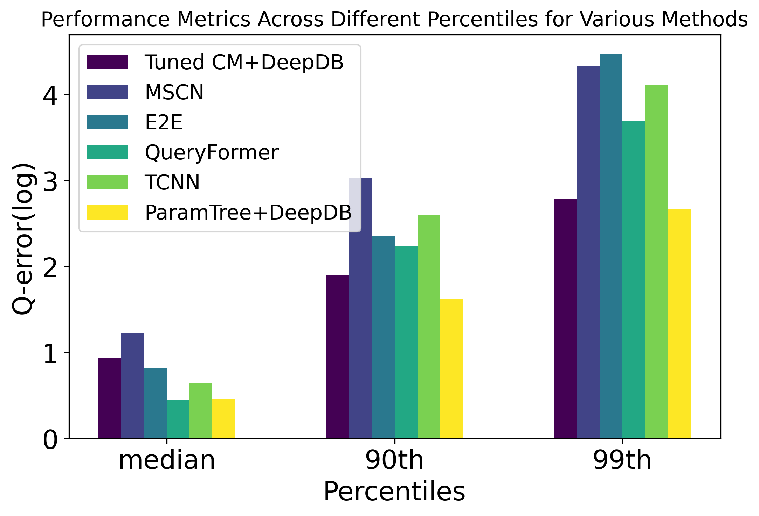
Experiment Highlight: Accuracy
Setting
Training Set: queries from IMDB synthetic workload
Testing Set: queries from IMDB Job-light workload
Learning-based Methods:
Training Set: 5,000 queries
ParamTree
Training Set: 2,000 queries
Observation
Perfomance | Main Queries | Tail Queries
Formula-based
Learning-based
ParamTree
Notes:
Next, we will present our experimental results. First , Accuracy.
We have applied various learning-based methods to compare the performance of ParamTree against other models.
Traditional cost models have a relatively high median Q-error but perform well in predicting tail queries, making them stand out in terms of average performance. On the contrary, deep learning methods show poor performance when predicting tail queries. This is because traditional cost models rely on formula-based estimation, allowing them to generate robust predictions for a wide range of queries.
While deep learning methods are highly sensitive to the change of query distribution, so the performance on tail queries is relatively poor.
ParamTree inherits the merit of the traditional cost model and learning-based models. It can make good predictions for all queries.

Slide 14
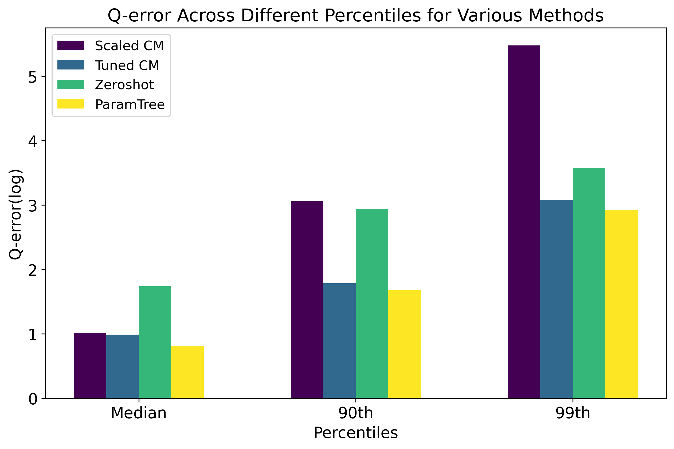
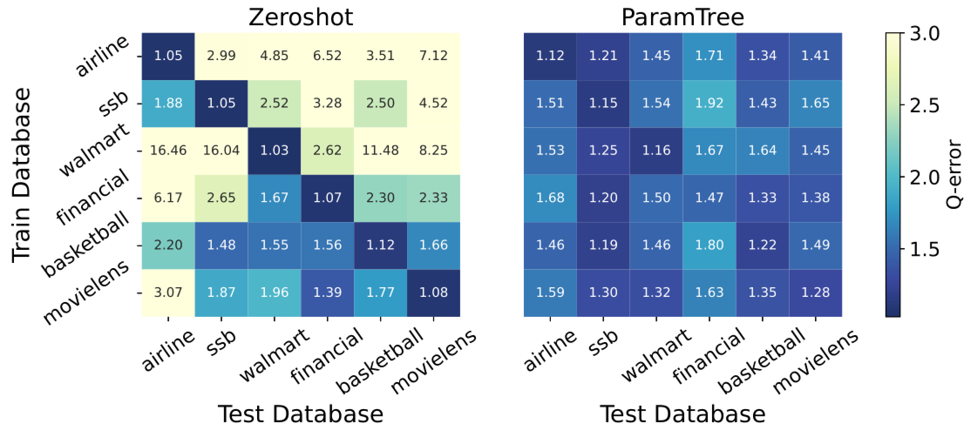
Experiment Highlight: Generalization
Generalization among different machines
Collect dataset from 20 cloud servers with different hardware configuration
Test on an unseen cloud server
Generalization among different databases
Train on one database, and test on an unseen database
5,000 training samples for Zeroshot
1,000 training samples for ParamTree
Notes:
On the left, To test the generalization ability, we collect dataset from 20 cloud servers with different hardware configuration. the bar graph demonstrates when deployed on an entirely new database, Our model achieves accuracy similar to a cost model that has been tuned by an expert.
Zeroshot is also a learning-based model that, by utilizing a complex network structure and being fed a large dataset, can achieve good generalization performance. In our experiments, we compared it with our method using six different datasets. By pairing these datasets, we tested the accuracy obtained by training on one dataset and testing on another. The results show that our method can achieve higher generalization performance with fewer training samples.

Slide 15
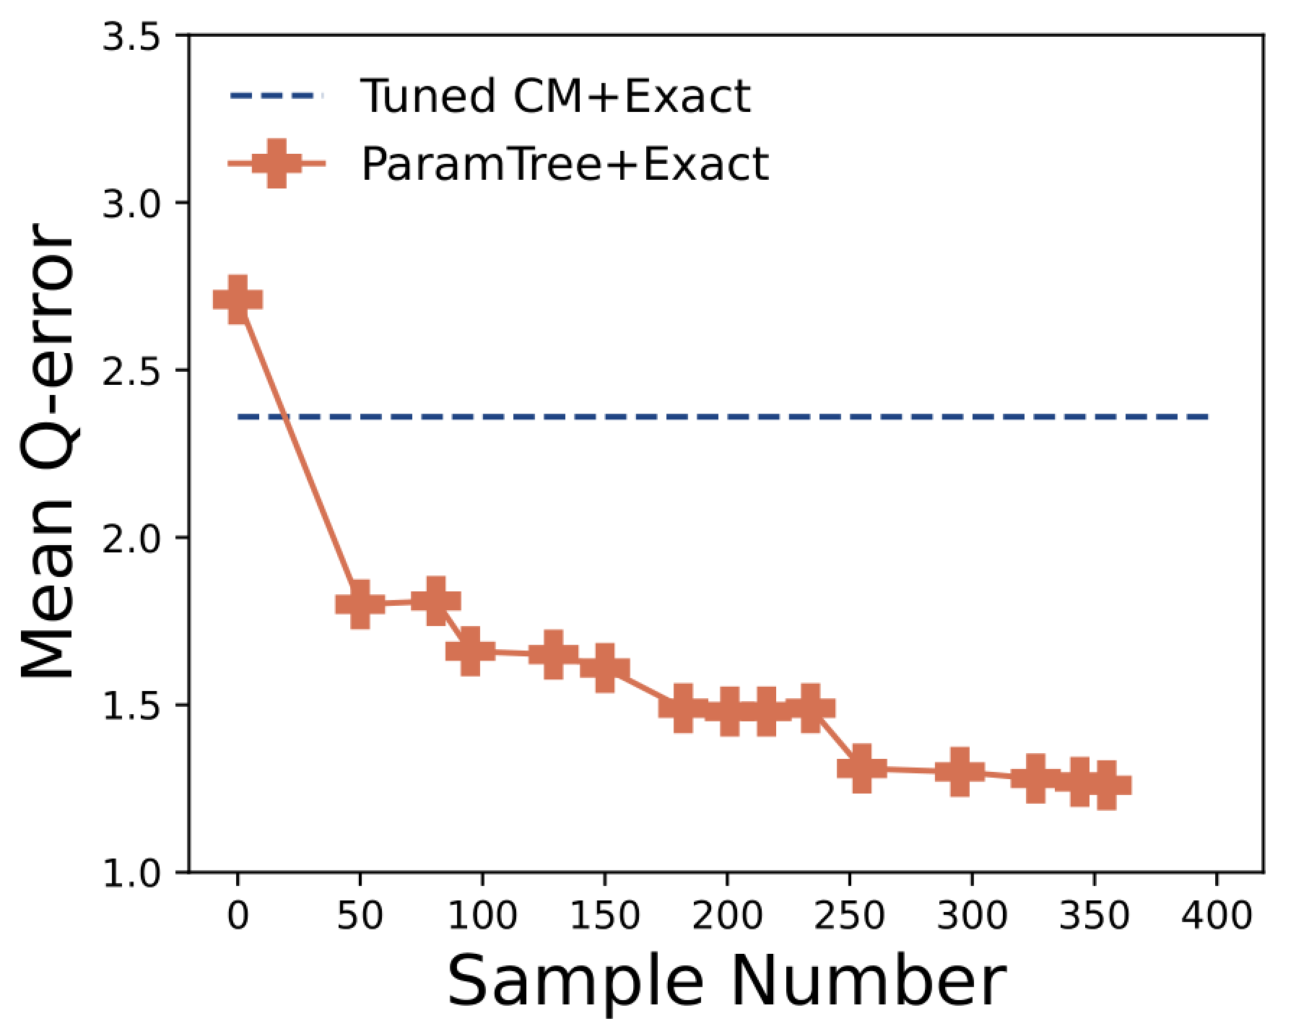
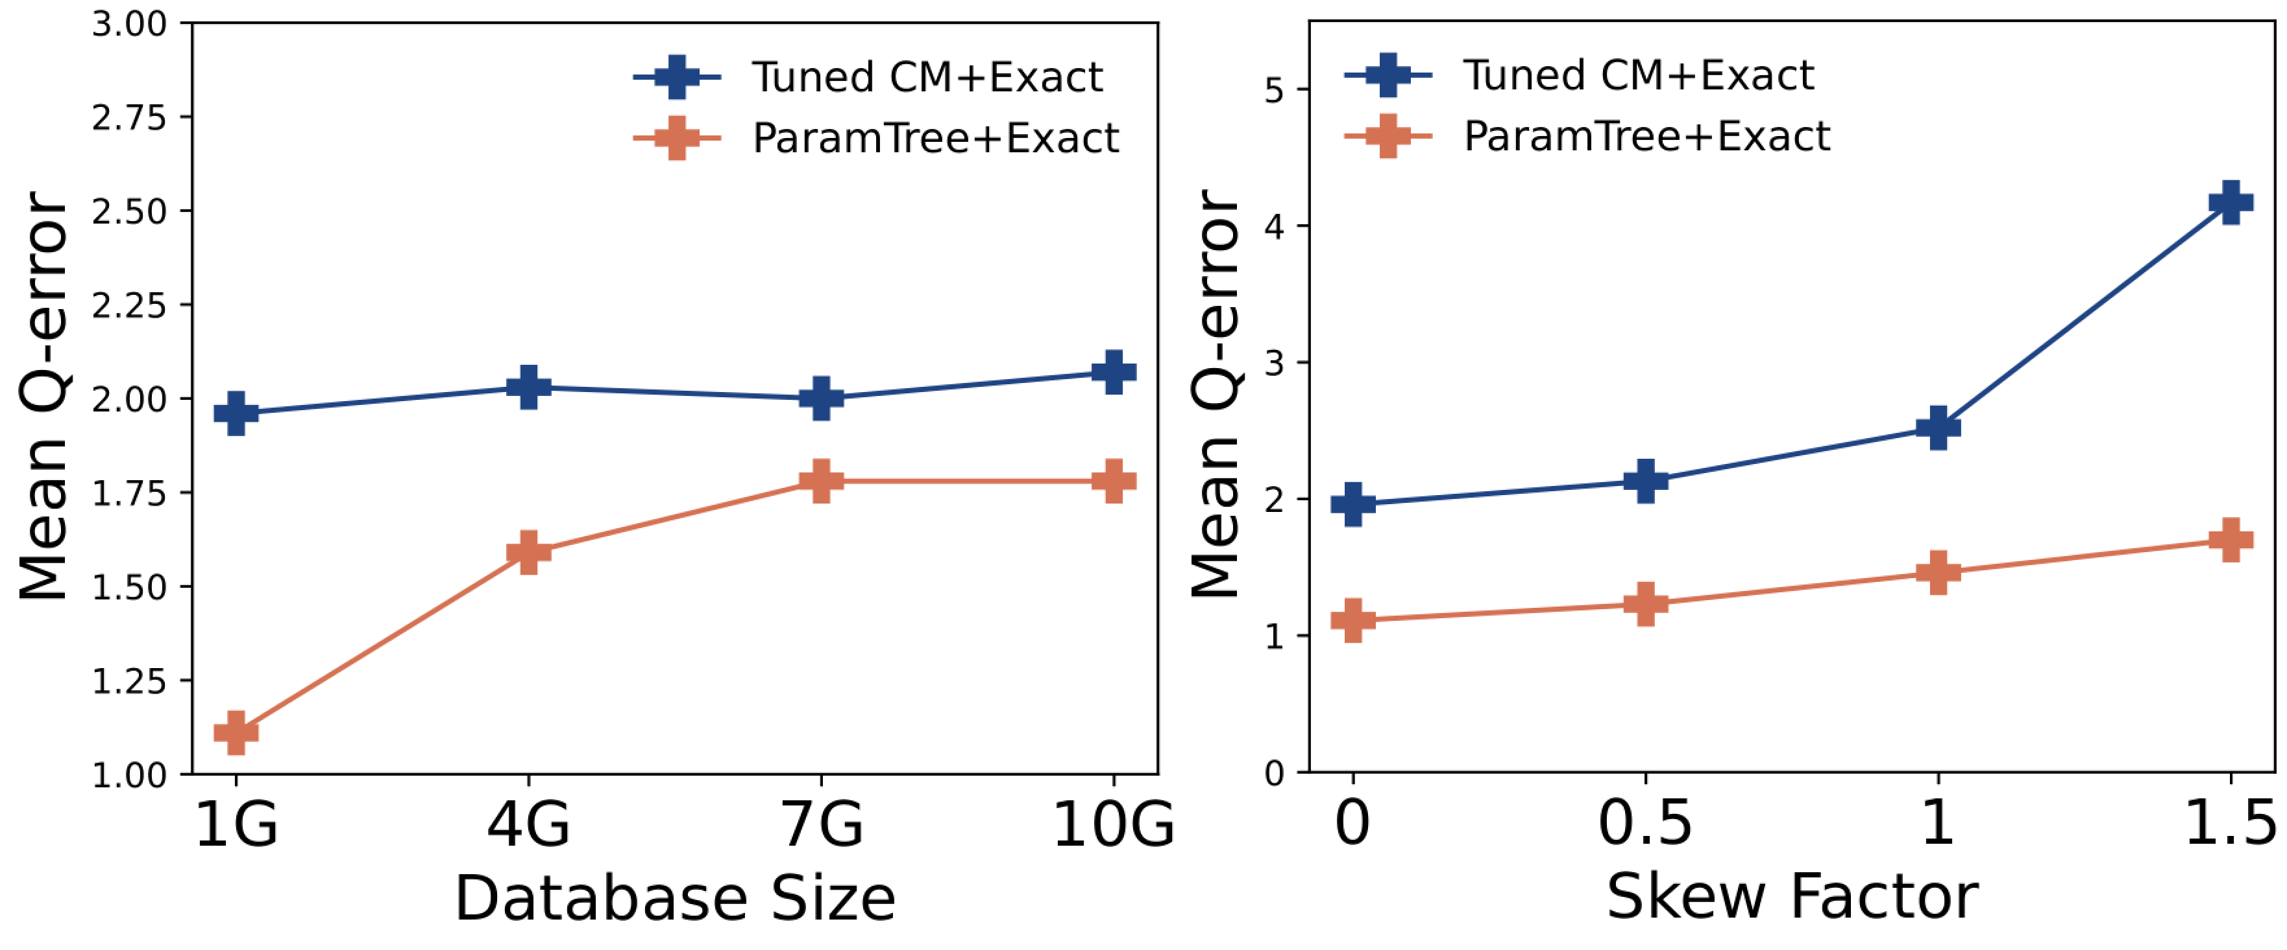
Experiment Highlight: Dynamic Scenarios
Performance on Dynamice Queries
Workload: IMDB Job-light
ParamTree evolves as new queries arrive
Performance on Data Dynamics
Workload: TPCH
ParamTree outperforms the traditional cost model when data updates
ParamTree is less sensitive to data skewness
Notes:
The next experiment tested the model's performance in dynamic scenarios.
The graph on the left shows the growth of the decision tree and the changes in the model's predictive performance as queries are executed. It's evident that with just over 300 samples, the Q-error has significantly decreased.
Another common challenge that all databases face is data dynamics, which include updates and changes in data skewness. For learning-based methods, significant changes in data often require retraining the model. However, our model is designed to maintain robust predictive performance, even with dynamic data changes.

Slide 16
Q&A
Rethinking Learned Cost Models: Why Start from Scratch?
Jiani Yang, Sai Wu*, Dongxiang Zhang, Jian Dai, Feifei Li, Gang Chen
Zhejiang University & Alibaba Group
Take Home Message
We have provided an interpretable model that predicts query execution times more accurately in dynamic settings. Everyone is welcome to try it out; the code is available at https://github.com/yplusone/ParamTree.
Jiani Yang
Email: jianiyang_cs@zju.edu.cn
Notes:
That concludes the presentation. The main takeaway is that we have developed an interpretable model that predicts query execution times more accurately in dynamic settings. Everyone is welcome to try it out—the code is available on GitHub. I'd like to thank our team, and I appreciate the opportunity to share our work with you. If you have any questions, please feel free to ask.

