Slide 1
Hostel management
GROUP 6

Slide 2
members
Yan Paing Oo(Leader)
Ye Thu Aung
La Min Thant
Shoon Lei Phyu
Aye Myat Mon
Thet Eain San

Slide 3
System purpose
To manage various activities in hostel
Deals with the stuffs managed manually and avoid human mistakes
Reduce human effort and time consuming
Also provides accurate data

Slide 4
System overview
Students firstly need to register to get rooms
Hostel manager can maintain the rooms and payment through the system
This also display the rules and regulations of the hostel
Bill will be automatically calculated
Students will also be notified for some urgent issues

Slide 5
System details
USER VIEW
A student has to get room by filling the requisition form
Registration form will appear if there left a vacancy
Then the system will pending for a while as the notification is sent to the admin
Then one will receive a message of achievement along with the “RoomID”
They can login to the system by using their own email account to get some further notice related to hostel conditions
Students will be notified before the due date of the payment and fined if the date is expired

Slide 6
System details
ADMIN PERFORMANCE
The admin checks and accepts the requested form then give the room ID along with the notification back to the user side
Student’s details are recorded in the database
Admin can check the presence of student in hostel after the limited time and keep the data
The payment record will shown in the student history with some other issues
Admin can also handle the rooms’ data and history

Slide 7
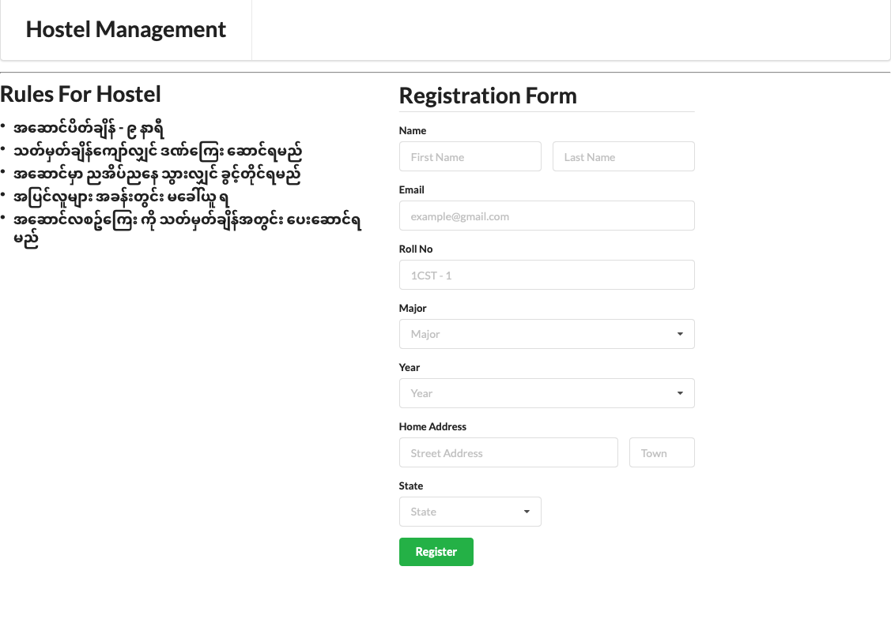
System user interface ( Student)
REGISTRATION FORM
The system requests some personal details

Slide 8
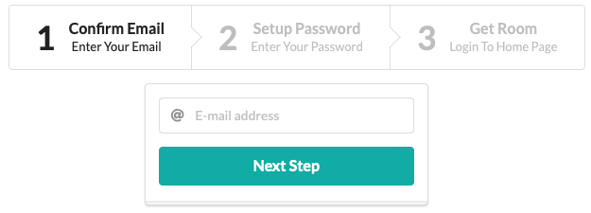
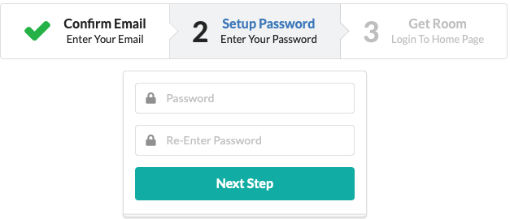
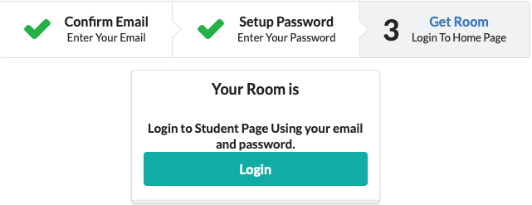
System user interface ( Student)
Confirmation Form
When Student gets an mail from admin, student go to the confirmation form.
Setup for password
Get RoomID and login to Student Home page

Slide 9
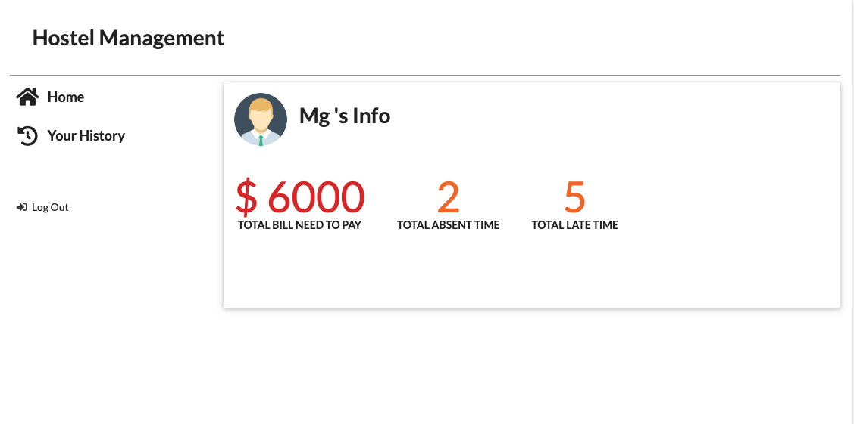
System user interface ( Student)
Student
Student can check attendance history.
Student can check bill history and amount which need to pay.

Slide 10
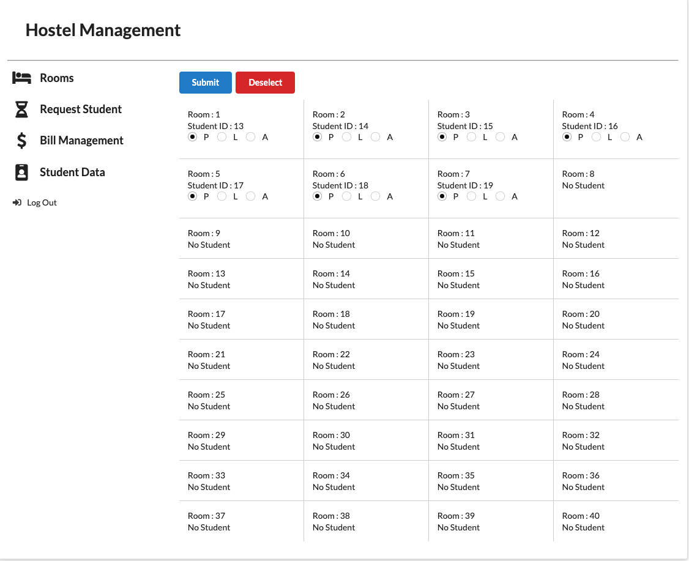
System user interface (admin)
ROOMS
include checkboxes to record the presence of students
P => present
L => late
A => absent

Slide 11
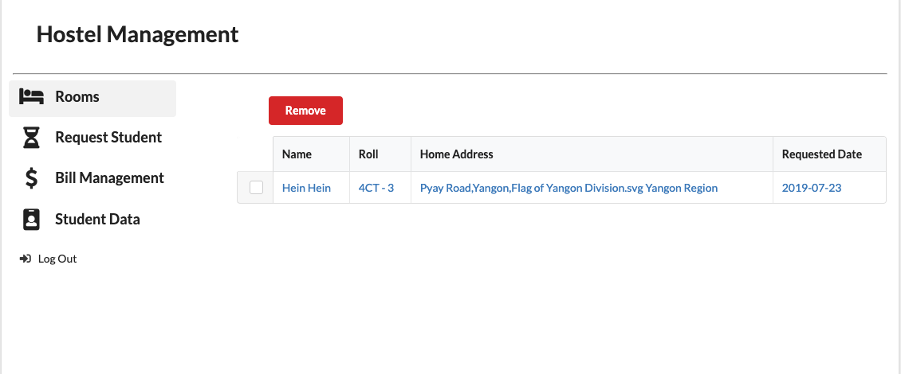
System user interface (admin)
Request Student
First
Checks registered student details
And confirm room or remove

Slide 12
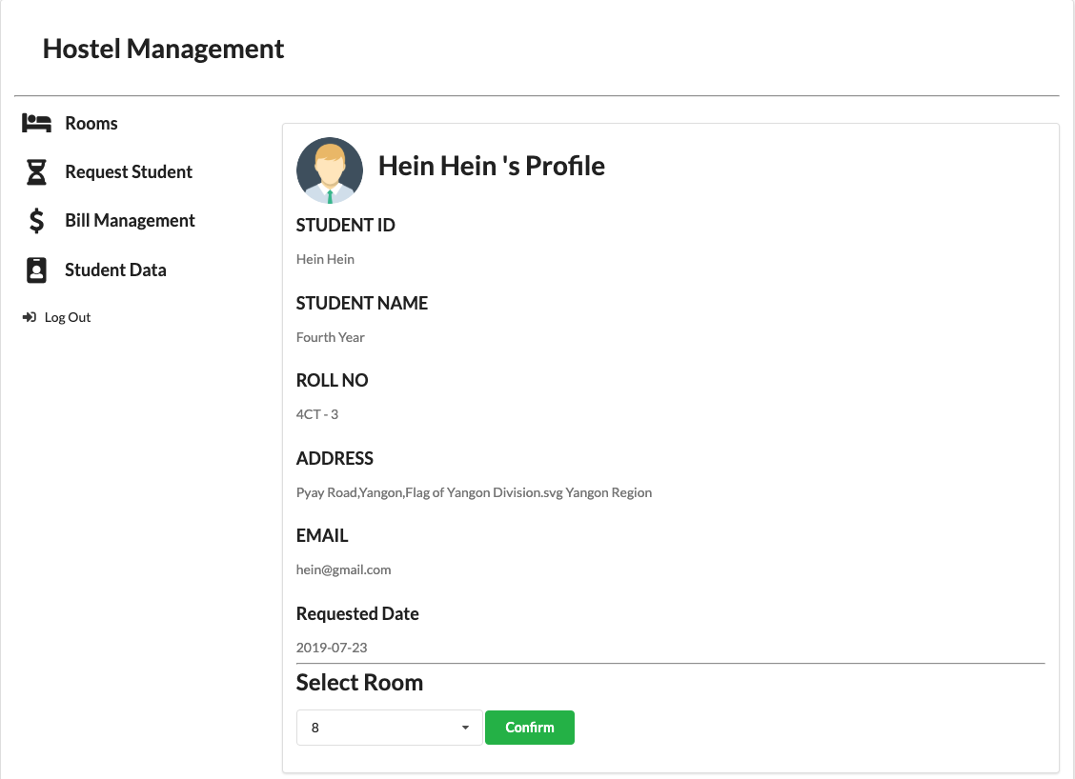
System user interface (admin)
Request Student
Second
View All Student Data
Confirm Room

Slide 13
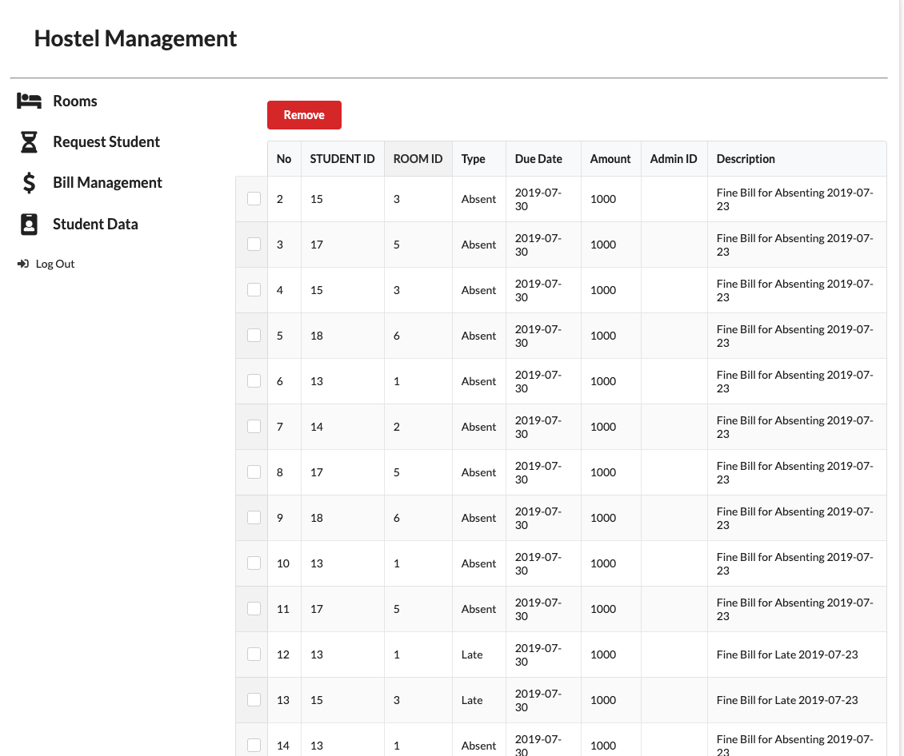
System user interface (admin)
Bill Management
Manage Bill for Student

Slide 14
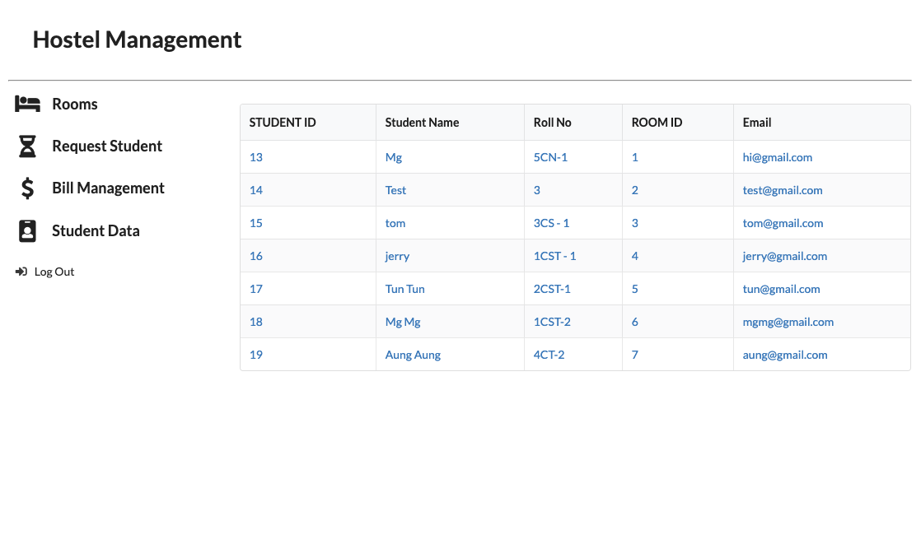
System user interface (admin)
Student Data
Manage Student in Hostel
Can update student data

Slide 15
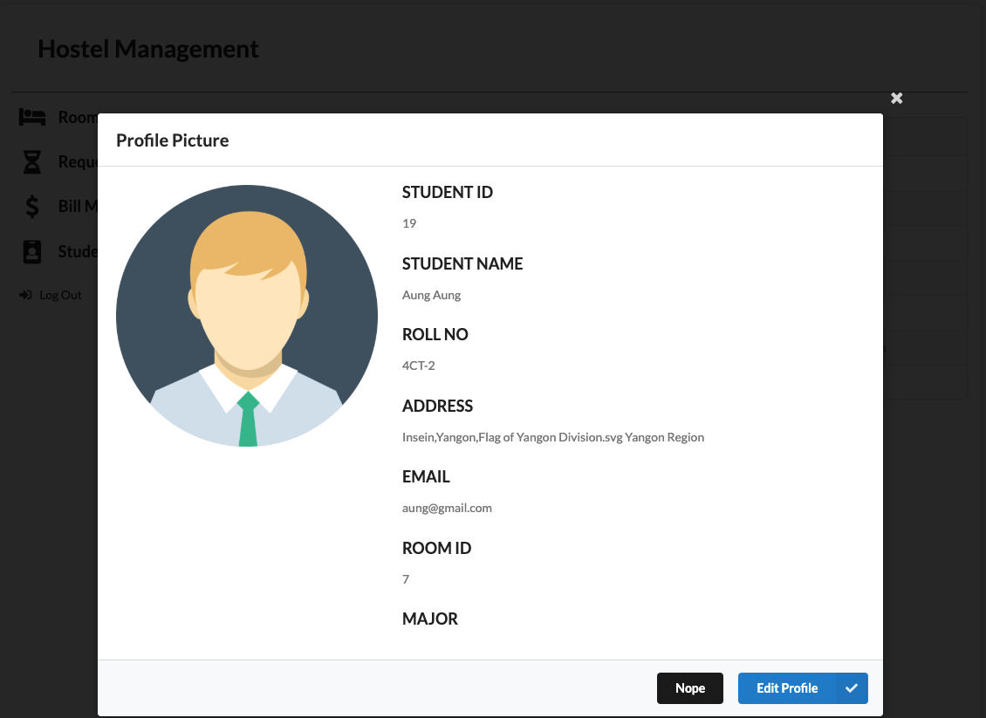
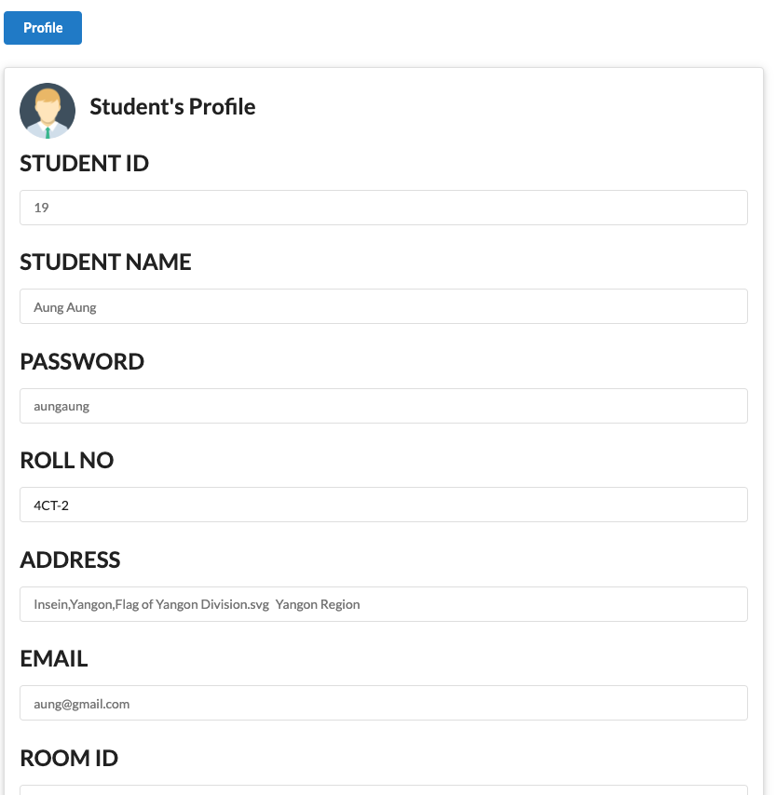
System user interface (admin)
Student Data
To update Student Data
Click on the Student
Edit Profile
-All Tables in Project are Sortable Table.

Slide 16
Thank you!!

