Slide 1
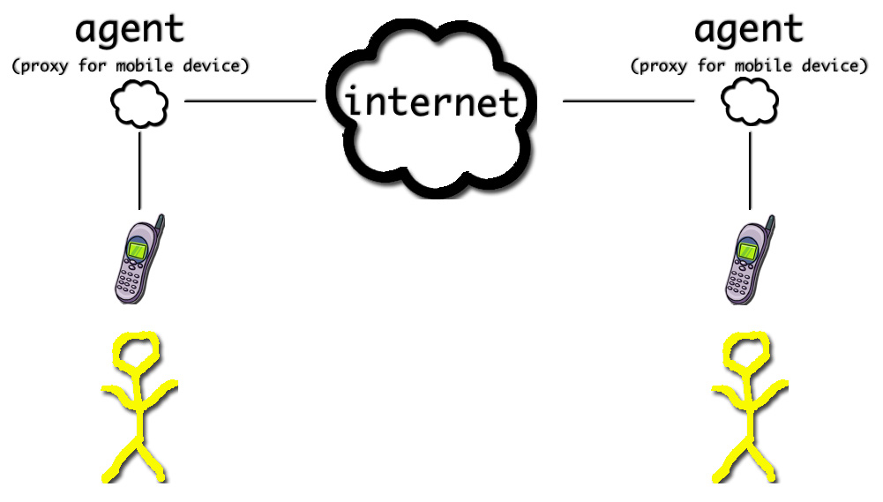
EGO: Indirect Connections Between People and Objects
What agents do:
Represent humans and objects
Run in the cloud
Form decentralized architecture
Act as proxy to your context
Discover each other based on your context
Ego powers “Glass Infrastructure”

