Slide 1
Capstone of Prithvi Yarlagadda
Statistics & Modeling
Coding with Performance on Big Data
Communicating Results for Decision-Making
Venn Diagram of Data Science Skills

Slide 2
Contribution of Competitor’s Article
Analyze the relationship and to develop a more flexible framework to allow communication between transport emissions and air quality
Provide high time/space resolution measurements of both air pollutant concentrations and traffic emissions data
Notes:
The aim of this study was to analyze this relationship and to develop a more flexible framework to allow communication
between transport emissions and air quality concentrations. This paper describes the development of this framework, suggests methodological
tools to mitigate its problems and shows its application to the mega-city
The result of implementing this
methodology would be a system providing high time/space resolution measurements of both air pollutant concentrations and traffic emissions
data, as well as real-time transportation and dispersion modelling of those data. The key advantage of the system proposed would be the runtime
integration of modelling, to interpret the data measured, with measurements, to validate the data modelled. The findings from the case-study of
Beijing show that the integrated system can link traffic air pollution measurements through various modelling modules in order to automate
transport-related air pollution assessment.

Slide 3
Description of Your Contribution
Time series for daily, monthly and yearly
Geospatial map using locations
Included traffic and weather data for our analysis
Correlation and regression model
Cross-spectrum analysis
Notes:
So each location can be taken at a time and sum all the values. These can be categorized into different time series like calculate for monthly, daily and hourly. From this we can find a pattern and may predict for the next day or hour. These can be very helpful in understanding the pollution distribution
Scipy.signal.coherence

Slide 4
Data Source and Content
Pollution
Smartcity dataset
Weather
Traffic
United States Environmental Protection Agency
The traffic flow volume was determined by counting the vehicles total number for one intersection during one rush hour
The measurement points number was chosen according to the traffic flows, the intersection geometrical parameters and placement of the buildings.
Notes:
road traffic data and chemical pollution data. The used method for this study was the traffic data manual collecting. For one input it is established the following data measurement: traffic volume, vehicles number for each direction (left, forward, right) and for each vehicle category [2]. The traffic flow volume was determined by counting the vehicles total number for one intersection during one rush hour (Example: 8.00-9.00, 15.00-16.00). Chemical pollution measurement methodology: for each studied intersection were selected a number of measurement points for chemical pollution data. The measurement points number was chosen according to the traffic flows, the intersection geometrical parameters and placement of the buildings.

Slide 5
Your Method
Weather – Air pollution synchronization
Correlation between Weather parameters
and Pollutants
Merge traffic data
Build regression model
Zeppelin, R, Pyspark
Notes:
In the first step of data analysis, linear relationships between analyzed pollutants and meteorological parameters were tested using Pearson’s correlation resulting 48 possible pollutant –meteorological factor pairs

Slide 6
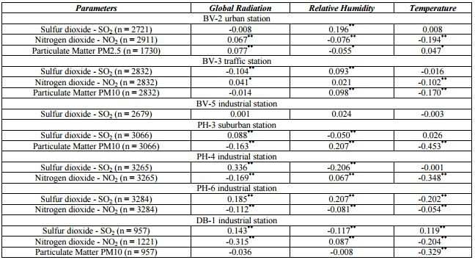
Quantitative Results 1

Slide 7
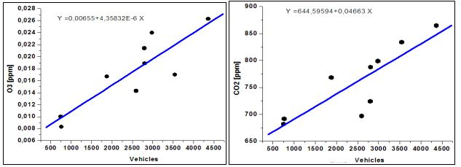
Quantitative Results 2
The most common frequencies were 0.0416 and 0.0833. An interesting remark is that the week period (7 days) did not occur in the highest five peaks of cross amplitude.

Slide 8
Discussion: Comparison With Your Competitor
Competitor’s Results
Your Results
Built a regression model based on pollution data
Cross-spectrum analysis of air pollution and weather data
Reveal the correlations between two series at different frequencies.
The number of valid observations was odd, padding has been applied to have even series for Fourier analysis.
Built regression model by considering parameters like traffic volume and air pollutants
Correlation between air pollutants and weather parameters.
33 strong correlations (p < 0.01) and 3 moderately strong correlations (p < 0.05) were identified. The remaining 12 pairs did not show a linear correlation

Slide 9
Performance on Big Data: Time Measurements
Total time: 4 mins
Data Load: 20 Secs * 3
Data Merge: 30 secs
Run Models: 120 sec

Slide 10
Conclusion
The results show an important contribution of short-term fluctuations to the total variance for analyzed pollutants (nitrogen dioxide, sulfur dioxide and suspended particles), with high dependence on the meteorological factor (incident radiation, air temperature or relative humidity) and less on the site specific conditions.
This type of exploratory approach might help as a pre-assessment tool identifying constants or patterns that can characterize the interactions between variables, which is a useful tool for the parameterization and calibration of air pollution models.
Furthermore, the technique can provide comprehensive classifications of the monitoring sites.

Slide 11
Quiz for Your Classmates
What statistical method was used?
What programming tool was used?
What scientific contribution was made?
What idea could be useful for your project?

