Slide 1

Article on Pollution data
Prithvi Yarlagadda
Ds-670 Capstone

Slide 2
Agenda
Air pollution
Dataset and article
Methodology
Action Scheme
Results
Capstone
Graphs

Slide 3

Air Pollution
Air pollution is increasing mainly due to Road transport
Due to Air pollution Human health is in danger. It may cause skin cancer and many lung diseases
Controlling pollution is High priority in every country around the world

Slide 4
Dataset
Air Pollution data from City pulse smart city dataset
This dataset consists of pollution measurements for the city of Brasov in Romania
Article
A new approach to link transport emissions and air quality: An intelligent transport system based on the control of traffic air pollution

Slide 5
Methodology used in article
Requirement Analysis
System Design
System Implementation
System Testing

Slide 6
Action Scheme
Draw.io

Slide 7
Draw.io

Slide 8
Emission amount and main source of CO

Slide 9
Public transport in Beijing

Slide 10
Pollutant | Period | European limit | Chinese sta
SO2 | Year Avg | 20 | 60
 | Day Avg | 125 | 150
 | 1 h avg | 350 | 500
TSP | Year avg |  | 200
 | Day Avg |  | 300
PM | Year Avg | 40 | 100
 | Day Avg | 50 | 150
NO2 | Year | 50
 | Day |  | 120
 | Hour | 250
CO | Day |  | 4
 | Max | 10
 | Hour |  | 10
O3 | Max | 120
 | Hour |  | 160
Pb | Season |  | 1,5
 | Year Avg | 0,5 | 1

Slide 11
Results
Runtime integration of modelling and measurements
Measurement of pollutant concentrations in ambient air
Measurements on the road of traffic emissions and sources
Results from the Beijing feasibility study and system design

Slide 12
Capstone
Regression
Run our dataset with different regression models and compare. See which one has good model
Use this model to predict the pollution in next hour of next day

Slide 13
Geomap
Use Latitudes and longitudes from the dataset and plot in the map
Show which areas are highly polluted and maybe show case with heatmap
Which factor among five different pollution factors is highest and lowest.

Slide 14
Safe Travel
After developing GeoMap’s , identify which parts of city are not being polluted on daily basis
Once we get low polluted areas, suggest those routes for travelling. This may help people to minimize their chances of being sick due to air pollution
This should be updated regularly and predict, so that people can follow and be healthy

Slide 15
Ideas to minimize air pollution
Plant more trees where there is high rates of air pollution
Install sensors around the city and keep constant record of pollution
Increase public transportation, which in turn make people to use vehicles less frequent
Use vehicles when required and use public transport so that emissions from vehicles also will be minimized

Slide 16
Approach planned to follow for capstone
Run our dataset with different regression models and compare. predict the pollution in next hour
Show which areas are highly polluted
Suggest those routes for travelling

Slide 17
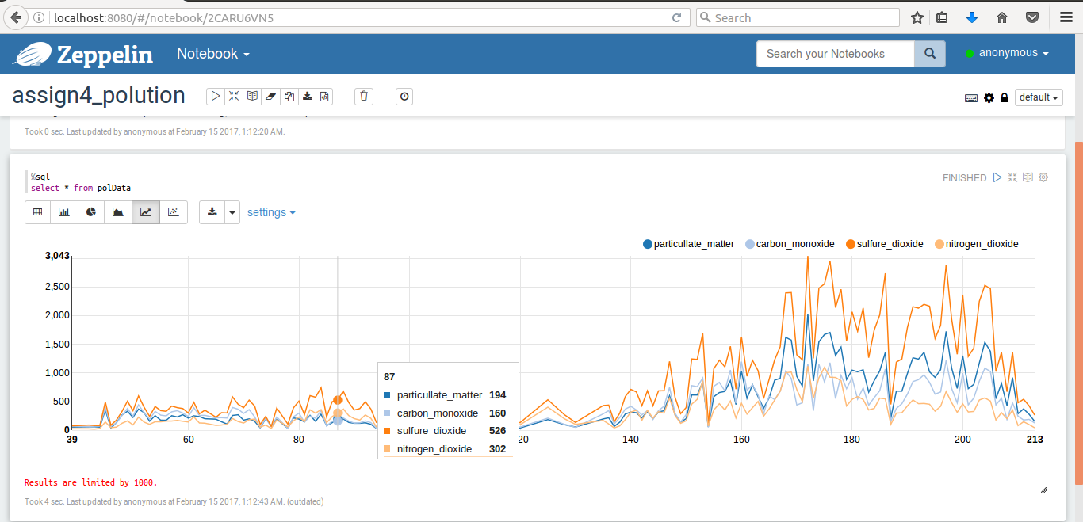
Factors of air pollution
Zeppelin

Slide 18
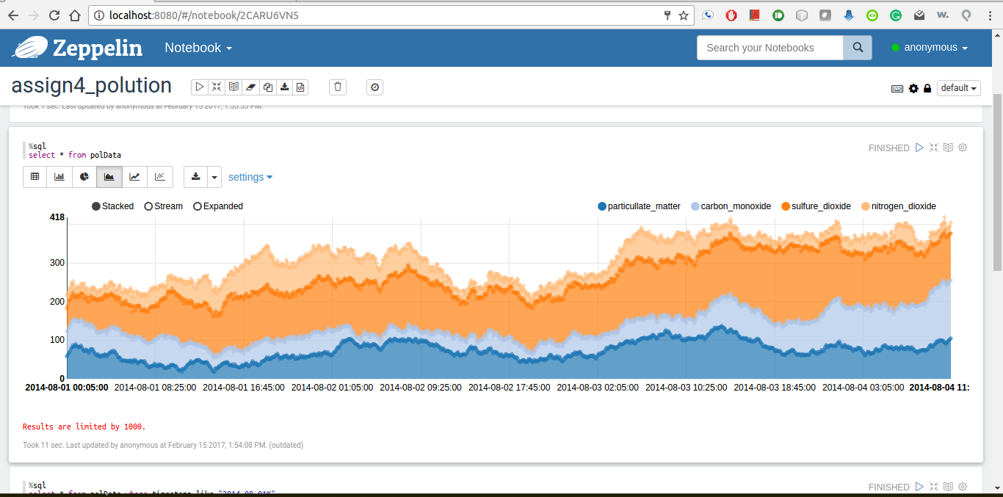
Area Plot
Zeppelin

Slide 19
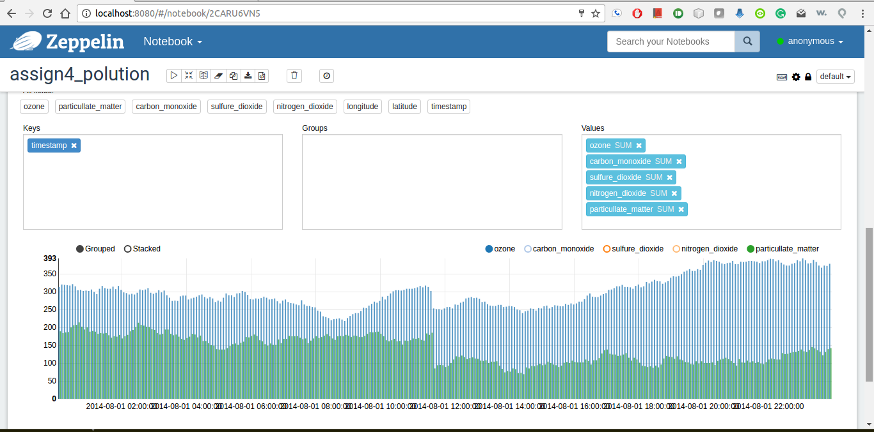
Ozone Vs particullate_matter
Zeppelin

Slide 20
Conclusion
Better understanding of how improvement of transport technology and take steps to save environment
Decrease vehicles pollution by technology like hybrid cars and electric vehicles
Install sensors and maintain traffic-related air quality
Real-time traffic related air pollution

Slide 21
ACM/IEEE References:
Zaheer Khan, Ashiq Anjum, and Saad Liaquat Kiani. 2013. Cloud Based Big Data Analytics for Smart Future Cities. In Proceedings of the 2013 IEEE/ACM 6th International Conference on Utility and Cloud Computing (UCC '13). IEEE Computer Society, Washington, DC, USA, 381-386. DOI=http://dx.doi.org/10.1109/UCC.2013.77
Andrew Lewis, David Abramson, and Rod Simpson. 1997. Parallel non-linear optimization: towards the design of a decision support system for air quality management. In Proceedings of the 1997 ACM/IEEE conference on Supercomputing (SC '97). ACM, New York, NY, USA, 1-12. DOI: https://doi.org/10.1145/509593.509634Air quality index. (n.d.). Retrieved February 04, 2017, from https://en.wikipedia.org/wiki/Air_quality_index

Slide 22
Thank you

