Slide 1
Article on Pollution data
Prithvi Yarlagadda
Ds-670 Capstone

Slide 2
Agenda
Air pollution
Dataset and article
Methodology
Action Scheme
Results
Capstone
Graphs

Slide 3
Air Pollution
Road transport
Human health
High priority

Slide 4
Dataset
Pollution
City pulse smart city dataset
Article
A new approach to link transport emissions and Air quality

Slide 5
Methodology
Requirement Analysis
System Design
System Implementation
System Testing

Slide 6
Action Scheme
Draw.io

Slide 7
Draw.io

Slide 8
Emission amount and main source of CO

Slide 9
Pollutant | Period | European limit | Chinese sta
SO2 | Year Avg | 20 | 60
 | Day Avg | 125 | 150
 | 1 h avg | 350 | 500
TSP | Year avg |  | 200
 | Day Avg |  | 300
PM | Year Avg | 40 | 100
 | Day Avg | 50 | 150
NO2 | Year | 50
 | Day |  | 120
 | Hour | 250
CO | Day |  | 4
 | Max | 10
 | Hour |  | 10
O3 | Max | 120
 | Hour |  | 160
Pb | Season |  | 1,5
 | Year Avg | 0,5 | 1

Slide 10
Results
Runtime integration of modelling and measurements
Measurement of pollutant concentrations in ambient air
Measurements on the road of traffic emissions and sources
Results from the Beijing feasibility study and system design

Slide 11
Capstone
Regression
Compare different regression models
Use this model to predict the pollution in next hour of next day

Slide 12
Geomap
Use Latitudes and longitudes
Show highly polluted areas
Which factor is more in which part of city

Slide 13
Safe Travel
Using GeoMap’s and show which area’s are not polluted
Suggest those routes for travelling
Update regularly and predict

Slide 14
Minimize
Plantation
Sensors
Public transport
Use vehicles when required

Slide 15
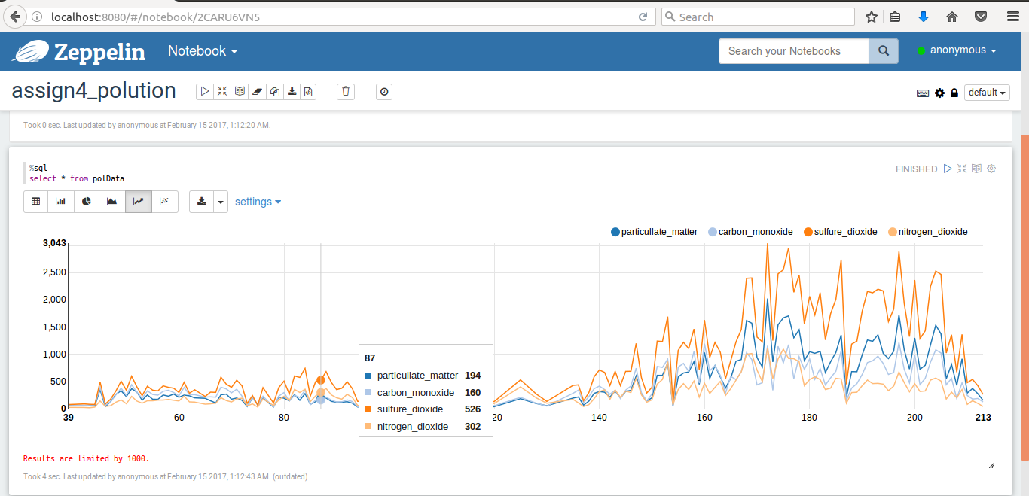
Factors of air pollution
Zeppelin

Slide 16
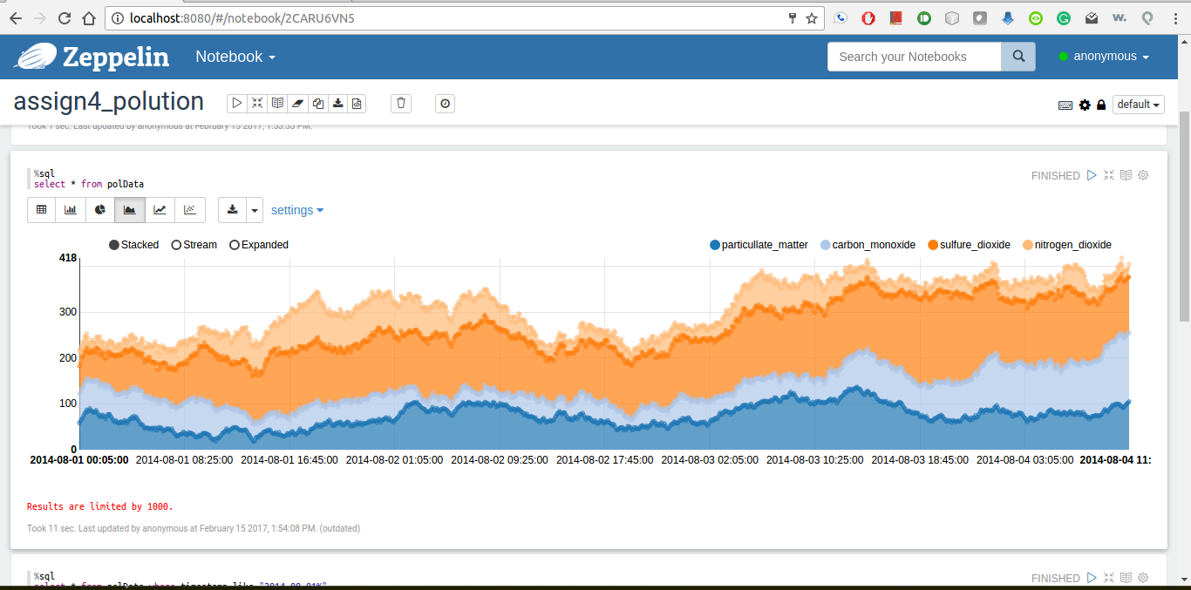
Area Plot
Zeppelin

Slide 17
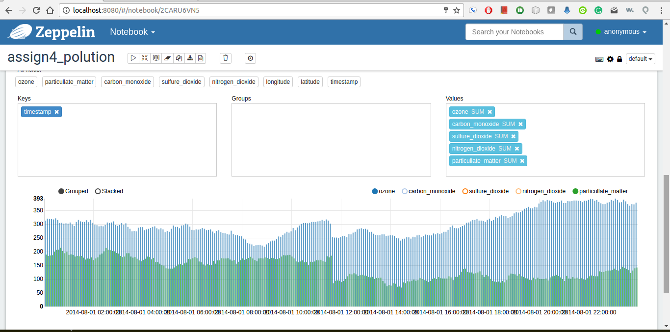
Ozone Vs particullate_matter
Zeppelin

Slide 18
Conclusion
Better understanding of how improvement of transport technology
Vehicles pollution by technology
Sensors, traffic-related air quality
Real-time traffic related air pollution

Slide 19
References:
Costabile, F., & Allegrini, I. (2008). A new approach to link transport emissions and air quality: An intelligent transport system based on the control of traffic air pollution. Environmental Modelling & Software, 23(3), 258-267.
Hordijk, L., & Amann, M. (2007). How science and policy combined to combat air pollution problems. Envtl. Pol'y & L., 37, 336.
Air quality index. (n.d.). Retrieved February 04, 2017, from https://en.wikipedia.org/wiki/Air_quality_index

Slide 20
Thank you

