Slide 1
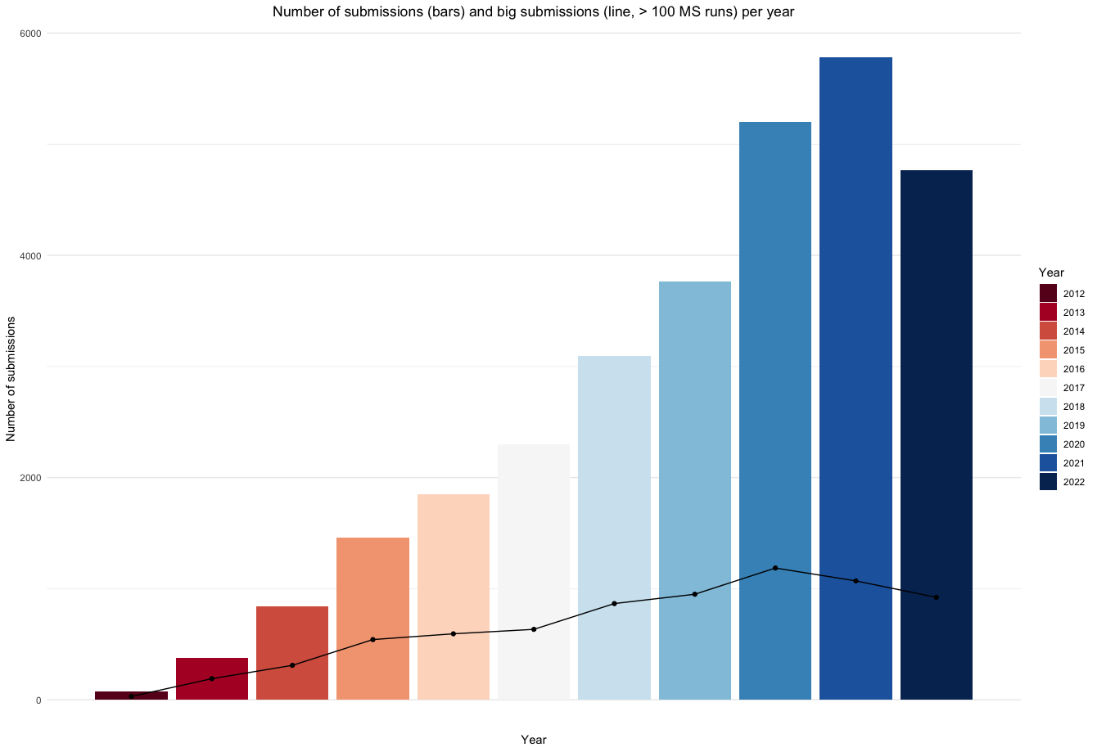
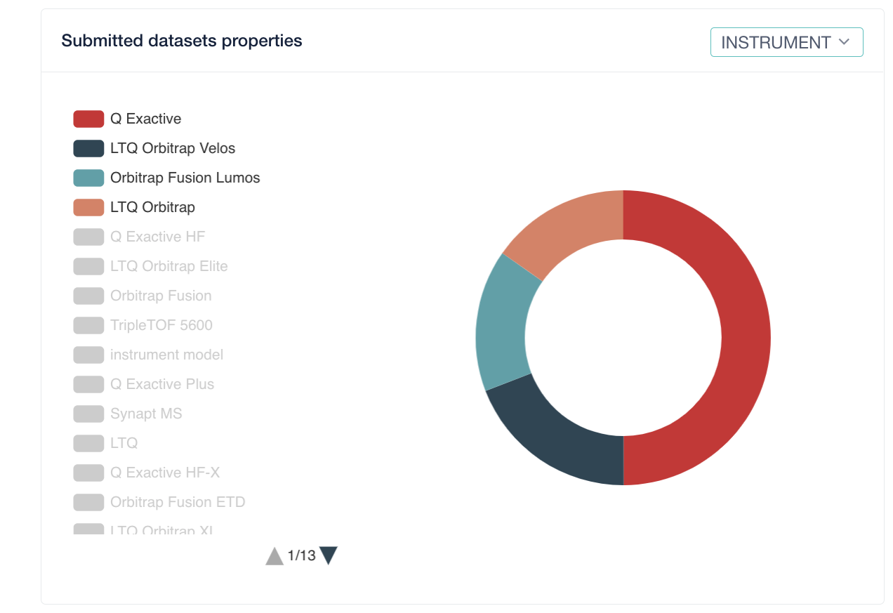




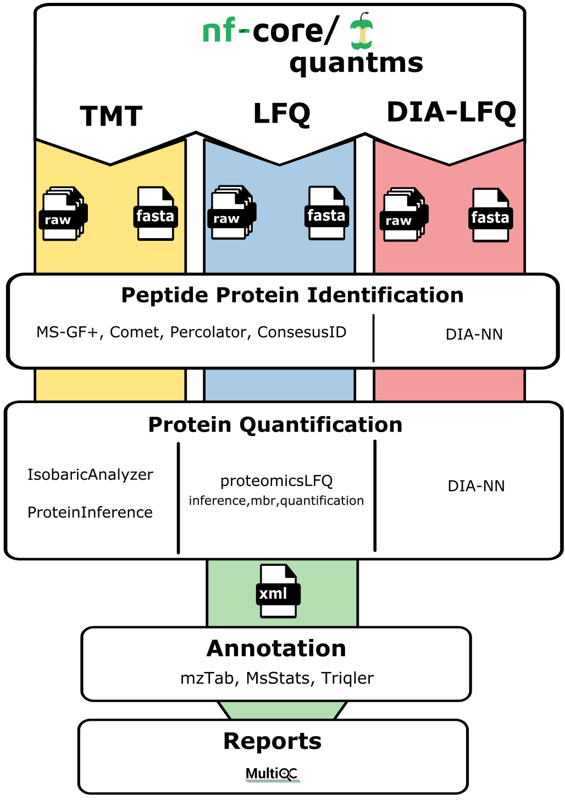
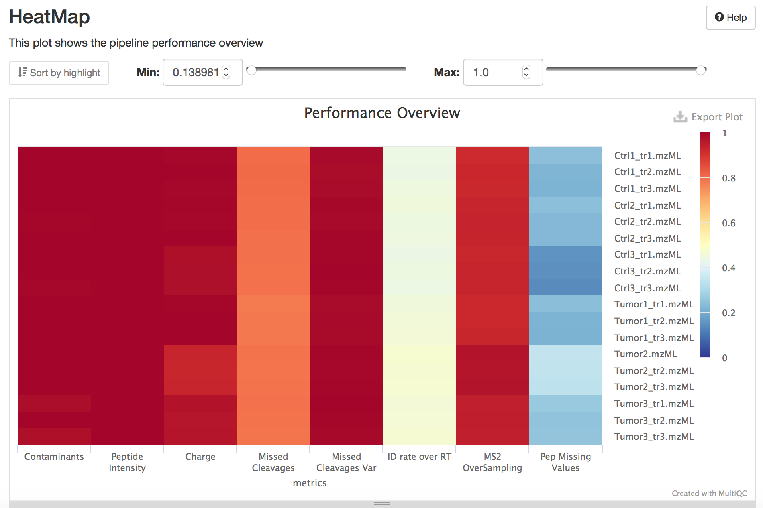
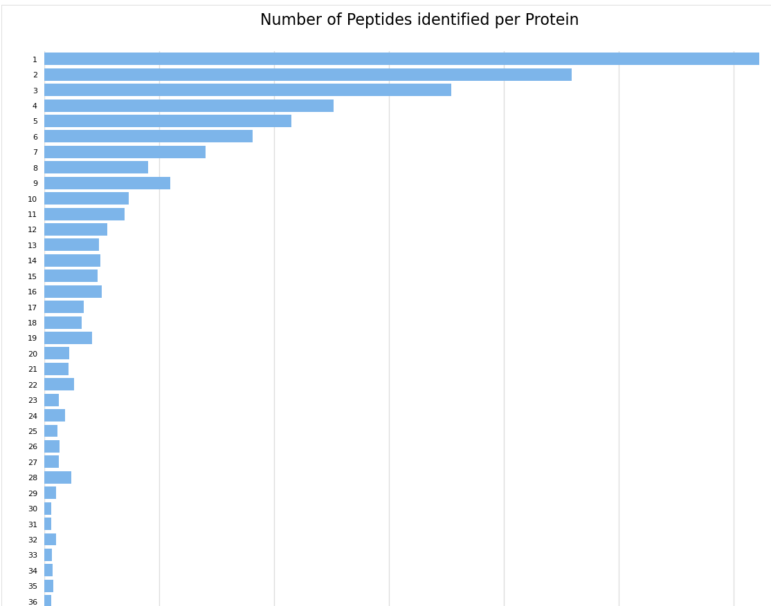
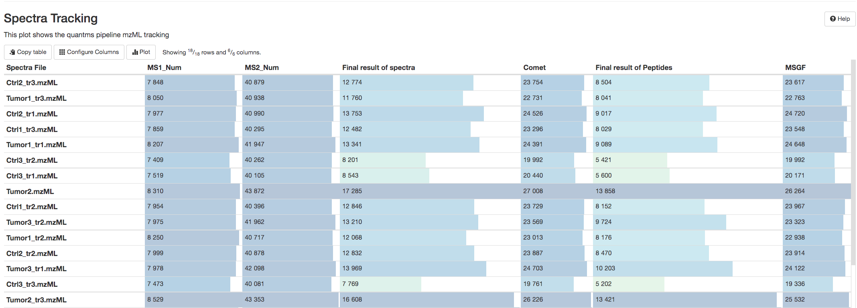

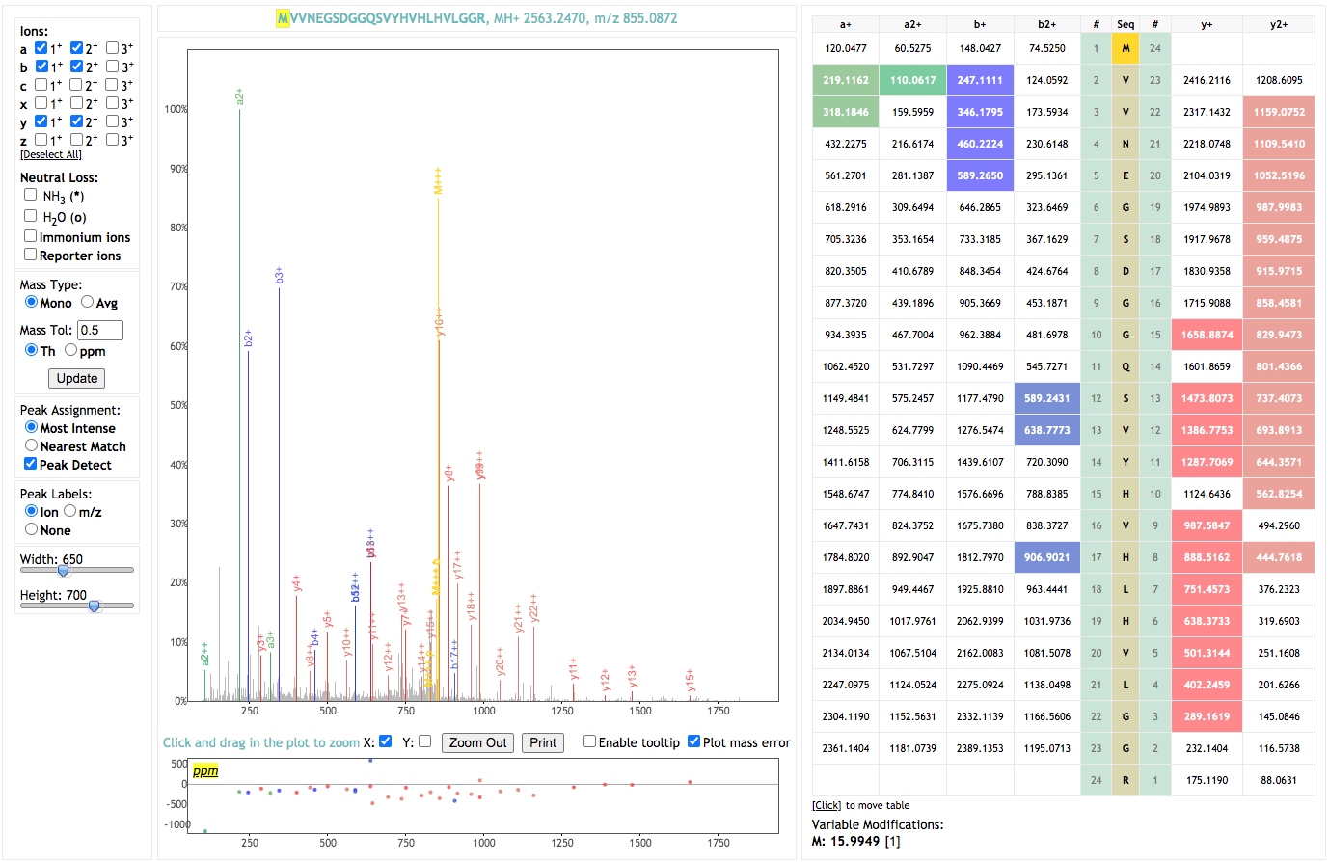
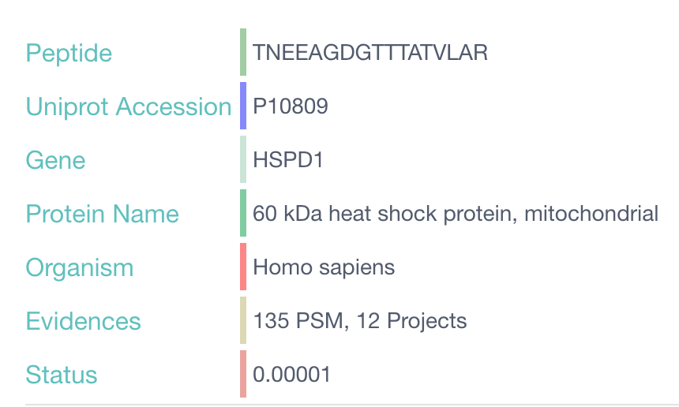
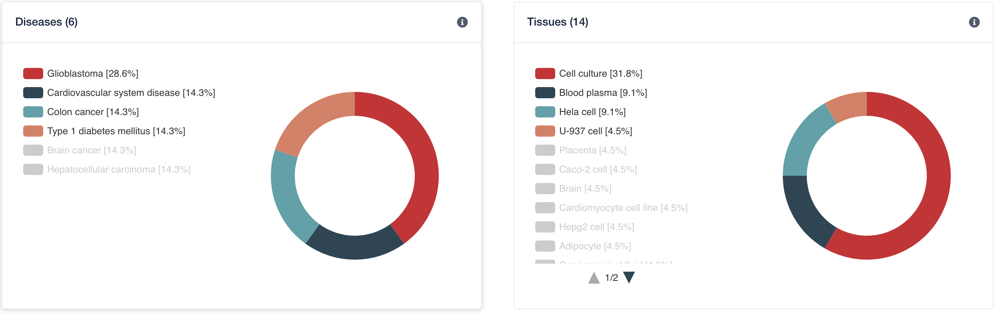
PRIDE Peptidome: A hub for peptide evidences from public proteomics datasets for ENSEMBL and Uniprot
Yasset Perez-Riverol ¹, Chakradhar Reddy Bandla ¹, Selvakumar Kamatchinathan ¹, Juan Antonio Vizcaíno ¹
European Molecular Biology Laboratory, European Bioinformatics Institute (EMBL-EBI), Wellcome Trust Genome Campus, Hinxton, Cambridge, CB10 1SD, UK.
https://www.ebi.ac.uk/pride/. https://quantms.readthedocs.io/
The PRIDE database – Public data reuse: Bringing proteomics data to biologists
EMBL-EBI’s PRIDE database is the largest data resource of MS proteomics data worldwide.
During 2021 alone, 490 datasets were submitted per month on average to PRIDE.
Reuse of public proteomics datasets is increasing dramatically, with multiple applications.
Rather than in the creation of new bioinformatic resources, for sustainability reasons, our focus is to disseminate and integrate PRIDE proteomics data into added-value EMBL-EBI resources, namely UniProt (PTM data, protein sequences), Expression Atlas (protein expression information, the focus of this poster), Ensembl (proteogenomics data) and MGnify (metaproteomics and metagenomics data).
The goal is to make proteomics data more accessible to life science scientists, especially those non-expert in proteomics.
Internal reanalysis of dataset using quantms (DDA-LFQ, DDA-TMT, DIA)
QC components
Major Data-related features:
Use multiple search engines in combination (msgf+, comet), boost the number of peptides by using percolator.
Perform multiple protein quantification methods: LFQ-intensity based, spectral counting, TMT intensity, DIA-LFQ intensity based.
False localization rate analysis for PTMs including Phosphorylation and acetylation.
Based on HUPO-PSI standard file formats including mzTab, mzML, SDRF.
Major cloud features:
Can be executed in LSF, AWS, Google Cloud, Kubernetes, local PC, HPC. Based on BioContainers.
^{Open-source, open access.}
Include features for compute resource allocation, automatic fail-tolerance and resume workflows.
References:
Umer, Husen M., et al. Bioinformatics 38.5 (2022): 1470-1472.
Bai, Mingze, et al. chemRxiv (2022). 10.26434/chemrxiv-2022-x18d5
https://quantms.readthedocs.io/
From complete submissions to peptide evidences
mzid/mztab
Peak lists
Json Files
1294 Projects
217’261 Proteins
2’300’389 Peptides
1’922’855 Unique Peptides
150’658’201 PSMs
PX
Complete
PRIDE Archive Import
MaraCluster
High-quality clusters
PIA
FDR Filtering for 1%.
Peptide length 8 AA
Peptidome and spectra archive
Search by peptides, protein accessions, names, gene names.
Peptide + protein visualization including names, number of psms and projects.
ENSEMBL and Uniprot links to the corresponding spectra that validate a specific sequence feature (e.g., PTM or variant)
References:
Yasset Perez-Riverol, et. al. Nucleic Acids Research (2022), Pages D543–D552,
Deutsch, E. W., Perez-Riverol, et. Al. (2021). Nature methods, 18(7), 768-770.
https://www.ebi.ac.uk/pride/peptidome
Acknowledgements
BBSRC grants BB/P024599/1, BB/P024424/1, BB/T019670/1, BB/T019557/1;
Open Targets grants OTAR-043, OTAR-02-068; Wellcome grant 208391/Z/17/Z
EMBL’s European Bioinformatics Institute (EMBL-EBI)
Wellcome Genome Campus, Hinxton, Cambridgeshire. CB10 1SD. UK.
T +44(0)1223 494 444

