Slide 1
Sample Code Install
陳柏志 P76104710@gs.ncku.edu.tw
張浩綸 P76114074 @gs.ncku.edu.tw
實驗室：資訊新館65701

Slide 2
Environment
C++ & CMake (Cross Platform)
OpenGL 3.3
Libraries
glfw (not included) – creating windows, contexts and surfaces, handling events, etc.
glad - OpenGL loading library.
glm (0.9.9.8) – OpenGL mathematic library.
stb_image (v2.25) - Image loader.
tinyobjloader (version 0.9.20) - obj (3D model) file loader.
dear imgui (v1.77) – Graphical user interface.

Slide 3
Install CMake
Go to CMake official download website
https://cmake.org/download/
Select the Binary distributions of your platform and install.
Restart your computer if needed.
You can also use the package manager to install it. E.g., apt
sudo apt-get install cmake cmake-qt-gui

Slide 4
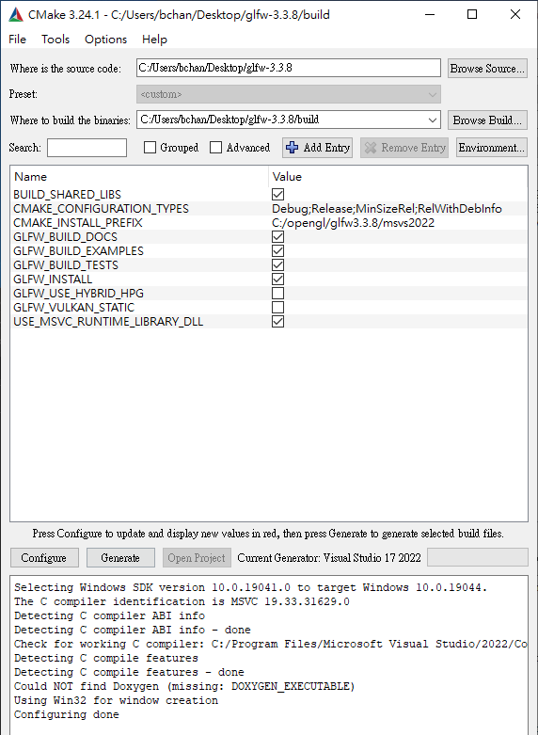
Re-Install GLFW
Manually install
Go to GLFW official website and download
Open with CMake GUI mode
Click Configure and choose Visual Studio version
Change settings.
CMAKE_INSTALL_PREFIX is the library install directory, select your favor directory and remember it.
Click Configure again to apply and then click Generate.

Slide 5
Re-Install GLFW
CMake build types
In library building process, we wish to build multiple build type.
In multi-configuration generator, leave it until we build the program.
In single-configuration generator, once we build the specific type, go back to this step to generate different type.

Slide 6
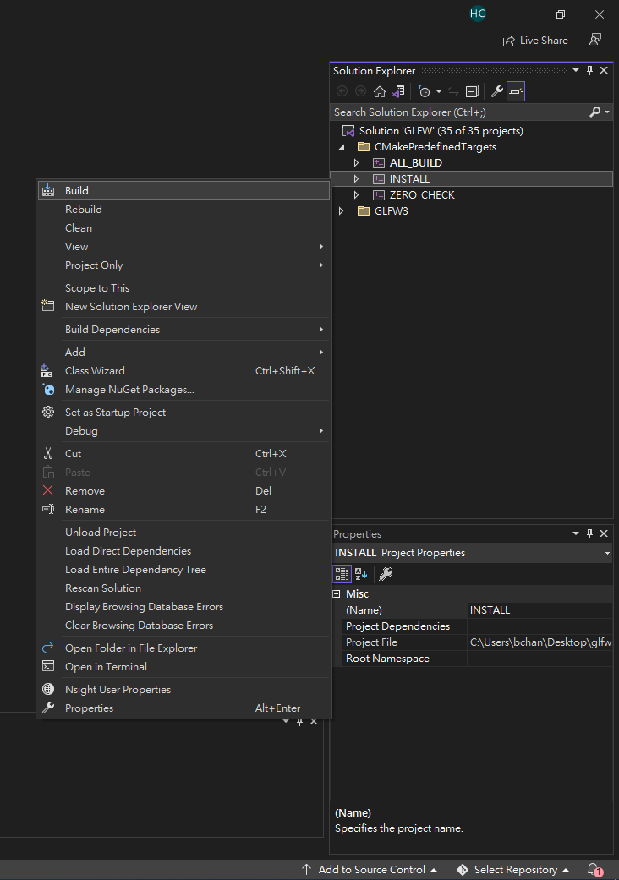
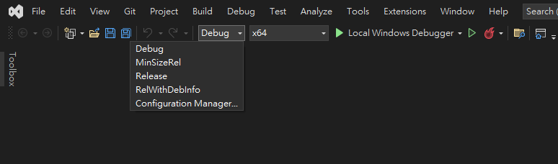
Re-Install GLFW
For MSVC
Right click the INSTALL solution.
Click build
Remember to build different type.

Slide 7
Re-Install GLFW
For gcc, clang
In your binary directory, type the following command.
gcc & clang : make install
MinGW-w64: mingw32-make.exe install
Remember the trailing install command.
Remember to build different type.
After that, you can see the compiled library in the library directory.
You can delete binary directory now.

Slide 8
Build the sample code
You need CMake to build the sample code.
Aside from GLFW, other required libraries are in the “thirdparty” directory.
You can download other libraries if you want.

Slide 9
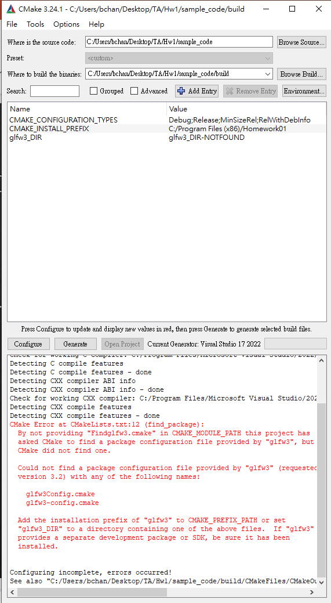
Build the sample code
CMake provide command line and GUI mode.
Choose the source code and binary code directory.
You can create binary folder inside the source code directory.
e.g., sample_code/build
Click Configure

Slide 10
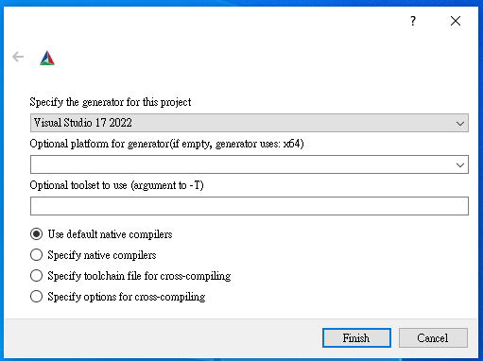
Build the sample code
Choose a compiler.
MSVC, Clang, GCC…
Choose toolchain if you use package manager
Conan, vcpkg, etc.
Use Visual Studio as example.
After everything is set, click Finish.

Slide 11
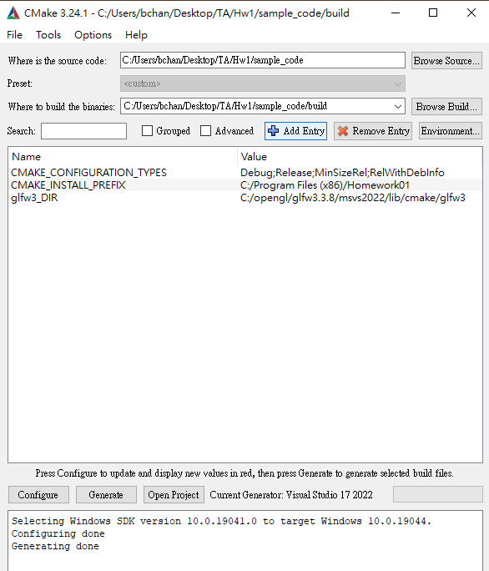
Build the sample code
Configure process reads the computer setting, decide which library, data, and program it should use.
Sometimes configure fails.
Read the error message carefully.
${LIBRARY_NAME}_DIR
This will try to find the directory of the library.
Set it to the directory where it contains the following files.
${LIBRARY_NAME}-config.cmake
${LIBRARY_NAME} Config.cmake.
E.g., sets glm_DIR to “sample_code/thirdparty/glm/cmake/glm”

Slide 12
Re-Install GLFW
Review
Manually install
Go to GLFW official website and download
Open with CMake GUI mode
Click Configure and choose Visual Studio version
Change settings.
CMAKE_INSTALL_PREFIX is the library install directory, select your favor directory and remember it.
Click Configure again to apply and then click Generate.

Slide 13
Build the sample code
CMAKE_CONFIGURATION_TYPES
Debug: Used for debug purpose. No optimization. Suited for debugger.
Release: Used for final product. Full optimization. Not suited for debugger.
RelWithDebInfo: A little bit less efficient than Release. It will generate symbol files for debugging.
MinSizeRel: Optimized for smallest program size.

Slide 14
Build the sample code
Click Configure again to apply and then click Generate.
After Generating Done, click Open Project (For MSVS).

Slide 15
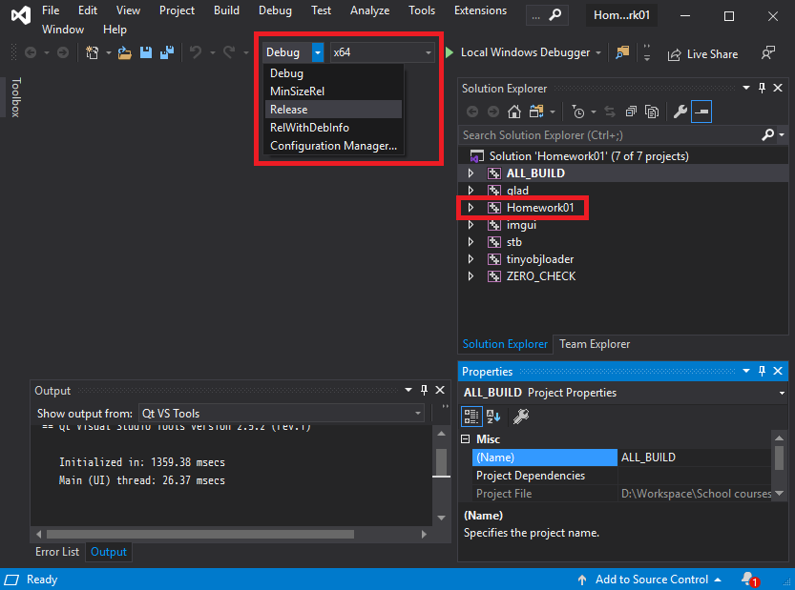
Build the sample code
MSVS
You can start filling the code.
In the solution explorer, choose Homework01 and build.
You might want to check the platform and configuration.
CMAKE_CONFIGURATION_TYPES.

Slide 16
Build the sample code
Other compilers
In the binary folder, run the command.
GCC: $make
mingw-w64: $mingw32-make.exe

Slide 17
Run the sample code
If the build process is successful, you will see the following files in the “bin/${Configuration type}” folder when it finished.
Executable file
Resource folder
Copy from the root directory.
Shader folder
Copy from the source code directory.
Dynamic-link library (.dll & .so)
Do not delete it.

Slide 18
Run the sample code
Use the following command to run the program
.\(program name) "resources/model/Utah_teapot_(solid)_texture.obj" "resources/texture/uv.png" "Shader/BasicVertexShader.vs.glsl" "Shader/BasicFragmentShader.fs.glsl"
Arguments:
Model name
Texture name
Vertex shader name
Fragment shader name

Slide 19
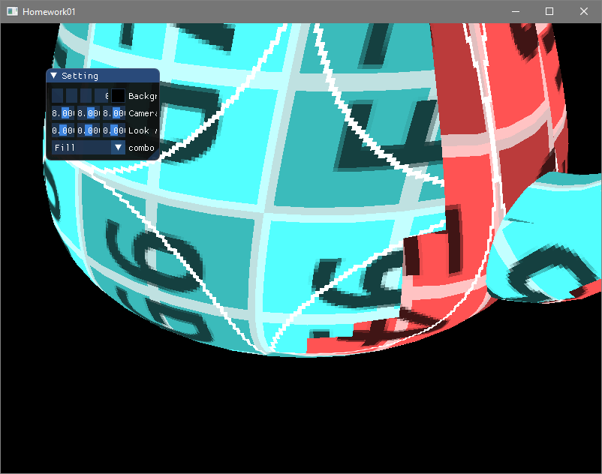
Run the sample code
Result

Slide 20
Build & Run (Linux)
Build
$mkdir build
$cd build
$cmake ..
$make
Run
$./(program name) "resources/model/Utah_teapot_(solid)_texture.obj" "resources/texture/uv.png" "Shader/BasicVertexShader.vs.glsl" "Shader/BasicFragmentShader.fs.glsl"

