Slide 1
Skeletal Animation
Instruction

Slide 2
Model Loading
Collada file format (.dae)
Mesh
Vertices
Position
Normal
Texture coordinate
Indices
Skeleton
Bone names
Hierarchy
Transformation matrix
The number of bones that influences the vertex
Weights
https://learnopengl.com/Guest-Articles/2020/Skeletal-Animation
Notes:
儲存座標（點、線、面）、顏色、相機、動畫、 節點 、骨架

Slide 3
Model Loading
Collada file format (.dae)
Animation
keyframes
https://learnopengl.com/Guest-Articles/2020/Skeletal-Animation

Slide 4
Model Loading
Assimp 5.0.1 (3D model importer)
https://github.com/assimp/assimp
https://learnopengl.com/Guest-Articles/2020/Skeletal-Animation

Slide 5
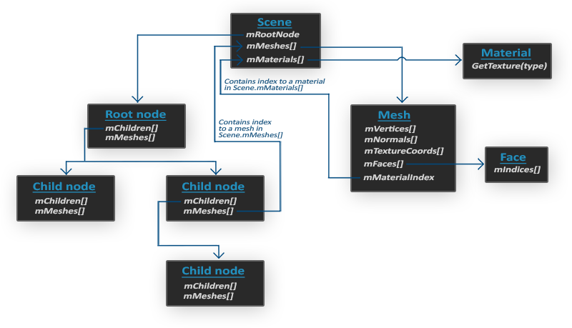
Mesh Data
https://learnopengl.com/Model-Loading/Assimp

Slide 6
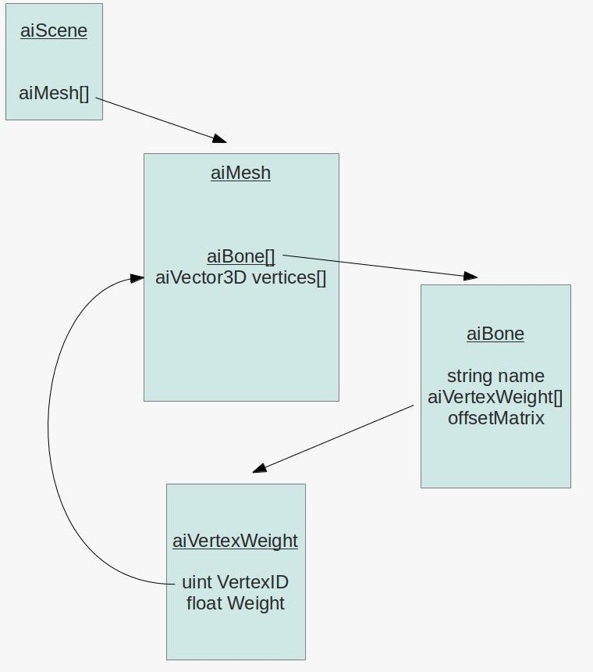
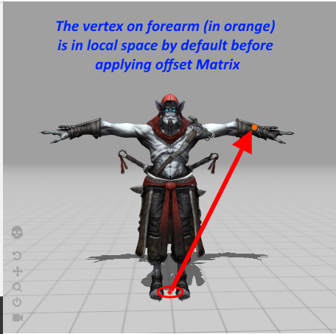
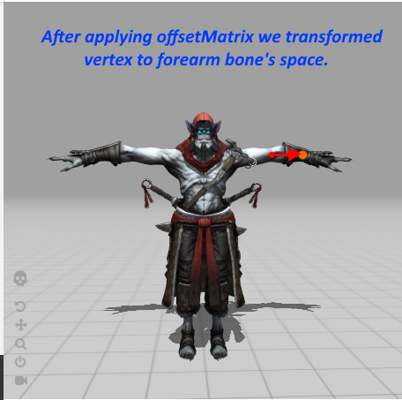
Bone Data
https://learnopengl.com/Guest-Articles/2020/Skeletal-Animation

Slide 7
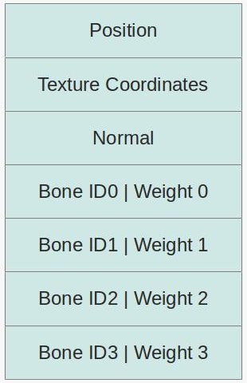
Bone Data
Vertex Structure
https://learnopengl.com/Guest-Articles/2020/Skeletal-Animation

Slide 8
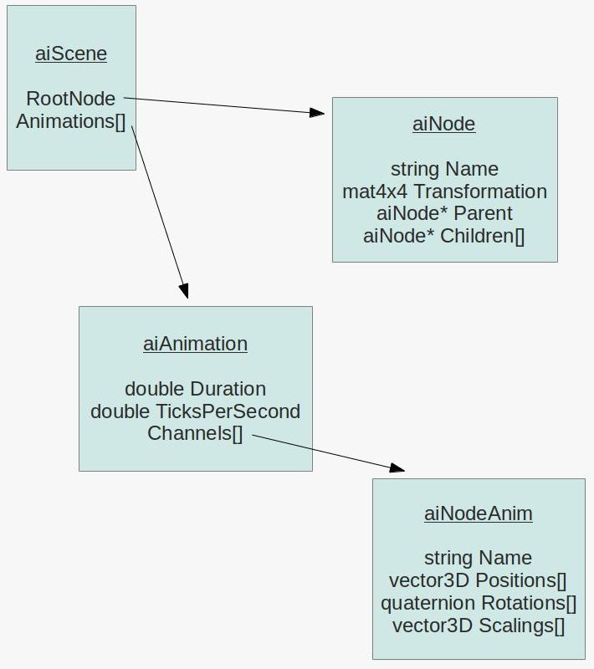
Animation Data
hierarchy info.
bones
https://learnopengl.com/Guest-Articles/2020/Skeletal-Animation
keyframes info.
Notes:
ticks: in game loop

Slide 9
Animation Data
Node hierarchy:
Scene
Armature
bone_root
bone_body
…
Camera
Light
https://learnopengl.com/Guest-Articles/2020/Skeletal-Animation
Notes:
ticks: in game loop

Slide 10
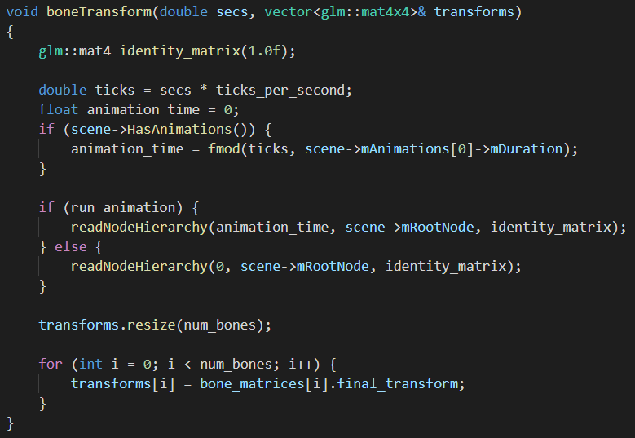
Bone Transformation Calculation
Current time
Output: Final Bone transformations
Calculate the bone transformations that go into the shader every frame
Process the node hierarchy
https://ogldev.org/www/tutorial38/tutorial38.html

Slide 11
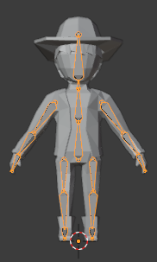
Bone Transformation Calculation
Given current time, process the node hierarchy and get the vertex transformation for each bone.
Get the bone_space_transformation (scaling, rotation, and translation)
Interpolation
global_transformation = parent_tranformation * bone_space_transformation
vertexTransformation = globalTransformation * boneInfo[nodeName].offset
new_vertex = global_transformation * space_offset_matrix (model space to bone space) * vertex
https://ogldev.org/www/tutorial38/tutorial38.html

Slide 12
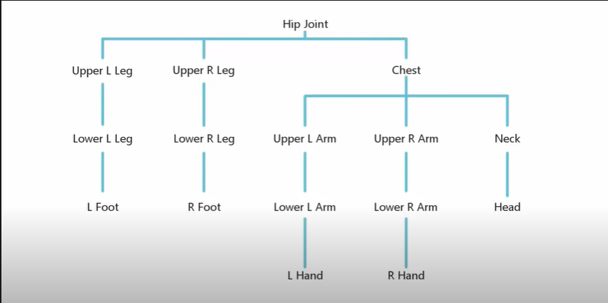
Bone Transformation Calculation
https://ogldev.org/www/tutorial38/tutorial38.html

Slide 13
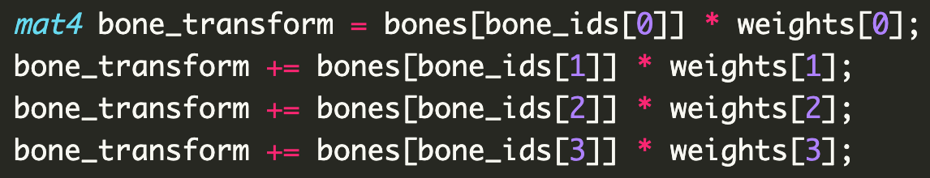
Skinning
Linear blending skinning (in vertex shader)
https://ogldev.org/www/tutorial38/tutorial38.html

Slide 14
References

Slide 15
References
3D models
https://www.cgtrader.com/free-3d-models?file_types%5B%5D=25
Skeletal Animation
https://learnopengl.com/Guest-Articles/2020/Skeletal-Animation
https://ogldev.org/www/tutorial38/tutorial38.html
https://www.youtube.com/watch?v=f3Cr8Yx3GGA&list=PLRIWtICgwaX2tKWCxdeB7Wv_rTET9JtWW
Assimp (3D model importer)
https://assimp.org/index.php
Blender
https://www.blender.org/
Notes:
所有bones都會根據階級去安排

