Slide 1
Prativimb
A patient twin that answers what if, not just what next.
Hybrid digital twin for Type 2 diabetes and cardiovascular risk, built for Indian patients.
Happiest Health hackathon. Digital Twin track, Phase 1: prototype and code.
<TeamName>, <CollegeName>. Prativimb is Sanskrit for reflection. All patient data shown is synthetic.

Slide 2
WHY NOW
The problem
• India has about 101 million adults with diabetes and 136
million with prediabetes (ICMR-INDIAB, Lancet Diabetes &
Endocrinology, 2023).
• Most see a doctor every three months. Glucose, sleep and
heart rhythm change every five minutes.
• CGMs and watches now record that stream, but they show
what already happened.
• Risk scores say who is at risk. They do not say what to
change today, or how sure they are.
What a clinician needs at the bedside
• Which patients will go out of range in the next
two hours?
• Why, in words, not feature names?
• What would help this patient: a walk, a different
grain, an earlier dinner?
• Who is drifting towards a cardiac event this week?
Prativimb 2

Slide 3
OUR ANGLE
Why a twin, and not another classifier
Risk classifier
Prativimb twin
Question
What happens next?
What happens next, and what if we change
something?
Model
Learned from data only
Physiology (ODE) plus a learned residual
Personal
Population average
Parameters fitted to each patient's first
week
Out of range inputs
Unreliable
Physics extrapolates plausibly
Uncertainty
A score
Calibrated interval with stated coverage
Reasons
Feature importances
mg/dL contributions, one plain sentence
Prativimb is a reflection of the patient you can question.
Prativimb 3

Slide 4
METHOD
Our approach in four ideas
1. Hybrid twin
2. Counterfactuals
Bergman minimal model extended with meals, exercise, sleep debt,
circadian rhythm, night shifts and metformin. EHR sets the
prior, the first week of wearables fits 8 personal parameters,
LightGBM learns what the physics misses.
Re-simulate the next six hours after a walk, a millet swap, a
shifted dinner, a missed dose, more sleep or a night shift.
Shows peak and time above range for both.
3. Honest uncertainty
4. India first
Conformalised quantile regression gives 90% intervals that reach
89.2% coverage at 60 min on unseen patients. Alerts fire only
when the lower bound crosses 180.
Rice, roti, idli and iftar meals with their absorption speeds;
Ramadan, Shivaratri, Ekadashi and Holi in the calendar; night
shift workers; cardiovascular risk at lower BMI.
Prativimb 4

Slide 5
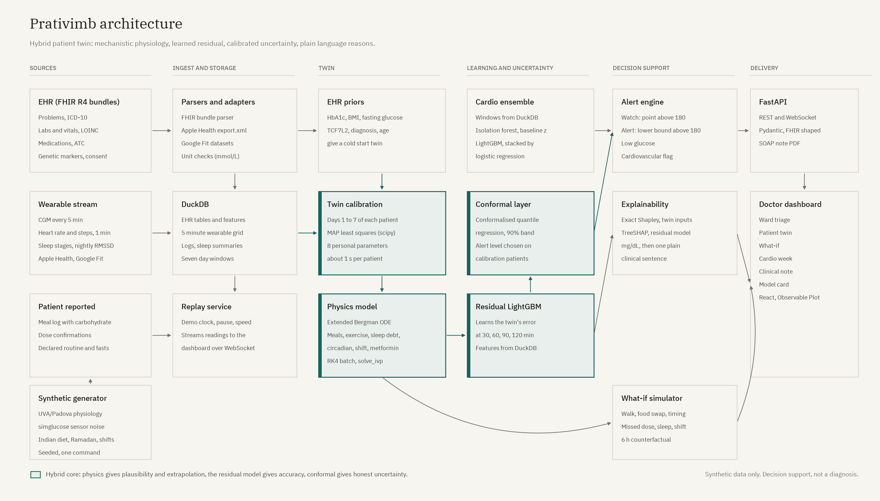
SYSTEM
Architecture
Prativimb 5

Slide 6
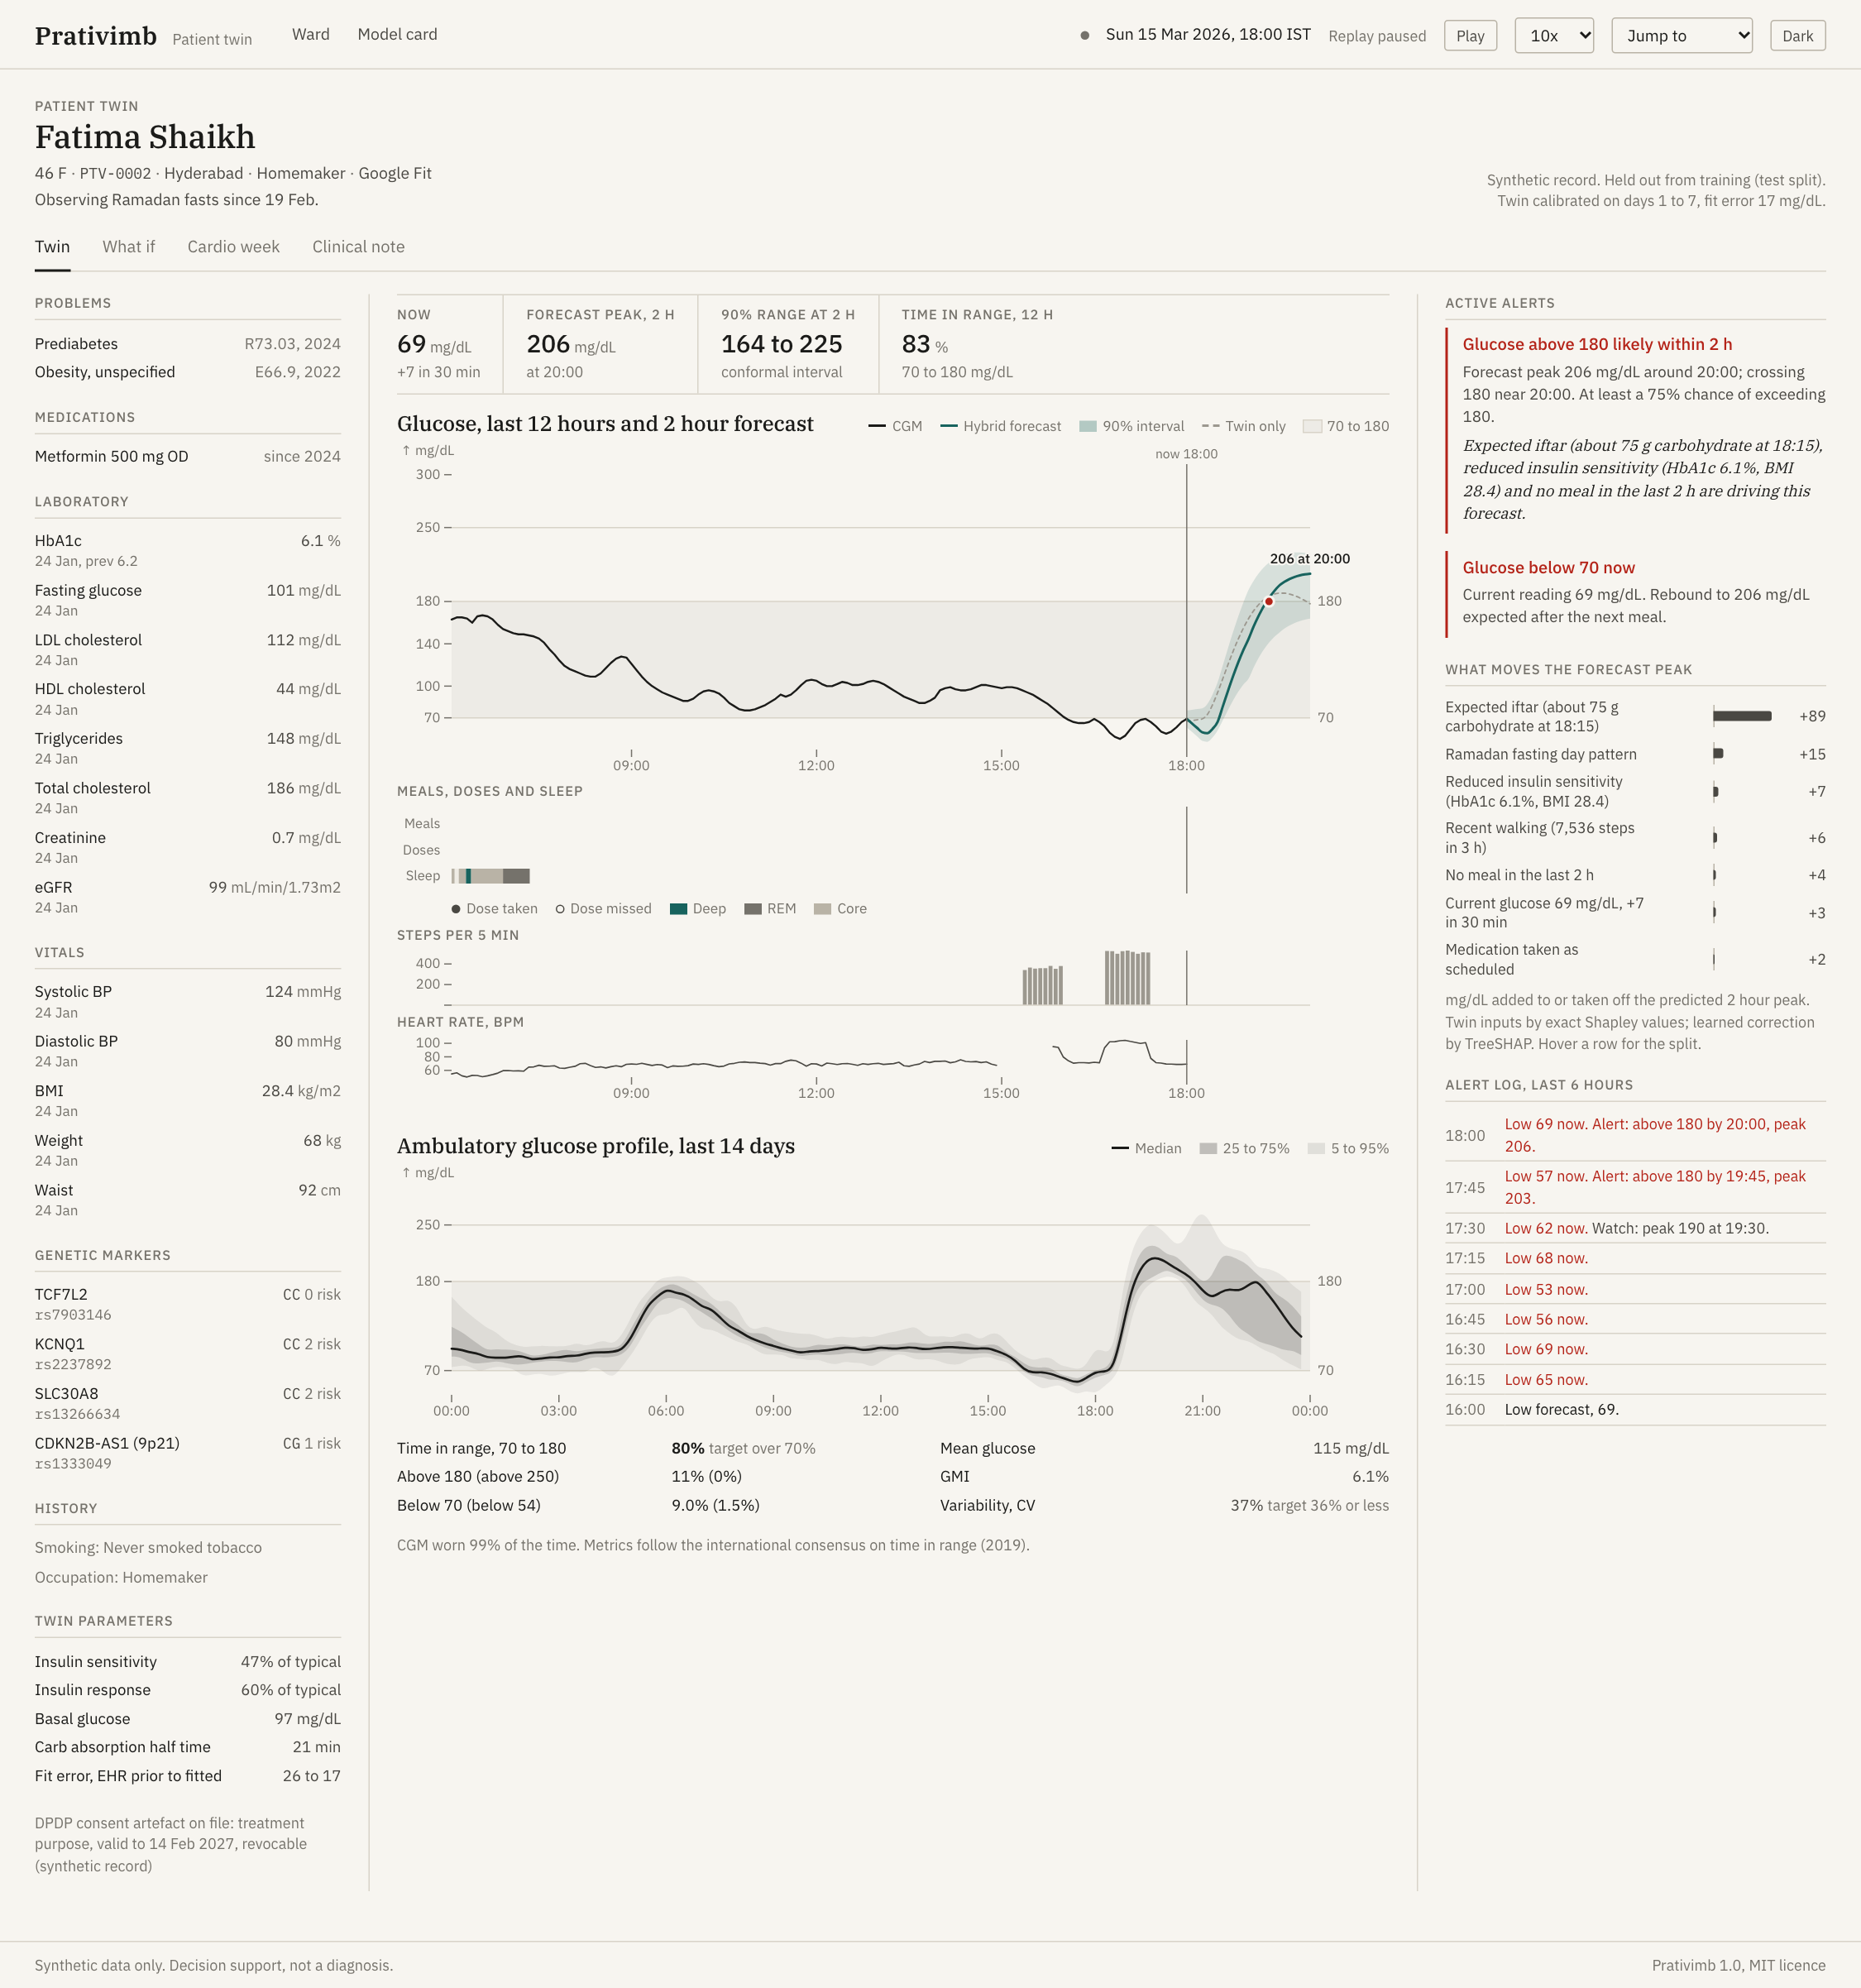
DATA
Data: synthetic, Indian, reproducible
• 200 fictional patients, 30 days each (14 Feb to 15 Mar 2026):
healthy, prediabetes and T2D; hypertension, dyslipidaemia,
family history.
• EHR as FHIR R4 bundles: ICD-10, LOINC, ATC, TCF7L2, KCNQ1,
SLC30A8 and 9p21 markers, DPDP style consent.
• Glucose from the UVA/Padova model with simglucose parameters and
Dexcom noise, adapted for T2D. HR every minute, sleep stages,
nightly HRV, steps.
• Apple Health and Google Fit export formats, parsed back by our
adapters.
• One command regenerates everything in about 20 seconds from seed
20260315.
Fatima (synthetic): Ramadan pattern in her glucose profile.
Prativimb 6

Slide 7
METHOD
Models
Component
What it does
Twin ODE
dG/dt = -(SG + X)G + SG Gb H(t) + cf Ra(t) - eE E G, with insulin action, insulin, two gut compartments,
exercise and metformin states
Calibration
MAP least squares on days 1 to 7 with EHR priors; about one second per patient
Residual model
LightGBM on twin error at 30, 60, 90, 120 min from CGM history, meals, activity, sleep, adherence, EHR
Uncertainty
CQR intervals at 90%; the alert tier uses the lower bound of the 50% interval, chosen on calibration
patients
Cardio
Isolation forest and personal z scores (unsupervised) plus LightGBM, stacked by logistic regression
Explanations
Exact Shapley values over six twin inputs plus TreeSHAP on the residual, in mg/dL
Prativimb 7

Slide 8
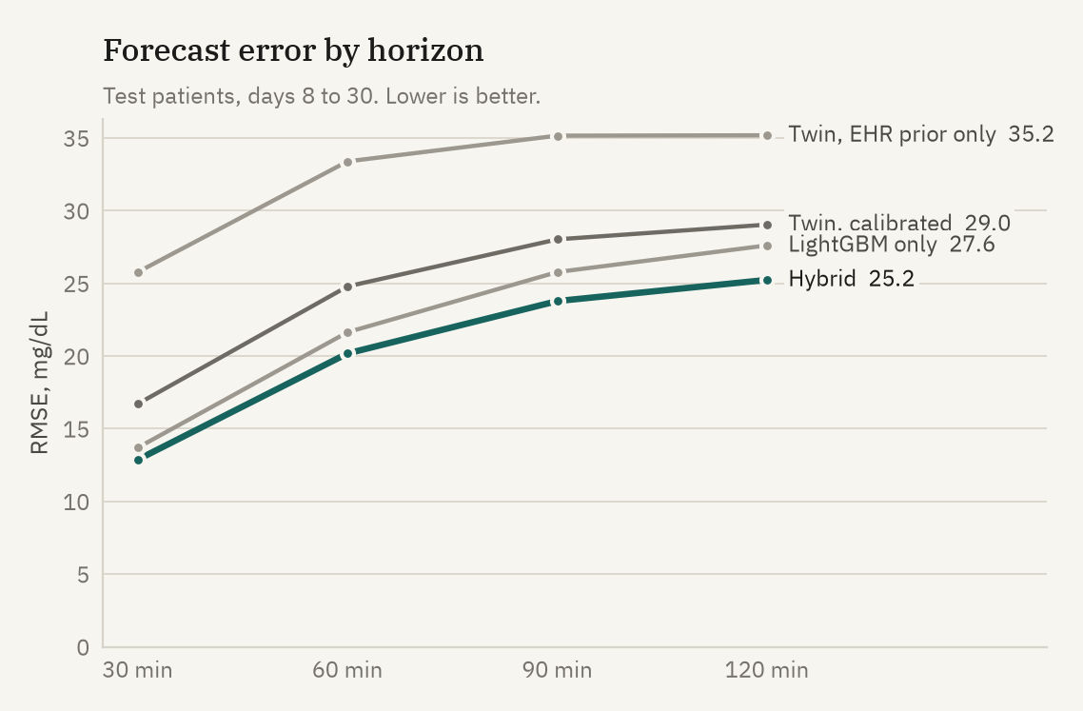
EVENT A
Results: glucose forecasting
RMSE, mg/dL
30
60
120
Twin, EHR only
25.8
33.4
35.2
Twin, calibrated
16.7
24.8
29.0
LightGBM only
13.7
21.6
27.6
Hybrid
12.9
20.2
25.2
Hybrid beats both of its parts at every horizon. MARD at
60 min 11.1%. Clarke zone A 85.4% at 60 min, zones C to E
2.5%.
40 test patients never seen in training or calibration. Scored on days 8 to 30.
Prativimb 8

Slide 9
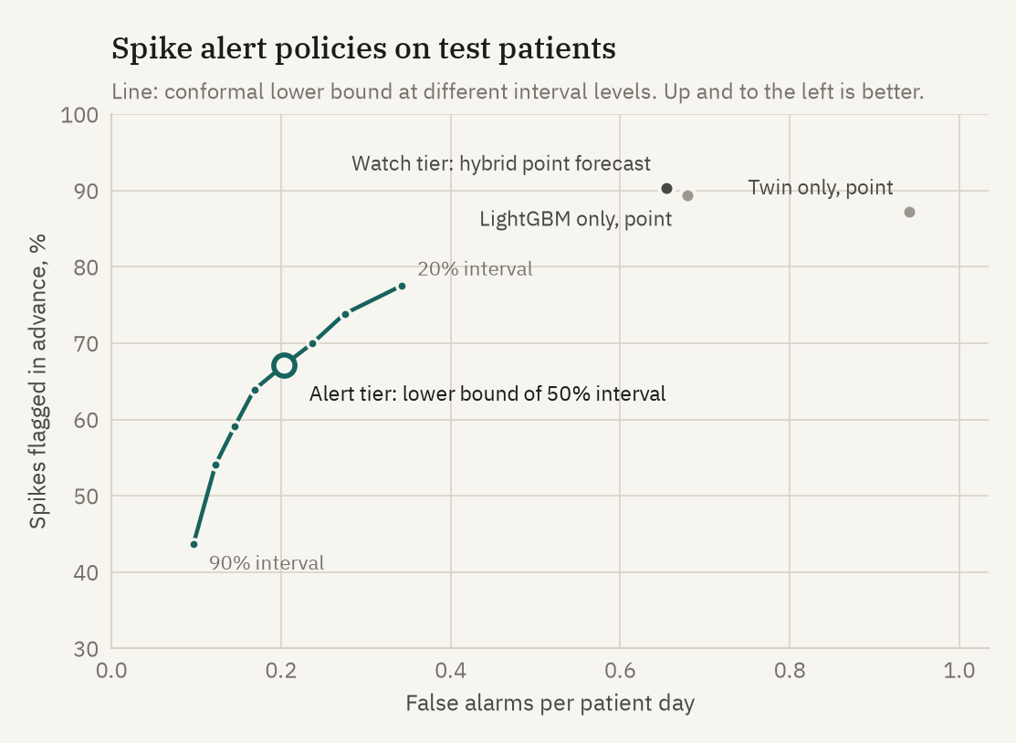
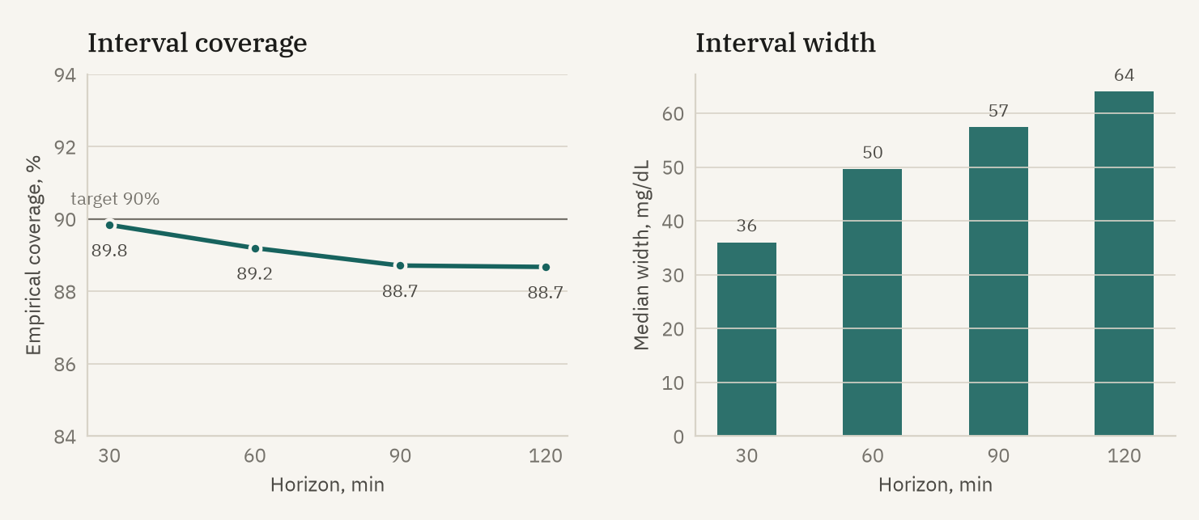
EVENT A
Results: alerts and honest uncertainty
• Alert tier: 67% of spikes flagged, 85% precision, 0.20 false alarms
per patient day, median 30 min ahead.
• Watch tier: 90% flagged a median 75 min ahead, shown but not pushed.
• Coverage of the 90% interval: 89.8% to 88.7% across horizons.
Prativimb 9

Slide 10
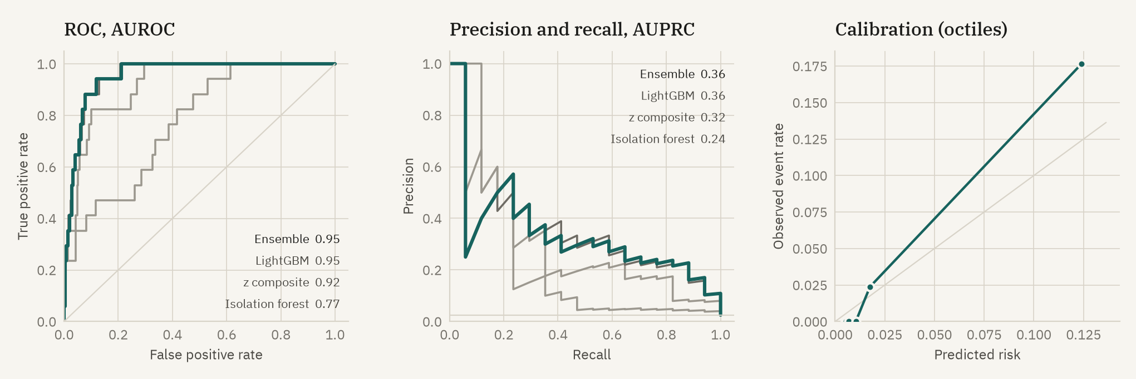
EVENT B
Results: cardiovascular risk flag
Ensemble AUROC 0.95 (95% CI 0.90 to 0.99), AUPRC 0.36 at 2.5% prevalence, sensitivity 88% at 90% specificity. At the 95% specificity
operating point 5 of 6 test events were flagged up to 3 days ahead. Only 6 test events, so intervals are wide.
Prativimb 10

Slide 11
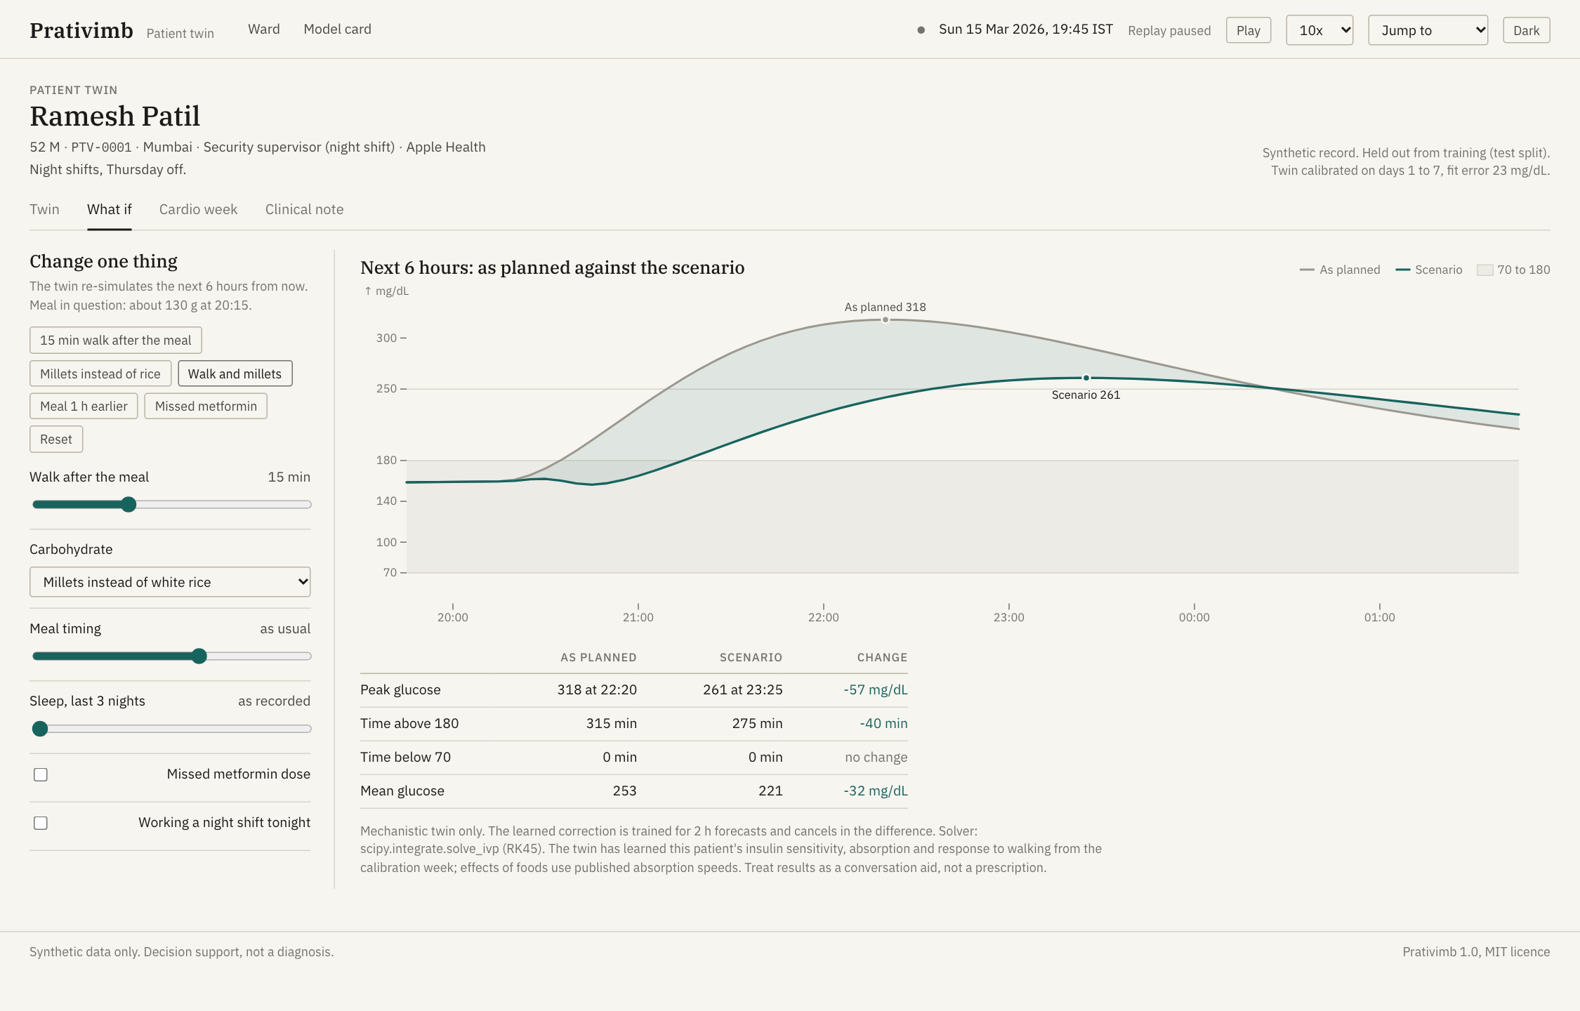
CASE STUDY
What if: Ramesh, 52, night shift, T2D
• 19:45. The hybrid forecast expects dinner at
20:15 and a peak near 278 mg/dL, after three
nights of 4.9 h sleep.
• A 15 minute walk after dinner takes 15 mg/dL
off the twin's 6 hour peak. Millets instead of
white rice take 48.
• Together: peak 57 mg/dL lower and 40 minutes
less above 180.
• Moving dinner earlier barely changes the peak
tonight (it can only move to 19:50). The twin
can say no.
Prativimb 11

Slide 12
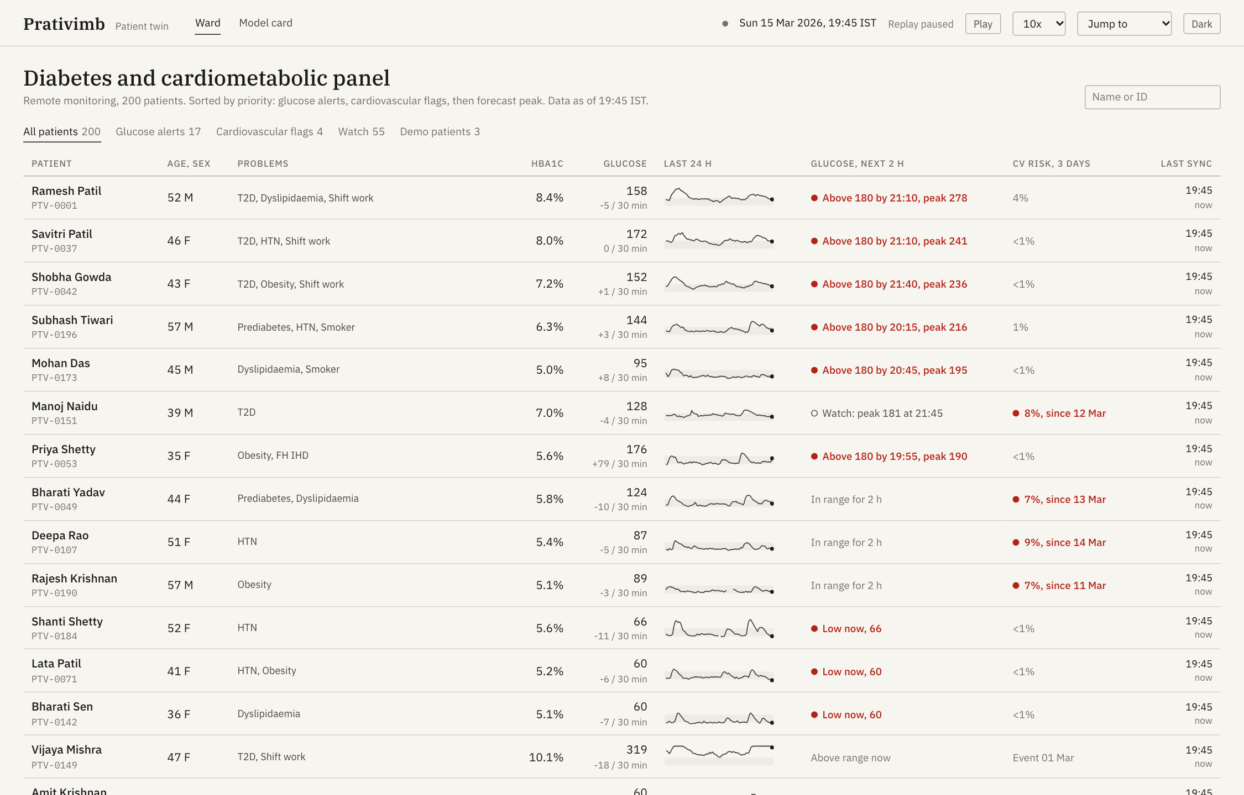
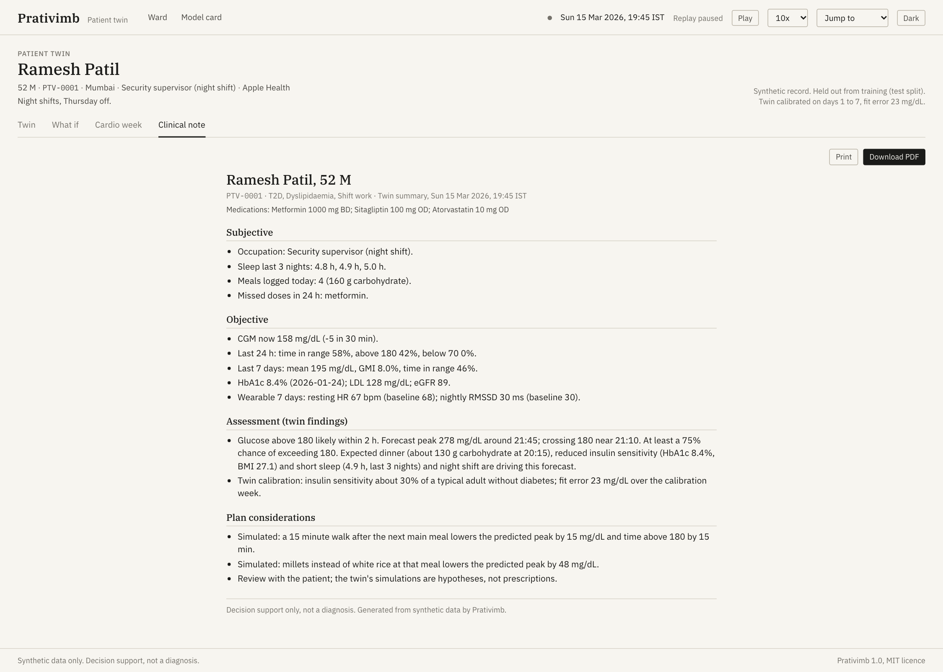
USE
Clinical workflow
1. Ward list sorted by alerts, cardiovascular flags and forecast peak. 2.
Open the twin: forecast band, reasons, alert log, AGP.
3. Try what if with the patient. 4. One click SOAP note, printable or PDF,
for the record.
Prativimb 12

Slide 13
GOVERNANCE
Privacy, safety and limits
• Synthetic data only: no personal data under the DPDP Act
2023 or HIPAA was used.
• Each record carries a consent artefact: purpose limited,
time bound, revocable.
• Deployment design: on premises inference, no identifiers in
model features, audit log, ABDM consent flow.
• Decision support only, not a diagnosis. The clinician
decides.
Limitations we state openly
• Synthetic ground truth is still a model; real data will be
harder.
• Only 6 cardiovascular events in test patients.
• Conformal coverage is approximate with serially correlated
readings, and lower below 70 mg/dL.
• Unlogged meals remain the main source of missed spikes.
Prativimb 13

Slide 14
NEXT
Impact and roadmap
Now
Working prototype: data, twin, models, API, dashboard, tests, docs. Reproducible from one seed.
3 months
Retrospective validation on de-identified CGM and EHR data under an ethics approval; Indian food
absorption library.
6 months
Federated learning of the residual model across hospitals; the twin stays per patient, only model updates
move.
9 months
ABDM integration (health ID, consent manager, FHIR); real device APIs (Libre, Dexcom, Health Connect).
12 months
Prospective pilot in a diabetes clinic with alert burden and time in range as outcomes.
Impact: fewer hours above range, earlier review of cardiac drift, and conversations about change grounded in the patient's
own physiology.
Prativimb 14

Slide 15
CONTACT
Team
Name
Role
Email
<Member 1>
<Role>
<email>
<Member 2>
<Role>
<email>
<Member 3>
<Role>
<email>
<Member 4>
<Role>
<email>
<CollegeName> / <Incubator>. Code: <public repository URL>. Demo video: <unlisted YouTube URL>.
Thank you.
Prativimb 15

