Slide 1
基于统计方法的PDE超分辨率重构
Presented by: Pengyu Zhang
Notes:
Hi, my name is Pengyu. Thank you for providing me the opportunity for this Dphil interview, I’ll be giving presentation on my past experience and future plan.
First, I’ll talk about my previous research experience. I’m interested in the application of artificial intelligence in fields that could truly benefit the society, and I’ve been doing research in two particular fields, climate science and medical imaging.

Slide 2
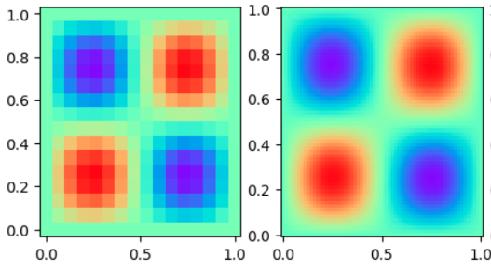
目的
仅生成低分辨率 PDE 解并将其上采样到高维度，获得高分辨率的 PDE 解。
Notes:
In medical imaging, I’ve worked on MRI image reconstruction. In MRI scanning process, the data in the frequency domain needs to be converted to an image through inverse fourier transform, which takes a long time. Thus, fastMRI methods, which use AI to accelerate the process have been developed. The process of a fastMRI method is shown in this Figure. Firstly, the data in the frequency domain is sub-sampled, and then inverse fourier transform is applied to obtain a noisy image. Different AI techniques are then used to reconstruct the original image from the noisy one.
Being inspired by a multi-contrast dictionary learning model, I chose to alter the structure of traditional UNet by stacking two images of different modalities together as the input. As I expect feature maps in CNNs could extract and combine important information in different modalities and improve the performance.
However, the performance of this model did not improve from the traditional UNet structure. And convolutional network structures do not show satisfactory performance on extracting and comparing features of two modalities. Thus, I believe that a deep convolutional dictionary learning could be a better fit, as dictionary learning works better on capturing structural dependencies in different contrasts and its combination with deep learning could improve its efficiency.
Through this experience, I developed strong interest in applications of AI in medical imaging as I believe AI could significantly improve the performance of a variety of tasks in medical image analysis in clinical practice, making the process more efficient, accurate and labour-saving.

Slide 3


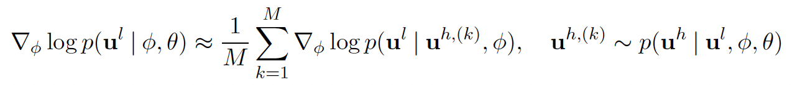





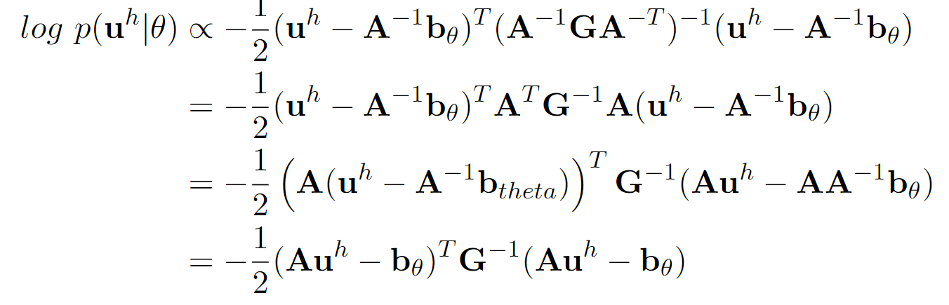
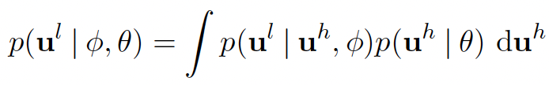

方法
1. 定义一个Poisson Equation，然后把PDE用概率模型来表示
5. Monte Carlo Approximation
6. 使用Langevin dynamics从后验概率中采样高分辨率样本
2. 定义高分辨率数据的先验概率
3. 定义一个下采样神经网络，得到likelihood
4. 训练数据只需要低分辨率数据，所以需要最小化低分辨率数据的marginal likelihood

Slide 4
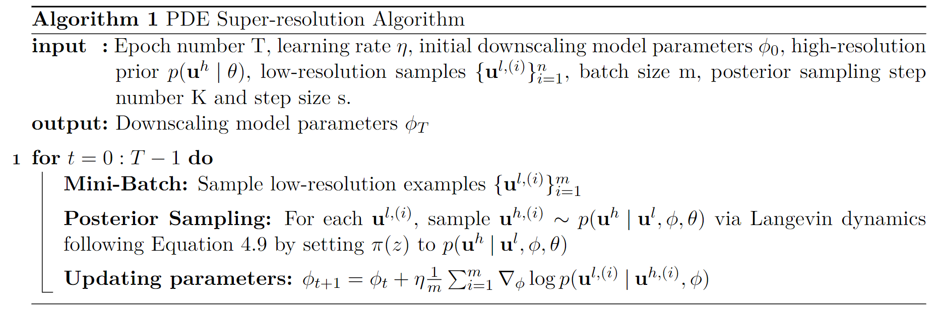
Pseudocode
训练过程：需要先生成一些有不同f的低分辨率数据，然后进行以下步骤
测试过程：给定一个低分辨率样本以及训练好的下采样神经网络，可以直接使用Langevin Dynamics从高分辨率数据的后验概率中采样得到所对应的SR结果
Notes:
In medical imaging, I’ve worked on MRI image reconstruction. In MRI scanning process, the data in the frequency domain needs to be converted to an image through inverse fourier transform, which takes a long time. Thus, fastMRI methods, which use AI to accelerate the process have been developed. The process of a fastMRI method is shown in this Figure. Firstly, the data in the frequency domain is sub-sampled, and then inverse fourier transform is applied to obtain a noisy image. Different AI techniques are then used to reconstruct the original image from the noisy one.
Being inspired by a multi-contrast dictionary learning model, I chose to alter the structure of traditional UNet by stacking two images of different modalities together as the input. As I expect feature maps in CNNs could extract and combine important information in different modalities and improve the performance.
However, the performance of this model did not improve from the traditional UNet structure. And convolutional network structures do not show satisfactory performance on extracting and comparing features of two modalities. Thus, I believe that a deep convolutional dictionary learning could be a better fit, as dictionary learning works better on capturing structural dependencies in different contrasts and its combination with deep learning could improve its efficiency.
Through this experience, I developed strong interest in applications of AI in medical imaging as I believe AI could significantly improve the performance of a variety of tasks in medical image analysis in clinical practice, making the process more efficient, accurate and labour-saving.

Slide 5
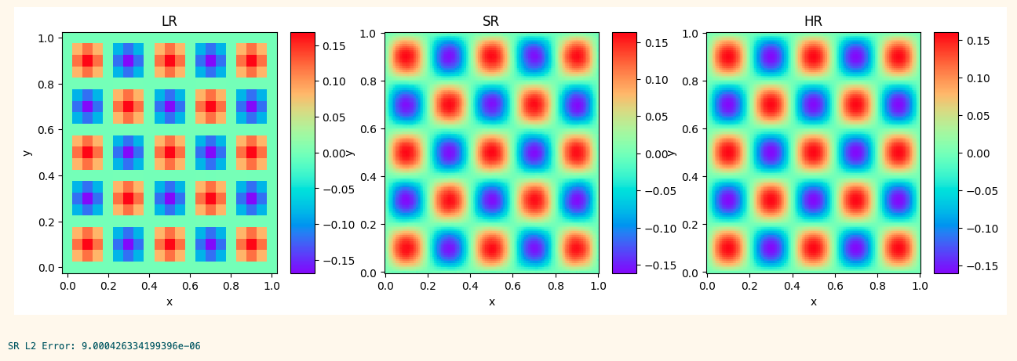
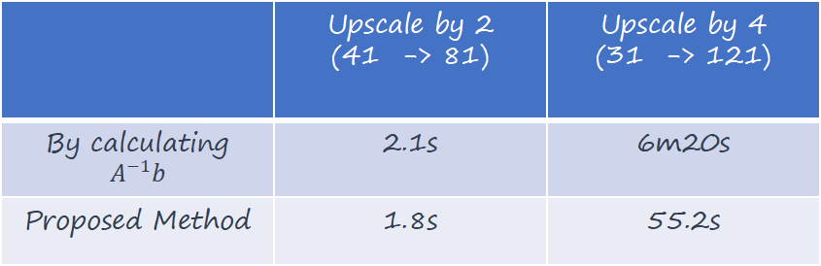
一些结果
提高了获得高分辨率 PDE 数据的效率，相比传统数值方法，有显著提升。
只需要训练一个简单的下采样网络，避免了训练计算成本高昂的上采样神经网络。
不需要生成高分辨率训练数据。
 | Upscale by 2 (41 -> 81) | Upscale by 4 (31 -> 121)
By calculating $A^{−1}b$ | 2.1s | 6m20s
Proposed Method | 1.8s | 55.2s
Notes:
In medical imaging, I’ve worked on MRI image reconstruction. In MRI scanning process, the data in the frequency domain needs to be converted to an image through inverse fourier transform, which takes a long time. Thus, fastMRI methods, which use AI to accelerate the process have been developed. The process of a fastMRI method is shown in this Figure. Firstly, the data in the frequency domain is sub-sampled, and then inverse fourier transform is applied to obtain a noisy image. Different AI techniques are then used to reconstruct the original image from the noisy one.
Being inspired by a multi-contrast dictionary learning model, I chose to alter the structure of traditional UNet by stacking two images of different modalities together as the input. As I expect feature maps in CNNs could extract and combine important information in different modalities and improve the performance.
However, the performance of this model did not improve from the traditional UNet structure. And convolutional network structures do not show satisfactory performance on extracting and comparing features of two modalities. Thus, I believe that a deep convolutional dictionary learning could be a better fit, as dictionary learning works better on capturing structural dependencies in different contrasts and its combination with deep learning could improve its efficiency.
Through this experience, I developed strong interest in applications of AI in medical imaging as I believe AI could significantly improve the performance of a variety of tasks in medical image analysis in clinical practice, making the process more efficient, accurate and labour-saving.

