Slide 1
SD6503 · Testing and Secure Coding
IT Asset Checkout
Custom-scenario coursework demo
Live demo path · Test evidence · Security · Agile process
About 10 minutes talk + 5 minutes Q&A · PowerPoint
Demo path
Login → Assets
→ Staff → Checkouts
Notes:
Open by stating this is a custom IT asset checkout scenario (not the in-class sample). Agenda points to live path on slide 5 and test evidence on slide 7. No school name. Password only via DEMO_ADMIN_PASSWORD env — never speak a plaintext password.

Slide 2
Background & goals
What asset checkout must solve (custom scenario, not the class example)
Problem
Who borrowed which device, when it is due, and whether a loan is still open is hard to track in spreadsheets.
Goal
A web app that registers Assets / Staff / Checkouts so signed-in users can look up and update records.
Constraint focus
Only one open checkout per asset at a time (ReturnAt is null), to stop double lending.
Demo scope
Sign-in + CRUD/search/sort on the three tables, plus the test and security evidence path (details in the repo docs).
2
Notes:
Map briefly to course aims: business app with ≥3 related tables, black-box/white-box testing, UI automation, performance, static analysis, and Agile evidence. Point forward to slides 5 and 7 for demos. No LO numbers as big on-slide headings. No school name.

Slide 3
Tech stack
ASP.NET Core 8 · Identity · SQLite by default · EF can switch to SQL Server
Backend
Data
Testing
Security tools
• ASP.NET Core 8 MVC
• Default: SQLite (local demo)
• xUnit
• Security Code Scan
• EF Core
• EF Core can switch to SQL Server
• Selenium
• OWASP mapping docs
• ASP.NET Identity
• Three tables + FKs / seed
• JMeter
• env demo password
Repo tip f7d5b172 · formal f474447 · github.com/yq6666-66/it-asset-checkout
Run overview: set DEMO_ADMIN_PASSWORD → dotnet run --project src/ItAssetCheckout
3
Notes:
For tip f7d5b172: local demo defaults to SQLite for easy run. Production target is SQL Server via EF provider switch—do not claim SQL Server is the live demo DB.
Three tables + FKs + seed are the same on both providers, so DB design marks come from schema/constraints. Align with FAQ on why SQLite. Never speak a plaintext password.

Slide 4
Feature overview
Sign-in / Assets / Staff / Checkouts
01
02
03
04
Sign-in
Assets
Staff
Checkouts
Identity auth
Authorized access to business pages
CRUD + search/sort
Tag / Status fields
CRUD + search/sort
Staff master data
CRUD + search/sort
One open checkout per asset
4
Notes:
Each card maps to what the live demo on slide 5 proves. Written test evidence is on slide 7. No school name.

Slide 5
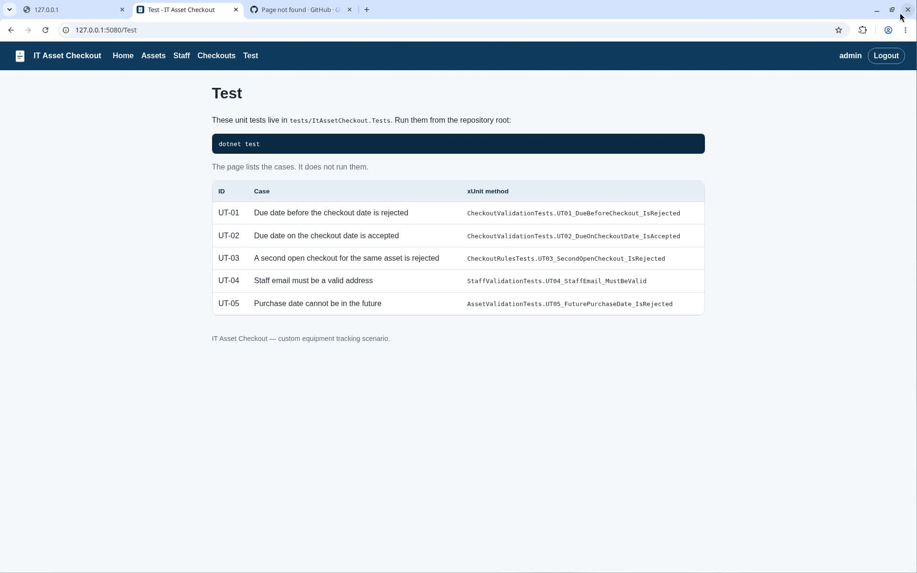
现场演示路径 / Live demo path
Login → Assets → Staff → Checkouts · ~3 min English dub (en-r2)
Agile 下把测试与安全做进 ASP.NET Core 业务站：登录后走 Assets → Staff → Checkouts，现场可见 CRUD、搜索排序与校验。
口令仅环境变量 DEMO_ADMIN_PASSWORD（幻灯不写明文）
5
Notes:
1. 开场：这门课要证明——你会在 Agile 节奏里，把测试和安全真正做进一个至少三表的 ASP.NET Core 业务站，而不是只背概念。本片场景是 IT Asset Checkout（非课上例题）。
2. 登录：Username admin；密码框只见圆点——首页登录与安全机制同屏。
3. Assets：搜 Dell、按 Name 排序；地址栏可见 sort=name——高级搜索与排序。
4. Create：新建 IT-LIVE02 成功；空提交出现 Tag number is required——白盒/服务端校验。
5. Staff / Checkouts：三表有数据；开放借出同行可见资产与员工——黑盒关系与「一资产一开放借出」。
6. 收束：回到 Test 页 UT 样例——测试规划与核心概念入口；Selenium / JMeter / SCS 证据在旁证片与第7–8页。
Marking Guide / LO 对照（仅备注，不上大字标题）
画面要点 | Marking Guide（有画面才说） | LO（列对照，不口播编号）
三表业务站非课例 | SQL / 三表关系 + ASP.NET Core | —
登录 + 圆点密码 | Homepage login/nav (10) | LO4
搜索排序 sort=name | Advanced sort/search (5) | —
Create + 空提交校验 | Basic CRUD (5) + White-box (6) | LO2
Staff/Checkouts 关联 | Black-box relations (6) | LO2
Test / UT 表 | Unit test / sample Test page (10) | LO1, LO2

Slide 6
Data & constraints
≥3 tables · foreign keys · one open checkout per asset
Assets
Staff
Checkouts
Tag, name, category, status, purchase info, etc.
StaffCode, name, email, department, etc.
AssetId / StaffId FK
CheckoutAt · DueAt · ReturnAt · Note
Key rules
• Only one open checkout per asset at a time (ReturnAt IS NULL) — DB index + app validation
• Validation examples: required fields; unique Tag/StaffCode; staff email; DueAt ≥ CheckoutAt
• Conflicting open checkout is rejected (ModelError)
6
Notes:
Marking maps to SQL/three-table relations + black-box rules and white-box server validation. Point to live demo slide 5. No LO big headings on-slide.

Slide 7
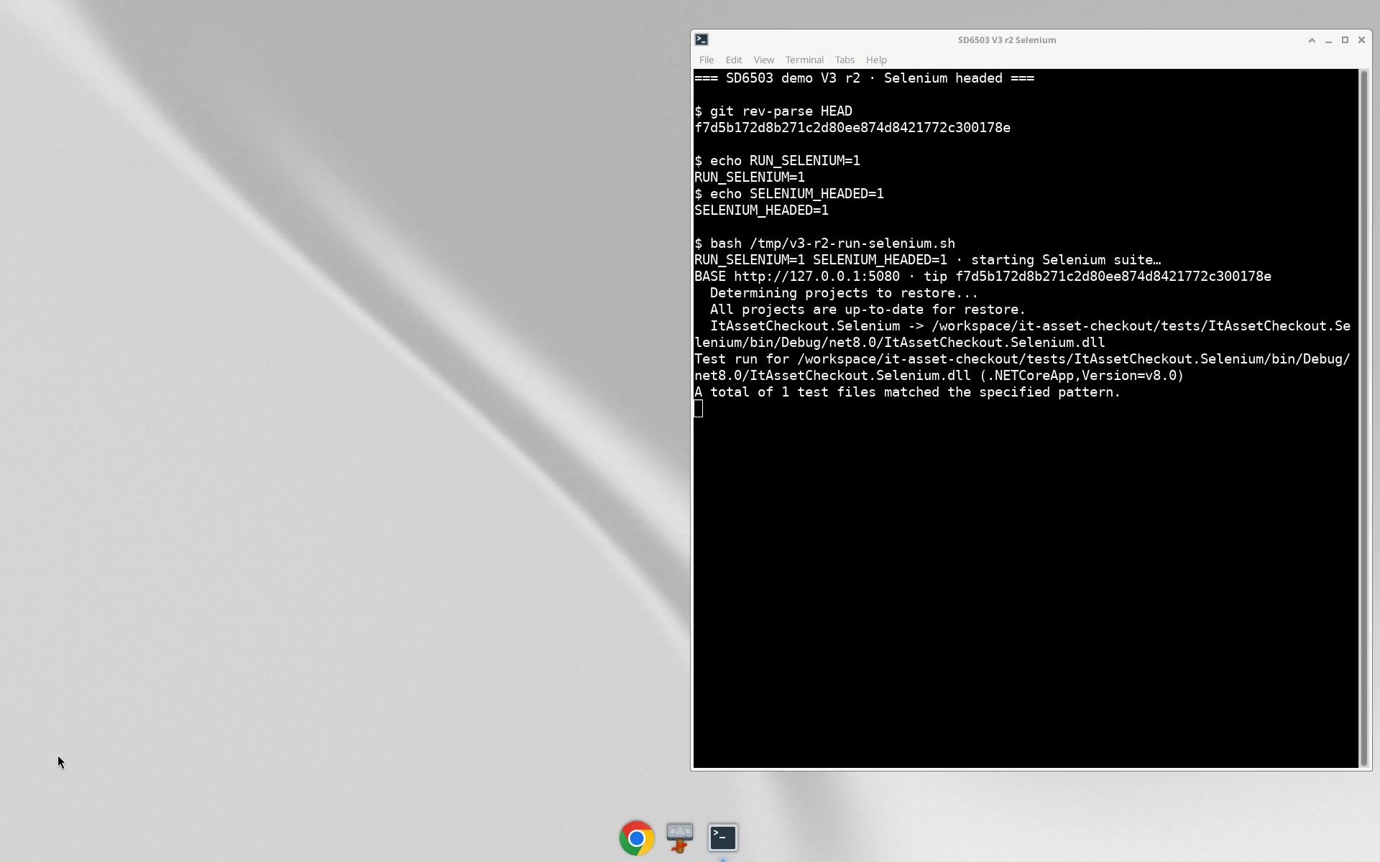
测试证据 / Test evidence
Step 8 evidence · ~4.6 min English dub (en-r2) · xUnit / Selenium / JMeter
仓内已记录的单元/UI/性能证据，旁证片现场可点播
证据指针 tip f7d5b172 · 仓内 docs/testing · docs/performance（旁证可点播）
7
Notes:
• Video (step8-en-r2, ~4.6 min English Molly): walk-through of recorded unit / UI / performance evidence.
• xUnit: UT-01…UT-05 pass counts (validation & business rules).
• Selenium: 4 passed / 0 failed (SEL-01…04).
• JMeter: p95 ~239 ms · 20 threads × 60s · error 0% (target p95 < 1s, error < 1%).
• On-slide: tip f7d5b172 is evidence pointer hash only; no school name; no plaintext password.
Marking Guide / LO 对照（仅备注，不上大字标题）
画面要点 | Marking Guide | LO
UT pass counts / Test page | Unit test sample (10) | LO1, LO2
Selenium 4/0 UI path | Black-box / UI evidence | LO2
JMeter p95 + error 0% | Performance evidence | LO3 (as applicable)
旁证片可点播 | Testing evidence pack | —

Slide 8
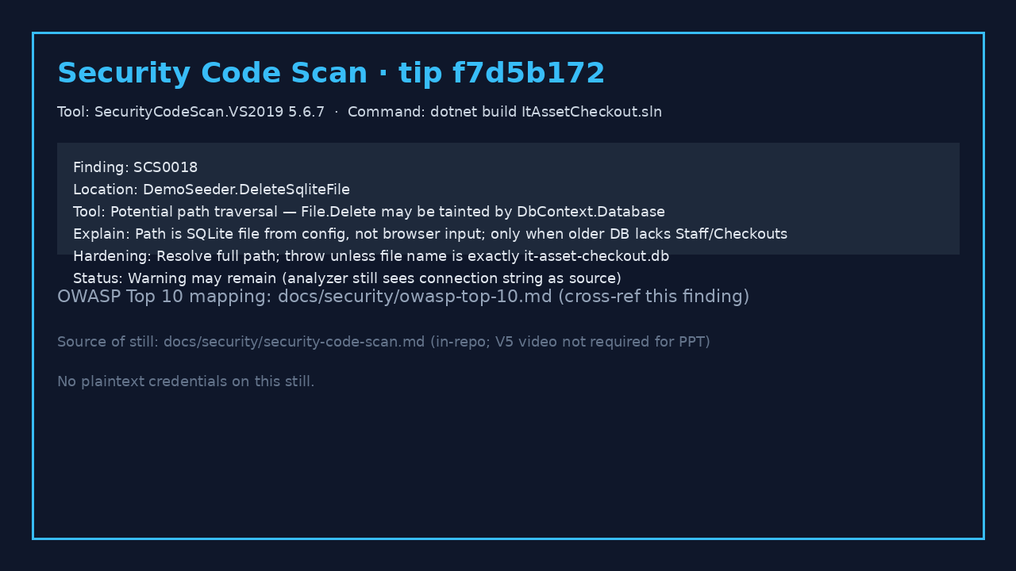
Security highlights
Demo password · OWASP · static analysis (tip f7d5b172)
Demo password
Injected only via env DEMO_ADMIN_PASSWORD; never written in plaintext on slides or in the repo.
OWASP mapping
Repo docs/security has an OWASP Top 10 mapping table cross-referenced with static-analysis findings.
SCS0018
Security Code Scan: DemoSeeder SQLite path delete warning; filename gate added; build may still show the warning (see right).
SCS finding still · tip f7d5b172
8
Notes:
Static analysis + remediation plan live in docs/security. Be honest about residual SCS0018. tip is an evidence pointer hash only. No plaintext password. No school name.

Slide 9
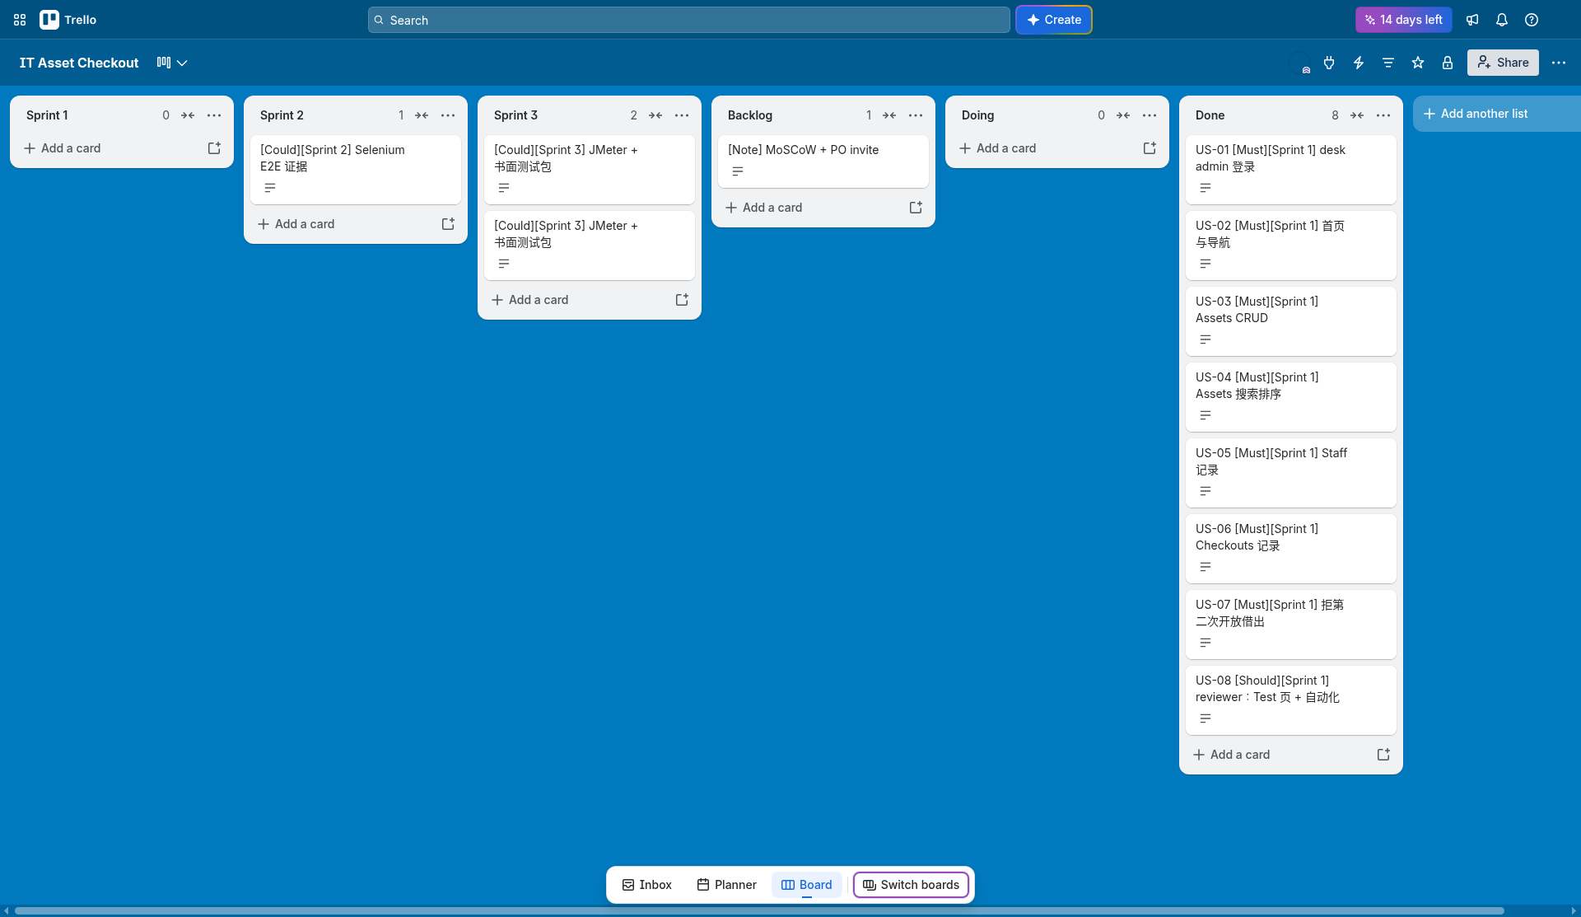
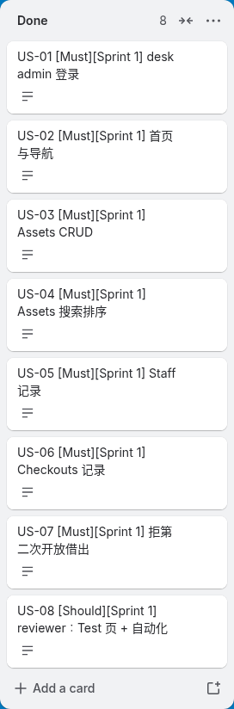
Agile process
Stories · MoSCoW · three Sprints · burndown
Stories
User stories in the backlog, sliced to features
MoSCoW
Priority method locked + rationale in docs
Live board https://trello.com/b/beKd2EVy/it-asset-checkout
PO invite status: team lead confirmed
Three Sprints
S1 sign-in + CRUD → S2 evidence freeze → S3 wrap-up
Burndown
Repo SVG / Sprint docs track progress
9
Notes:
Agile cadence continuously adds test and security evidence (not waterfall afterthought). Screenshots on this slide are the real board. No school name.

Slide 10
FAQ / Q&A card
About 10 minutes talk + 5 minutes Q&A · tip f7d5b172
Why SQLite?
Demo defaults to SQLite; EF can switch to SQL Server; three-table FKs/seed still satisfy DB design marks.
Unit 10 vs written cases 8?
Code xUnit + Test page on slide 7; written cases (purpose/method/cases/oracle) in docs/testing.
How to read JMeter?
p95 239 ms · 20×60s · error 0%; Dashboard still on slide 7 / docs/performance.
Why is SCS0018 still there?
Finding recorded; hardening in docs/security; admit residual warning and mitigations when speaking.
How to run locally / password?
export DEMO_ADMIN_PASSWORD=… → dotnet run --project src/ItAssetCheckout; never put plaintext on slides.
Trello / PO？
Live board https://trello.com/b/beKd2EVy/it-asset-checkout; PO invite status: team lead confirmed (see slide 9).
Talk order: 0–2′ background/stack → 2–5′ live path → 5–8′ test/security evidence → 8–10′ Agile → 10–15′ Q&A
10
Notes:
Q&A card supports Presentation answering questions. Remind: no plaintext password; tip f7d5b172 is evidence pointer.
Grey-box = xUnit + Test page smoke (slide 7). One open checkout rule: open Checkouts row shows Tag+Staff; same asset cannot open a second loan.
Why SQLite?: demo defaults to SQLite; EF can switch to SQL Server; three-table FKs/seed still satisfy DB design marks.
Unit 10 vs written cases 8?: code xUnit + Test page on slide 7; written cases in docs/testing.
JMeter: p95 239 ms · 20×60s · error 0%; Dashboard still on slide 7 / docs/performance.
SCS0018: finding recorded; hardening in docs/security; admit residual warning when speaking.
Local run: export DEMO_ADMIN_PASSWORD=… → dotnet run --project src/ItAssetCheckout; never speak plaintext.
Trello/PO: https://trello.com/b/beKd2EVy/it-asset-checkout; team lead confirmed (slide 9).

