Slide 1
C Model Implementation
SD1 實習生 賴宥齊
202408
Github

Slide 2
Outline
Input & Output
Format
Sample
Methods
Payload Generation
Length Field Recalculate
Default Values
TBD
Advise
Error Handling

Slide 3
Input Format & Output Format
Input Format:
MSA <Fill Count> <Lane Number>
BSP <SR> <CP> <Fill Count> <Lane Number>
VDP <EOC_1> <TU_type_1> <L_1> <Fill_Count_1> <Video_Count_1> ... <EOC_n> <TU_type_n> <L_n> <Fill_Count_n> <Video_Count_n>
SDP <EFC/ND_1> <NSS_1> <NSE_1> <L_1> <Fill_Count_1> <Secondary_Count_1> ... <EFC/ND_n> <NSS_n> <NSE_n> <L_n> <Fill_Count_n> <Secondary_Count_n>
Output Format:
<Valid> <Header> <B0> <B1> <B2> <B3>
Format File

Slide 4
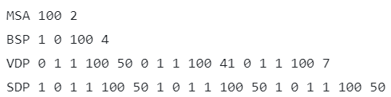
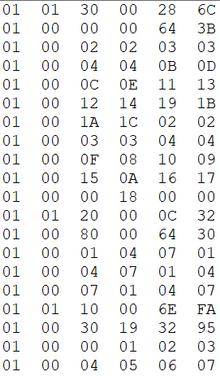
Sample Input & Sample Output
Input
Output (excerpt)

Slide 5
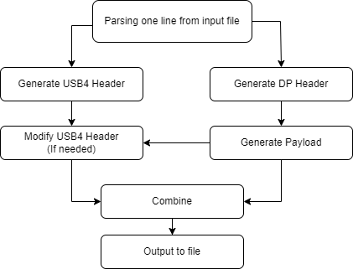
Method
Flow Chart

Slide 6
Method
Payload Generation
Payload is generated sequentially starting from 00 except the padding bytes which are 0.
Length Field Recalculate (VDP & SDP)
After generating payload of TU sets, recalculate the Length field and ECC.
Default Values
HopID = 9, Reserved = SuppID = 0

Slide 7
TBD
Advise
Require any modifications to the input format?
Are there any other methods for generating payload needed.
Error Handling
How should the program handle input that does not match the expected format? (e.g. Missing argument)
Should there be a check to ensure that the sum of Video/Secondary Count fields does not exceed 256?
Is there a need to set limits for specific input fields?

