Slide 1
AI Model
SD1 實習生 賴宥齊
202408

Slide 2
Outline
Language Models
PDF Parsing
Methods
End-to-end
Staged (Currently used)
Tools
Problems

Slide 3
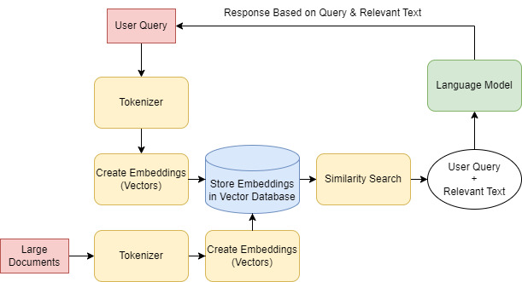
Language Models
Notes:
記得解釋一些terms

Slide 4



Language Models
Directly Use the Well-Trained Language Model
Feed PDF and query as input.
No additional training required.
An API key is required for remote access to the model.
Fine-Tune the Pre-Trained Language Model
Pre-trained LM as backbone following by downstream task head/model.
Fine-tuning is necessary.
No API key required.
Runs locally.
Notes:
解釋為何不自己train一個以LM為backbone的大模型

Slide 5
Language Models
Well-Trained Language Models
Gemini
ChatGPT (ChatWeb)
 | Directly use well-trained Language Model | Fine-tune the pre-trained Language Model
Resources | CPU | GPU
API Key | Need | No need
Dataset | No need | Need
Fine-tune | No need | Need
Model running on | Remote | Local
Feasibility | High | Low

Slide 6
PDF Parsing
Tools
Langchain
PyPDFLoader from langchain_community.document_loaders
Extract the text, transform the PDF file into string.
HuggingFaceEmbeddings from langchain_huggingface
Include the embedding model to tokenize string into vectors.
FAISS from langchain_community.vectorstores
Do the similarity search between PDF file and User Query.
Notes:
圖可能有點小

Slide 7
PDF Parsing
Tools
Similarity Search can be substituted with a more straightforward method.
pdfplumber
Extract the text and table, transform the PDF file into string.
Pandas
Handle the table.

Slide 8
PDF Parsing
Problems
The size of standard is large, so it is necessary for a person to select the required chapters.
Each standard or chapter has its own unique structure, which means that the same parsing method may yield different results.
Notes:
記得舉例。比如說SST就還要加上HEC以及ECC的部分。

Slide 9
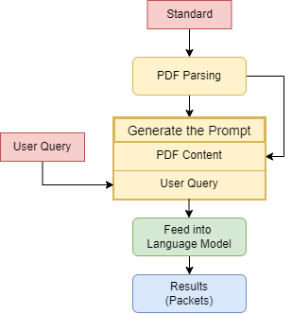
Methods – End-to-End
Prompt
PDF Content
User Query
Problems
The result is not solely the packet but also contains additional descriptions.
It is challenging to find a general method to parse the necessary parts.
There is no guarantee of the correctness of the result.
It is difficult to generate packets according to user-defined arguments.

Slide 10
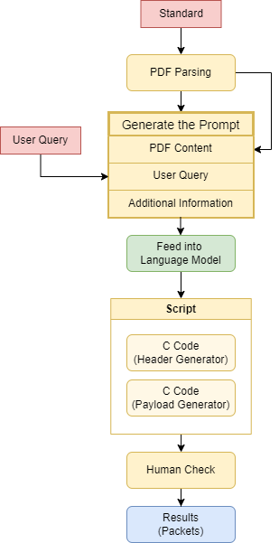
Methods - Staged
Workflow

Slide 11
Methods - Staged
Make the Language Model generate two C Codes.
Header Generator
LM needs to know the packet composition.
LM needs to specify which fields is fixed or can be user-defined.
Notes:
Individual info是因為沒有提示他很容易找錯東西

Slide 12
Methods - Staged
Make the Language Model generate two C Codes.
Payload Generator
LM needs to know how to parse the given header.

Slide 13
Generated C Code
Header Generator
MSA Packet
SD Packet
Payload Generator
BS Packet
VD Packet

Slide 14
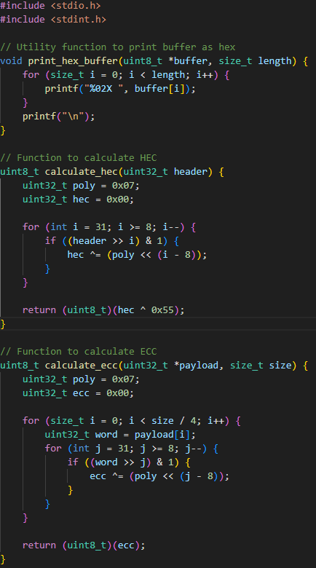
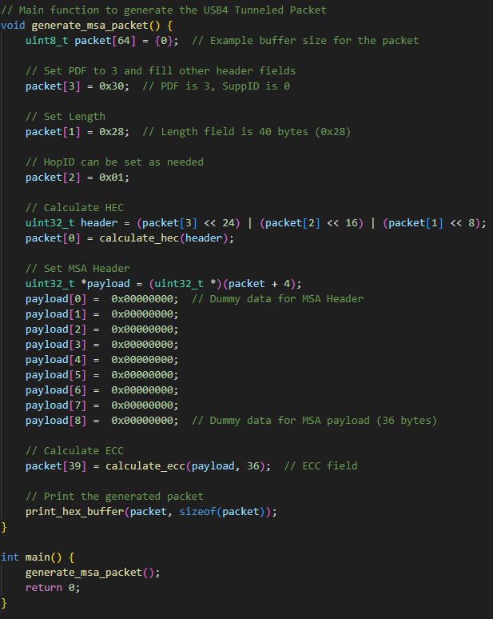
Notes:
Header Generator - MSA

Slide 15
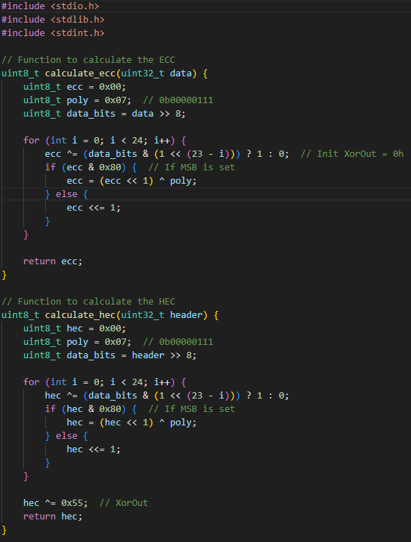
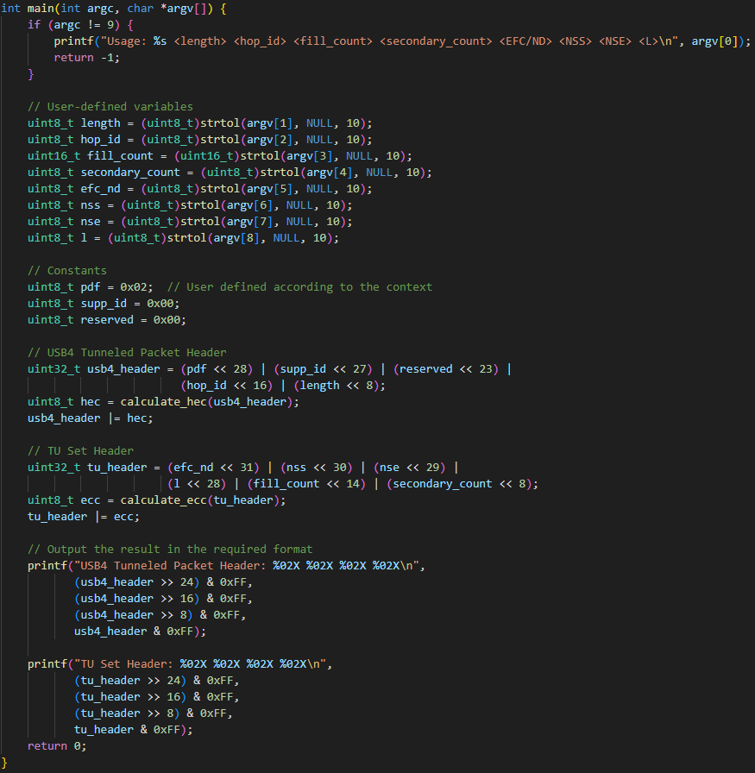
Notes:
Header Generator - SD

Slide 16
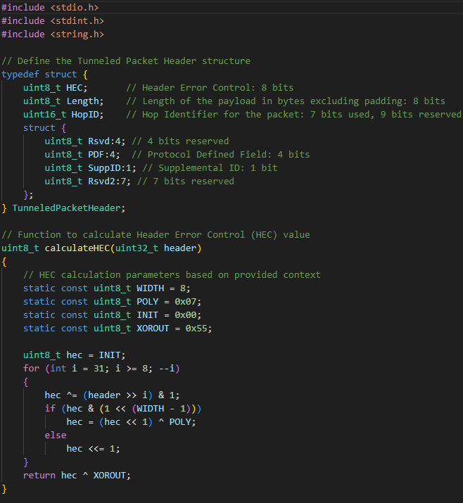
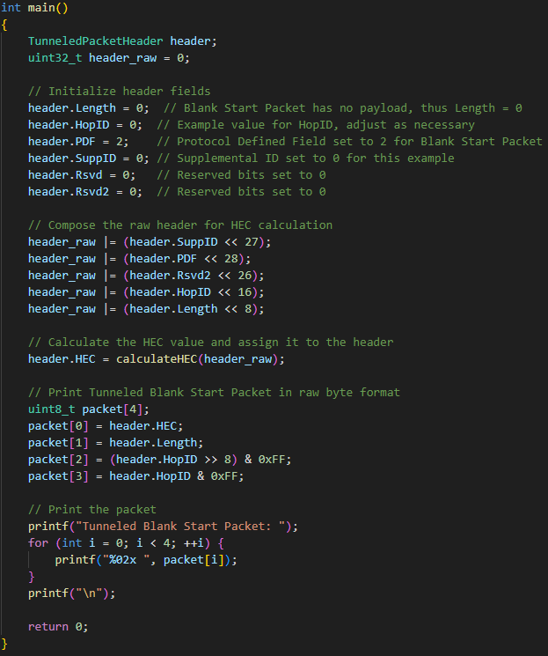
Notes:
Payload Generator - BS

Slide 17
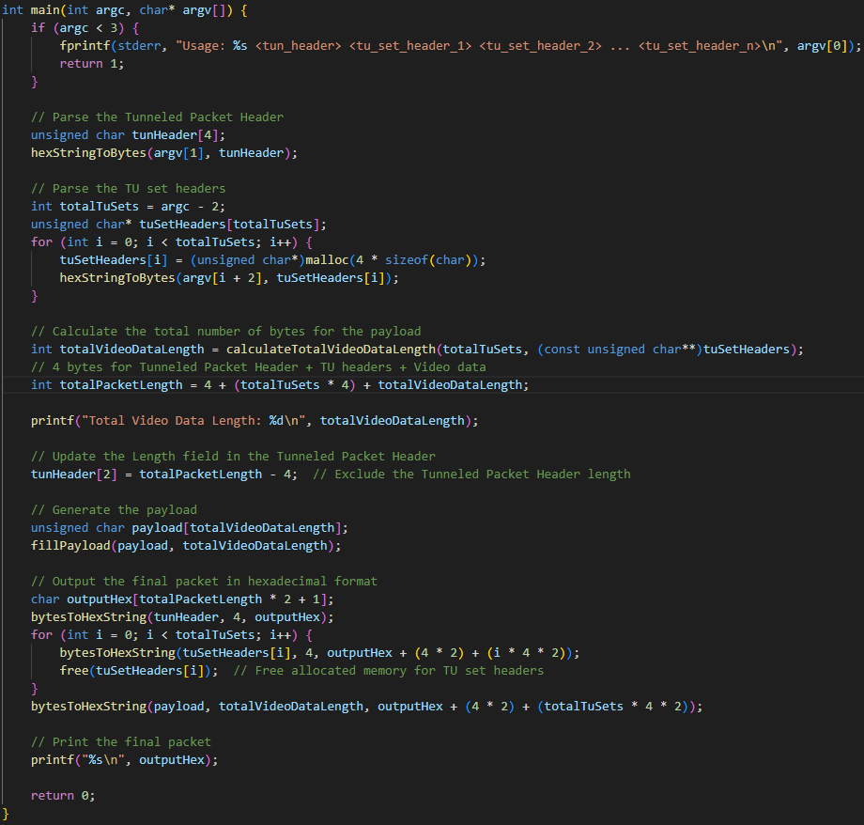
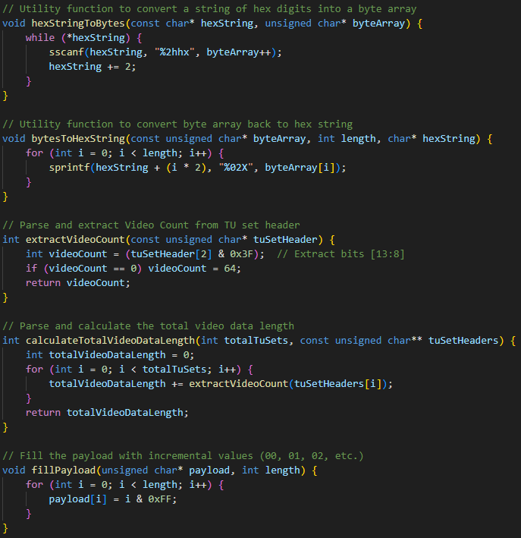
Notes:
Payload Generator - VD

Slide 18
Methods - Staged
Human Check
If there are errors in the generated code
e.g. Big/Little Endian, Wrong bit position, complex calculate, etc.
Modify the User Query
Add additional information provided to the Language Model
Debug the generated code
Trade-off
Consider the balance between performance and the amount of information provided.
Notes:
小結論：與其給更多資訊，不如直接用已經產生出來的code去改，可以比較有效率。

