Slide 1
C Model Implementation
SD1 實習生 賴宥齊
202408
Github

Slide 2
Outline
Introduction
Comparison
Input & Output
Methods
Payload Generation
Length Field Recalculate
Default Values
TBD
Advise
Error Handling

Slide 3
Introduction
DPTX -> DPIA
Given DP signal as input, program transforms the input DP signal into USB4 Tunneled Packet.
Script -> DPIA
Program generates the USB4 Tunneled Packet according to the given packet type and value of each fields.
 | DPTX -> DPIA | Script -> DPIA
Input | DP signal | Self-defined packets
Number of packets | Acc. DP signal | Can be user-defined
Packets order | Acc. DP signal | Can be user-defined
Value of each fields | Acc. DP signal | Can be user-defined
Coverage | Low | High
Additional input file | No need | Need
Output | USB4 Tunneled Packet in txt file | USB4 Tunneled Packet in txt file

Slide 4
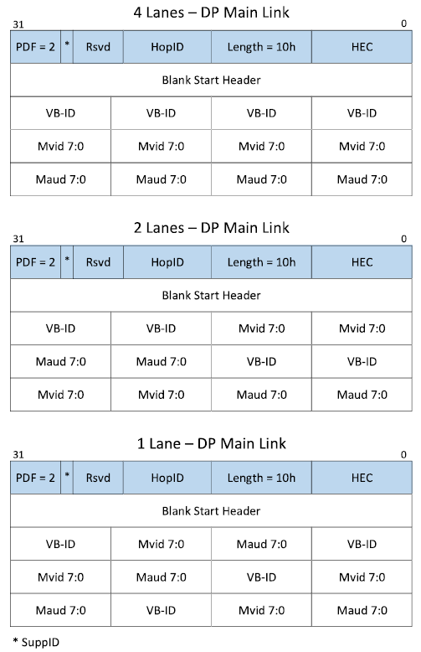
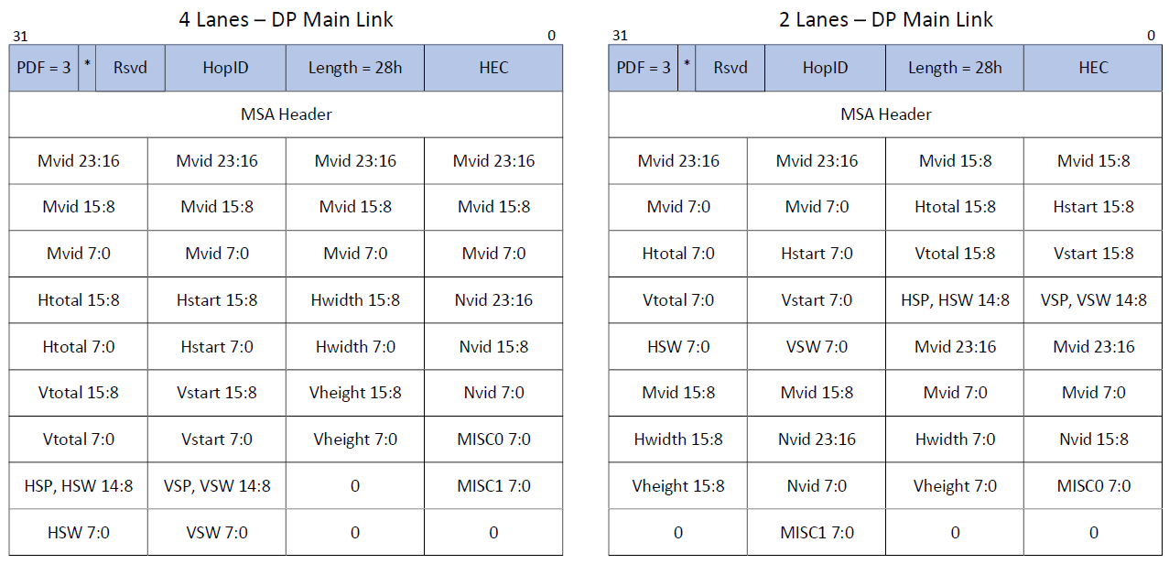
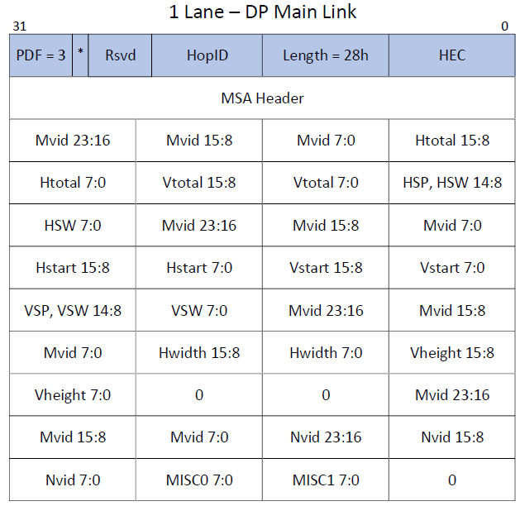

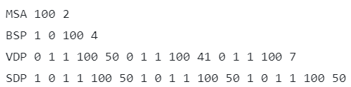
Input
Input Format:
MSA <Fill Count> <Lane Number>
BSP <SR> <CP> <Fill Count> <Lane Number>
VDP <EOC_1> <TU_type_1> <L_1> <Fill_Count_1> <Video_Count_1> ... <EOC_n> <TU_type_n> <L_n> <Fill_Count_n> <Video_Count_n>
SDP <EFC/ND_1> <NSS_1> <NSE_1> <L_1> <Fill_Count_1> <Secondary_Count_1> ... <EFC/ND_n> <NSS_n> <NSE_n> <L_n> <Fill_Count_n> <Secondary_Count_n>
Ignore ‘\n’ and ‘#’
Format File
Notes:
Explain why lane number needed in MSA and BS.

Slide 5
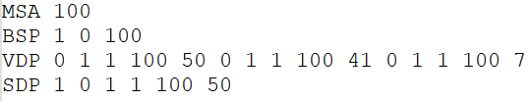
Input
Input Format:
MSA <Fill Count>
BSP <SR> <CP> <Fill Count>
VDP <EOC_1> <TU_type_1> <L_1> <Fill_Count_1> <Video_Count_1> ... <EOC_n> <TU_type_n> <L_n> <Fill_Count_n> <Video_Count_n>
SDP <EFC/ND_1> <NSS_1> <NSE_1> <L_1> <Fill_Count_1> <Secondary_Count_1> ... <EFC/ND_n> <NSS_n> <NSE_n> <L_n> <Fill_Count_n> <Secondary_Count_n>
Ignore ‘\n’ and ‘#’
Format File
Notes:
為何只有MSA跟BSP需要lane number

Slide 6
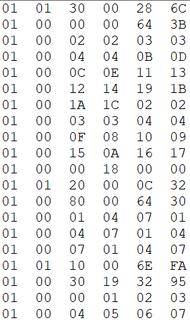
Output
Output Format:
<Valid> <Header> <B0> <B1> <B2> <B3>

Slide 7
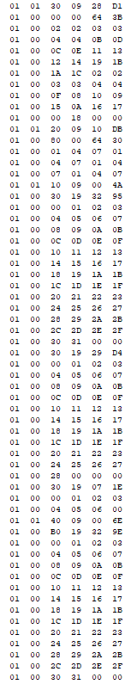
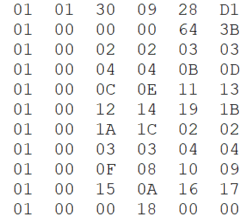
Input & Output

Slide 8
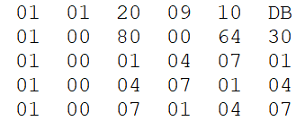
Input & Output

Slide 9
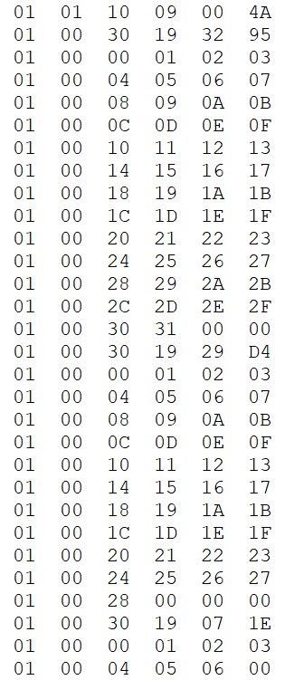
Input & Output

Slide 10
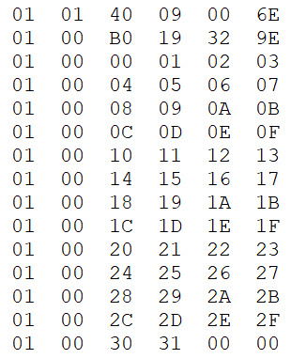
Input & Output

Slide 11
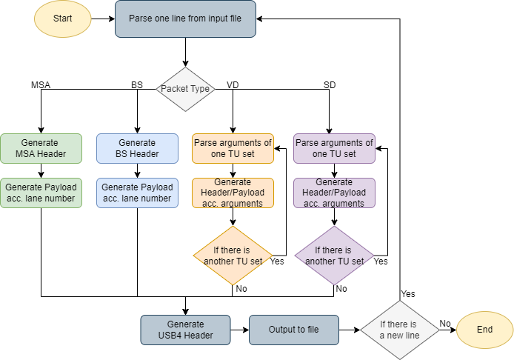
Method
Flow Chart
Notes:
改成一條龍

Slide 12
Method
Payload Generation
(MSA & BS) Payload is generated according to the give number of lanes.
(VD & SD) Payload is generated sequentially starting from 00 except the padding bytes which are 0.
Length Field Recalculate (VDP & SDP)
After generating payload of TU sets, recalculate the Length field and HEC.
Default Values
HopID = 9, Reserved = SuppID = 0
Notes:
Padding setting? 給一下enum

Slide 13
Method
 |  | Enum Values
ZERO | VBID | MVID 23:16 | MVID 15:8 | MVID 7:0 (MVID)
0 | 1 | 2 | 3 | 4
MAUD 23:16 | MAUD 15:8 | MAUD 7:0 | NVID 23:16 | NVID 15:8
5 | 6 | 7 | 8 | 9
NVID 7:0 | HTOTAL 15:8 | HTOTAL 7:0 | HSTART 15:8 | HSTART 7:0
10 | 11 | 12 | 13 | 14
HWIDTH 15:8 | HWIDTH 7:0 | VTOTAL 15:8 | VTOTAL 7:0 | VSTART 15:8
15 | 16 | 17 | 18 | 19
VSTART 7:0 | VHEIGHT 15:8 | VHEIGHT 7:0 | MISC0 7:0 | MISC1 7:0
20 | 21 | 22 | 23 | 24
HSP, HSW 14:8 | HSW 7:0 | VSP, VSW 14:8 | VSW 7:0
25 | 26 | 27 | 28

Slide 14
TBD
Advise
Require any modifications to the input format?
Are there any other methods for generating payload needed.
Error Handling
How should the program handle input that does not match the expected format? (e.g. Missing argument)
Should there be a check to ensure that the sum of Video/Secondary Count fields does not exceed 256?
Is there a need to set limits for specific input fields?

