Slide 1
AI Model
SD1 實習生 賴宥齊
202408

Slide 2
Outline
Introduction
PDF Parsing
Language Models
Methods
End-to-end
Staged (Currently used)
Tools
Problems

Slide 3
PDF Parsing
Tools
(With Similarity Search)
PyPDFLoader from langchain_community.document_loaders
HuggingFaceEmbeddings from langchain_huggingface
FAISS from langchain_community.vectorstores
(Without Similarity Search, Currently Used)
pdfplumber
Pandas

Slide 4
Language Model
Directly use the well-trained Language Model
Feed PDF and query as input.
Don’t need to train.
Need the API key to access model.
Fine-tune the pre-trained Language Model
Pre-trained LM as backbone following by downstream task head/model.
Need fine-tuning.
Don’t need the API key.
Run locally.
Notes:
解釋為何不自己train一個以LM為backbone的大模型

Slide 5
Language Models
Language Models needed
Gemini
ChatGPT (ChatWeb)
 | Directly use well-trained Language Model | Fine-tune the pre-trained Language Model
Resources | CPU | GPU
API Key | Need | No need
Dataset | No need | Need
Fine-tune | No need | Need
Model running on | Remote | Local
Feasibility

Slide 6
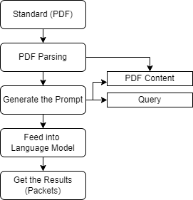
Methods – End-to-End
Prompt
PDF Content
Query
Result is uncontrollable (need image)
May contain another description but not only the packet.
Poor correctness (need image)

Slide 7
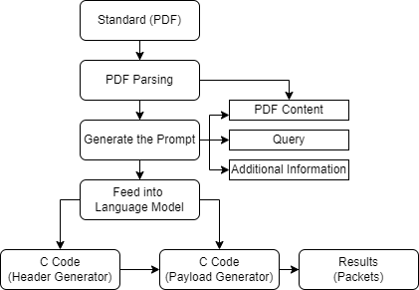
Methods - Staged
Workflow

Slide 8
Methods - Staged
Make the Language Model generate two C Codes.
Header Generator
LM needs to know the packet composition.
LM needs to specify which fields is fixed or can be user-defined.
Payload Generator
LM needs to know how to parse the given header.

Slide 9
Methods - Staged
Make the Language Model generate two C Codes.
Header Generator
Query (Need image)
Additional information (Need image)
Payload Generator
Query
Additional information

Slide 10
Methods - Staged
Problems
There may be lots of bugs in generated code, needs modification.
e.g. Big/Little Endian, Wrong bit position, complex calculate, etc.
Trade-off between performance and the amount of information given.

Slide 11
Problems
Parsing
The size of standard is large, so it is necessary to select the required chapters in person.
Each standard or chapter has its own unique structure, which means that the same parsing method may yield different results.
Prompts
Additional information needs to be provided, but there is a trade-off between performance and the amount of information given.
Results
The generated code may contain bugs.

