Slide 1
C Model Implementation
SD1 實習生 賴宥齊
202408
Github

Slide 2
Outline
Introduction
Comparison
Input & Output
Methods
Payload Generation
Length Field Recalculate
Default Values
TBD
Advise
Error Handling

Slide 3
Introduction
DPTX -> DPIA
Given DP signal as input, program transforms the input DP signal into USB4 Tunneled Packet.
Script -> DPIA
Program generates the USB4 Tunneled Packet according to the given packet type and value of each fields.
 | DPTX -> DPIA | Script -> DPIA
Input | DP signal | Self-defined packets
Number of packets | Acc. DP signal | Can be user-defined
Packets order | Acc. DP signal | Can be user-defined
Value of each fields | Acc. DP signal | Can be user-defined
Coverage | Low | High
Additional input file | No need | Need
Output | USB4 Tunneled Packet in txt file | USB4 Tunneled Packet in txt file

Slide 4
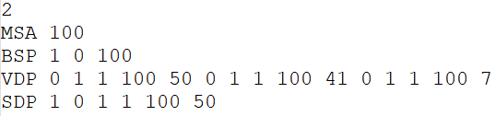
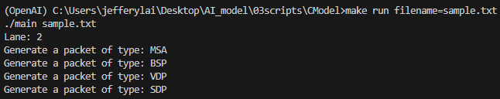
Input
Input: TXT file
Notes:
這一份script主要是8b/10b的部分。
那input file就是一份TXT，內容大致長這樣。
第一行是lane number，後面則是要產生的packet。
下面的是執行畫面。
產生的packet會輸出到另外一個資料夾，檔名設定和input file一樣。

Slide 5
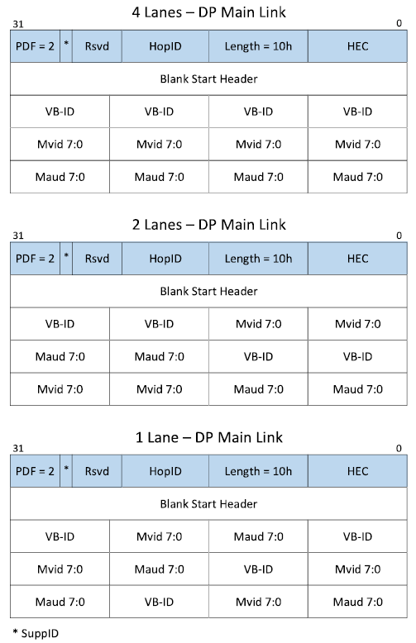
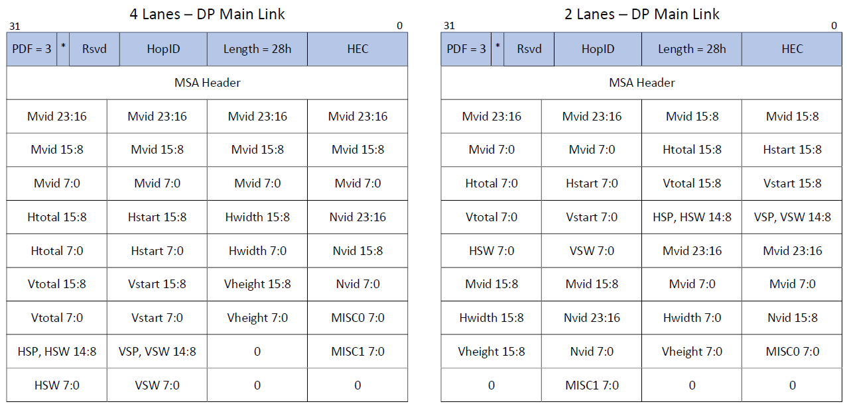
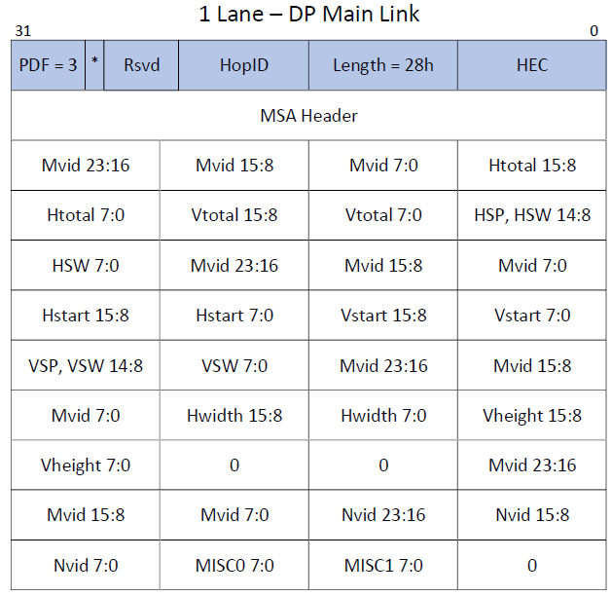

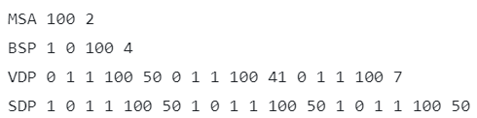
Input
Input Format:
MSA <Fill Count>
BSP <SR> <CP> <Fill Count>
VDP <EOC_1> <TU_type_1> <L_1> <Fill_Count_1> <Video_Count_1> ... <EOC_n> <TU_type_n> <L_n> <Fill_Count_n> <Video_Count_n>
SDP <EFC/ND_1> <NSS_1> <NSE_1> <L_1> <Fill_Count_1> <Secondary_Count_1> ... <EFC/ND_n> <NSS_n> <NSE_n> <L_n> <Fill_Count_n> <Secondary_Count_n>
Ignore ‘\n’ and ‘#’
Format File
Notes:
Reserved = 0
SuppID = 0 (well-defined)
HopID = 9 (well-defined)
此外，第一行需要lane number的原因。
Explain why lane number needed in MSA and BS.

Slide 6
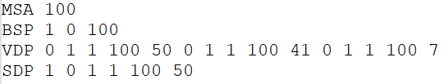
Input
Input Format:
MSA <Fill Count>
BSP <SR> <CP> <Fill Count>
VDP <EOC_1> <TU_type_1> <L_1> <Fill_Count_1> <Video_Count_1> ... <EOC_n> <TU_type_n> <L_n> <Fill_Count_n> <Video_Count_n>
SDP <EFC/ND_1> <NSS_1> <NSE_1> <L_1> <Fill_Count_1> <Secondary_Count_1> ... <EFC/ND_n> <NSS_n> <NSE_n> <L_n> <Fill_Count_n> <Secondary_Count_n>
Ignore ‘\n’ and ‘#’ and ‘//’
Format File
Notes:
像是這裡的VDP就代表有三個TU。

Slide 7
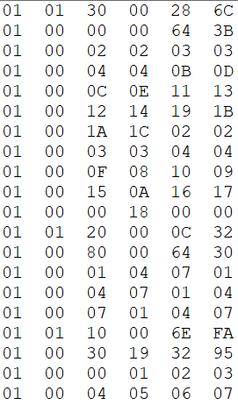
Output
Output Format:
<Valid> <Header> <B0> <B1> <B2> <B3>
Notes:
Valid DP Tunneling
Packet Header

Slide 8
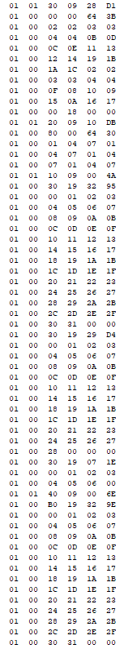
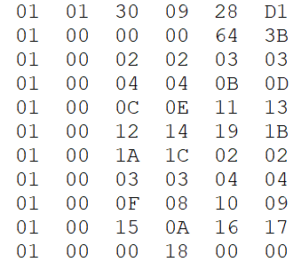
Input & Output
Notes:
Payload照著lane number的設定產生
詳細的值在後面會補充

Slide 9
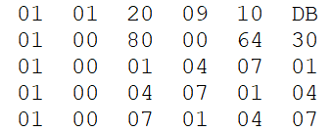
Input & Output

Slide 10
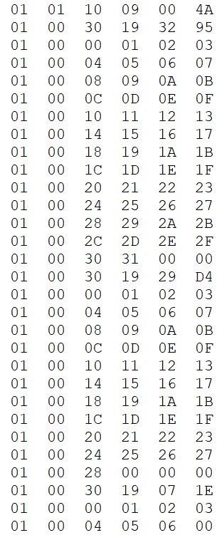
Input & Output

Slide 11
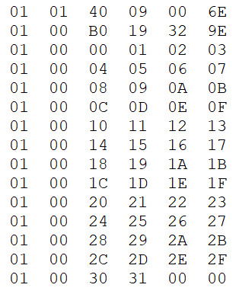
Input & Output

Slide 12
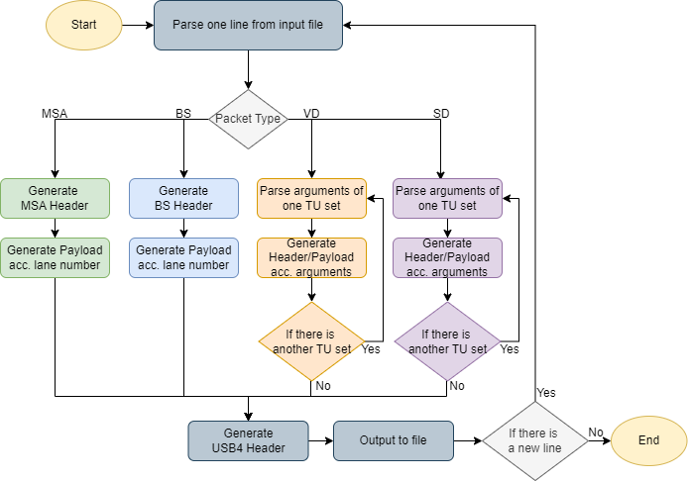
Method
Flow Chart
Notes:
改成一條龍

Slide 13
Method
Payload Generation
(MSA & BS) Payload is generated according to the give number of lanes.
(VD & SD) Payload is generated sequentially starting from 00 except the padding bytes which are 0.
Length Field Recalculate (VDP & SDP)
After generating payload of TU sets, recalculate the Length field and HEC.
Default Values
HopID = 9, Reserved = SuppID = 0
Notes:
Padding setting? 給一下enum

Slide 14
Method
 |  | Enum Values
ZERO | VBID | MVID 23:16 | MVID 15:8 | MVID 7:0 (MVID)
0 | 1 | 2 | 3 | 4
MAUD 23:16 | MAUD 15:8 | MAUD 7:0 | NVID 23:16 | NVID 15:8
5 | 6 | 7 | 8 | 9
NVID 7:0 | HTOTAL 15:8 | HTOTAL 7:0 | HSTART 15:8 | HSTART 7:0
10 | 11 | 12 | 13 | 14
HWIDTH 15:8 | HWIDTH 7:0 | VTOTAL 15:8 | VTOTAL 7:0 | VSTART 15:8
15 | 16 | 17 | 18 | 19
VSTART 7:0 | VHEIGHT 15:8 | VHEIGHT 7:0 | MISC0 7:0 | MISC1 7:0
20 | 21 | 22 | 23 | 24
HSP, HSW 14:8 | HSW 7:0 | VSP, VSW 14:8 | VSW 7:0
25 | 26 | 27 | 28

Slide 15
TBD
Advise
Require any modifications to the input format?
Are there any other methods for generating payload needed.
Error Handling
How should the program handle input that does not match the expected format? (e.g. Missing argument)
Should there be a check to ensure that the sum of Video/Secondary Count fields does not exceed 256?
Is there a need to set limits for specific input fields?

