Slide 1
Tutorial on
(HSG5) Analysis Framework for
Run 2
Kristian Gregersen, Josh McFayden

Slide 2
Outline
Framework Layout
  How the code is organised
  What functionality/calibration/etc is included
  Contents of the output file
  Configuration
Demonstration of CxAODMaker (Interactive)
  The ”Quick Guide”
  Browse output xAOD in ROOT
Grid running
How to modify the code
  How to add new variables to the output
  How to add new analysis code
How to get help
  Useful links / mailing lists

Slide 3
DISCLAIMER
This framework is developed within the VHbb analysis group (HSG5).
“Out of the box” compile/runtime configurations follow the VHbb analysis!
Usage:
  For running the VHbb analysis, the code is simply checked out and run.
  For optimisation studies of the VHbb analysis, the code is checked out and
  modified. Optimisations are then merged into the repository.
  For other analysis, the code is checked out and used as the base for new
  derived analysis classes. More on this later...
“Out of the box”-contents:
  The recommended calibrations are applied (CP tools).
  Overlap removal is performed (using official ASG tool).
  MET is rebuild.
  Object and event selections are applied.
  Systematic variations are run, i.e. the above steps are rerun for each variation.
  The output xAOD file contains the superset of objects among sys. variations,
  along with event level information.

Slide 4
Framework layout
Based on RootCore (a C++ compilation framework which depends on ROOT).
Uses EventLoop (EL) and SampleHandler.
Currently there are 7 “RootCore” packages :
CxAODMaker
Contains the main code for processing the input xAOD files, applying the calibration tools (CP tools), and writing the output CxAOD (C for Calibrated).
Contains tools that are shared outside of the main CxAODMaker work-flow, such as object and event selection.
Contains the code for the executables for running CxAODMaker jobs, along with any associated configuration files.
Contains files relating to defining datasets and related information for tracking processing.
Contains code to read CxAOD using the xAOD EDM (Event Data Model). Implements plotting style used in HSG5.
Contains example code for producing a compact flat TTree based tuple that could be used for diagnostics or analysis.
Contains the common TTree definition and example code to read a compact flat TTree.
CxAODTools
FrameworkExe
FrameworkSub
CxAODReader
TupleMaker
TupleReader

Slide 5
Framework layout
Based on RootCore (a C++ compilation framework which depends on ROOT).
Uses EventLoop (EL) and SampleHandler.
Currently there are 7 “RootCore” packages :
CxAODMaker
DxAODs
CxAODTools
CxAODMaker
FrameworkExe
Focus will be on these today
CxAODs
FrameworkSub
CxAODReader
TupleMaker
TupleMaker
tuples
TupleReader

Slide 6
CxAODMaker
<Particle>Handler
<Particle> is:
Electron, FatJet, Jet, Muon, Photon, Tau, TrackJet, TruthParticle.
Applies calibrations (where appropriate) including sys. variations.
Classifies particles and attaches corresponding flags to each particle for each sys. variation (HSG5 specific, e.g. 'isVHLooseElectron').
EventInfoHandler
Holds event level info, e.g. run/event number, GRL pass/fail, MC event weight, vertex info,...
Visible to Particle Handlers
METHandler
Rebuilds the MET from calibrated objects, including sys. varations.
Uses 'official' METRebuilder tool (which implements its own overlap removal.)
Note: Trigger info is still not accessible in current xAODs (JIRA)
AnalysisBase
Controls the work flow.
Defines the EL algorithm.
Contains the methods executed by EL, i.e. initialize(), execute(),...
Declares and executes all “handlers” and the “selector”, i.e. these are plugged in to the EL work-flow through this class.
Has access to the TEvent, and pass it on to the Handlers
EventSelector
Note: Each Handler retrieves/writes data from/to TEvent directly.
Applies event level selection.
Uses 'official' overlap removal tool for resolving conflicts for object appearing in multiple containers.
Apart from the overlap removal, the selection is HSG5 specific.

Slide 7
CxAODMaker
List of Calibration Tools in framework
  Jets :
    JetCalibrationTool
    JetCleaningTool
    JERTool
    JERSmearingTool
    BTaggingEfficiencyTool
  Taus :
    TauSmearingTool
    TauSelectionTool
    TauEfficiencyCorrectionsTool
  Photons :
    EgammaCalibrationAndSmearingTool
    AsgPhotonIsEMSelector
ASG analysis tools xAOD migration progress
  https://twiki.cern.ch/twiki/bin/viewauth/AtlasProtected/ASGUserAnalysisToolsxAODMigration
  Electrons :
    EgammaCalibrationAndSmearingTool
    AsgElectronLikelihoodTool
    AsgElectronIsEMSelector
  Muons :
    MuonCalibrationAndSmearingTool
    MuonSelectionTool
    MuonEfficiencyScaleFactors

Slide 8
CxAODMaker
Contents of the output xAOD
The main guideline is to store as little as possible – which in practical terms implies a trade-off :
  The output file is (fairly) well organised, without too many variables cluttering/creating
  confusion.
  But, occasionally, this will also result in important variables missing, and thus re-running
  of the code.
For particle-type objects:
  The 4-vector is always stored.
  Other chosen quantities are explicitly added by hand (with 'decorators') and stored.
  (e.g. object scale factors, or flags which specify if an object passed some selection criteria).
  The particle-index is also stored, i.e. the index of a given particle in the container in
  the input file. This enables exact comparisons of objects if/when discrepancies occur between
  analysis groups (instead of e.g. doing 4-vector comparisons to figure out which objects match up).
Event information:
  Run number, event number, NVtx3Trks, MCEventWeight, …
  Eventually, also trigger information.
Systematic variations are stored with the original collection name as “base” name and then the name
of the variation appended to it (after 3 “_”), so e.g “Muons___Nominal” and “Muons___someVariation”.

Slide 9
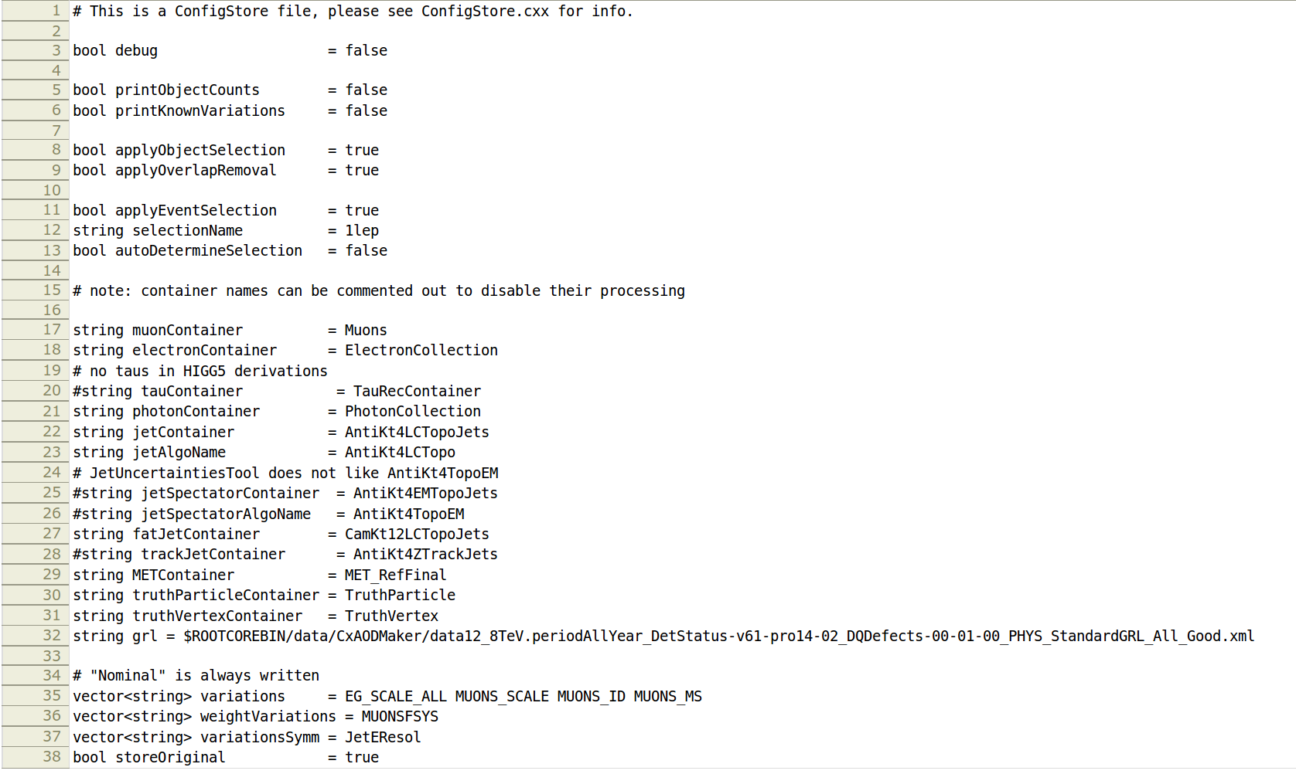
CxAODMaker
Configuration
The configuration file is located here:
FrameworkExe/data/CxAODMaker-job.cfg
Note: By default the VHbb “1 lepton” selection is applied
Names of collections, used by MuonHandler, JetHandler,...
List of sys. variations

Slide 10
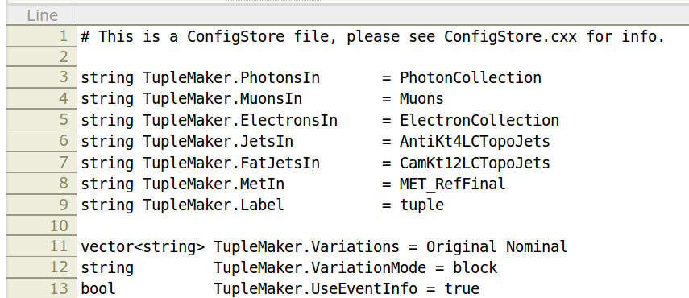
TupleMaker
Produces flat ntuples
  int, float and arrays
  An EventLoop algorithm, like AnalysisBase in CxAODMaker.
  Configured independent of CxAODMaker:
  FrameworkExe/data/TupleMaker-job.cfg
  Run with : hsg5frameworkTuple
    will run CxAODMaker followed by TupleMaker such that the output collections in TEvent
    from the CxAODMaker are read in by TupleMaker.
  The systematic variations can be written out in 3 different ways:
    “file” : A separate file with one TTree for each variation
    “tree” : One file with one TTree for each variation
    “block” : One file with one tree where the variables have the variation appended to their name
Names of collections (sys. variations are appended automatically)
List of sys. variations

Slide 11
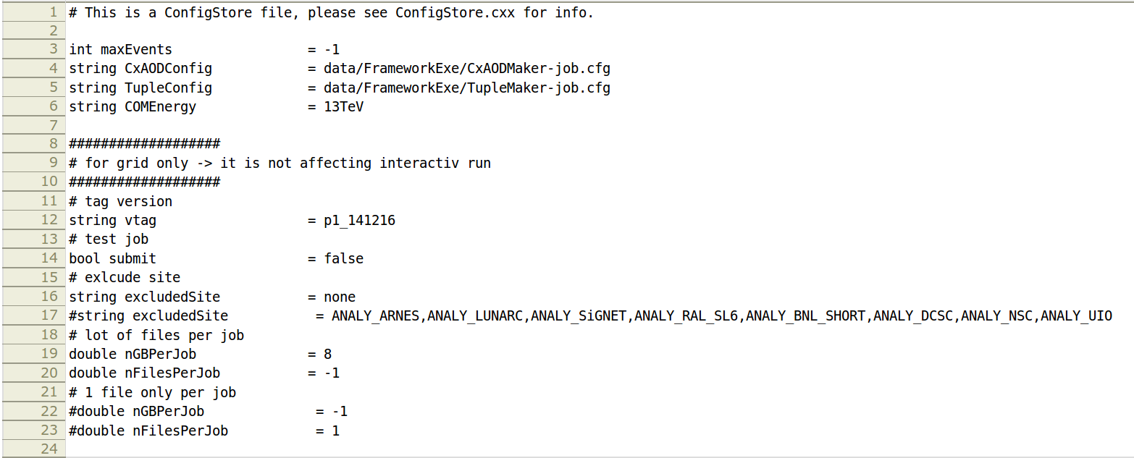
FrameworkExe
The framework executables
  Contains the files that defines the “main()” methods which are compiled into executables
    hsg5framework (runs CxAODMaker)
    Hsg5frameworkTuple (runs CxAODMaker and TupleMaker in sequence)
    Hsg5frameworkReader (runs CxAODMakerReader, which processes CxAODs)
  Configured in
  FrameworkExe/data/framework-run.cfg
  Final note on runtime configuration:
    The steering file is distributed to all the Handlers in CxAODMaker, so modifying/adding
    configuration variables to a Handler is easy.
Reads in the config files for CxAODMaker and TupleMaker from the previous 2 slides by default.

Slide 12
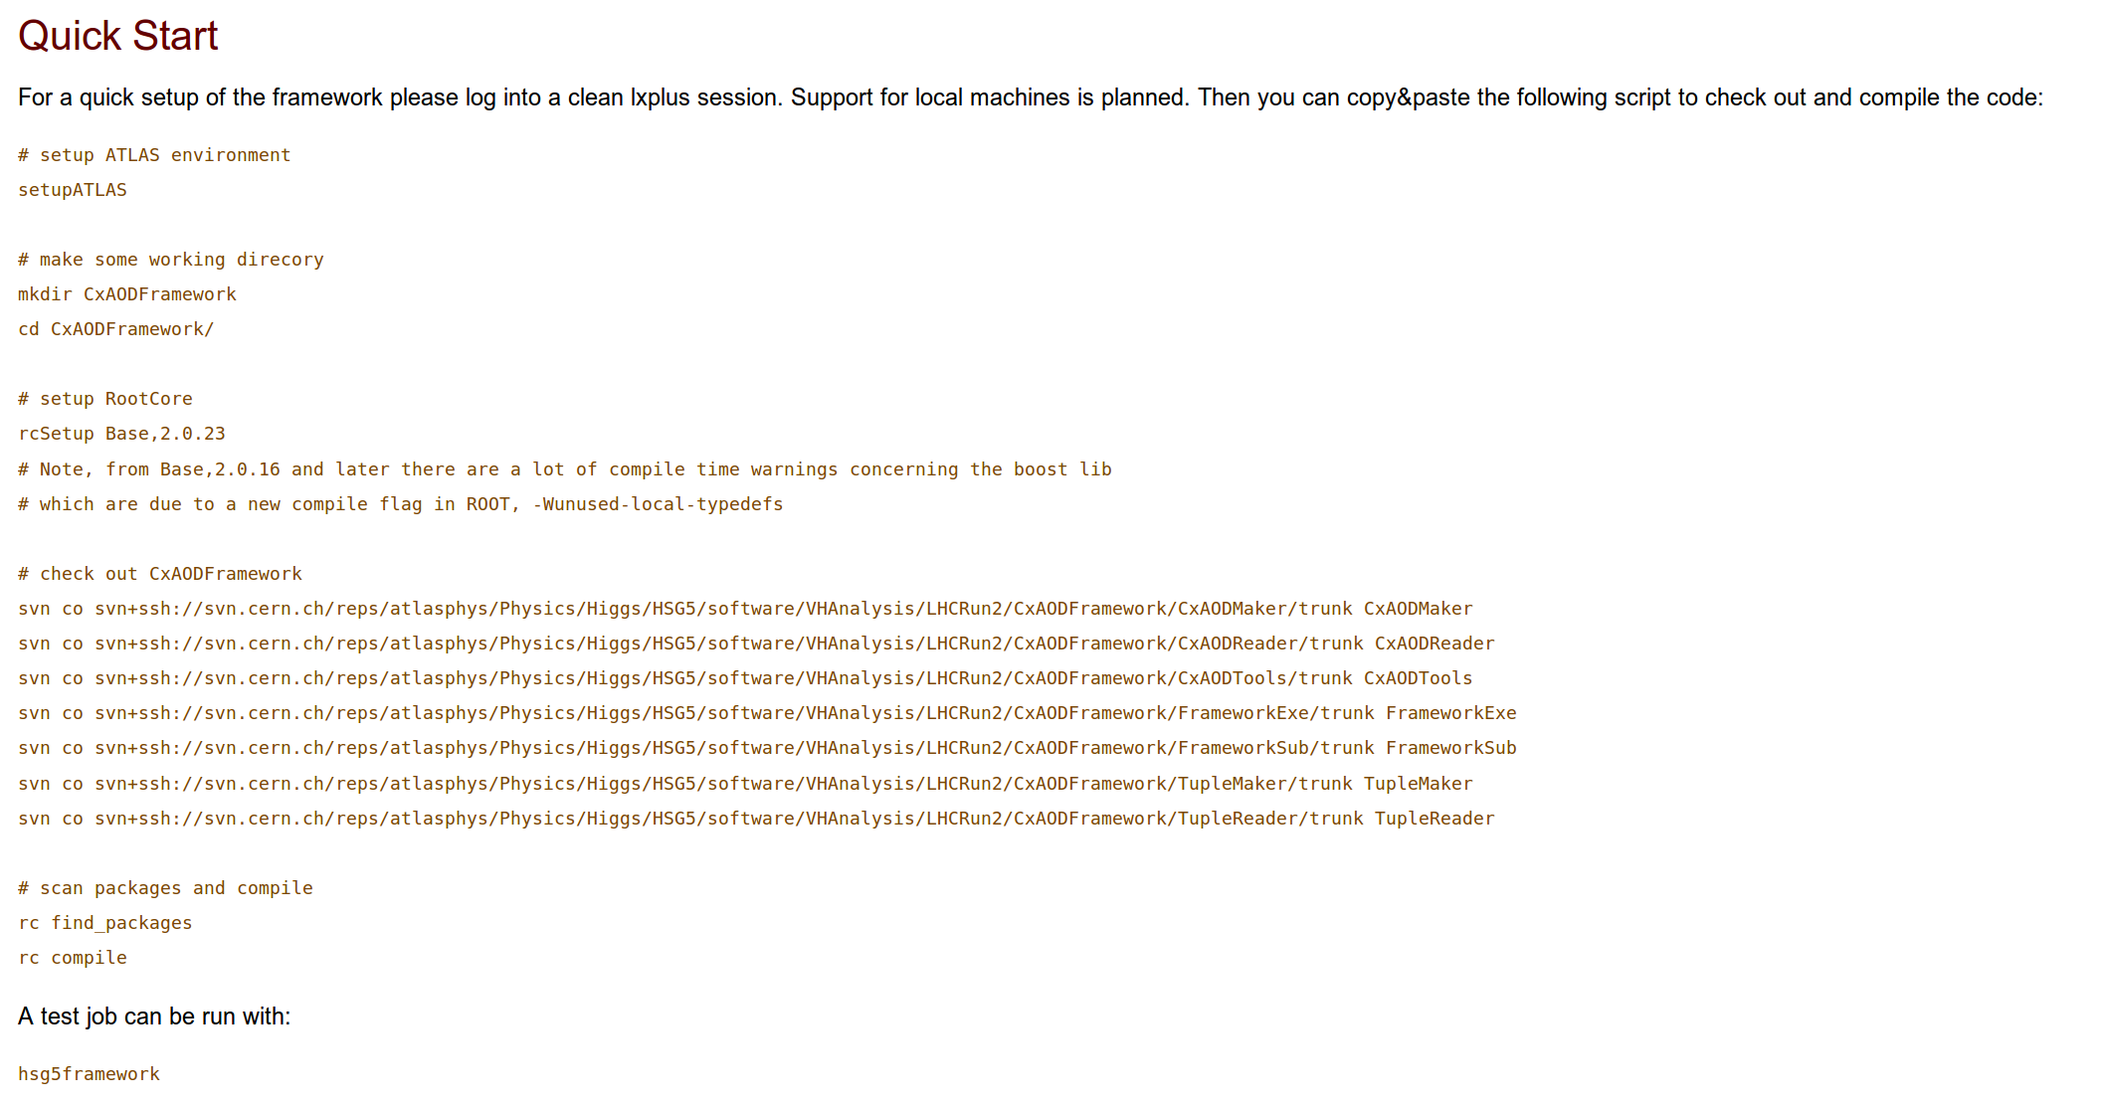
Demonstration of CxAODMaker / TupleMaker

Slide 13
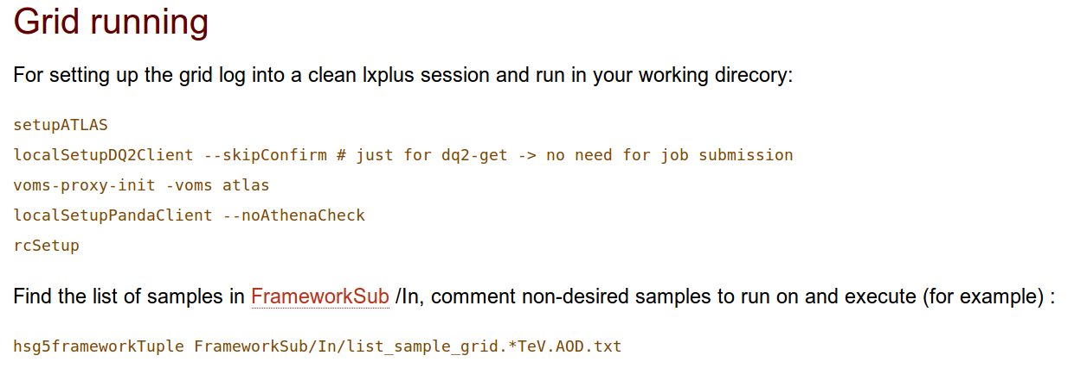
FrameworkExe
Grid running
  We will not cover this part of the framework in this tutorial, but refer to the documentation
  provided here:
  https://twiki.cern.ch/twiki/bin/viewauth/AtlasProtected/CxAODFramework
The code scans the argument for “grid” to change to the grid driver

Slide 14
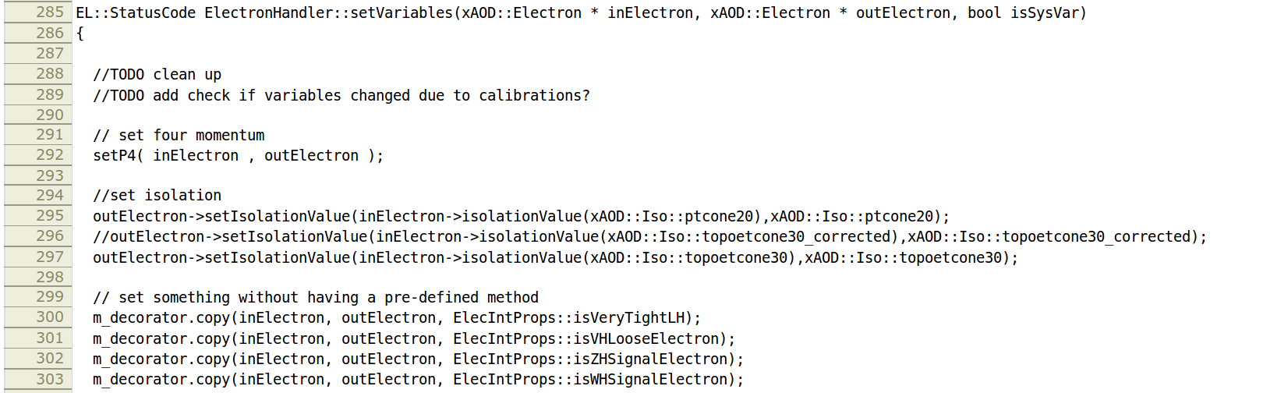
Modifying the code
Adding a variable to the output
  Output variables are set in the method “setVariables()” which each handler has,
  e.g. ElectronHandler:
The I/O structure in the code is not entirely transparent – the “inElectron” is an object from a socalled
“shallow copy” of the collection in the input file. This is the calibrated object which has additional
“decorations” attached to it. The “outElectron” is the object which is written out. For the nominal calibration,
this is a new memory allocation, while for sys. variations, it is a shallow copy of the nominal output object.

Slide 15
Modifying the code
Adding a variable to the output
  Output variables are set in the method “setVariables()” which each handler has,
  e.g. ElectronHandler:
So, what this method does is to copy properties from the calibrated object (“inElectron”) to the
output object (“outElectron”).
Thus, to add a variable to “outElectron”, a line must be put here copying the property.

Slide 16
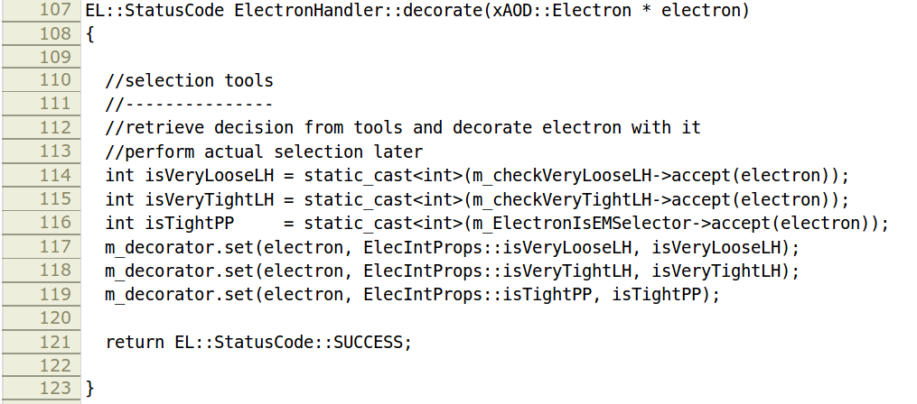
Modifying the code
Adding a variable to the output
  In case the variable is not a known property to “inElectron”, it must first be calculated and
  added to this object, e.g. in the method decorate():
  But, there is more...
This is the same object as
“inElectron” on the previous
slide

Slide 17
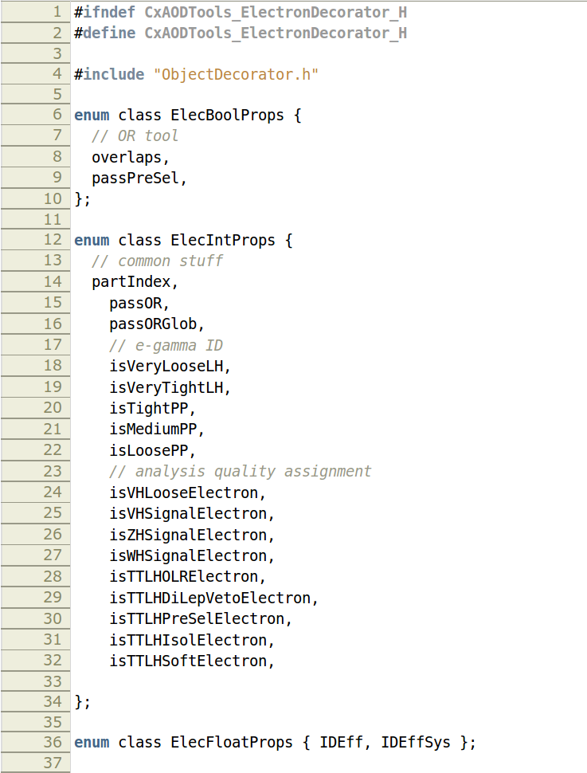
Modifying the code
Adding a variable to the output
  In case the property is unknown to the object, one has to add it to its decorator which is defined
  in CxAODTools, e.g. for electrons: CxAODTools/CxAODTools/ElectronDecorator.h
  That should do it
Boolean properties
Boolean properties
Integer properties
Float properties

Slide 18
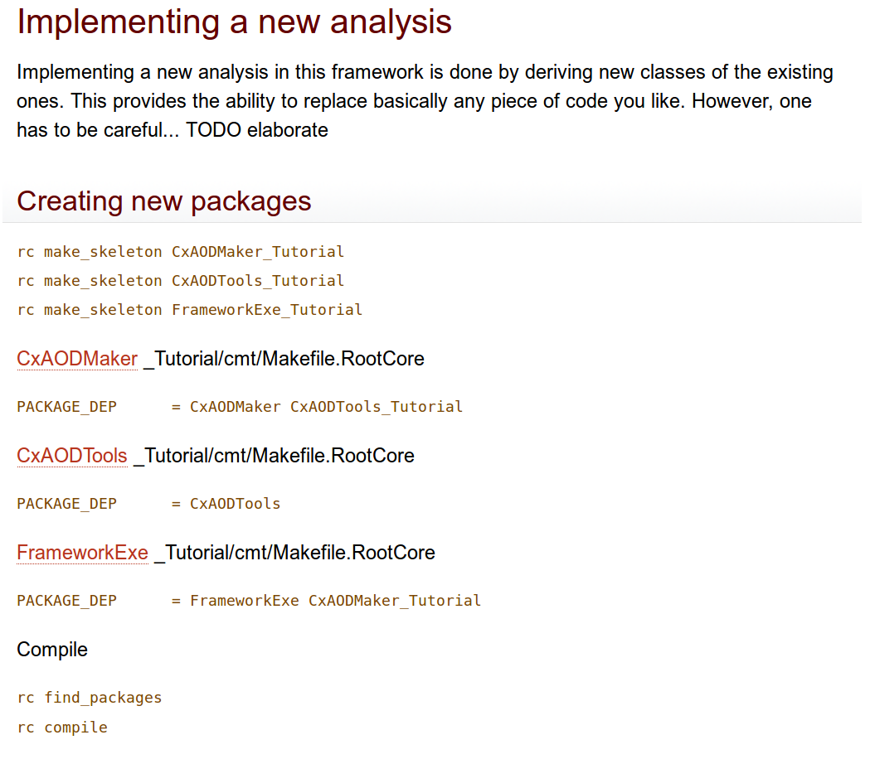
Modifying the code
Doing a different analysis than VHbb
  This case is a bit more involved, and there are several ways to do it.
  We have experimented with this, and some volunteers have already tried it out.
  Here's a link to the TWiki with the current tutorial: CxAODFrameworkTutorial

Slide 19
How to get help
Ask Josh or Kristian
Framework mailing list:
atlas-phys-higgs-hsg5Framework
Framework TWiki:
CxAODFramework
Framework repository:
Physics/Higgs/HSG5/software/VHAnalysis/LHCRun2/CxAODFramework
xAOD Tutorial:
SoftwareTuturialxAODAnalysisInROOT
RootCore Twiki:
RootCore

