Slide 1
HSG5 Analysis Framework for Run 2
Flavour Tagging Weekly
Feb. 10, 2015
Kristian Gregersen

Slide 2
Outline
How the code is organised
Calibration/Analysis tools in the framework
Contents of the output file
Technical details on I/O structure
Configuration and running
Performance numbers
Mailing list and links

Slide 3
Framework layout
Based on RootCore (a C++ compilation framework which depends on ROOT).
Uses EventLoop (EL) and SampleHandler.
Currently there are 7 “RootCore” packages :
CxAODMaker
Contains the main code for processing the input xAOD files, applying the calibration tools (CP tools), and writing the output CxAOD (C for Calibrated).
Contains tools that are shared outside of the main CxAODMaker work-flow, such as object and event selection.
Contains the code for the executables for running CxAODMaker, along with any associated configuration files.
Contains files related to defining datasets and information for tracking processing.
Contains code to read CxAOD using the xAOD EDM. Implements plotting style used in HSG5.
Contains example code for producing a compact flat TTree based tuple.
Contains the common TTree definition and example code to read a compact flat TTree.
CxAODTools
FrameworkExe
FrameworkSub
CxAODReader
TupleMaker
TupleReader

Slide 4
Framework layout
Based on RootCore (a C++ compilation framework which depends on ROOT).
Uses EventLoop (EL) and SampleHandler.
Currently there are 7 “RootCore” packages :
CxAODMaker
Work flow for processing (D)xAODs:
CxAODTools
Focus will be on these today
DxAODs
FrameworkExe
CxAODMaker
FrameworkSub
CxAODReader
CxAODs
TupleMaker
TupleMaker
Optional
tuples
TupleReader

Slide 5
CxAODMaker
List of Calibration/Analysis Tools in Framework
  Jets :
    JetCalibrationTool
    JetCleaningTool
    JERTool
    JERSmearingTool
    BTaggingEfficiencyTool
  Taus :
    TauSmearingTool
    TauSelectionTool
    TauEfficiencyCorrectionsTool
  Photons :
    EgammaCalibrationAndSmearingTool
    AsgPhotonIsEMSelector
  Electrons :
    EgammaCalibrationAndSmearingTool
    AsgElectronLikelihoodTool
    AsgElectronIsEMSelector
  Muons :
    MuonCalibrationAndSmearingTool
    MuonSelectionTool
    MuonEfficiencyScaleFactors
  MET :
    METRebuilder
  Overlap removal :
    OverlapRemovalTool

Slide 6
CxAODMaker
Contents of the output xAOD
We store as little as possible – which in practical terms implies a trade-off :
  The output file is small and (fairly) well organised, without too many variables cluttering/creating
  confusion.
  But, while developing the code, this will also result in important variables missing, and thus re-running
  of the code.
For particle-type objects:
  The 4-vector is always stored.
  Other chosen quantities are explicitly added by hand (with 'decorators') and stored.
  (e.g. object scale factors, or flags which specify if an object passed some selection criteria).
Event information:
  Run number, event number, NVtx3Trks, MCEventWeight, …
  Eventually, also trigger information.
Systematic variations are stored with the original collection name as “base” name and then the name
of the variation appended to it (after 3 “_”), so e.g “Muons___Nominal” and “Muons___someVariation”.

Slide 7
CxAODMaker
Technical details on I/O structure
Objects (here 6 as example)
In this example, object 5 is not stored!
Nominal output container – new memory allocation for each object. Stored in output xAOD.
Input container
1
2
3
4
5
6
1
2
3
4
6
Shallow
Copies
Shallow
Copies
Nominal
1
2
3
4
5
6
Properties are copied across
Systematic variations
(Here 2 as
example)
1
2
3
4
5
6
1
2
3
4
6
Systematic variations
output containers. Stored in output xAOD.
1
2
3
4
5
6
1
2
3
4
6
Summary:
Shallow copies are made of the input (for nominal + systematic variations).
These are calibrated and the object selection is applied.
For the nominal output, new memory allocations are made based on selected objects (across variations).
For the systematic variations, shallow copies are made of the nominal output.
Properties are copied from calibrated shallow copies to output containers.
Calibration + Selection applied:
Pass selection
Fail selection
In this example, object 5 doesn't pass the selection for nominal or any variation – it will not be stored!

Slide 8
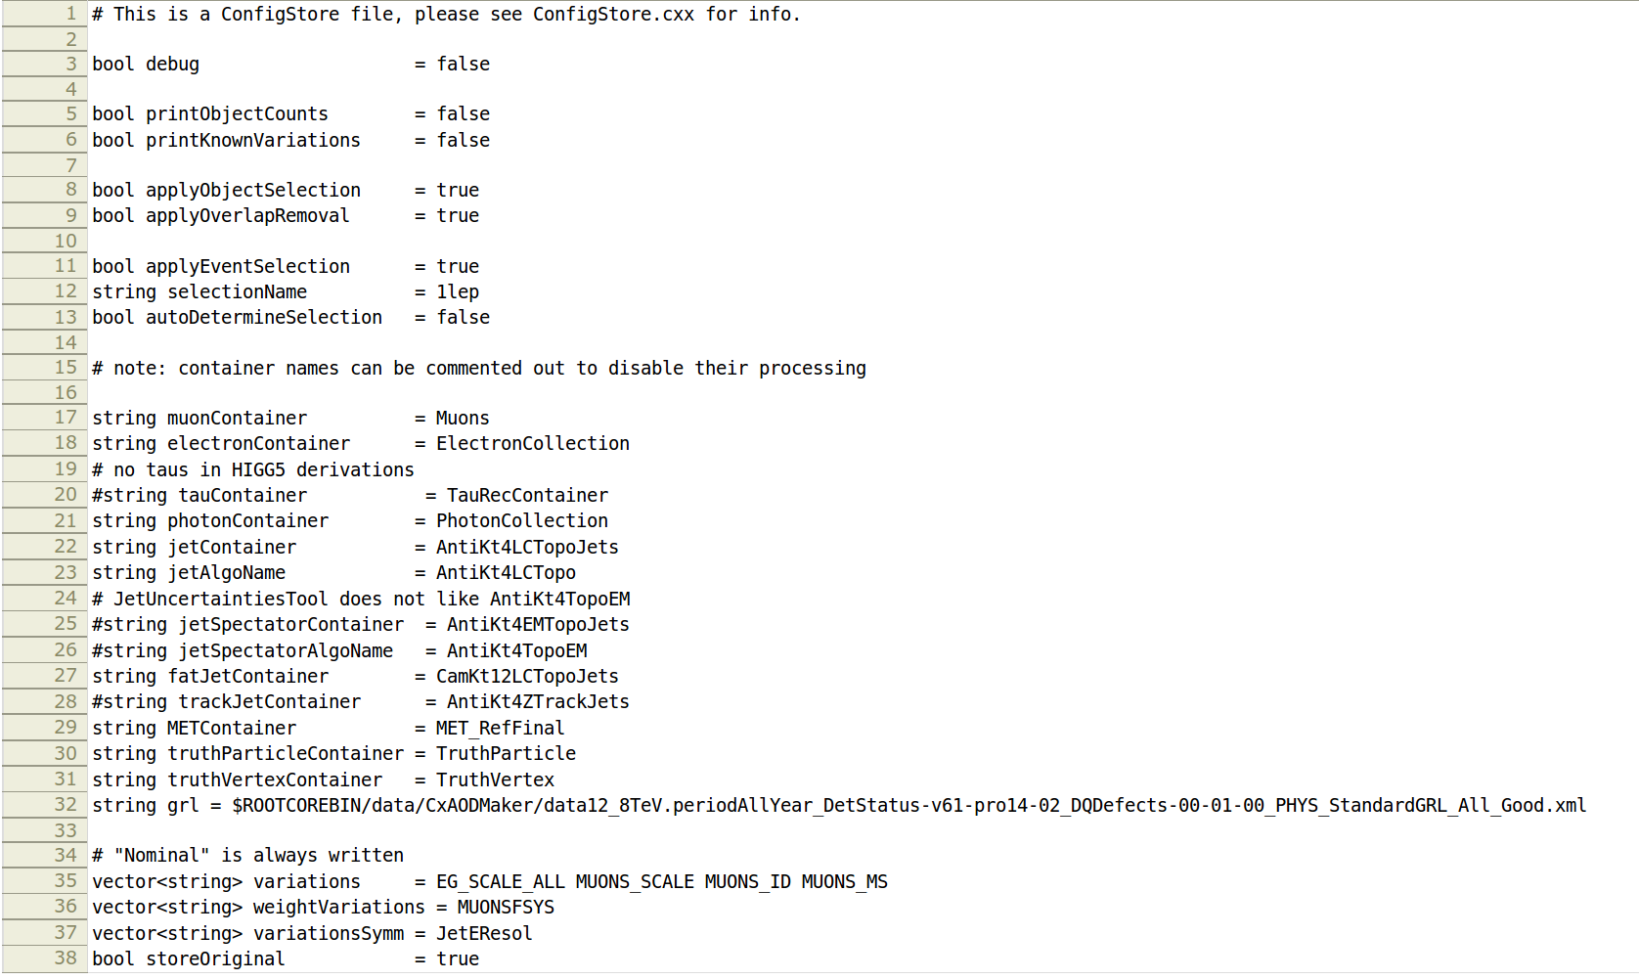
CxAODMaker
Configuration
The configuration file is located here:
FrameworkExe/data/CxAODMaker-job.cfg
Note: By default the VHbb “1 lepton” selection is applied
Names of collections
List of sys. variations

Slide 9
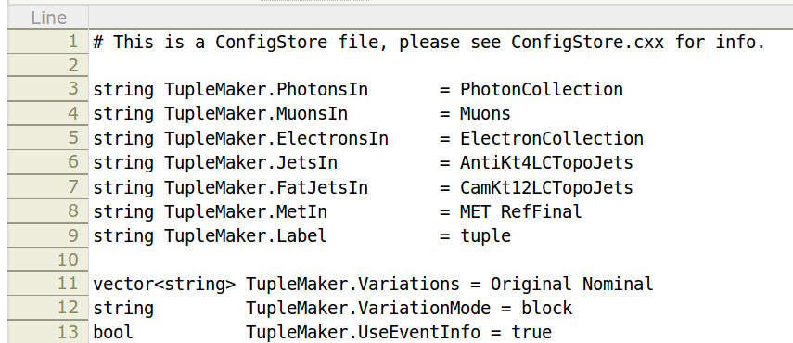
TupleMaker
Produces flat ntuples
  int, float and arrays
  An EventLoop algorithm, like AnalysisBase in CxAODMaker.
  Configured independent of CxAODMaker:
  FrameworkExe/data/TupleMaker-job.cfg
  Run with : hsg5frameworkTuple
    will run CxAODMaker followed by TupleMaker such that the output collections in TEvent
    from the CxAODMaker are read in by TupleMaker.
  The systematic variations can be written out in 3 different ways:
    “file” : A separate file with one TTree for each variation
    “tree” : One file with one TTree for each variation
    “block” : One file with one tree where the variables have the variation appended to their name
Names of collections (sys. variations are appended automatically)
List of sys. variations

Slide 10
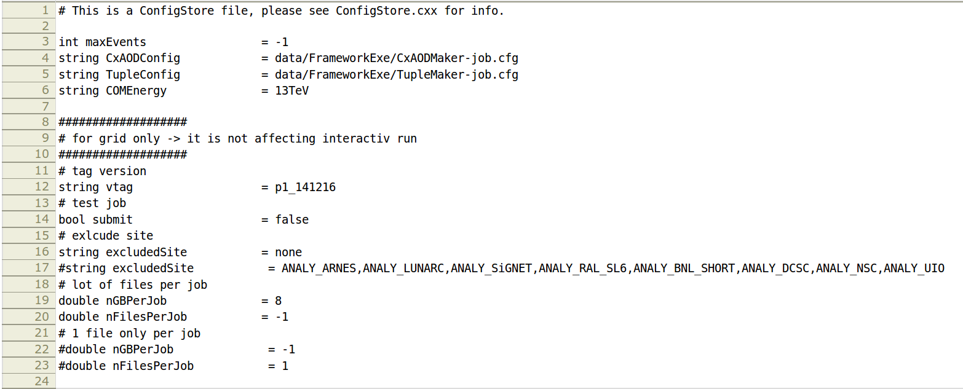
FrameworkExe
The framework executables
  Contains the files that defines the “main()” methods which are compiled into executables
    hsg5framework (runs CxAODMaker)
    Hsg5frameworkTuple (runs CxAODMaker and TupleMaker in sequence)
    Hsg5frameworkReader (runs CxAODMakerReader, which processes CxAODs)
  Configured in
  FrameworkExe/data/framework-run.cfg
  Final note on runtime configuration:
    The steering file is distributed to all the Handlers in CxAODMaker, so modifying/adding
    configuration variables to a Handler is easy.
Reads in the config files for CxAODMaker and TupleMaker from the previous 2 slides by default.

Slide 11
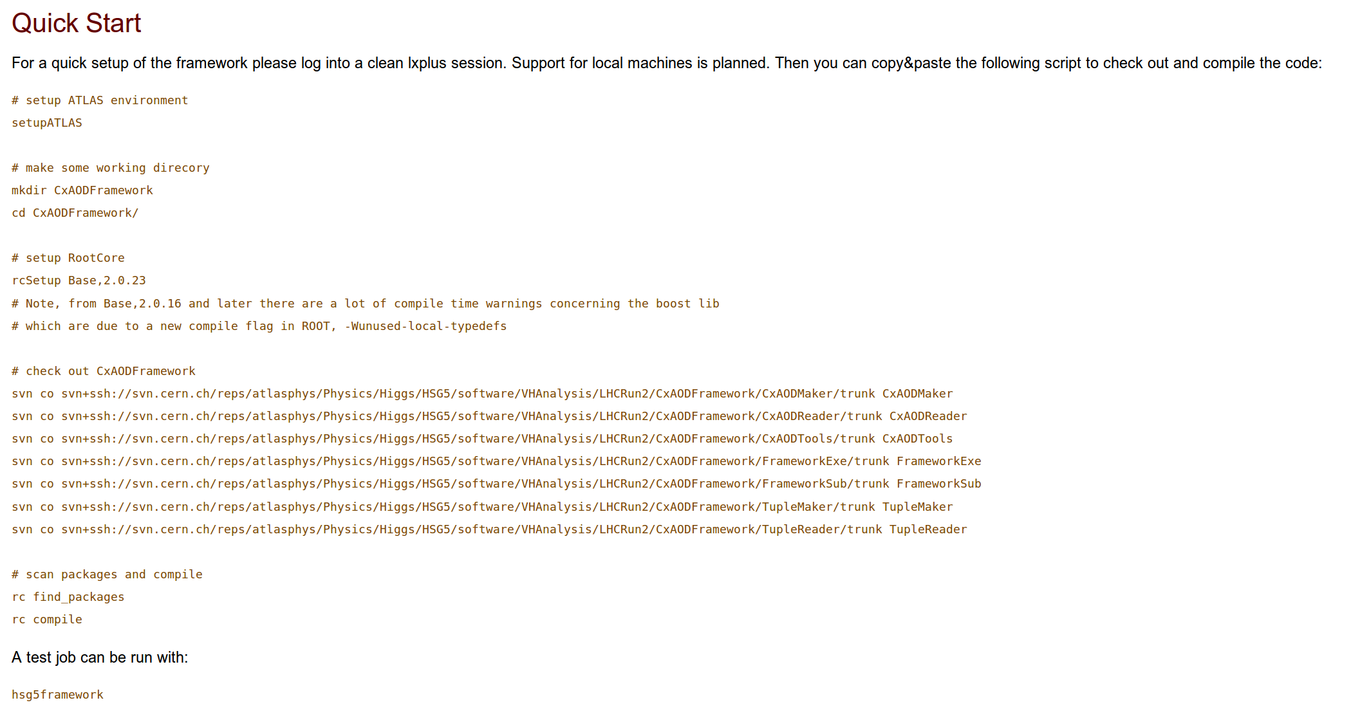
Running CxAODMaker / TupleMaker

Slide 12
Performance
Sample specifics
  HIGG2D4 DxAOD (2 lepton filter),
  10000 ttbar events (2.3 Gb)
  (mc14_8TeV.117050.PowhegPythia_P2011C_ttbar.merge.DAOD_HIGG2D4.e1727_s1933_s1911_r5591_r5625_p1784)
Reading/writing:
  ElectronCollection
  Muons
  AntiKt4LCTopoJets
  CamKt12LCTopoJets
  AntiKt4ZTrackJets
  MET_RefFinal
Configuration
  10 systematic variations
  VHbb “2 lepton” event selection
Processing time (CPU time):
  ~ 120 evt/sec
Disk space:
  Output CxAOD file size 3.5 Mb (reduction factor ~ 650)

Slide 13
Mailing list and links
HSG5 Framework mailing list:
atlas-phys-higgs-hsg5Framework
Framework TWiki:
CxAODFramework
Framework repository:
Physics/Higgs/HSG5/software/VHAnalysis/LHCRun2/CxAODFramework

Slide 14
Backup slides

Slide 15
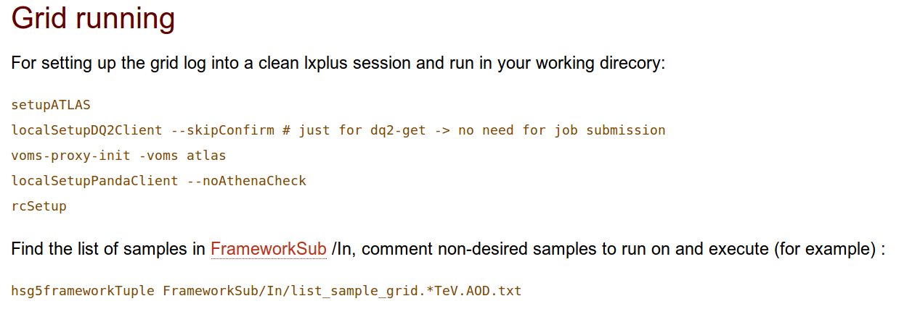
FrameworkExe
Grid running
  This part of the framework is not covered here, please see the documentation
  provided on our TWiki:
  https://twiki.cern.ch/twiki/bin/viewauth/AtlasProtected/CxAODFramework

Slide 16
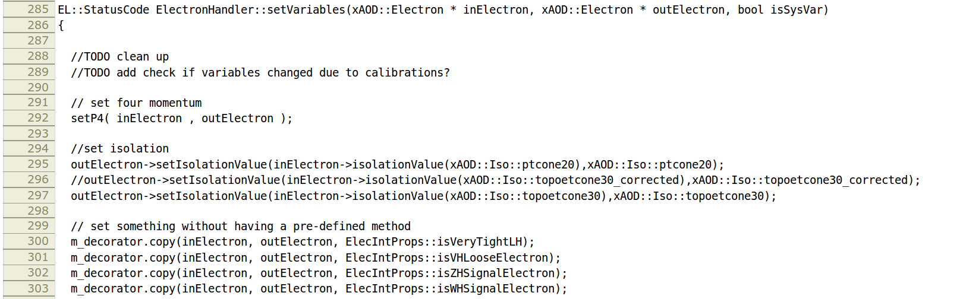
Modifying the code
Adding a variable to the output
  Output variables are set in the method “setVariables()” which each handler has,
  e.g. ElectronHandler:
The I/O structure in the code is not entirely transparent – the “inElectron” is an object from a socalled
“shallow copy” of the collection in the input file. This is the calibrated object which has additional
“decorations” attached to it. The “outElectron” is the object which is written out. For the nominal calibration,
this is a new memory allocation, while for sys. variations, it is a shallow copy of the nominal output object.

Slide 17
Modifying the code
Adding a variable to the output
  Output variables are set in the method “setVariables()” which each handler has,
  e.g. ElectronHandler:
So, what this method does is to copy properties from the calibrated object (“inElectron”) to the
output object (“outElectron”).
Thus, to add a variable to “outElectron”, a line must be put here copying the property.

Slide 18
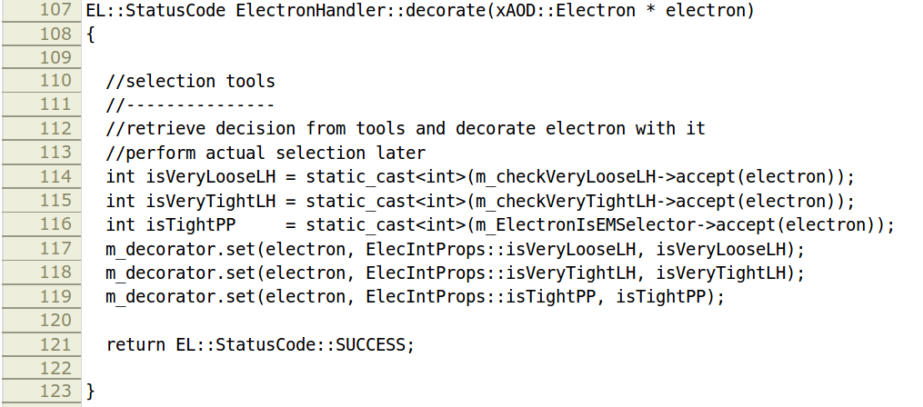
Modifying the code
Adding a variable to the output
  In case the variable is not a known property to “inElectron”, it must first be calculated and
  added to this object, e.g. in the method decorate():
  There is more...
This is the same object as
“inElectron” on the previous
slide

Slide 19
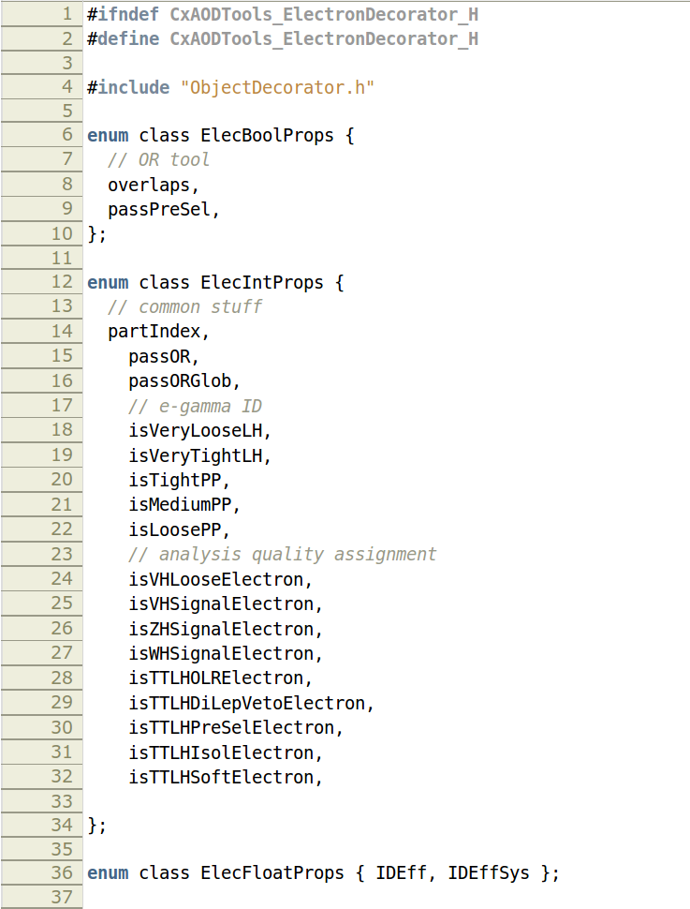
Modifying the code
Adding a variable to the output
  … the property also needs to be added the object's decorator, which is defined in CxAODTools,
  e.g. for electrons: CxAODTools/CxAODTools/ElectronDecorator.h
Boolean properties
Boolean properties
Integer properties
Float properties

Slide 20
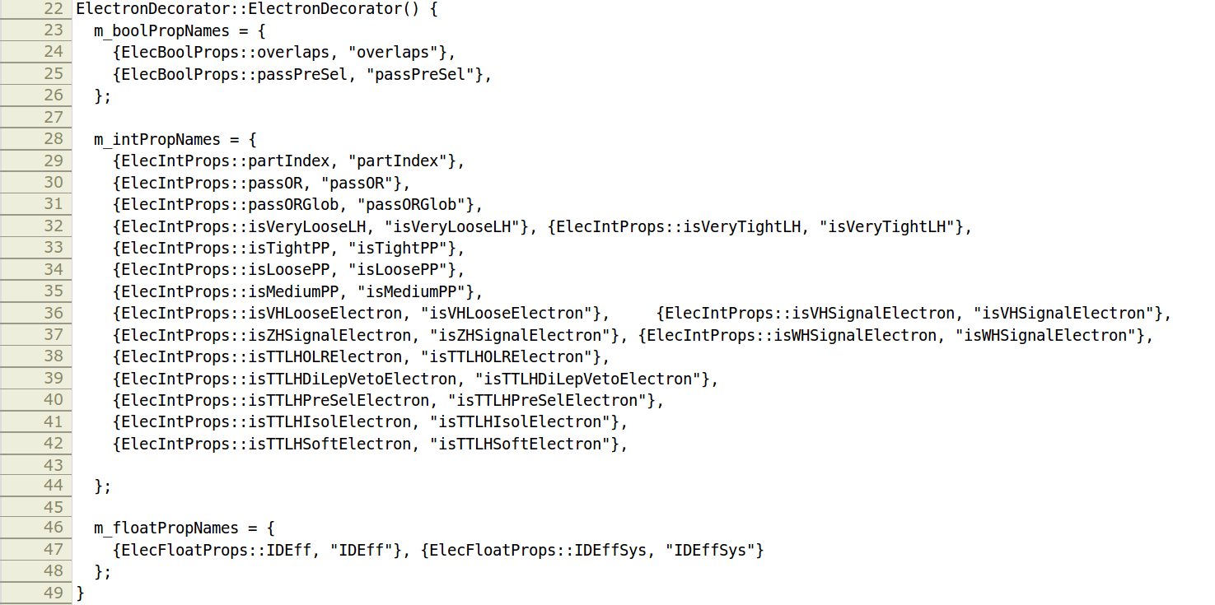
Modifying the code
Adding a variable to the output
  And also modify the .cxx file according
  CxAODTools/Root/ElectronDecorator.cxx
  That should do it

Slide 21
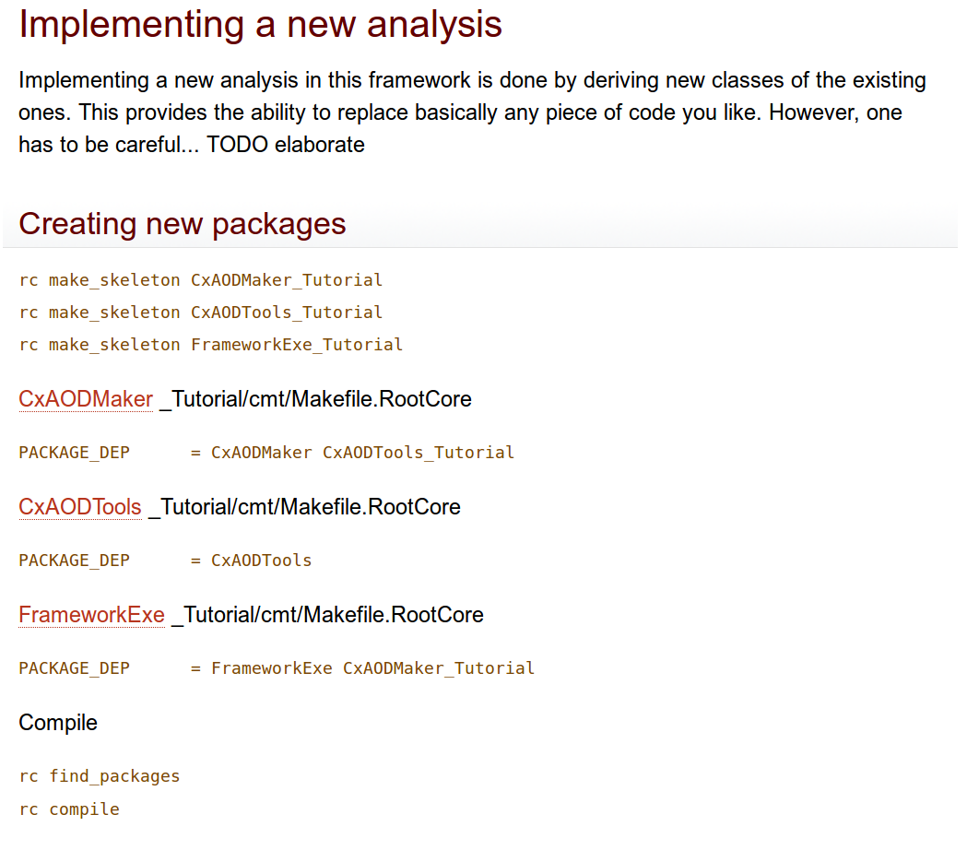
Modifying the code
Doing a different analysis than VHbb
  This case is a bit more involved, and there are several ways to do it.
  We have experimented with this, and some volunteers have already tried it out.
  Here's a link to the TWiki with the current tutorial: CxAODFrameworkTutorial

