Slide 1
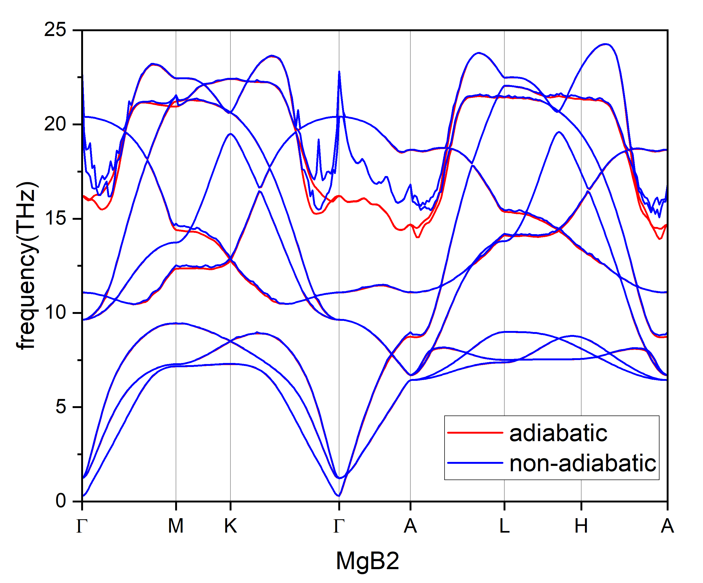
input file from
epiq-EPIq-1.1/tutorials/mgb2/input_examples
q-points 6x6x4
asr: no

