Slide 1

The effect of the non-adiabatic phonon on Tc in $δ$-NbN inside and outside a cavity
Qinyan Yi
Peking University, China
Supervised by Dr. I-Te Lu, Dr. Hannes Huebener, and Prof. Angel Rubio
(an intern project in Prof. Angel Rubio’s research group from Sep. to Nov. 2023)

Slide 2
Introduction (motivation and goal)
NbN is a good superconducting material with a relatively high transition temperature. Its notable superconductivity and mechanical properties make it have various technological applications.
Non-adiabatic (dynamical) phonon takes into account the propagation time for the force acting on nucleus due to the atom displacement. This leads to a change in phonon frequencies, thus change T_{c}.
Light-matter interaction change (adiabatic and non-adiabatic) phonon dispersions, leading to the change in T_{c} of NbN inside a cavity.

Slide 3
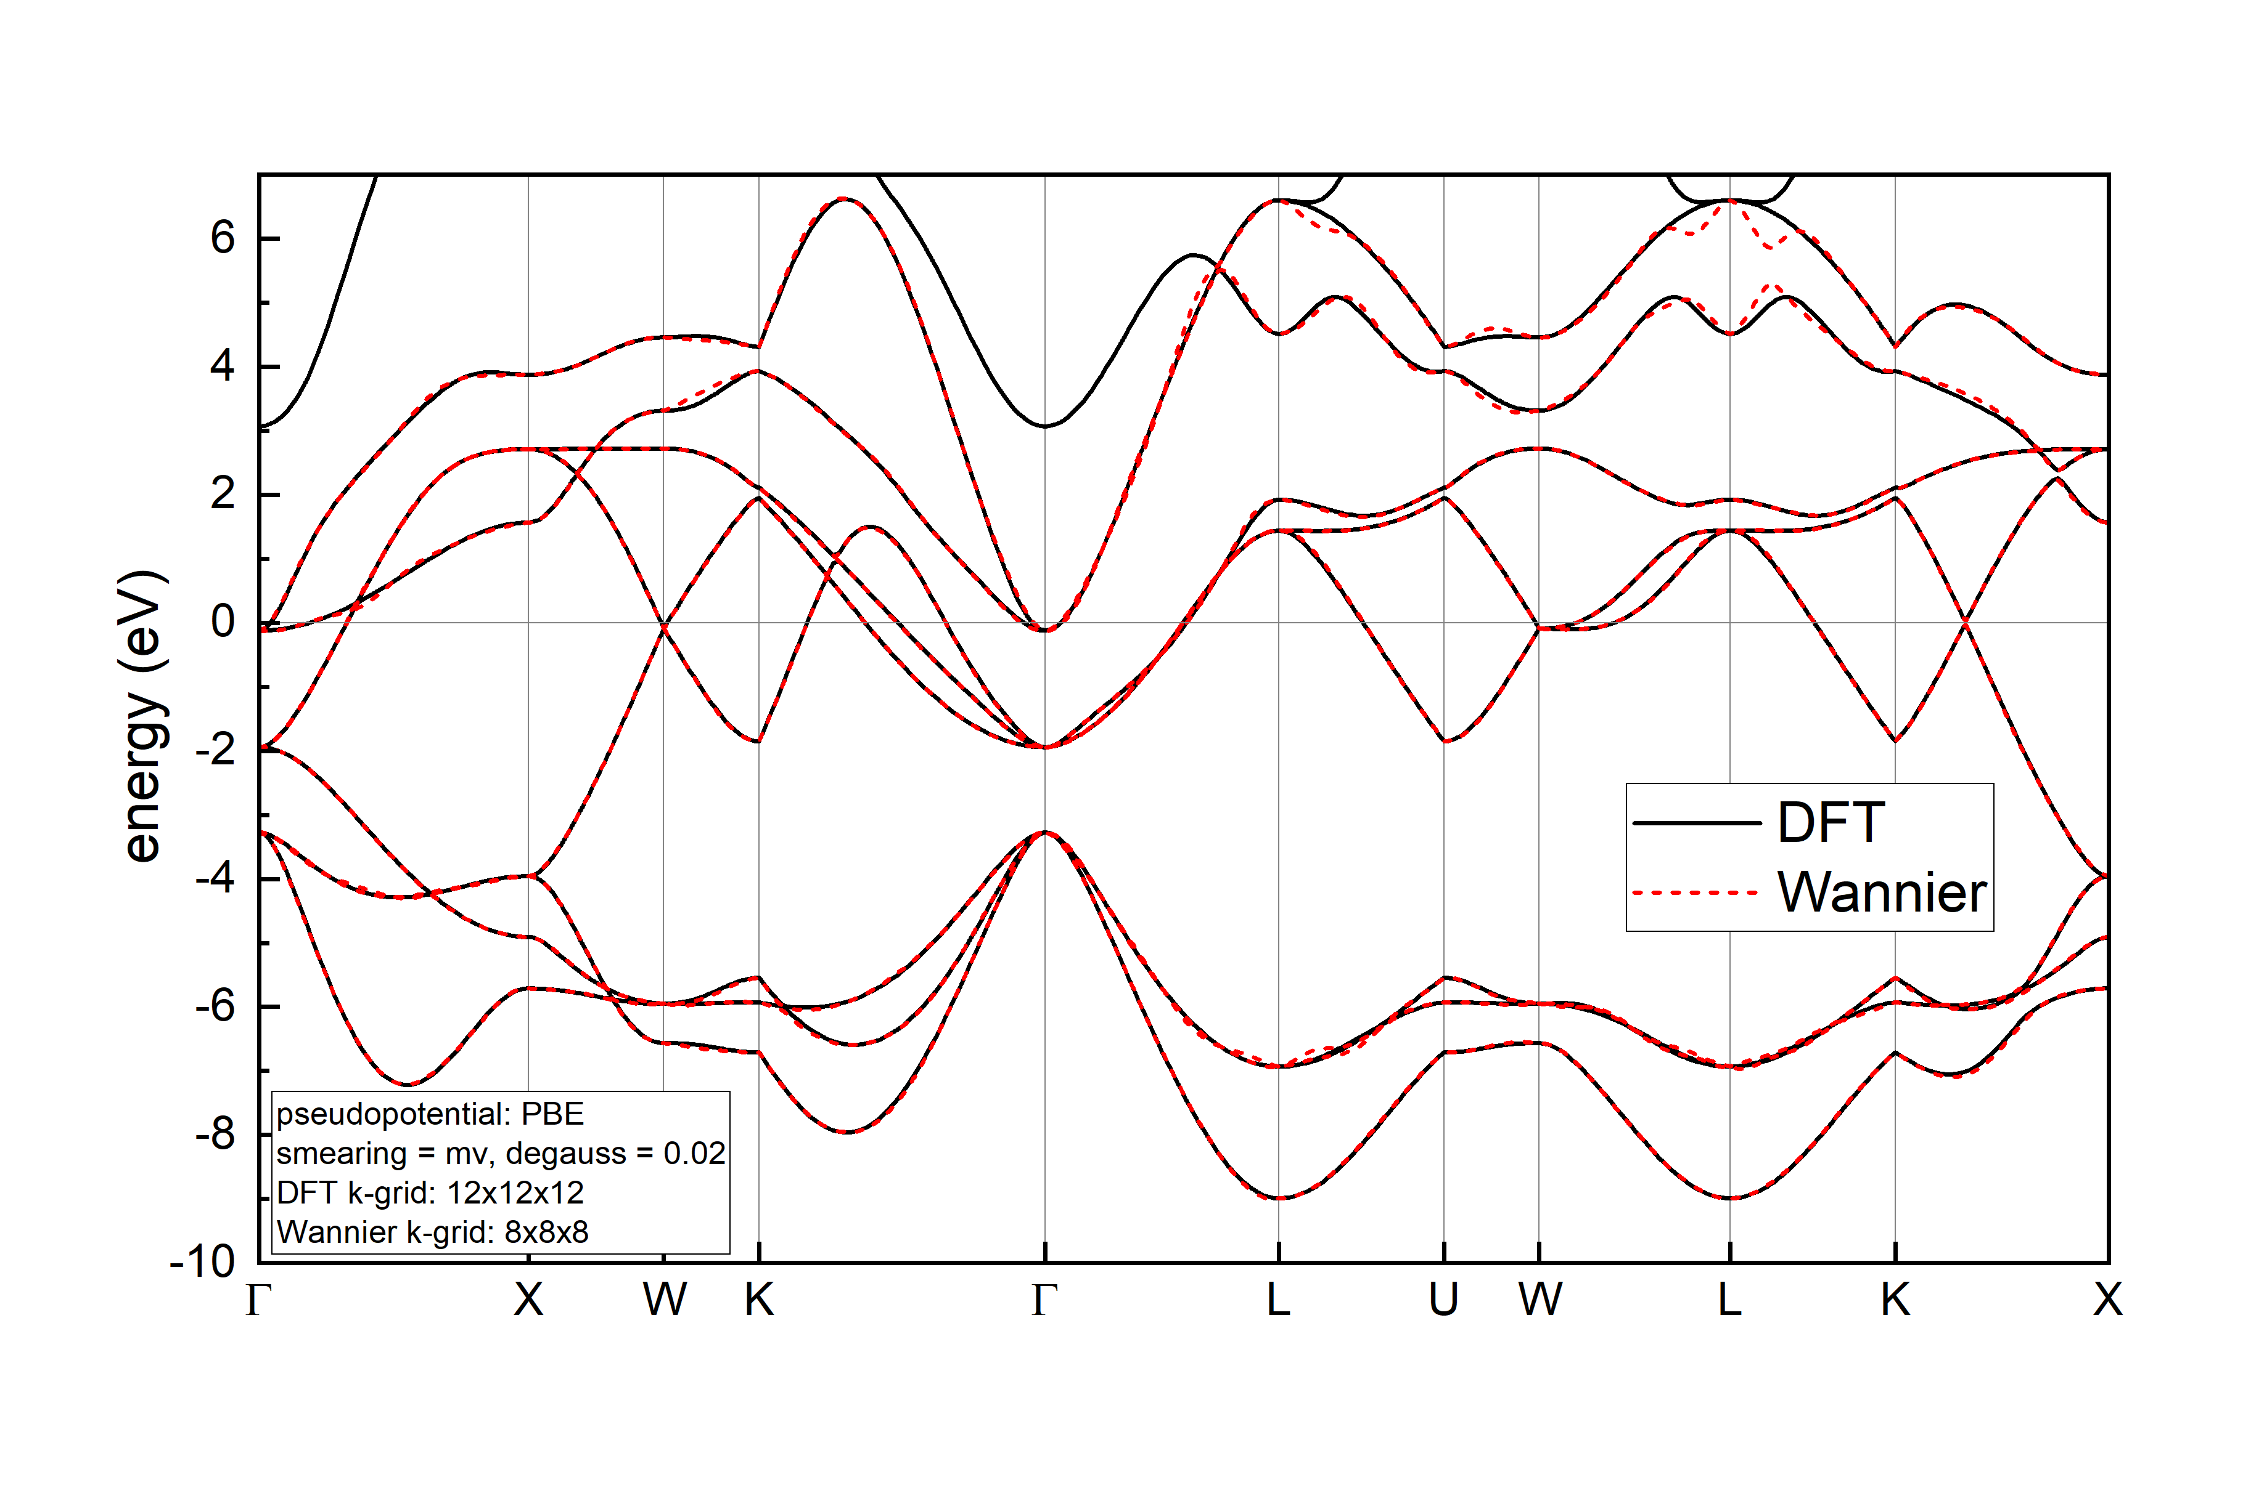
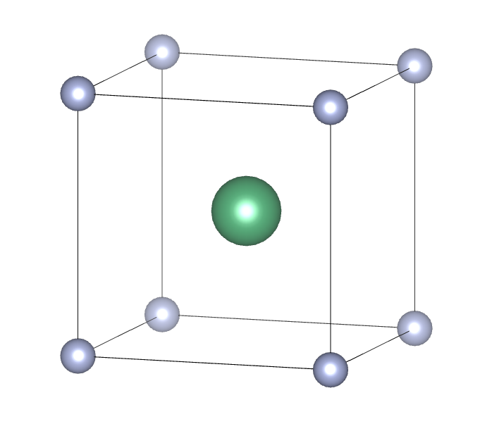




Crystal structure and electronic band structure of $δ$-NbN
Nb
N
unit cell of $δ$-NbN
Band structure of $δ$-NbN

Slide 4
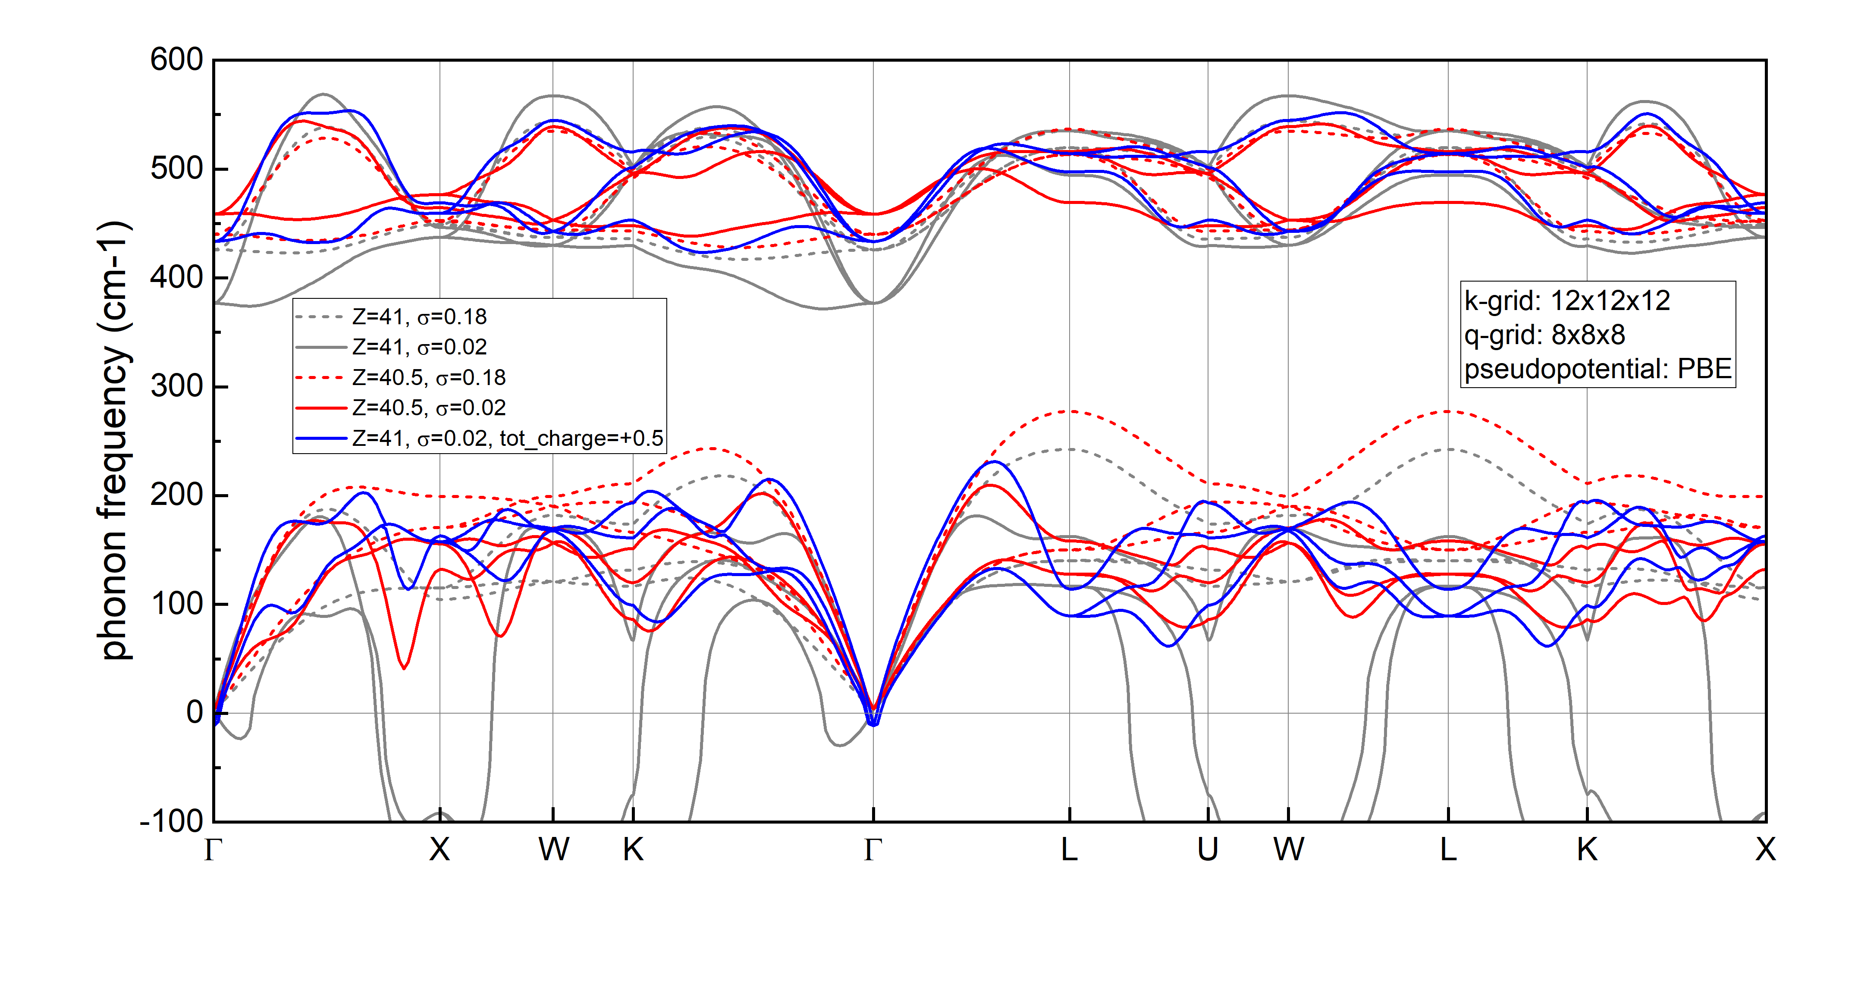

Phonon-dispersion of $δ$-NbN
Phonon instability issue can be avoided by using 1) a pseudopotential of Nb with 40.5 nuclear charge or 2) electrons taken out from the unit cell
phonon-dispersions calculated by ph.x using different smearing and pseudopotentials

Slide 5
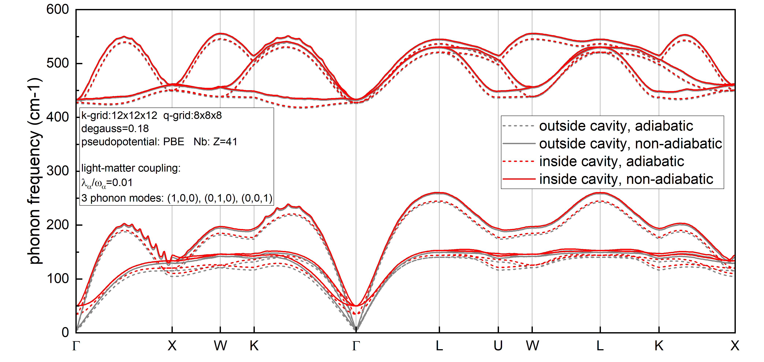
Phonon-dispersion of $δ$-NbN
Adiabatic phonon calculated by ph.x, non-adiabatic phonon calculated by EPIq. Non-zero frequencies at gamma point are probably caused by numerical error. Following Eliashberg function calculations show that this does not affect T_{c} much.
phonon-dispersion of $δ$-NbN inside and outside a cavity

Slide 6
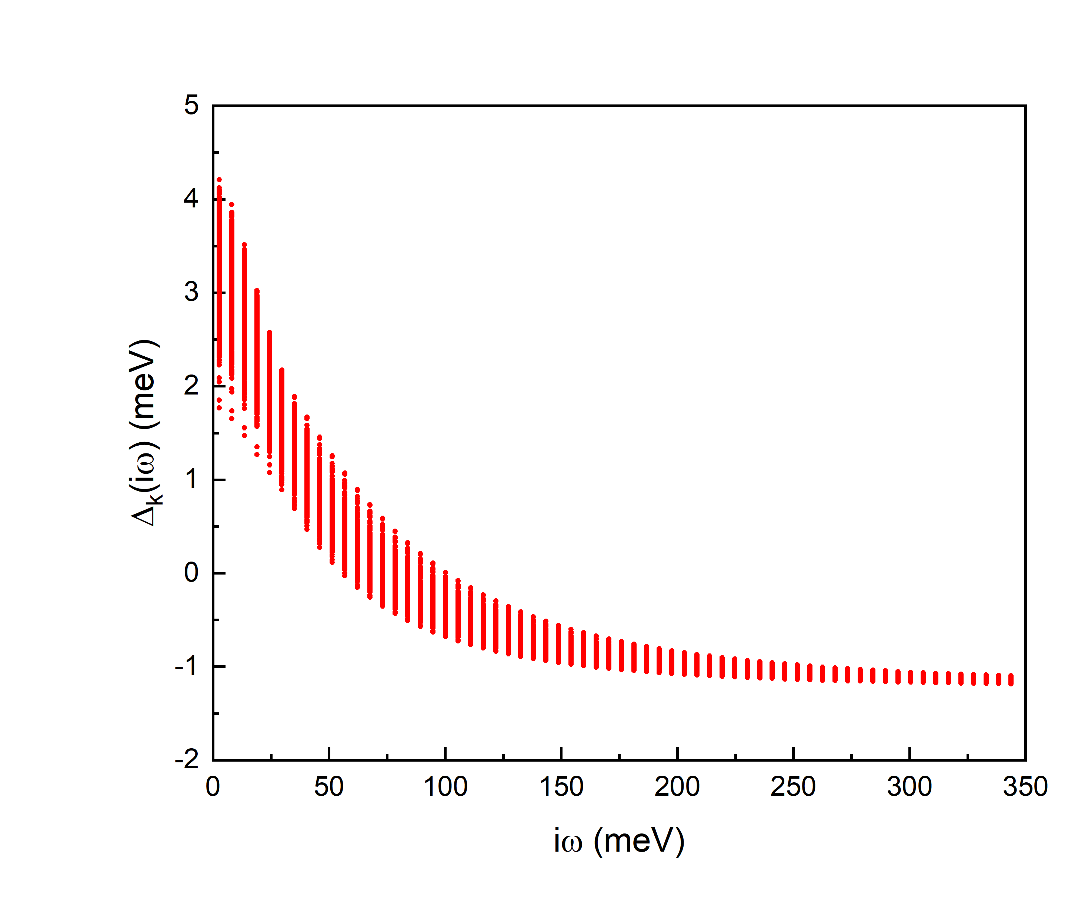
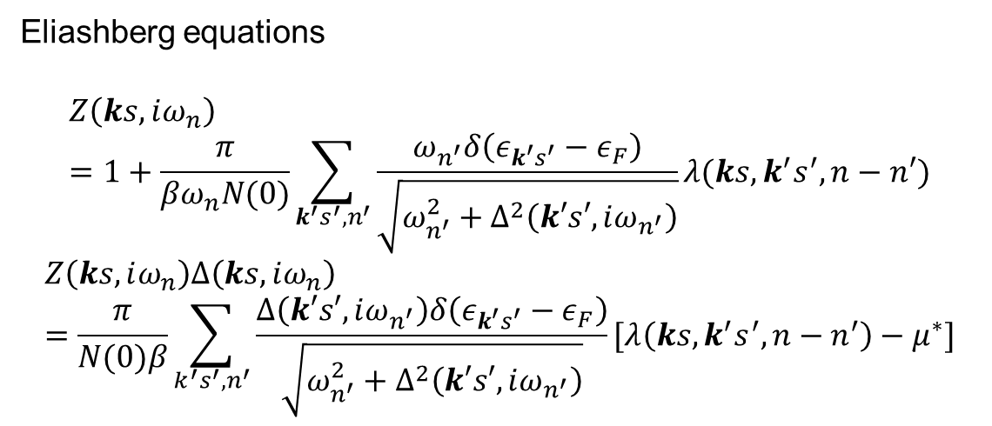
Anisotropic superconducting gaps
Anisotropic superconducting gaps from the anisotropic Midgal-Eliashberg equations shows that the superconducting gaps are isotropic => use the isotropic Eliashberg equations to reduce computational cost
Eliashberg equations
$$Z\left(ks,iω_{n}\right)=1+\frac{π}{βω_{n}N(0)}\sum_{k^{′}s^{′},n^{′}}{\frac{ω_{n^{′}}δ\left(ε_{k^{′}s^{′}}−ε_{F}\right)}{\sqrt{ω_{n^{′}}^{2}+Δ^{2}\left(k′s′,iω_{n^{′}}\right)}}λ(ks,k^{′}s^{′},n−n′)}$$
$$Z\left(ks,iω_{n}\right)Δ\left(ks,iω_{n}\right)=\frac{π}{N(0)β}\sum_{k^{′}s^{′},n^{′}}{\frac{Δ\left(k′s′,iω_{n^{′}}\right)δ\left(ε_{k^{′}s^{′}}−ε_{F}\right)}{\sqrt{ω_{n^{′}}^{2}+Δ^{2}\left(k′s′,iω_{n^{′}}\right)}}}[λ\left(ks,k^{′}s^{′},n−n^{′}\right)−μ^{∗}]$$
k-resolved superconducting gap of 𝛿-NbN calculated by anisotrpic Eliashberg equations

Slide 7
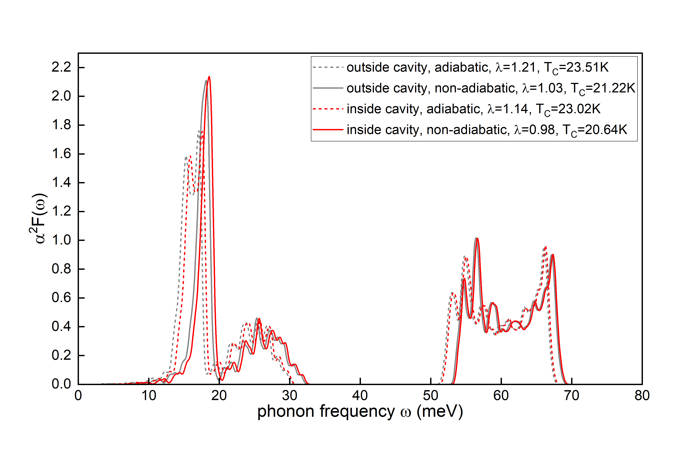
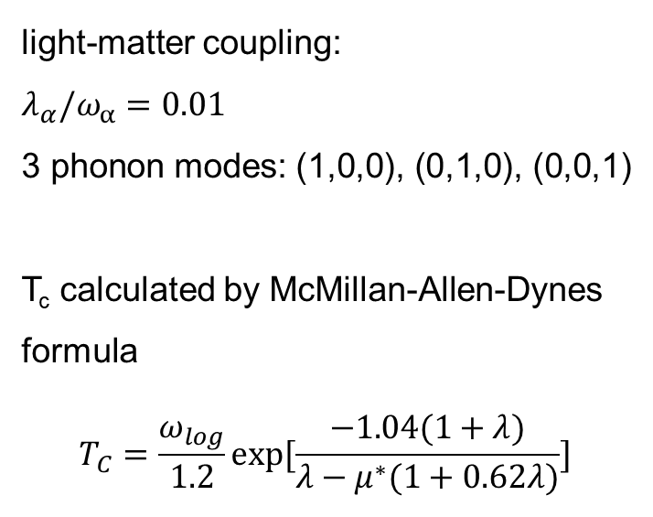
Isotropic Eliashberg spectral function, electron-phonon couplings, and superconducting temperature
light-matter coupling:
$$λ_{α}/ω_{α}=0.01$$
3 phonon modes: (1,0,0), (0,1,0), (0,0,1)
T_{c} calculated by McMillan-Allen-Dynes
formula
$$T_{C}=\frac{ω_{log}}{1.2}exp⁡[\frac{−1.04(1+λ)}{λ−μ^{∗}(1+0.62λ)}]$$

Slide 8
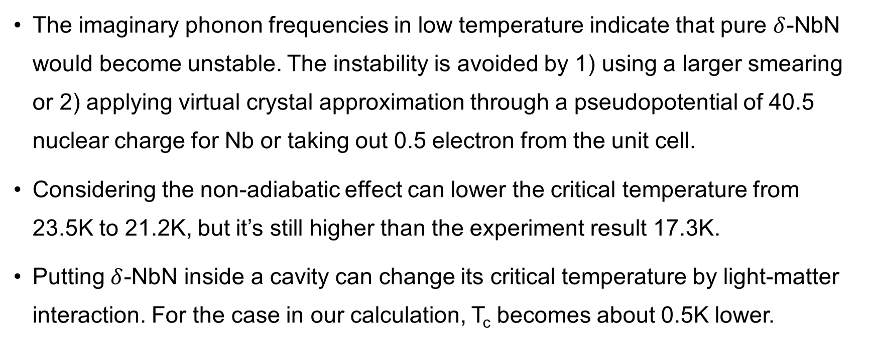
Summary of this project
The imaginary phonon frequencies in low temperature indicate that pure $δ$-NbN would become unstable. The instability is avoided by 1) using a larger smearing or 2) applying virtual crystal approximation through a pseudopotential of 40.5 nuclear charge for Nb or taking out 0.5 electron from the unit cell.
Considering the non-adiabatic effect can lower the critical temperature from 23.5K to 21.2K, but it’s still higher than the experiment result 17.3K.
Putting $δ$-NbN inside a cavity can change its critical temperature by light-matter interaction. For the case in our calculation, T_{c} becomes about 0.5K lower.

