Slide 1
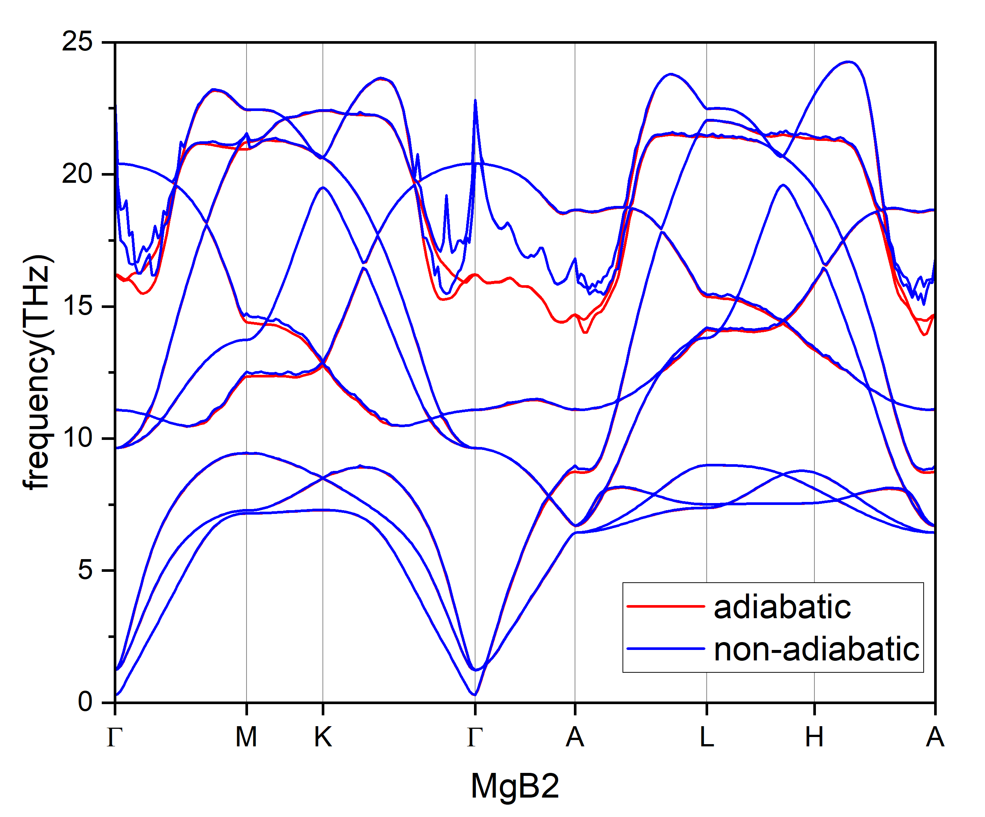
input file from
epiq-EPIq-1.1/tutorials/mgb2/input_examples
q-points 6x6x4
asr: no
SCF calculation：
k-points 16x16x12
ecutwfc=35
smearing=methfessel-paxton
degauss=0.025
functional PBE
Pseudopotential from tutorials

Slide 2
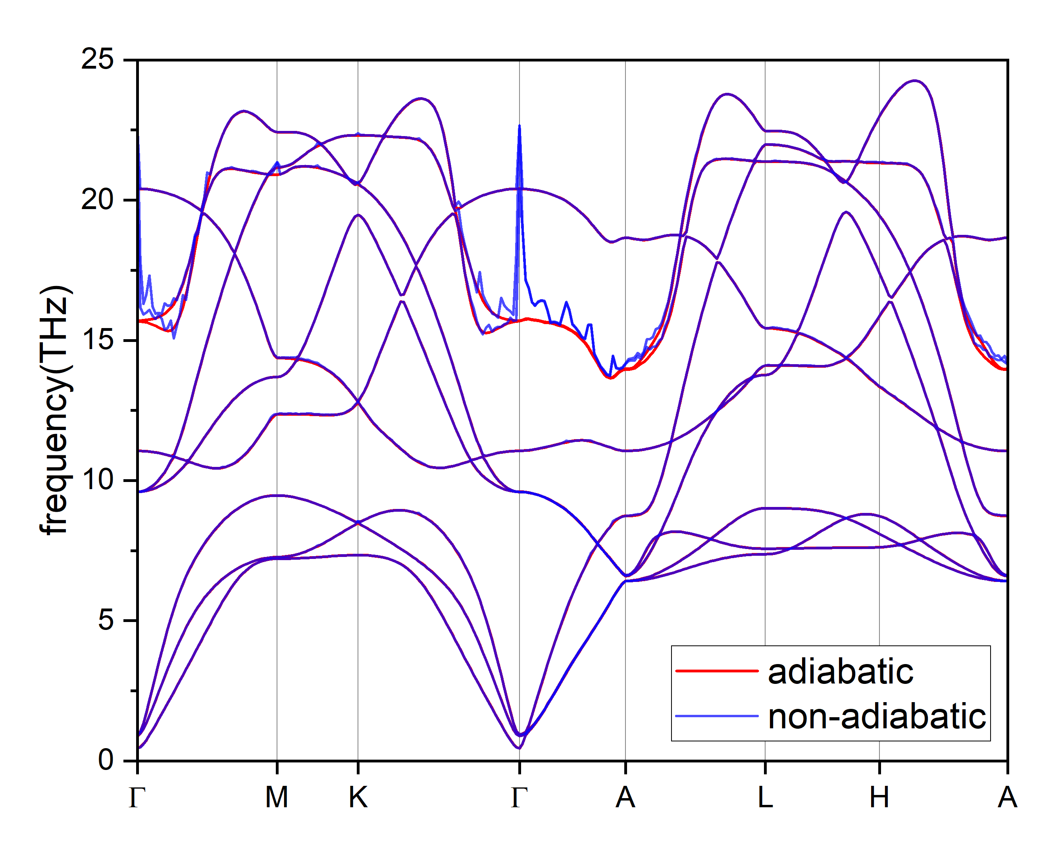
broad_min=0.0005
q-points 6x6x4
asr: no
k-points 24x24x18
Ecutwfc=50
smearing=methfessel-paxton
degauss=0.025
functional PBE
Pseudopotential from tutorials

