Slide 1
@
CPS 3320 · COURSE PROJECT GROUP10
Email Spam
Classifier.
A Keras neural network for ham / spam email detection,
built end-to-end from raw CSV to a Tkinter prediction GUI.
Yunxi Zhao
1307816
Qiyang Yu
1306031
Source
spam_classifier / SpamEmailClassifier.py

Slide 2
01 · OVERVIEW
Project Concept, Structure, and Contribution
Idea · class & function layout · what I personally built.
01
02
03
Project Concept
Code Structure
My Contribution
Goal. Classify email text as ham or spam.
The pipeline follows a professor-style AI workflow: read data → split → vectorize → build NN → train → evaluate → predict.
Output is fully usable: saved model, vocabulary, evaluation reports, and charts.
Connected raw CSV email data to a working neural-network classifier.
Key work:
· data cleaning & label mapping
· bag-of-words vectorization (1500 features)
· 8 hand-crafted risk signals
· Keras model & metric calculation
· model save / load + GUI prediction
main.py
launches the Tkinter GUI.
gui.py
buttons · progress · metrics · manual predict.
SpamEmailClassifier.py
read_dataset() · separate_data() · normalize() ·
build_my_model() · train_my_model() ·
evaluate_model() · predict_message()
Email Spam Classifier · CPS 3320
2 / 9

Slide 3
02 · DATA
How I Handled the Dataset
Processing and feature engineering before neural-network training.
83,448
39,538
43,910
20%
42
TOTAL ROWS
HAM
SPAM
TEST SPLIT
RANDOM SEED
Cleaning and Label Preparation
Text-to-Number Features
1 Read combined_data.csv with pandas.
2 Auto-detect text & label columns.
3 Keep only text + label; drop missing rows.
4 Map labels: ham → 0, spam → 1.
5 train_test_split(test_size=0.2, random_state=42, stratify=label).
CountVectorizer builds 1500 word-count features (lowercase, English stop-words, alphabetic tokens).
Plus 8 hand-crafted risk signals: url, digit, offer, urgency, action, money, delivery, security.
1500 words + 8 signals = 1508 features
Email Spam Classifier · CPS 3320
3 / 9

Slide 4
03 · MODEL
How I Built the Neural Network
Keras Sequential — Dense(48, ReLU + L2) → Dense(1, sigmoid).
Input
Dense (hidden)
Output
1508 features
48 units
1 unit
1500 word counts
+ 8 risk signals
ReLU activation
L2 regularization
Sigmoid
P(spam)
Training setup
Generalization
Saved assets
Loss
binary_crossentropy
L2
0.0001 on Dense layers
my_model.keras
trained model weights
Optimizer
Adam, lr = 0.001
EarlyStop
patience = 3 (val)
vocabulary.json
CountVectorizer vocab
Epochs
10 · batch 128
Validation
split = 0.2
Email Spam Classifier · CPS 3320
4 / 9

Slide 5
04 · RESULTS
What Results I Obtained
Saved evaluation on 16,690 held-out test messages.
0.9829
0.9791
0.9886
0.9838
0.9975
ACCURACY
PRECISION
RECALL
F1-SCORE
AUC
Confusion matrix
Interpretation
Predicted Ham
Predicted Spam
Correctly identified 8,652 spam and 7,753 ham emails.
F1 = 0.9838 shows balanced precision and recall.
AUC = 0.9975 indicates very strong separation between ham and spam probabilities.
False positives: 185 False negatives: 100
Actual
Ham
7,753
185
TN
FP
Actual
Spam
100
8,652
FN
TP
Email Spam Classifier · CPS 3320
5 / 9

Slide 6
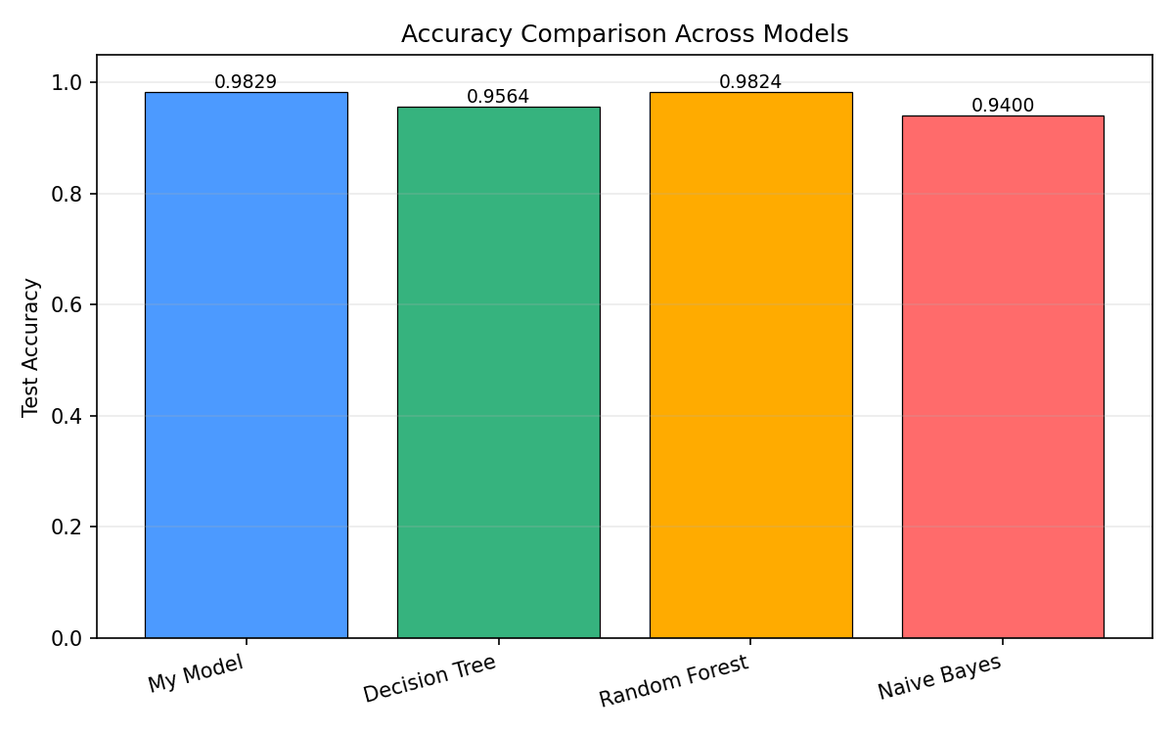
05 · DESIGN CHOICES
Neural Network Modification & Comparison Choice
Was the network modified or compared with known algorithms?
01
02
03
MODIFICATION
MODIFICATION
COMPARISON
Stronger Inputs
Better Generalization
vs. Other Algorithms
The network does not receive raw text directly.
Each email is converted to:
· 1500 bag-of-words counts
· 8 hand-crafted spam-risk signals
This combines vocabulary evidence with domain knowledge before training begins.
Two complementary regularizers keep the model honest:
· L2 on every Dense layer
· EarlyStopping (patience = 3)
Reduces overfitting while keeping the architecture easy to explain in class.
Same train / test split, same features.
Email Spam Classifier · CPS 3320
6 / 9

Slide 7
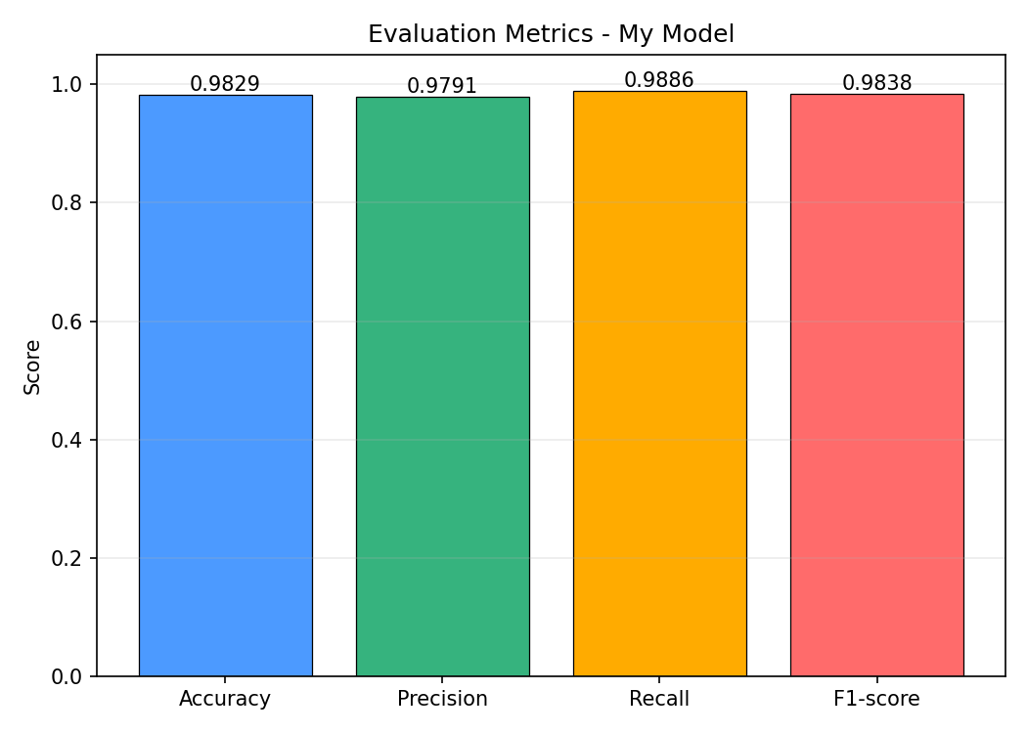
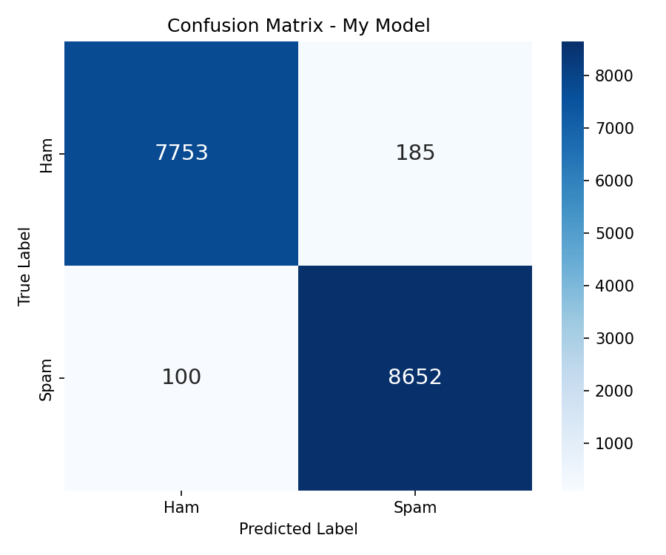
06 · VISUALIZATION I
Results & Statistics Visualization · I
Required: loss function, accuracy, precision, recall, F1, AUC, and confusion matrix.
Loss function: binary_crossentropy · Scores are taken from the saved model evaluation; AUC is computed on test probabilities.
TN 7,753 · FP 185 · FN 100 · TP 8,652
Diagonal cells (correct) shown in green; off-diagonal errors in red.
Email Spam Classifier · CPS 3320
7 / 9

Slide 8
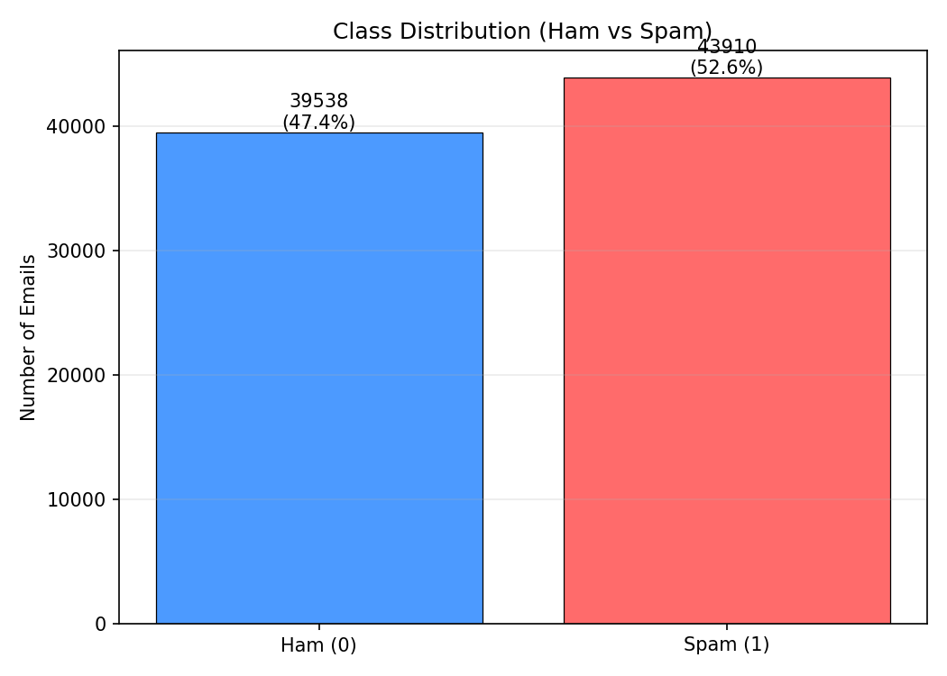
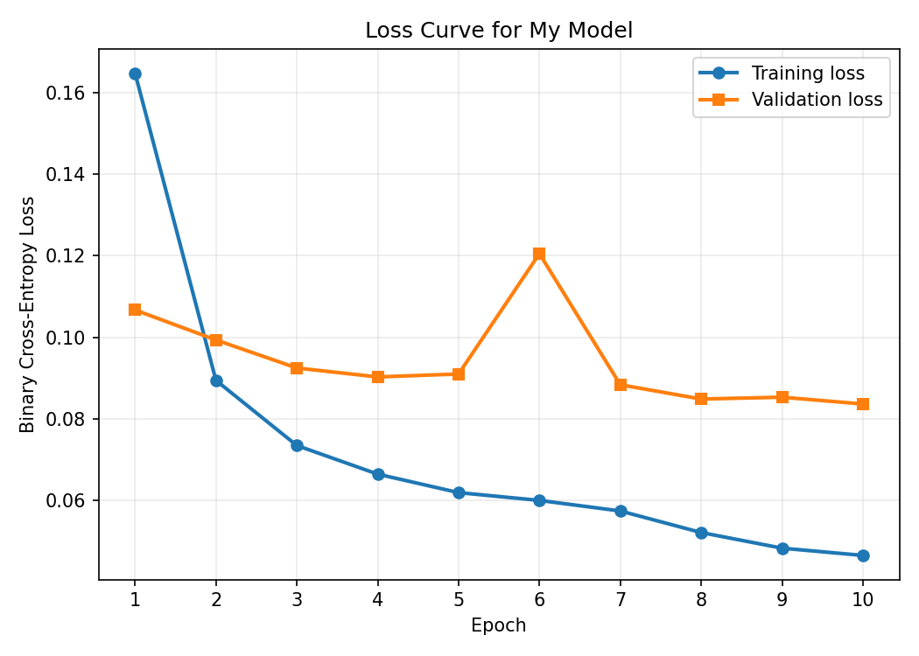
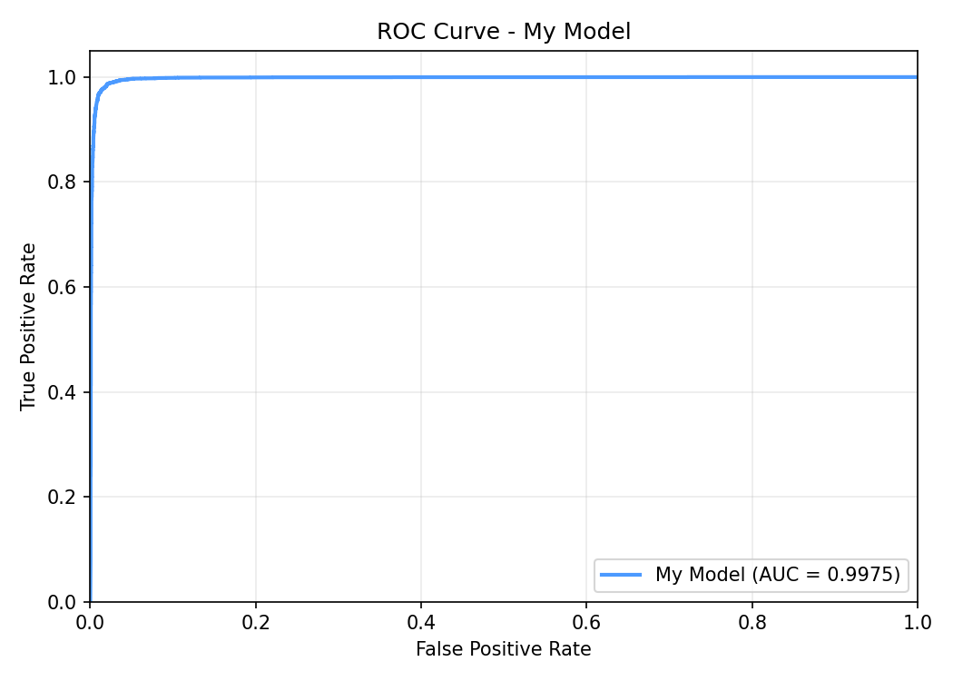
07 · VISUALIZATION II
Results & Statistics Visualization · II
Before · during · after training — dataset balance, loss curve, and ROC.
Before training · nearly balanced classes after cleaning.
During training · val-loss bottoms at epoch 7 — EarlyStopping triggers next.
After training · AUC 0.9975 · near-perfect ham / spam separation.
Email Spam Classifier · CPS 3320
8 / 9

Slide 9
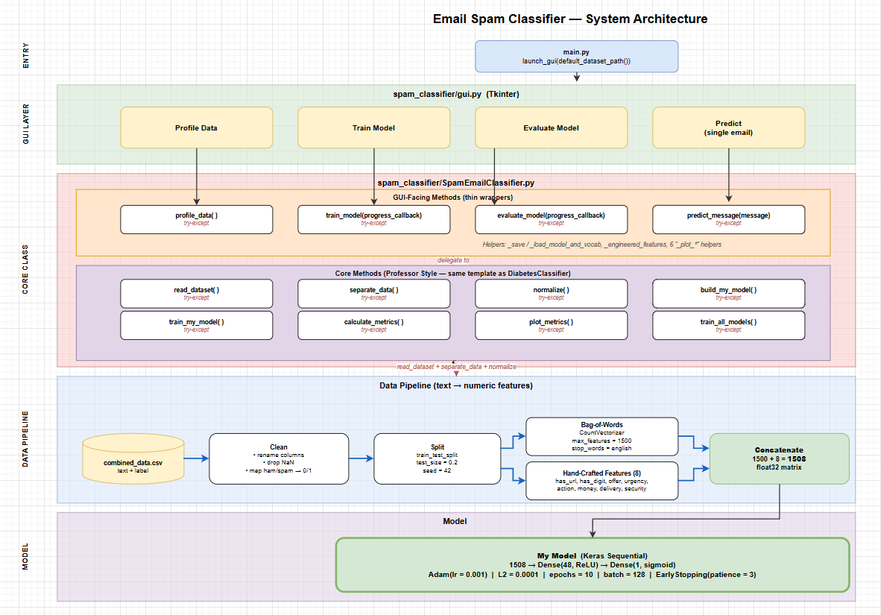
08 · APPENDIX
Email Spam Classifier · CPS 3320
9 / 9

