Slide 1
1995年SEI统计，美国共取消了810亿美元的商业软件项目，其中31％的项目未做完就被取消，53％的软件项目进度通常要延长50%的时间，只有9％的软件项目能够及时交付并且费用也控制在预算之内。
2000年Tech Republic公司发表了有关IT项目的调查结果。该调查是以北美的1375个IT专家为对象实施问卷调查进行的。根据此调查，IT项目中有40%失败，这些项目的平均成本每年花费100万美元。（近十年来软件成功率提高了，失败率降低了，但同时软件工程利润下降了【见下页图】）
……, if a postmortem were to be conducted for every project, it is very likely that a consistent theme would be encountered: project management was weak ！
问题: 1.什么是软件项目管理？
2.软件项目管理的内容是什么？
3.如果我是项目经理，我应该做什么？
4.我可以胜任软件项目管理吗？

Slide 2



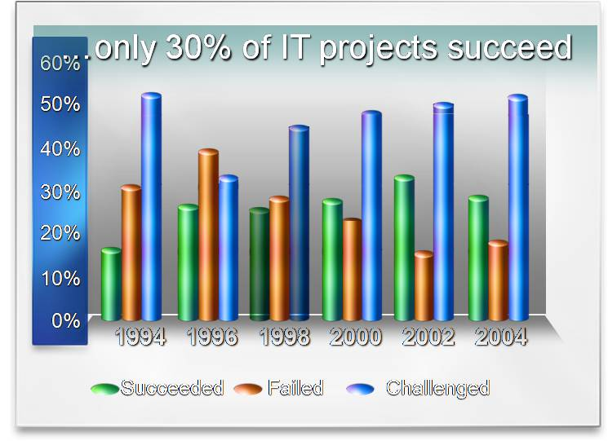


Are we getting better?
Cost overruns down over 100%
200%
150%
100%
50%
0%
1994 1996 1998 2000 2002 2004
Percent Overrun
Source: Standish Group, 2004 Third Quarter
Research Report, CHAOS Research Results
Good news!
  It now costs less to fail

Slide 3
Chapter 3 Planning and Managing the project
Notes: A: the position in SE(本章内容在SE中的位置)
B: cost/effort(工作量) _{estimation}
time(完成时间)
C: goal of the chapter----necessary activities to
plan and manage a software developing project
Contents:
A: tracking project progress
B: project personnel and organization
C: effort and schedule estimation
D: risk management
E: using process modeling with project
planning

Slide 4
Chapter 3 Planning and Managing the project
3.1 Tracking Project Progress(项目进展情况跟踪)
1. Introduction:
project beginning: customer
A: meeting users discuss a need
developers
B: questions from customers (1---- 4 (P82))
understand the problem and the need ?
can ? ----大型/复杂项目需要一系列验证！
how long? how much ?----需深思熟虑 ！
project schedule (项目进度):
A: necessity: (to answer how long and how much )

Slide 5
Chapter 3 Planning and Managing the project
B: schedule : 项目进度是对特定项目的软件开发周期的刻
画。包括对项目阶段、步骤、活动的分解，对各个离散
活动的交互关系的描述，以及对各个活动完成时间及整
个项目完成时间的初步估算。 (P83)
C: SE approach: （by the way of system engineering）
analysis+synthesis documents/deliverables
^{generate} (1—5 see P83 )
途径之一 :
X：先确定提交物（一般性文档，功能模块的说
明，子系统的说明和展示，精确度的说明和展
示，可靠性、安全性或性能说明或展示文档）
Y：再确定完成上述提交物必须要执行的活动。
Z：弄清活动之间的彼此依赖关系。

Slide 6
Chapter 3 Planning and Managing the project
D: task：analysis of the project----important task
phases steps activities (P84 fig3.1)
E: notions:
X: activity(P83): 项目的一部分, 一般占用项目进度计划
中的一段时间。
Y: milestone: 指特定的时间点, 标志着活动的结束, 通常
伴随着提交物( milestone ≈deliverables )
F：significance of analyzing a project(P84--Segment 2)
---- we and customer will have a better grasp of
what is involved in building and maintaining a
system

Slide 7
Fig 3.1
Work breakdown structure
Activity1.1
Step 1
Activity1.2
Phase 1
Step 2
Activity1.3
:
:
Activity1.1
Project
Step 1
Activity1.2
Phase 2
Activity1.3
Step 2
:
:
:
Phase n
Step 1
Step 2
:

Slide 8
Chapter 3 Planning and Managing the project
2. Work Breakdown and Activity Graphs
(工作任务分解和活动图的含义)
drawback for purely work breakdown:
(单纯的任务分解的缺点)
activities(活动) v
interdependence(相互依赖性) x
concurrency(并发性) x

Slide 9
Chapter 3 Planning and Managing the project
activity graph（活动图）
A: meaning:describe activities and interdependencies
in which the nodes are the project milestones,
and the lines represent the activities involved.
B: several notions/parameters for describing an
activity: (P84)
precursor(前驱)—本次活动完成之前必须要完成的活动
duration(工期)—完成本次活动所需时间
due date(截止日期)—合同规定的本次活动的预定完成日
期
endpoint(终点)—活动完成的标志, 通常是里程碑/提交物
node(结点)—项目活动完成标志(里程碑).
line(线段)–-代表本次活动.

Slide 10
Chapter 3 Planning and Managing the project
C: explain about activity graph (P87—s1)
------(fig3.2)
------活动的阶段性和顺序性
------活动的并行性
------虚线的具体含义
D: significance: the parallel nature of tasks in activity
graph.

Slide 11
Request permit
START
surveying
1.2
1.1
excavation
1.3
Buy materials
1.4
Lay foundation
2.1
Install exterior plumbing
Build outside wall
2.3
3.1
2.2
Install interior plumbing
Install exterior electrical
Install interior electrical
2.4
3.2
Install exterior siding
Install wallboard
3.3
Paint interior
2.5
Paint exterior
Install flooring
3.5
2.6
Install roofing
3.4
Install interior doors and fixtures
Install exterior doors and fixtures
2.8
3.6
2.7
FINISH

Slide 12
Chapter 3 Planning and Managing the project
3. Estimating completion (估算项目完成时间)
improvement to activity graph
A: explain: adding information about estimated
duration（添加预估的权值信息）
B: Fig3.3 (P89)
 CP(critical paths): The paths can show us the minimum amount of time it will take to complete the project, given our estimates of each activity’s duration (根据每个活动持续时间的估算, 关键路径将能够标明完成项目所需的最少时间)
CPM: analyzing paths in graph find critical paths
master project progress/schedule
A: several notions

Slide 13
15
START
Estimating Completion
3
1.2
1.1
10
1.3
10
1.4
15
2.1
20
2.3
10
3.1
2.2
12
10
15
2.4
3.2
8
9
3.3
11
2.5
5
18
3.5
2.6
9
3.4
7
6
2.8
0
0
3.6
2.7
0
0
FINISH

Slide 14
Chapter 3 Planning and Managing the project
----available time, real time, slack time (P88)
Slack time=available time–real time(结合结点1.1和1.2)
B: computing for slack time, lastest start time,
earliest start time
slack time = lastest start time - earliest start time
steps of finding critical path (CP): (P89,90)
X: find earliest start time
Y: find latest start time
Z: computing for slack time (Table3.4)
C: CP(critical path ): slack time = 0 (P90)
D: influence ( by CP )
E: loops in activity graph(hard to estimate schedule)
F: transmutation to activity graph---Bar Chart(Fig 3.4)

Slide 15
Activity Earliest Start time Latest Start Time Slack time
1.1 1 13 12
1.2 1 1 0
1.3 16 16 0
1.4 26 26 0
2.1 36 36 0
2.2 51 51 0
2.3 71 83 12
2.4 81 93 12
2.5 91 103 12
为什么不是114 ?
2.6 99 111 12
2.7 104 119 15
2.8 104 116 12
3.1 71 71 0
3.2 83 83 0
3.3 98 98 0
3.4 107 107 0
3.5 107 107 0
3.6 118 118 0
Finish 124 124 0

Slide 16
Fig3.4 CPM bar chart
Description | Early Date | Late Date | Jan 1 | Jan 8 | Jan 15 | Jan 22 | Jan 29 | Feb 5 | Feb 12 | Feb 17 | Feb 24
Test of phase 1 | 1 Jan 98 | 5 Feb 98
Define test cases | 1 Jan 98 | 8 Jan 98
Write test plan | 9 Jan 98 | 22 Jan 98
Inspect test plan | 9 Jan 98 | 22 Jan 98
Integration testing | 23 Jan 98 | 1 Feb 98
Interface testing | 23 Jan 98 | 1 Feb 98
Document results | 23 Jan 98 | 1 Feb 98
System testing | 2 Feb 98 | 17 Feb 98
Performance tests | 2 Feb 98 | 17 Feb 98
Configuration tests | 2 Feb 98 | 17 Feb 98
Document results | 17 Feb 98 | 24 Feb 98
********************
*******
*******
*******
*******
--FFFFF
-----FFF
********* ***
-------- FFFFFFF
-------- FFFFFFF
****

Slide 17
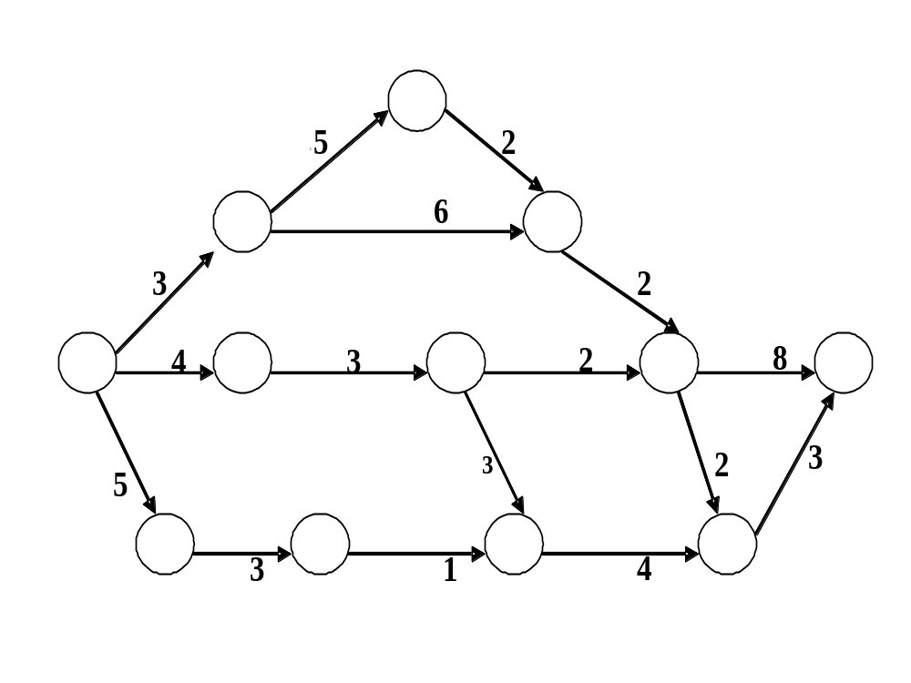

Slide 18
实例：针对上述活动图的“课程设计”目标
  基本功能：
    提供系统输入，建立各个活动图。
    存储活动图以备翻阅。
    关键路径的计算和展示。
  拓展功能：复杂图形展示、活动图的变形展示（甘特图等）
  设计要求：完善的测试计划与测试报告等（也许是工程设计重点）
  设计基础：掌握一定的树、图等二维结构的计算基础。

Slide 19
Chapter 3 Planning and Managing the project
4. Tools to track progress
focus on: project begin in “work breakdown” (Fig3.5)
-----many project management software can draw
these structures
several tools for tracking progress
(can also be drawn by project management software)
A:Gantt Chart X:meaning (dynamic graph)
Y:role --identify concurrent activities and CP
Z:explain to Fig3.6（甘特图）
B: resource histogram (Fig3.7)（资源直方图）
C: cost/expenditure graph ---Fig3.8（开销对比图）

Slide 20
Fig3.5 Example work breakdown structure
Build communications software
System planning (1.0)
System design (2.0)
Coding (3.0)
Testing (4.0)
Delivery (5.0)
Review specification (1.1)
Top-level design (2.1)
Review budget (1.2)
Prototyping (2.2)
Review schedule (1.3)
User interface (2.3)
Develop plan (1.4)
Detailed design (2.4)

Slide 21
Work breakdown structure
Review specification (1.1)
Review budget (1.2)
Review schedule (1.3)
Develop plan (1.4)
System planning (1.0)
Build communication software
System design (2.0)
Top-level design (2.1)
Prototyping (2.2)
User interface (2.3)
Detailed design (2.4)
Coding (3.0)
Testing (4.0)
Delivery (5.0)

Slide 22
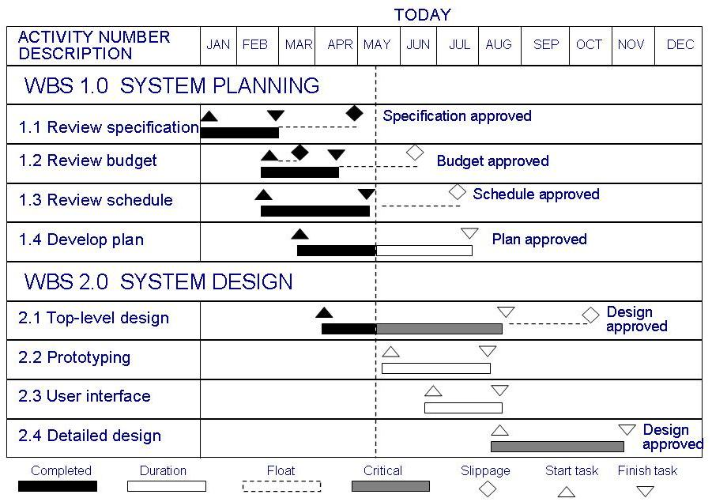
3.1 Tracking Progress
Tools to Track Progress: Gantt Chart
Activities shown in parallel
  helps understand which activities can be performed concurrently

Slide 23
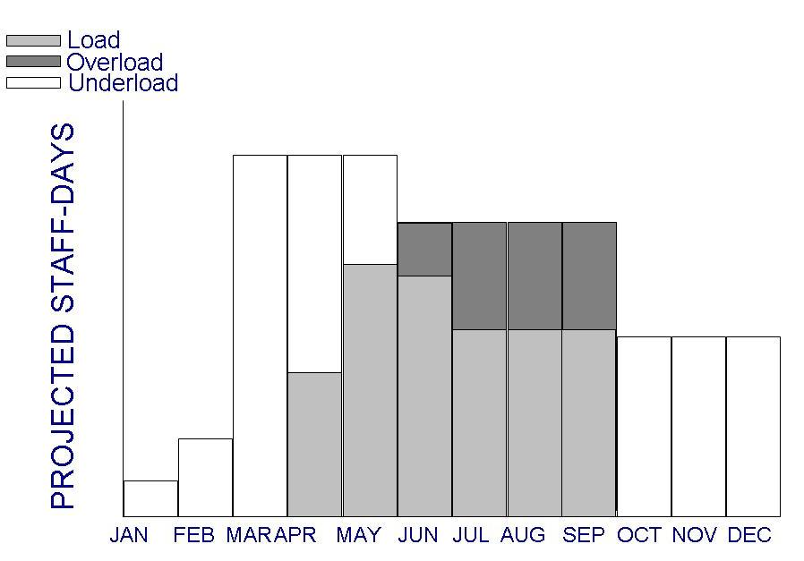
3.1 Tracking Progress
Tools to Track Progress: Resource Histogram
Shows people assigned to the project and those needed for each stage of development
People needed
People assigned

Slide 24
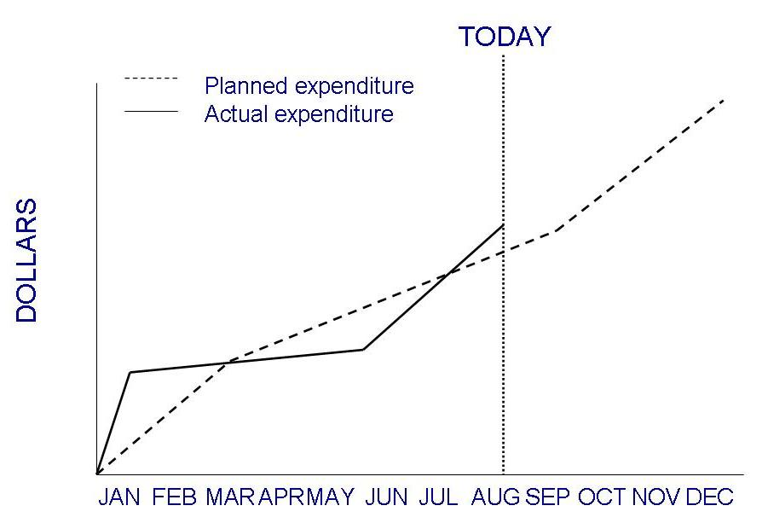
3.1 Tracking Progress
Tools to Track Progress: Expenditures Tracking
An example of how expenditures can be monitored

Slide 25
Chapter 3 Planning and Managing the project
3.2 Project Personnel(项目人事组织)
Brief Introduction:
project schedule need to _{project personnel}
costs estimation know
1. Staff Roles and characteristics(人员职责和特点)
key activities requiring personnel(关键活动需要特定职责和特点的团队成员)
Key activities (P95):
1. requirements analysis
2. system design
3. program design
4. program implementation

Slide 26
Chapter 3 Planning and Managing the project
5. testing
6. training
7. maintenance
8. quality assurance
Note:
A:neighbored activities performed by different staffs
B:test team independent
C:review by neighbored activity keep continuity
^{participators} double checking

Slide 27
Chapter 3 Planning and Managing the project
 choosing personnel (P96) ( 人员选择的要求 )
A: ability to perform work ---- (具体哪个方面的能力?)
B: interest in work (无论能力、经验还是兴趣等都强调
舒适度的感觉！)
C: experience
D: training
E: ability to communicate with others
F: ability to share responsibility
G: management skills
note: 图3.9----交流的途径很复杂，充分交流很不容易，而
交流程度和能力对项目进程有大的影响。
(根据图3.9可以看出软件项目不可以随便增加人手)

Slide 28

Fig3.9 Communication paths on a project
Two people
1 line of communication
Three people
3 lines of communication
Four people
6 lines of communication
Five people
10 lines of communication
n people
n(n-1)/2 lines of communication

Slide 29
Chapter 3 Planning and Managing the project
conclusion(P98)_{should}
project manager personnel’s interesting and ability,
^{know} experience, etc.
get workers working
together perfectly
2. Work styles (工作风格/方式) (P99)
 说明：人们的工作方式一般由两方面决定：
A： 交流思想和收集信息的方式；
B： 感情影响决策的程度。

Slide 30
Chapter 3 Planning and Managing the project
 Work styles
A: Extroverts（外向性格的人）: tell their thoughts
B: Introverts（内向性格的人）: ask for suggestions
C: Intuitive（感性的人）: base decisions on feelings
D: Rationales（理性的人）: base decisions on facts
or options
● advantages (of knowing work style)
A: be useful for communication and understanding
between colleagues or developers and customers
---- is critical to project success.
B: get best choice for workers(to perform task)
---- ( reasonable arrangement)
软件工程强调人性化管理

Slide 31
Fig3.10 Work styles
INTUITIVE
INTUITIVE
INTROVERT:
Asks others
Acknowledges feelings
INTUITIVE
EXTROVERT
Tells others
Acknowledges feelings
INTROVERT
EXTROVERT
RATIONAL
INTROVERT:
Asks others
Decides logically
RATIONAL
EXTROVERT
Tells others
Decides logically
RATIONAL

Slide 32
Chapter 3 Planning and Managing the project
3. Project organization（项目(团队)组织）
 Three factors (the choice of project structure depends on)
A: backgrounds and work styles of team members
B: number of people on team
C: management styles of customers and developers
 Examples---- organizational structure（组织结构）
A: chief programmer team（主程序员组） (IBM)
X: brief introduction (P101)
Y: advantages: (1) minimize communication
(2) making decisions quickly
B: egoless approach: making decision by all team
member, share responsibility by all team member

Slide 33
Fig3.11 Chief programmer team organization
Chief
programmer
Assistant chief
programmer
Senior
programmer
Librarian
Administration
Test team
Junior
programmers

Slide 34
Chapter 3 Planning and Managing the project
● 项目组织的结构化与创造性(Sidebar 3-2) （P103）
A: 结构化较强的团队: 能按时完成任务, 但工作比较循规蹈
矩, 完成的项目普通但功能完备 .
------ 一般当项目组人员较多、或项目有较高稳定性和一
致性时，使用较正规的结构。
B: 结构化较弱的团队: 经常性的不能按时完成任务, 但“未
经组织的小组总是具有令人难以置信的创造性” . 但有
很多时候这样的团队难以管理 .
------ 一般项目涉及大量的不确定性因素时，采用较为民
主的方法和相关的团队结构。事实上，很多软件
创新是由这样的团队来完成的，如”微信”的开发。

Slide 35
Chapter 3 Planning and Managing the project
3.3 Effort estimation（工作量估算）
1. Introduction
 importance for cost estimation(费用估算)
A: it’s a crucial aspects in project plan stage
_{cost overrun(超限)}
B: inaccurate estimate _{cost underestimates(过低)}
C: there are many reasons for inaccurate estimate
D: good cost estimate help manager to make
appropriate arrangement
 several types of costs [软件项目成本的类型]
A: facilities costs(设施成本): provide the physical
environment
Sidebar 3.3

Slide 36
Chapter 3 Planning and Managing the project
B: project costs: involve purchasing software and
(项目成本) tools to support development , and
efforts/payload（工作量/工资）
(为支持软件开发而购买软件和工具的开支,用于支持需求分
析,设计,编码,测试,处理需求变更等等,另外加上工作量开支)
C: effort（工作量）（is a large part in project costs）
----staff days / staff months / staff years
----flexible cost ( 软成本/软费用/可变成本 )
● uncertainty（不确定性） of cost estimation
---- (see fig3.12: estimation should be done
repeatedly throughout the life cycle )
❍ focus on: ---- effort （工作量）(in later sections)

Slide 37
4x
* Size(SLOC)
+ Cost($)
2x
*
+
*
1.5x
*
+
+
*
1.25x
*
+
+
+
x
*
*
+
*
+
+
*
+
+
*
0.5x
*
+
*
Product design specs.
Detailed design specs.
Concept of operations
Requirement specs.
Accepted software
0.25x
feasibility
Plans& requirement
Product design
Detailed design
Development& test

Slide 38
Chapter 3 Planning and Managing the project
2. Expert judgment（专家评判法）
 explain: effort estimation----rely on expert’s judgment
(accuracy –rely on competence, experience, objectivity, etc.)
 analogy(类推法):A(have completed) B(will perform)
formula: (x+4y+z)/6
● Delphi technique(Delphi 技术)
results from several experts get average
❍ Wolverton model (Wolverton 模型) (P102, table3.6)
O---old, N---new; E---easy, M---moderate, H---hard
■ drawback(该方法的缺点)
----variability(可变性) and subjectivity(主观性)
----influenced by current data(当前经验数据)

Slide 39
Wolverton model software cost matrix
Difficulty
Type of software OE OM OH NE NM NH
Control 21 27 30 33 40 49
Input/output 17 24 27 28 35 43
Pre/post procedure 16 23 26 28 34 42
Algorithm 15 20 22 25 30 35
Data management 24 31 35 37 46 57
Time-critical 75 75 75 75 75 75
Old and Easy I/O module: 100 LOC
New and Hard Algorithm module: 200 LOC
Old and Medium Data management module: 100 LOC
A system
Cost=(100×17)+(200 ×35)+(100 ×31)=11800$

Slide 40
Chapter 3 Planning and Managing the project
3. Algorithmic methods（算式估算法）
 basic equation : E = (a + bS^{c}) m(X) （各因子的含义）
 Walston and Felix model: (IBM)
E = 5.25S ^{0.91} E = 5.25S ^{0.91} m(X) (table3.7)
● Bailey and Basili model ( meta-model )
A: E = (5.5 + 0.73S^{1.16}) m(X)
R=E(actual effort) / E’(predicted effort)
ERadj =R – 1 if R > 1
^{=1 – 1/R if R < 1}
Eadj = (1 + ERadj)E if R > 1
= E /(1 + ERadj) if R < 1
B:note: project A (finished) project B(will be realized)
元模型
Project A has finished
Use on next project B

Slide 41
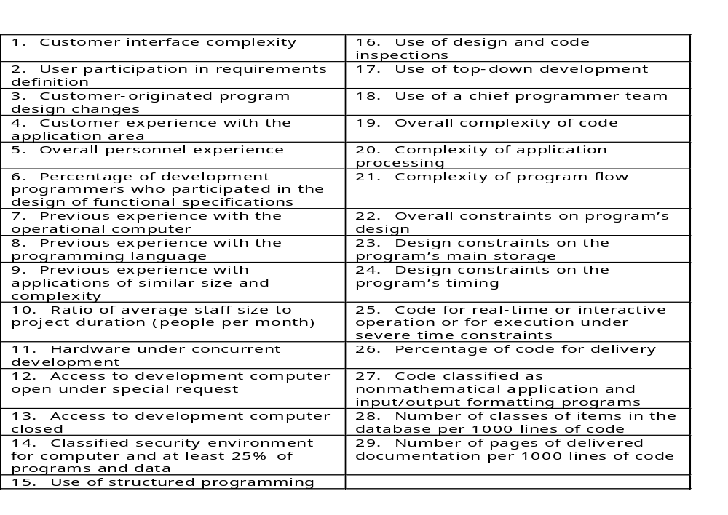

Watson and Felix Model Productivity Factors

Slide 42
Chapter 3 Planning and Managing the project
❍ COCOMOⅡ(Constructive Cost Model) (1990s)
--------introduce basic thought
A: note: giving estimation at beginning (P111)
get three normal estimation in software
process (at least)
B: stage 1: E = bS^{c} m(X) (plan stage)
X: projects build prototypes to resolve high-risk
issues involving user interfaces, software and
interaction, performance, or technological
maturity.
Y: Size estimation---by AP(应用点)----估算的屏幕
数、报表数、组件数等

Slide 43
Chapter 3 Planning and Managing the project
Z: m(X)----see table3.9
W: other ---- see table 3.10, 3.11（根据应用点的复
杂性等级，进行加权调整）
C: stage 2: E = bS^{c} m(X) (in early design) (P111, P112)
X： the designers must explore alternative
architectures and concepts of operation
Y：Size estimation---by FP(需求文档中的功能点)
Z：m(X)----see table3.9,
others----see table 3.12

Slide 44
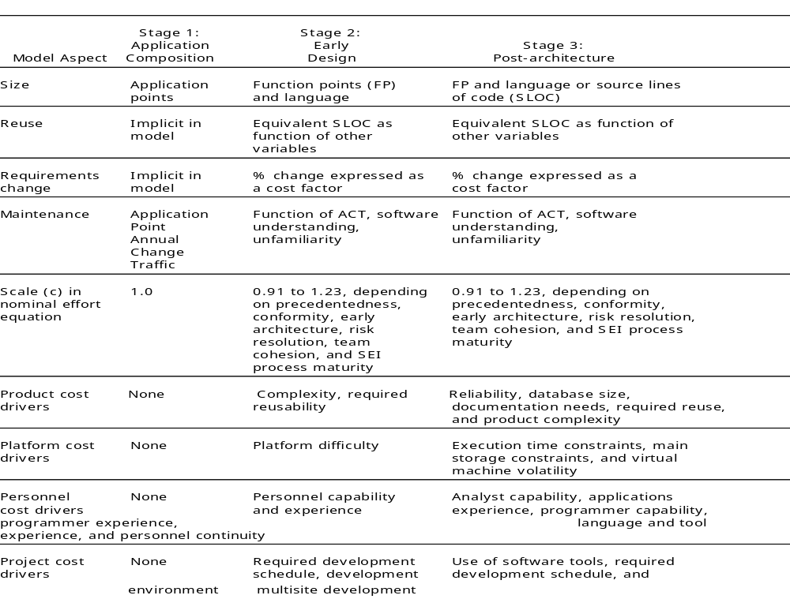

Slide 45
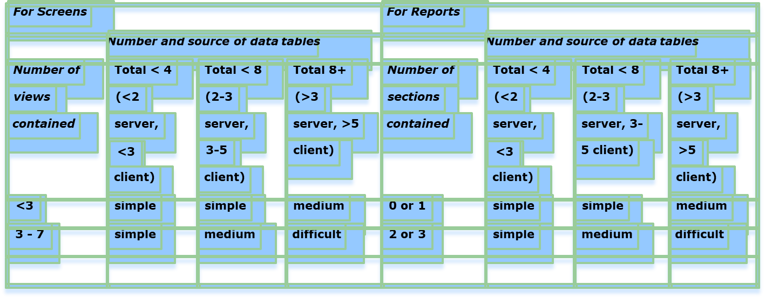
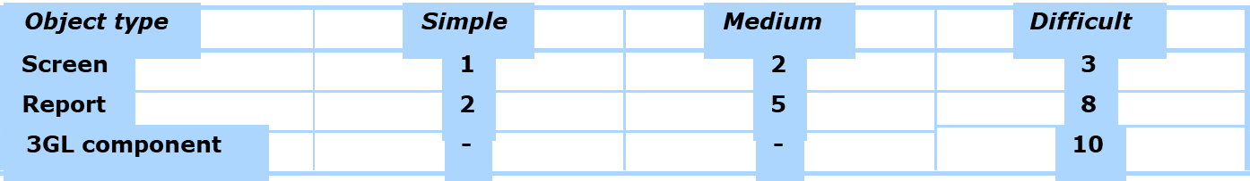
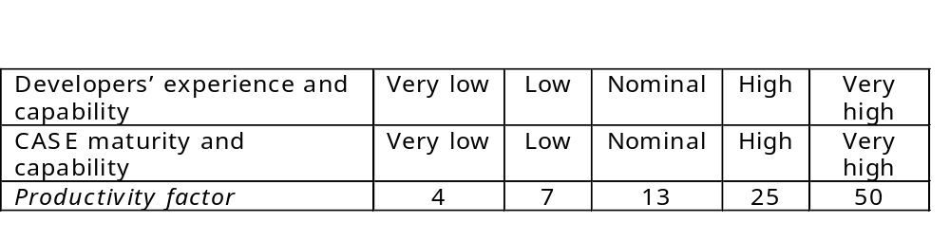

Slide 46
D: stage 3: E = bS^{c} m(X)
--------postarchitecture (P111, P114)
X：project is under developing，software is
partially implemented 。
Y：Size estimation---by FP(需求文档中的功能点)
+LOCs
Z：m(X)----see table3.9, others----see table 3.13
E: note: using the model should consider own
situation ，then make tailoring (P115)

Slide 47
Chapter 3 Planning and Managing the project
4. Finding the Model for Your Situation
------- (Evaluating Models)
Mean magnitude of relative error (MMRE)
(MMRE: 相对误差的平均幅度)
  A:---- absolute value of mean of
    [(actual - estimate)/actual]
  B: goal: should be 0.25 or less (≦0.25)
Pred(x/100):
A:percentage of projects for which estimate is within
x% of the actual (估算实际值在x%范围内的项目的百
分比)
B:goal: should be 0.75 or greater for x = .75 (≧0.75)

Slide 48
Chapter 3 Planning and Managing the project
3.4 Risk management
Cause:项目管理所涉及的远非仅仅是工作量和项目进度跟踪,
而是更要有一套完整的应对意外事件(风险)的计划.
1. What is risk
 notion: ----risk (P119)
(在软件生产过程中不希望看到的、有负面结
果的事件）
----risk management
（了解和控制项目风险的各种活动）
aspects (the risk involves)
A：与该事件有关的损失 （Risk impact----风险影响）
B：事件发生的可能性
（Risk probability----风险概率 ----the likelihood）

Slide 49
Chapter 3 Planning and Managing the project
C：我们能改变结果的程度( the degree to which we can
change the outcome )
Risk control----风险控制 ---- a set of actions
taken to reduce a risk
Risk exposure = (risk probability) x (risk impact)
(风险成本)
● Boehm’s top ten risk items
(P119 siderbar3.4 )

Slide 50
Chapter 3 Planning and Managing the project
2. Risk Management Activities
steps and activities: risk identification
risk assessment risk analysis
(风险估算) risk prioritization
steps risk reduction(降低)
risk control risk management planning
(风险控制) risk resolution(化解)
risk assessment
------risk prioritization (by “risk exposure”)
(see P122, example----figure 3.16)

Slide 51
Checklist
Risk Management Activities
Decomposition
Assumption analysis
Decision driver analysis
System dynamics
Risk identification
Risk analysis
Risk prioritization
Performance models
Cost models
Risk assessment
Network analysis
Decision analysis
Quality risk factor analysis
Risk management
Risk exposure
Compound risk reduction
Buying information
Risk avoidance
Risk reduction
Risk management planning
Risk resolution
Risk transfer
Risk reduction leverage
Risk control
Development process
Risk element planning
Risk plan integration
Risk mitigation
Risk monitoring and reporting
Risk reassessment

Slide 52
The probability of an unwanted outcome: P(UO)
The loss associated with unwanted outcome:L(UO)
RISK EXPOSURE
COMBINEDRISK EXPOSURE
L(UO)=$.5M
P(UO)=0.75
$.375M
Find critical fault
P(UO)=0.05
L(UO)=$30M
Don’t find critical fault
$1.5M
$1.95M
yes
P(UO)=0.20
L(UO)=$.5M
No critical fault
$.10M
Do regression testing?
risk impact × risk probability = Risk exposure
L(UO)=$.5M
P(UO)=0.25
$.125M
no
Find critical fault
P(UO)=0.55
L(UO)=$30M
$16.5M
$16.725M
Don’t find critical fault
L(UO)=$.5M
P(UO)=0.20
$.10M
No critical fault

Slide 53
Chapter 3 Planning and Managing the project
risk control
A: Three strategies for risk reduction
X:avoiding the risk: change requirements for
performance or functionality
Y: transferring the risk: transfer to other system,
or buy insurance
Z: assuming the risk: accept and control it (by
project resource)
B: risk leverage=difference in risk exposure divided
by cost of reducing the risk

Slide 54
Chapter 3 Planning and Managing the project
3. Risk Management discussing
 讨论
  在软件工程早期的过程中，最基本的目标就是尽量减少风险。
  最可能出现的风险：
    试图设计一个过大的产品，导致你的时间不足。
  其他可能的风险：
    你可能遇到一种或更多的、你不会设计的功能；(需要建立原型来验证等等)
    你可能遇到系统支持问题而延误工作；(版本支持等)
    产品缺陷太大，测试时间太长；(过程不规范,测试技术不够先进等等)
    你无法控制产品或改变产品，在你已经开发过的程序上浪费时间；(没有好的配置管理)
    你的小组没法有效率地一起工作。

Slide 55
Chapter 3 Planning and Managing the project
 风险管理活动：
针对以上各种风险的有效缓解措施：
  产品过大。从一个小的产品内核开始，在以后的开发循环中再添加各种功能。
  过难或是复杂的功能。在工程开始时化简这些功能，再考虑它们的代替品。
  系统支持问题。建立一个早期原型或者小产品版本，以确定你了解支持系统是如何工作的。（通过对核心功能的测试，可以确定其他系统对本软件的系统支持程度）
  测试时间。按照TSPi进行工作，使用规范的PSP方法。
  产品控制。这就是在工程开始时进行配置管理的原因。
  协同工作问题。(工作人员合理搭配问题)
团队基本实力

Slide 56
Chapter 3 Planning and Managing the project
3.5 The Project Plan
1. Project Plan (P123)
risk analysis management
a document includes project cost estimates
schedule
project organization
2. Contents (P123-124-125)
(1) project scope
………
(14) risk management plan
(15) maintenance

Slide 57
Chapter 3 Planning and Managing the project
3. 项目计划文档举例
(4) 技术描述：
罗列硬件和软件，包括编译器、接口、专用设备和专用软件。对布线、执行时间、响应时间、安全性、功能和性能的特殊限制，等等。
另外计划还列出必须使用的标准和方法：
--算法，
--工具，
--评审或审查技术，
--设计语言或表示，
--编码语言，
--测试技术

Slide 58
欲擒故纵——微软的自由作息时间制度
微软给予每位员工的充分自由，事实上他们完全让员工自己安排作息时间。听起来很美，是吗？
一.自由来自于严格的制度
管理一群软件设计师，就像放牧一群骄傲的猫，如果缺乏有效的约束，必然是猫跑了个光光，公司随之完蛋。
我们看到微软相当自由化、个人化的人才管理，但是，应该看到另一方面，微软是一个整体CMM2级，局部CMM3级的公司。试想，一个公司没有完备而严格的管理制度，如何能达到CMM2级以上？
要知道在中国真正CMM2级以上的公司绝对是凤毛麟角。
每个财年Scrub开始前，微软的经理们都会召集手下，总结他们过去一个年度的得失，并且共同制定出下个阶段应该达到的目标。之后的一个年度，员工就把完成这个目标作为自己的任务。假如员工的目标达到了，那么奖励将是丰厚的，如果做不到，惩罚也是严厉的，甚至有可能失去在微软的工作。
共同制定计划，奖惩严明，这就是微软管理的真面目。
微软员工能够自由安排时间，恰是因为他们有了更严格的约束：年度目标。

Slide 59
二 优秀人才渴望的是认可
优秀人才渴望什么？钱？名誉？错了。他们渴望的是认可。
真正优秀的人才，总是希望能够被同样优秀的人才接纳，这是对他们最大的认可。微软一贯秉承的传统，就是用人才来吸引人。
比尔盖茨说：我的员工会不满，但是他不会愿意和其他公司的员工交换工作。唐骏的经历告诉我们，每一个员工在微软，都有机会接触到更高层次的挑战。1975年以来，微软一直保持了很高的淘汰率(85%以上)，但是工作5年以上的人员，几乎都会选择继续留在微软，这些人构成了微软稳定的主力开发人员群体。
在微软，竞争随处存在，你会发现周围的每一个人都极其优秀，进而感到一种由衷的自豪，最终转化为前进的动力。这样的环境里，员工犹如欧洲五大联赛的球员，自豪的同时，不敢有丝毫的懈怠，同时又充满激情。
事实上微软的工资并不高，但是充满挑战的环境、高额的目标完成奖励，都是对人才极大的吸引。到1992年，依靠公司为奖励目标达成配送的股票，微软有近3000名员工成为百万富翁。

Slide 60
三 优秀制度总是面向全局
软件开发要讲究模块化，力求把问题局限在小范围内解决。但是，对于人才的管理，却不是这样。一个举措一旦实施，其影响必然是广泛而深远的。可以说每一个局部变化都会牵扯到全局。制度的制定必须总关全局，根据具体的情况选择最佳的方案.这里我想对比一下印度和日本软件业的管理。
印度和日本是标准的分工型软件业，编码就是编码，永远接触不到上层。对于程序员，他们的管理近乎于军事化，目的就是要你按时写出代码，至于个性什么的，统统不重视。很多人说要学习日本、学习印度，另一种声音想效法MSF(微软开发管理体系)。不错，他们都很先进，但都是根据自身特点推出的。
中国程序员强调个性，但是又缺乏美国程序员的高技术和创造力，因此，照搬哪一套都将是失败的。
这里我不尝试讨论什么样的制度最合适中国人，不过我认为，微软的今天，是最接近我们的明天的。对于中国人，微软强调个性，加大个体自由度的方法，肯定更受欢迎。
结论：微软的“完全自由作息时间”，实际上只是一种欲擒故纵的手段，这个制度的背后，有一个完备的管理体系支持，甚至可以说,是微软管理体系在“呼唤”完全自由作息时间制度！
这种手段，非常适合以充满个性为特色的中国程序员群体，当然，对印度、日本的工业化软件管理，也有必要适当借鉴。

