Slide 1
Chapter 5 Designing the Architecture
Contents: A: conceptual design and technical design
B: design style,techniques and tools
C: characteristics of good design
D: validating design
E: documenting the design
5.1 The Design Process （设计过程）
1. Introduction _{creative}
design : problem description solution (P223)
(requirements(SRS)) ^{process}
（将需求中的问题描述转变成软件解决方案的创造性过程）

Slide 2
体系结构（Architecture）:一种软件解决方案，用于解释如何将系统分解为单元，以及单元如何相互关联，还包括这些单元的所有外部特性。
设计模式（Design pattern）：一种针对单个软件模块或少量模块而给出的一般性解决方案，它提供较低层次的设计决策。
设计公约（Design Convention）：一系列设计决策和建议的集合，用于提高系统某方面的设计质量。（例如：敏捷方法中的很多原则就属于设计公约。）

Slide 3
Chapter 5 Designing the System
 example: _{house building}
A: one problem/requirement several rough solutions
one real solution
B: one requirement several prototypes
one design(solution)
● notes:
A: _{in SE} problem <SRS>
solution practical software description
B: requirement changes（需求变更） will happen in
software design process or latter processes
其频繁程度比建造房屋要大得多

Slide 4
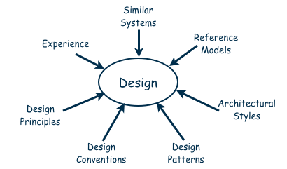
Design is a Creative Process (continued)
Many ways to leverage existing solutions
  Cloning: Borrow design/code in its entirety, with minor adjustments
  Reference models: Generic architecture that suggests how to decompose the system (F 5-3：编译器的设计参考模型 )

Slide 5
Chapter 5 Designing the System
2. Conceptual and Technical Designs
（概念设计与技术设计）
 purpose: (two part iterative process)
A: conceptual design(≈system design)—satisfy customer
B: technical design –satisfy the system builders on
^{(≈ program design)} our development team
 definition:
A: conceptual design: Tells the customer what the
system will do (software architecture and function)
B: technical design: Tells the programmers how the
system will do----software function and interface’s
implementation method (coder’s reference
document )

Slide 6
Chapter 5 Designing the System
answering questions by conceptual design
1—6(see P225)
characteristics of good conceptual design
1—5(see P226)
contents by technical design (algorithm,etc.) (P226)
A: major hardware components and their function
B: hierarchy and function of software components
C: data structures and data flow
□note: (P225)
conceptual design when customers _{combined}
technical design are sophisticated

Slide 7
Chapter 5 Designing the System
3. Design Process Model（设计过程模型）
A: Modeling (初始建模): 尝试可能的分解：根据需求描述的系统的关键特性等确定软件体系结构风格，进行系统级别的决策。(比如：MVC模式就不适合路由选择服务程序的设计，因为事件触发引起的服务程序指向很明确，没有太多的逻辑处理。)
B: Analysis(分析): 主要关注软件系统的质量属性、各种约束等等。
C: Documentation(文档化): 确定各个不同的模型视图。
D: Review(复审): 检查文档是否满足了所有需求。
E: final output: Software Architecture Document
(正式的 <SAD> ：软件体系结构文档)

Slide 8
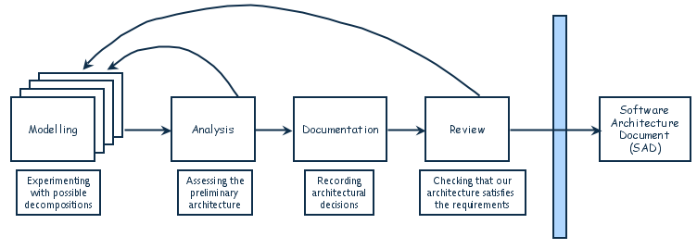
Designing software system is an iterative process
The final outcome is the software architecture document (SAD) (FIG5.4)

Slide 9
Chapter 5 Designing the System
5.2 Decomposition and Modularity(conceptual design)
（系统设计中的分解与模块化）
1. Five ways to create designs（五种设计方法）
 Modular decomposition(example:layered DFD SC diagram)
 Data-oriented decomposition(example: Jackson approach)
● Event-oriented decomposition (Event=condition)
❍ Outside-in design
■ Object-oriented design (identify classes and relations)
2. Explain
 five ways ---- all have hierarchy (fig5.3)
 example ---- data-oriented decomposition ( including
“deal with” different data in different layers )

Slide 10
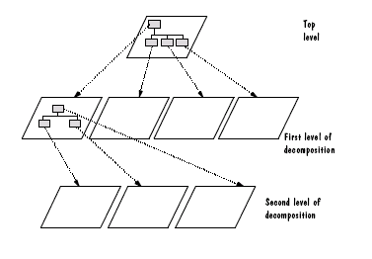

Slide 11
Modular : when each activity of the system is performed by exactly one component, and when inputs and outputs of each components are well-defined, a system is modular.
C(x): complexity of problem x; E(x): effort to solve x
If C(p1)>C(p2) then E(p1)>E(p2)
C(p1+p2)>C(p1)+C(p2)
E(p1+p2)>E(p1)+E(p2)
module development cost
cost of
software
module
integration
cost
optimal number
number of modules
of modules

Slide 12
Chapter 5 Designing the System
5.3 Architecture Styles and Strategies
（软件结构风格和设计策略）
1. Three design levels （三种设计层次）(P229)
architecture design----associates the system
（体系结构设计） capabilities(in SRS) with the system
components that will implement them
（由软件需求中的系统能力与系统部件关联
起来而得到软件整体结构的过程）
note: architecture design≈system design (in chapter 1)
architecture(体系结构)：一种软件设计方案，说明如何将
系统分解为单元以及这些单元的关联方式，
以及所有单元的外部可见特性。

Slide 13
Chapter 5 Designing the System
code design----involves algorithms and data
（代码设计） structures for each component
（各个部件（模块）的算法、数据结构的设计）
components = programming primitives
+primitive operators
+composition mechanisms)
executable design----lowest level of design, including
（运行设计） memory allocation, data formats,
bit patterns
（最底层设计—内存分配、数据格
式、位模式等等）

Slide 14
Chapter 5 Designing the System
note
A: top down work----designing an architecture, then
the code design, and finally the
executable design.
B: code design+executable design ≈ program design
C: repeatability (taking modification to architecture,
code design,executable design several times,
as the designers’s understanding and
creativity permit )
D: design style----includes component, connector,
constraints on combining components.
体系结构风格: 大规模系统结构模式, 包括规则、元素、技术

Slide 15
Chapter 5 Designing the System
2. Several (system) design styles（几种体系结构风格）
 pipes and filters（管道与过滤器）
(一种组件式设计,常用于语义分析、字典分析等设计 )
A: pipe----streams of data for input and output
B: filter----a component finishing reading the input
stream
 object-oriented design （面向对象设计）
A: OOA--get abstract data type(class)
B: OOD--get instance(object) and its detailed definition
characteristics----integrity of the data representation
----data representation must be hidden
from other objects (encapsulation)
OO观点: 软件等于一系列对象的演化
用于一般软件设计

Slide 16
Chapter 5 Designing the System
用于分组交换网络软件设计等等
● implicit invocation （隐含调用）
focus on: event-driven, based on the notion of
event broadcasting/announcement
application---- packet-switched networks
---- user interfaces (to separate the
presentation of data from applications
that manage the data)
❍ layering （分层设计）
A: meaning X: hierarchical structure
Y: each layer provides service to the one
outside
类似于C/S结构的软件设计等

Slide 17
Chapter 5 Designing the System
B: example (fig5.6)----file security system
----(1)加密解密算法,(2)文件加密解密接口,(3)密钥管理:
文件签名,检验签名,获得文件访问等. (4) 认证:加密文
件的管理, 用户标识和密码的管理, 认证协议实现等.
C: feature: take advantage of the notion of abstraction
repositories(资源仓库)
(常用于信号处理、知识发现、模式识别系统等设计 )
A:construction: a central data store and a collection
of components
B: black board system (one of repositories)
--includes the black board itself, knowledge sources
and the control. When the state of black board
changes, the knowledge source will responds.

Slide 18
Cryptography
File interface
Key management
Authentication
Fig 5.6 Layered security architecture

Slide 19
Layering
Layers are hierarchical
  Each layer provides service to the one outside it and acts as a client to the layer inside it
  Layer bridging: allowing a layer to access the services of layers below its lower neighbor
The design includes protocols
  Explain how each pair of layers will interact
Advantages
  High levels of abstraction
  Relatively easy to add and modify a layer
Disadvantages
  Not always easy to structure system layers
  System performance may suffer from the extra coordination among layers

Slide 20
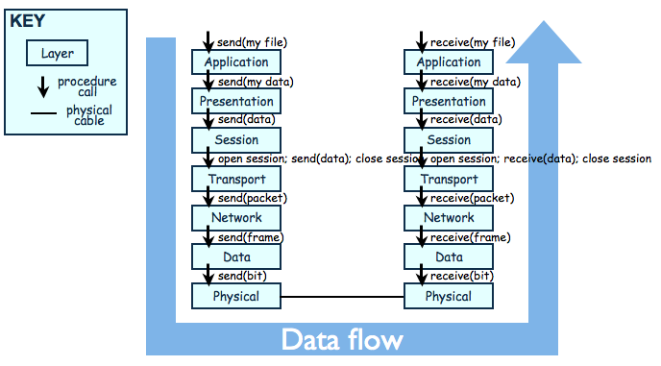
Example of Layering System
The OSI Model

Slide 21
Chapter 5 Designing the System
□ interpreters (用于解释器专用设计)
⑦ process control（过程控制）
A: explain—maintain specified properties of process
output at or near specified reference values
B: two types X: feedback
Y: feedforward
⑧ other styles
A: distributed system architecture
B: client-server architecture or B/S architecture
用于工业过程控制的软件设计

Slide 22
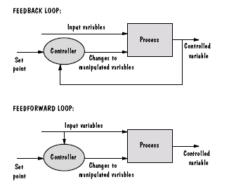

Slide 23
Chapter 5 Designing the System
#9: peer-to peer,P2P （对等网络）
A: meaning X: component-----client +server
Y: the interface-----provide service, and
can receive service
B: useness: X: self-organizing
Y: scale extending is easy.
C: example: file sharing network.

Slide 24
Chapter 5 Designing the System
5.4 Issues in Design Creation(设计过程中的若干问题)
1. Several Conceptions(涉及质量属性的几个概念)
A: Modifiability (可修改性)---- 更改软件系统的难易程度。
------设计时的诸多特性：高内聚、低耦合、接口等等。
------自我管理软件。
B: Maintenability (可维护性)----是指理解、改正、改动、改进软件的难易程度
------改正性维护
------适应性维护
------完善性维护
------预防性维护

Slide 25
Chapter 5 Designing the System
C: Performance (性能)----软件的性能是指在完成软件功能时展示出来的及时性、吞吐量等特性。
------响应时间。
------吞吐量。
------并发用户数。
------资源利用率。
D: Security (安全性)----实现软件各种安全保密措施的有效性度量。
------权限划分处理、软件加密分析、硬加密措施分析等。
E: Reliability (可靠性)----软件产品在规定的条件下和规定的时间区间完成规定功能的能力。

Slide 26
Chapter 5 Designing the System
当探讨或分析两个模块共享某数据时,模块各自的私有细节应隐藏
2. Modularity and levels of Abstraction
（模块化与抽象的层次）
 feature
A: modular design(modularity)---- 模块有清晰的输入
和输出, 设计目的明确, 功能独立, 可以做独立检测。
B: abstraction(levels of abstraction)—hiding details
（对细节的隐藏称为抽象）
C: 抽象的层次----设计师的考虑：设计从抽象开始！
----hierarchy (of components)---- 模块/部件都以某种
不同层次结构的抽象的形式出现, 越上层、越早期的
模块层次或框架是越抽象的设计。
模块化是优秀设计的特征之一

Slide 27
Chapter 5 Designing the System
 advantage (of combining modular components with
abstraction hierarchy )
A: top level give a view to solution(by hiding details),
other levels show major functions and
implementation details
B: OOD—(ADT: high level objects and relationships,
not care the instance designing )
C: the ability to design different components in
different ways
（例如：可以用OO和原型化的方法设计用户界面，而在
考虑安全性设计时使用状态图等）

Slide 28
Chapter 5 Designing the System
● example of using abstraction – sidebar 5.2
A: sorting a L(list) (see next page)
(1): 三个抽象层次各有用处;
----若只关心L在排序前后的样子, 仅需第一层次.
----若关心算法的速度, 第二层次足亦.
----若要考虑编写源码, 则需要第三层次.
(2): 三个层次的连续表达不可或缺
----三种不同的抽象形式
----完整文档供不同开发阶段的不同使用者参考.
B: using abstraction in OOD –--stack: ADT(P239)

Slide 29
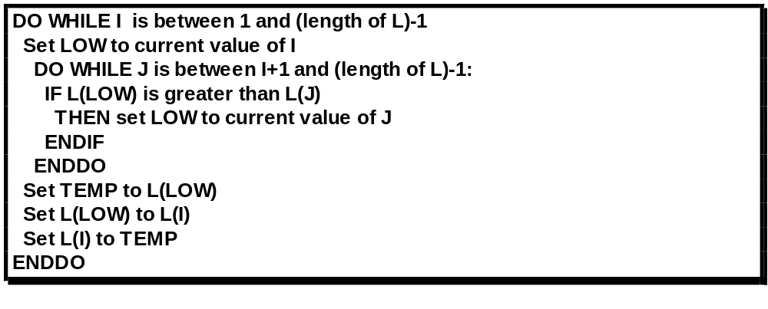
Chapter 5 Designing the System
Rearrange L in non-decreasing order
DO WHILE I is between 1 and (length of L)-1:
Set LOW to index of smallest value in L(I), ..., L(length of L)
Interchange L(I) and L(LOW)
END DO

Slide 30
Chapter 5 Designing the System
3. Collaborative design（设计中的协作关系）
 several tasks (for developing team)(group behavior)
（关于开发团队的几个任务）
A: personnel choice（人员选择与分工）
（谁最适合设计系统的某个部分？！）
B: problem expression and document organization
（问题的表达语言和文档组织形式）
（目标：每个团队成员都能理解他人的设计！）
C: coordinating the design components
（设计的部件之间的协调----以达到有效运行）

Slide 31
Chapter 5 Designing the System
 the cause of design breakdown—siderbar5.7 (P256)
设计过程崩溃的主要类型：
A: 缺少具体的设计方案。
B: 缺少设计过程的元方案。（最高抽象模型----顶层设计）
C: 问题和解决方案的优先级选择不合理。
D: 约束不明。
E: 没有可验证的模拟设计。
F: 进度难以跟踪。
G: 解决方法不够完整。

Slide 32
Chapter 5 Designing the System
● major problems in performing Collaborative design
A: addressing differences in personal experience,
understanding, and preference .
(解决个人经验,理解能力和爱好等方面的差异,妥善搭配)
B: people behave difference between doing in groups
from do individually
(解决人们在团队的行为方式与单独的行为方式的不同)
(日本的团队, 美国团队, 混合团队)
❍ design is a collaborative and iterative process
( not just building a product, also building a shared
understanding of ……P241)

Slide 33
Outsourcing（外 包）
Coordination becomes increasing difficult
Collaborative team may be distributed around the world
Four stages in distributed development(分布式开发)
  Project performed at single site with on-site developers from foreign countries
  On-site analysts determine system requirements, which are in turn provided to off-site groups
  Off-site developers build generic products and components that are used worldwide
  Off-site developers build products that take advantage of their individual areas of expertise

Slide 34
外包式协作设计要注意的问题：
  工程设计次序有新的要求：设计师反复与需求分析人员、测试人员、编程人员交流。
  时差与不稳定的网络。
  不了解当地的商业规则、客户、法律。

Slide 35
Chapter 5 Designing the System
4. Designing the User Interface
（设计用户界面要注意的问题）
note: User interface can be tricky things to design,
because difference people have different styles
of perceiving, understanding, and working .
key elements(设计界面要注意解决的要素)
----metaphors(寓意/比喻)
----mental model(思维模型)
----navigation rules for the model(模型的导航规则)
----look (外观)
----feel(感觉)

Slide 36
Chapter 5 Designing the System
 cultural issues（文化差异问题）
issues ----we must consider the user’s beliefs,
values, norms, traditions, mores, and
myths.
solution ---- international design/Bias-free design
(it is best for the interface to be tested
in the culture in which it will be used)
---- tailoring the interface
● user preferences（用户爱好问题）
– making alternative interfaces for selecting by those
who have different preferences

Slide 37
Chapter 5 Designing the System
5. Concurrency (并发性)
note: in many systems, actions must take place
concurrently rather than sequentially
 synchronization(同步) ---- allowing two activities to take place concurrently without their interfering with one another使两个活动同时进行但互不干涉的方法.
 mutual exclusion(互斥) ---- making sure that when one process is accessing a data element, no other process can affect(改动) that element
● examples A: “can’t synchronization” (P245-246)
B: “mutual exclusion” (P246)
C: “in network---locking shared data”

Slide 38
Chapter 5 Designing the System
6. Design patterns and reuse (X)
 design patterns -- the key aspects of a common
design structure ,including objects and instances,
roles and collaborations, distributions of
responsibility
 reuse – reuse the design patterns

Slide 39
Chapter 5 Designing the System
5.5 Characteristics of good design
（优秀软件设计所具备的特征）
high-quality design should have such characteristics:
ease of understanding
ease of implementation
ease of testing
ease of modification ---is especially important
correct translation from the requirement
1. Component Independence（部件/模块独立性）
Focus : degree of component independency
---- decide by two concepts : cohesion（内聚）
coupling（耦合）

Slide 40
Chapter 5 Designing the System
 coupling : inter-dependency among software
components（两个软件部件之间的相互关联程度）
A: highly coupled,loosely coupled, uncoupled(Fig5.12)
B: examples (P249)—the ways of components depend
on each other. The measured degrees see Fig5.13
C: purpose for studying coupling
----minimize the dependence among modules (P249)
D: six levels(of coupling measures)
uncoupled（非直接耦合） ：模块相互之间没有信息传递
data coupling（数据耦合） ：模块间传递的是数据
stamp coupling（特征耦合）：模块间传递的是数据结构
control coupling（控制耦合）：模块间传递的是控制量

Slide 41
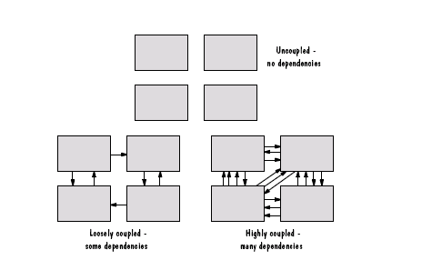

Slide 42
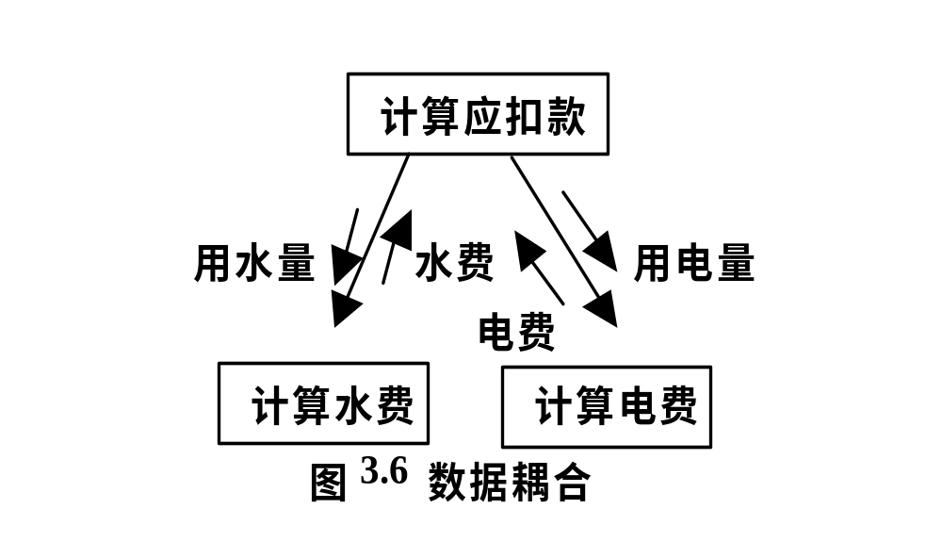
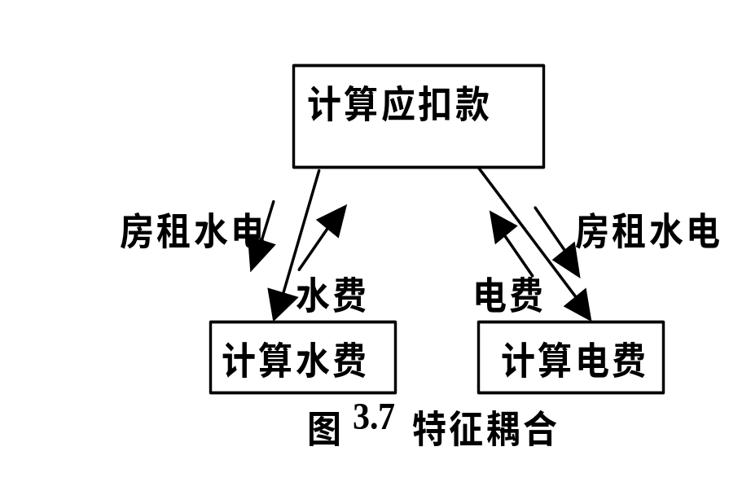
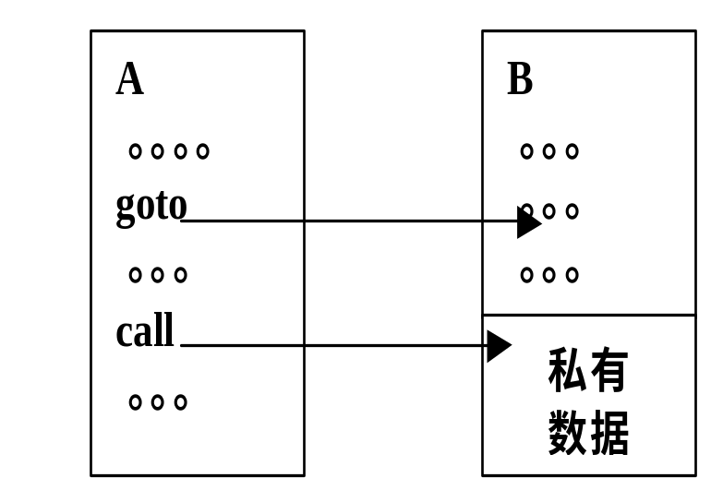
☺ The most desirable.
房租水电=房租十用水量＋用电量
内容耦合
控制耦合
B
Fn
Flag
……
A
Flag
F2
……
F1

Slide 43
公共耦合
内容耦合
Global : V1
V2
……
A
B
A:
…………
…………
V1++
…………
…………
B:
…………
…………
V2=B1+V1
…………
…………
A:
…………
…………
goto C1
…………
…………
C
D
C:
…………
…………
C1:
……
……
☹ The least desirable

Slide 44
Chapter 5 Designing the System
common coupling（公共耦合）：不同模块访问公共数据
content coupling（内容耦合）：一个模块直接修改另一个
模块(A模块直接调用B模
块的私有数据, 或直接转
移到B模块中去)
E: OOD—with low coupling (P251)
F: purpose(in design)—pursue low coupling (but we
can’t forbid using the highly coupled components)
 cohesion: internal glue among software components
（软件部件内部各组成成分的关联程度）
A: purpose(for study cohesion)
---- make each component as cohesive as possible

Slide 45
Chapter 5 Designing the System
B: seven levels (of cohesion measures)
coincidental（偶然性内聚）：不相关的功能, 过程,数
据等出现在同一个部件中.(例如，如果有几个模块都需
要执行“读A”、“写Ｂ”等相同的一组操作，为了避
免重 复书写，可以把这些操作汇成一个模块，供有关
的模块调用)
logical（逻辑性内聚）：逻辑上相关或相似的功能或数
据放置在同一个部件内 (例如一个用于计算全班学生
平均分和最高分的模块，无论计算哪种分数，都要经
过读入全班学生分数，进行计算，输出计算结果等步
骤。实际上除中间的一步须按不同的方法计算外，
前、后这两步都是相同的。把这两种在逻辑上相似的
功能放在一个模块中，就可省去程序中的重复部分)

Slide 46
Chapter 5 Designing the System
temporal（时间性内聚）：部件各部分要求在同一时间
完成 (例如:一个初始化模块可能包含“为变量
赋初值”、“打开某个文件”等为正式处理作
准备的功能。由于要求它们在同一时间内执行，
故称为时间性内聚。)
输入全班成绩
计算的过程:
计算平均成绩
查找最高成绩
输出结果

Slide 47
Chapter 5 Designing the System
procedural（过程性内聚）：各部分有特定次序(Fig5.17)
communicational（通讯性内聚）：各个部分访问共享数据
sequential（顺序性内聚）：各部分有输入输出关系(Fig5.17)
functional（功能性内聚）：各部分组成单一功能
C: OOD----with high cohesion (P253)
D: purpose(in design)—pursue high cohesion (but we
can’t forbid using the low cohesive components)
enter data
check data
manipulate data

Slide 48
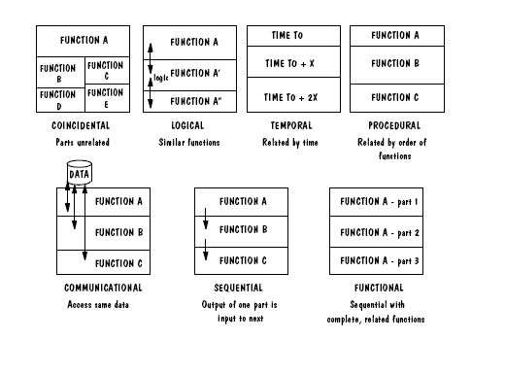
Chapter 5 Designing the System

Slide 49
Chapter 5 Designing the System
2. Exception Identification and handling
 note: the <SRS> tell us what the system is supposed
to do, but it does not usually make explicit what
the system is not supposed to do
 exception: unanticipated action/event
exception handling: a dealing method(P254)
● types: (P254)
A: failure to provide a service
B: providing the wrong service or data
C: corrupting data
❍ dealing ways (P255)
A: retrying
B: correct

Slide 50
C: report ----优秀的设计应该允许用户向系统报告异常，
系统设计时应该嵌入故障树分析（由此生成
割集树）和失效模式分析技术，来表示和识
别异常，以进行最后的异常处理，甚至对软
件系统进行有限更正。
⑤ 注：最难处理的异常时所谓的“不规律”异常，包括提供的不规律的错误服务和错误数据。

Slide 51
Chapter 5 Designing the System
3. Fault prevention and tolerance
 error(mistake), fault, failure (P6)
 active fault detection—periodical examine symptoms
of faults or anticipate failures
A: mutual suspicion : ----------做更多的预先检查和防范。
B: redundancy : -----------一个功能有多个预留的实现途径
● passive fault detection (P256)----等待故障发生再处理
❍ fault tolerance : 当软件失败发生时,采取措施减少损失并将损害隔离开来, 在用户接受的条件下使系统继续运行 .
A: explain: failure occurs isolate the damage
system continue running

Slide 52
Chapter 5 Designing the System
B: example
X: memory allocation
Y: “conveyor belts in an assembly line” (P258)
5.6 Techniques for Improving Design (X)
1. Reducing Complexity
2. Design by contract
3. Prototyping design
4. Fault-tree analysis

Slide 53
Chapter 5 Designing the System
5.7 Design evaluation and validation (X)
note: two ways of design inspection:
A: validation
B: verification
1. Mathematical validation
2. Measuring design quality
3. Comparing designs
  one specification, many designs
  comparison table
4. Design reviews

Slide 54
Chapter 5 Designing the System
4. Design reviews
preliminary design review (概念设计复审)
  examines conceptual design with customer and users
critical design review (技术设计复审)
  presents technical design to developers
program design review (技术/程序设计复审)
  programmers get feedback on their technical designs before implementation

Slide 55
Chapter 5 Designing the System
5.8 Documenting the design（设计文档化）
1.Document
design rationale
menus and other display-screen formats
……
fault-handling approach
2. Note
if it’s a distributed network, then the configuration
document should include:
topology, synchronization, control and routing
message of the nodes, etc. .

Slide 56
Chapter 5 Designing the System
 design description is cross-reference with <SRS>
(two documents should have completeness and
consistency), by 配置管理技术和工具 .

Slide 57
木 桶 定 律
盛水的木桶是由许多块木板箍成的，盛水量就是由这些木板共同决定的。若其中一块木板很短，则此木桶的盛水量就被短板所限制。这块短板就成了这个木桶盛水量的“限制因素”（或称“短板效应”）。人们把这一规律总结为“木桶原理”，或“木桶定律”，也称“短板理论”。
启示：
木桶定律无论对个体还是对一个组织，都有启迪。
木桶可以象征企业、部门、项目团队等，也可以象征一个独立的人，其盛水量就是企业、部门、项目团队或一个人的最大的能力、实力、竞争力。木桶之于企业，木板就是资金、技术、人力资源、产品、营销、内部管理等。
软件需求与软件设计不能有明显的弱点！劣势决定优势，劣势决定生死，这是竞争的残酷法则 ！

Slide 58
课程设计及课堂演讲若干问题:
1：在OOD的实施过程中，界面类、控制类、实体类等在软件工程中是如何实际使用的？举例说明。
2：在OOD的实施过程中，一般的系统设计和详细设计的区别与联系是什么？举出简单的事例加以说明。
3：在软件工程具体实施时，有时采用某些开发模式（如MVC），请将您使用的模式予以归纳，举例说明其与软件工程课程中的系统设计或详细设计的联系与区别以及对应关系。
4：你的软件测试是如何进行的？请举例介绍一般软件测试的数据分类及彻底性原则。
5. 结合实际案例，阐述本课件5.4节某些质量属性的实现与保证措施。

Slide 59
5.10 Software Product Lines软件产品线
Organizations can find success by reusing their expertise and software assets across families of related products
The corporate strategy for designing and developing the related products is based on the reuse of elements of a common product line（产品线）
A distinguishing feature of building a product line is the treatment of the derived products as a product family（产品系列）; their simultaneous development is planned from the beginning
The family’s commonalities are described as a collection of reusable assets (including requirements, designs, code, and test cases), all stored in a core asset base（核心资产库）

Slide 60
软件产品线：
是指具有一组可管理的公共特性的软件密集性系统的合集，这些系统满足特定的市场需求或任务需求，并且按预定义的方式从一个公共的核心资产集开发得到。

Slide 61
5.10 Software Product Lines
Core Asset Base
Candidate elements （候选元素）in a core asset base:
  Requirements
  Software architecture
  Models and analysis results
  Software units
  Testing
  Project planning
  Team organization

Slide 62
5.10 Software Product Lines
Strategic Scoping（战略范围）
Product lines are based not just on commonalities among products but also on the best way to exploit them
  First, employ strategic business planning to identify the family of products we want to build, using knowledge and good judgment to forecast market trends and predict the demand for various products（确定产品系列，判断市场趋势）
  Second, scope the plans, so that the focus is on products that have enough in common to warrant a product-line approach to development. That is, the cost of developing the (common) product line must be more than offset by the savings we expect to accrue from deriving family members from the product line（划定计划范围，确保产品线方式开发）

Slide 63
5.10 Software Product Lines
Sidebar 5.8 Product-line Productivity
CelsiusTech AB, a Swedish naval defense contractor, motivated by desperation, transitioned from custom to product-line development. In 1985, the company, then Philips Elektronikindustier AB, was awarded two major contracts simultaneously, one for the Swedish Navy and one for the Danish Navy.
  senior managers questioned whether they would be able to meet the demands of both contracts, particularly the promised (and fixed) schedules and budgets, using the company’s current practices and technologies.
Development of the product line and the first system were initiated at the same time; development of the second system started six months later. The two systems plus the product line were completed using roughly the same amount of time and staff that was needed previously for a single product. Subsequent products had shorter development timelines. On average, 70–80 percent of the seven systems’ software units were product-line units (re)used as is.

Slide 64
5.10 Software Product Lines
Advantages of Product-Line Architecture
A product lines promotes planned modifiability
Examples of product-line variability:
  Component replacements
  Component specializations
  Product-line parameters
  Architecture extensions and retractions

Slide 65
5.10 Software Product Lines
Sidebar 5.9 Generative Software Development
Generative software development（生成式软件开发） is a form of product-line development that enables products to be generated automatically from specifications
The domain engineer defines a domain-specific language (DSL) that application engineers then use to specify products to be generated
Lucent developed several product lines and generative tools for customizing different aspects of its 5ESS telephone switch

Slide 66
5.10 Software Product Lines
Product-Line Evolution
Key contributor to product-line success is having a product-line mindset
  Company’s primary focus is development and evolution of product-line assets as opposed to individual products
  Changes made to improve capability to derive products
  Backwards capability

Slide 67
Chapter 9 Testing the System
  Note A:unit and integration testing----by
  yourself or a small part of the
  development team
  B:system testing----by the entire
  develop team
9.1 Principles of system testing
Focus A:  objective of unit and integration
------ensure the code implemented
the design properly ⑧⑨ ⑦ ⑩

