Slide 1
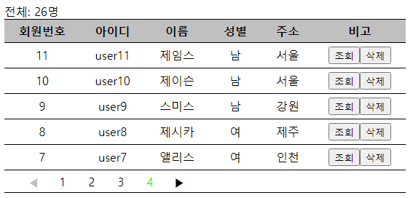
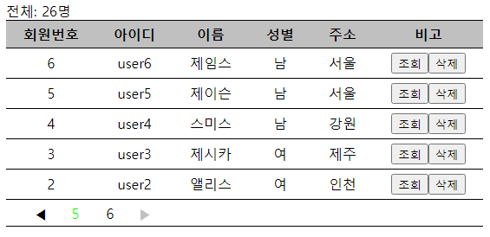
1번째 block
(page=1~4)
totalRecord
pagePerBlock=4
end
recordPerPage=5
begin
page
beginPage
endPage
2번째 block
(page=5~6)
page
totalPage

