Slide 1

Additional Link and Port Channel Configuration
SRM INSTITUTE OF SCIENCE AND TECHNOLOGY ​
COLLEGE OF ENGINEERING AND TECHNOLOGY​
DEPARTMENT OF COMPUTING TECHNOLOGIES
18CSP111L/18CSP112L- MAJOR PROJECT / INTERNSHIP​
Guide - Dr. V.M Gayathri Yash Rawat (RA1911031010029) Angad Singh(RA1911031010053

Slide 2
CONTENTS
Abstract
Literature Survey
Existing and Proposed Methodologies
Problem Identification and Description
Requirements
System Architecture and Design
Propose Methodologies and Module Description
Performance Measure and Evaluation
Result and Analysis

Slide 3


Slide 4
Abstract
The growing complexity of networks and the need to make them more open due to the growing importance and attractiveness of the Internet as a medium for business transactions means that networks are increasingly vulnerable to attacks from the exterior and interior.A firewall is essentially a barrier between a private internal network and the public Internet. The main purpose of a firewall is to let in non-threatening traffic and block dangerous traffic. In our project we have worked on existing firewalls,switches,LAN cables,WAN,Ports etc by removing the existing link and adding back post configuring the additional 1G link after which both the links take the load and all the slave and master interfaces have similar aggregate ID allowing them to communicate to the switches via port channel without any issues. As a result the throughput is converted to 2G as expected and have made the necessary configuration on the firewall end LAN cables and necessary configuration in load balancing issue stands resolved.We have also made successful firewall failover to test the load. And we also confirmed from the WAN side through the provider team and confirmed that after rebooting switches are also working efficiently.

Slide 5
Literature Survey
S.No | Title | Objective
1. | Habtamu Abie - Norwegian Computing Center | The search is on techniques for the protection of internal networks from such attacks. One of the protective mechanisms under serious consideration is the firewall. A firewall protects a network by guarding the points of entry to it. They continue to change and develop, and new features are regularly added as the need arises. If developments follow the present trend, they will continue to combine configurable access control and authentication mechanisms with their traditional functions, thus providing more powerful and flexible protection for networks to make them secure.

Slide 6
S.No | Title | Objective
2. | A Survey of Firewall Technologies [W. Richard Stevens, Gary R. Wright] Year - 1994 | This paper provides a useful introduction to firewall technology and is still relevant today as a historical reference for the development of firewall technology. The field of network security has evolved considerably since the publication of this paper, and modern firewalls incorporate additional security features such as intrusion detection and prevention, deep packet inspection, and more sophisticated filtering mechanisms.

Slide 7
S.No | Title | Objective
3. | A Comparative Study of Firewall Technologies [Mustafa Hammad, Seyed Mehdi Nasehi] Year - 2011 | The paper highlights the advantages and disadvantages of each type of firewall technology, such as their processing performance, granularity of control, and resistance to attacks. The paper concludes with a discussion of the challenges faced by firewall technologies, including the need to keep pace with the evolving nature of network threats, the difficulty of managing complex firewall configurations, and the need to balance security with performance.

Slide 8
S.No | Title | Objective
4. | Data Link Layer Firewall for Cloud Computing [Xu Chen, Qingwei Zhang, Tao Wang] Year - 2014 | The paper proposes a data link layer firewall for cloud computing that can improve the security of data transmission. The proposed firewall can detect and prevent attacks at the data link layer, which provides a higher level of security for cloud computing environments. The proposed firewall can detect and prevent attacks at the data link layer and improve the security of data transmission. The experimental results showed that the proposed firewall is effective in detecting and preventing various attacks.

Slide 9
S.No | Title | Objective
5. | A Survey on Ethernet Local Area Networks [K. Karthik, V. K. Pandey] Year - | The paper provides a comprehensive survey of Ethernet LANs, covering their history, architecture, standards, and protocols. The authors also highlight some of the emerging trends and challenges in Ethernet LAN technology, making this paper a useful resource for researchers and practitioners in the field.

Slide 10
Problem Identification
We are working with a project named Daimler based in Germany , our company provides all IT services to Daimler including security as well.
During regular checks our team noticed that the firewall installed isn’t working at an optimal speed .
A ticket was raised in a portal called Service Now, through which a member of our team contacted the person from Daimler via MS Teams .
After verifying the issue the analyst re assigned the ticket to security team in order to further troubleshoot the issue .

Slide 11
Description
The issue was was identified that the data flowing through the firewall wasnt at an optimal speed.
The security team then further contacted the SPOC at Daimler and checked the criticality of the problem.
Another ticket was raised and given the priority as P2 according to the criticality of the issue .
A CAB (Change Advisory Board )meeting was scheduled to discuss the timing and impact of the issue .
Further after the CAB approval the team added an additional link layer to the firewall to increase its speed .

Slide 12
Requirements
SERVICENOW PORTAL
WCP PORTAL
DAIMLER OS
MONITORING TOOL CCOPS SPECTRUM
DAIMLER MICROSOFT TEAMS
VPN

Slide 13
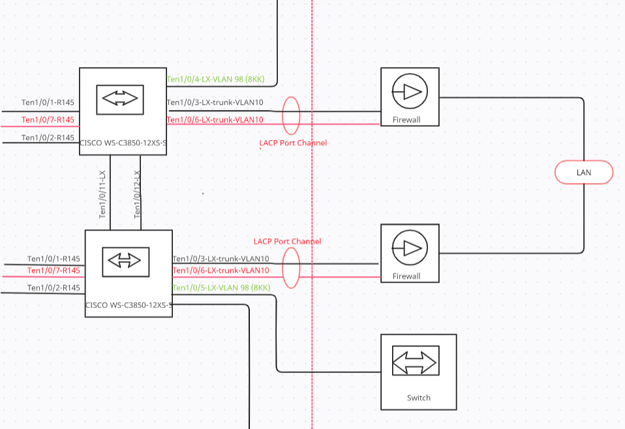
System Architecture & Design

Slide 14
Modules Description and Implementation
Modules-
Servicenow(Tickets)
Spectrum/ccops
Primary Firewall and Secondary Firewall
Steps in this module-
1. Bond Interface Creation
2. Configuring the bond interface
3. Addition of IP to the newly created bond
Rollback Plan for the Firewalls
In this process, the ip address of the newly created bond is removed and an ip address is added to the ethernet. Similarly, the interface in the bond group is removed and mgmt interface is added to the ethernet.
At last the snmp configurations and the interface in the bond are deleted and a snmp interface is added on the ethernet.

Slide 15
Modules Description and Implementation
Port channel configuration, also known as link aggregation or trunking, involves combining multiple physical interfaces into a single logical interface to increase bandwidth, improve fault tolerance, and optimize network performance.
Here are the steps for configuring port channels on Checkpoint firewalls and switches:
1. Identify the physical interfaces that will participate in the port channel. The interfaces must have the same speed and duplex settings and be connected to the same switch or firewall.
2. Creates port channels on Checkpoint firewalls and switches. A port channel configuration must specify the channel protocol, such as Link Aggregation Control Protocol (LACP) or Port Aggregation Protocol (PAgP), and the load balancing algorithm, such as source-destination MAC address, IP address or port number.
3. Assign physical interfaces to port channels on firewalls and switches. The interface configuration must specify the channel group number and the channel mode, such as active or passive.
4. Use the show interfaces port-channel command or equivalent to verify the port channel configuration on the firewall and switch.

Slide 16
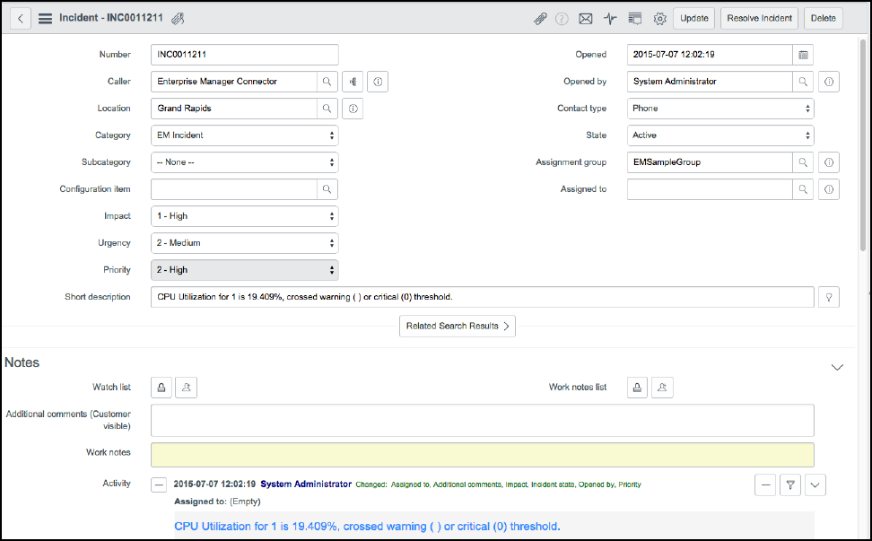
Servicenow

Slide 17
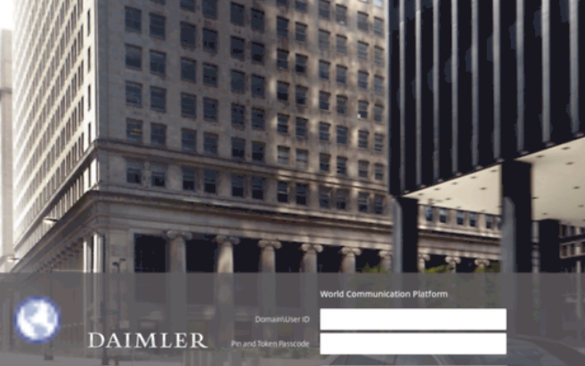
Daimler virtual desktop

Slide 18
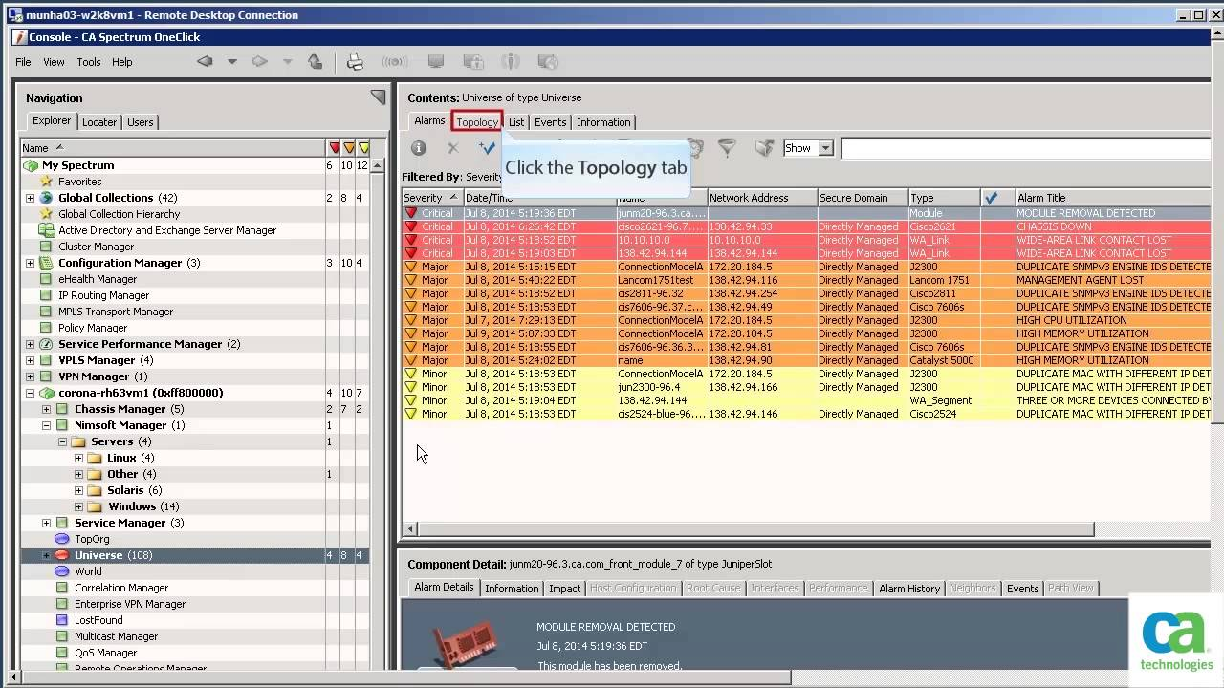
Spectrum

Slide 19

CCOPS

Slide 20
Performance Measure And Evaluation
For measuring the performance of the device and firewall we first login into the cmd prompt in the Daimler Desktop and then check for the for the connectivity in the network using basic CLI commands.
After confirming from our side we contact the customer/user for the confirmation by following the 3 strike rule.
After successful completion and evaluation, a report is made which contains the information regarding device name,ip,access points etc and update in the servicenow portal.
After creation of the report ,the ticket is closed in the servicenow portal

Slide 21
Testing/Result Analysis
Successfully complete the task assigned by removing the existing link and adding a new back post to configure the additional 1g link. This has resulted in both links taking an equal load and all slave and master interfaces having similar aggregate IDs, allowing for communication to switches via port channel without any issues. The throughput has increased to 2g, and we have confirmed with the provider team that after rebooting switches, everything is working fine. Overall, we were able to resolve the load balancing issue within the given time frame through necessary configurations.

Slide 22
Conclusion
In conclusion, the experience with Computacenter and the network team was valuable and rewarding. During the time with the organization, we gained valuable experience with and had the opportunity to work on several projects related to network and security domain. One of the most valuable aspects of my experience was the opportunity to work with and learn from experienced seniors who provided guidance and mentorship to help in developing networking skills. Their support allowed us to enhance the skills and also learn new technologies.Grateful for the experience and look forward to applying the skills and knowledge that has been gained will help in future .

Slide 23
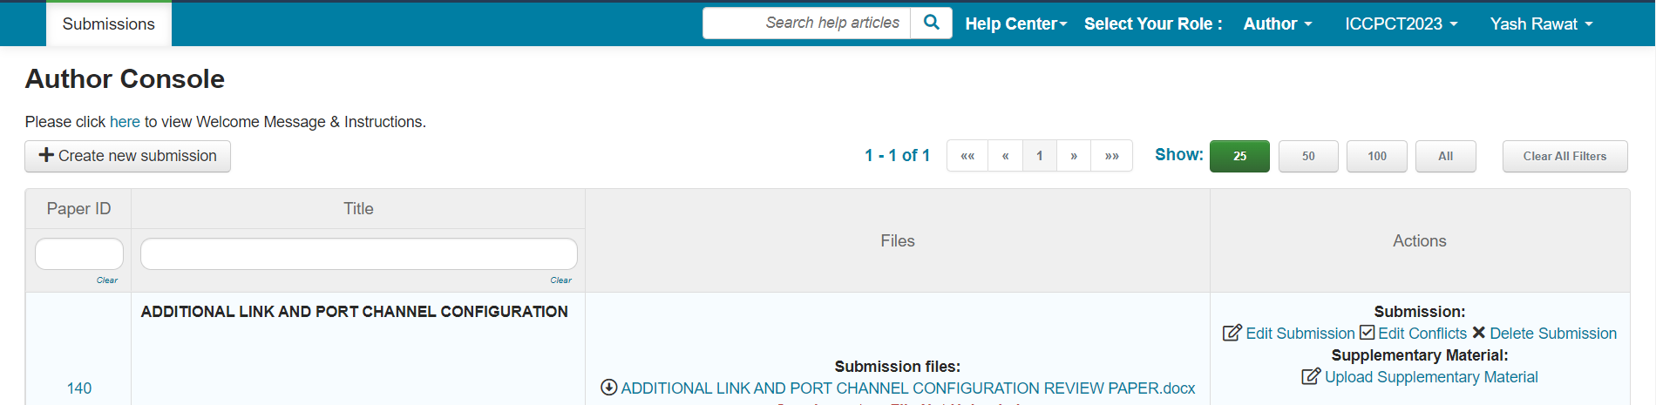
Publication Proof

Slide 24
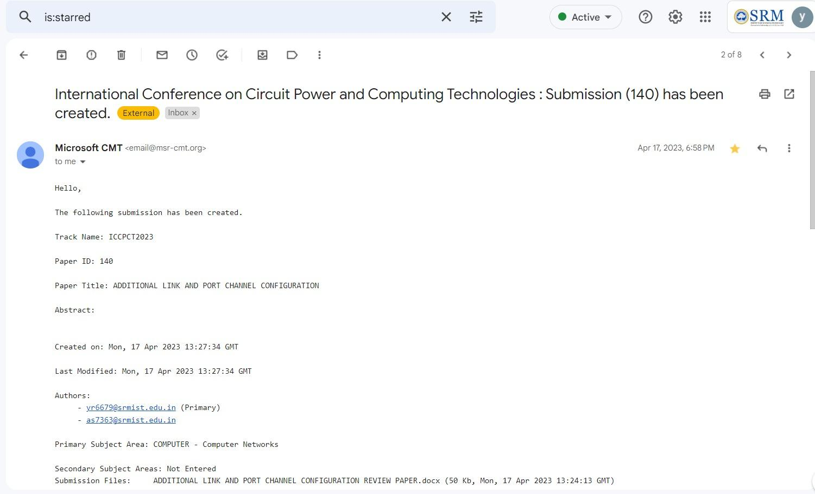
Publication Proof

Slide 25
Thank You

