Slide 1
Introduction to Database
CS3319 – Western University

Slide 2
Week 1
Introduction to Databases

Slide 3
Student Objectives
Upon completion of this video, you should be able to:
Define the following terms: Data, Database, Mini-World, DBSM
Identify a flat file
Find a piece of data and a record within a flat file.
Give at least 3 reasons why a DBMS is better than a flat file for storing data

Slide 4
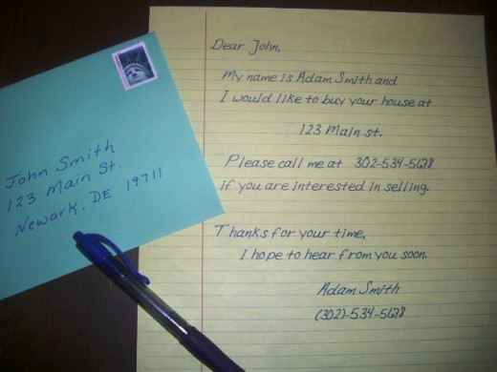

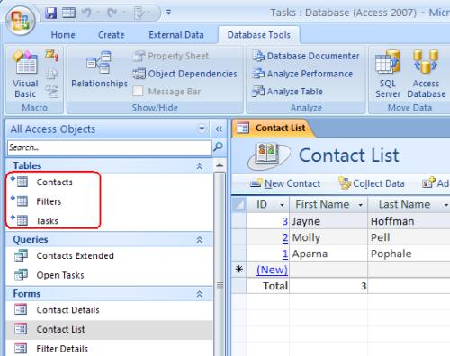
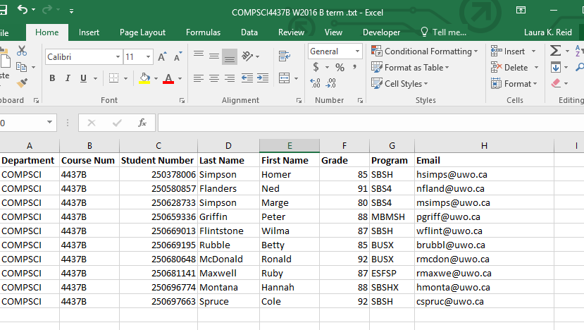
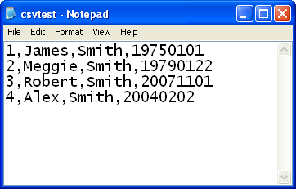
What is a database?
Which of the following are databases?

Slide 5
Basic Terminology
Data:
Known facts that can be recorded and have an implicit meaning.
Database:
A collection of related data.
Mini-world:
A database is a model of a mini world. Some part of the real world about which data is stored in a database. E.g. medical office, a retail business, a library are all mini worlds
Database Management System (DBMS):
A software package/system to facilitate the creation and maintenance of a computerized database.
Database System:
The DBMS software together with the data itself. Sometimes, the applications are also included.

Slide 6

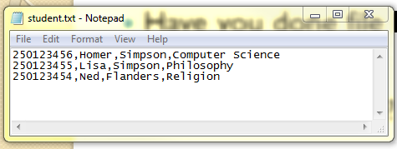
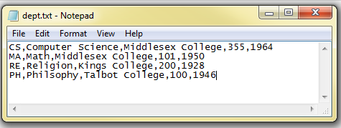
Life before DBMS… in the old days!
Have you done file I/O?
What is a “flat file”?
What is a “record”?
Or “instance”
Identify the following:
Data
Flat File
Record
Database

Slide 7
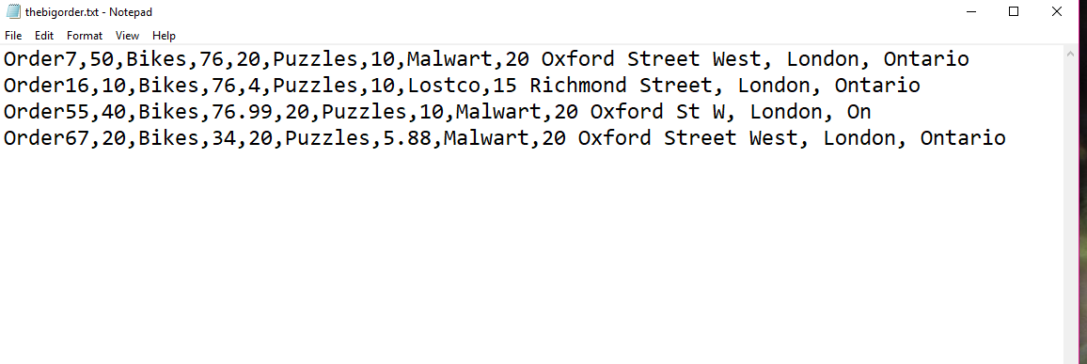
What was so bad about flat files?
Any ideas? (Or…why are DBMS better than flat files?)

Slide 8
What is a Database Management System (DBMS)
Program to help users create, maintain and use a database
Advantages of DBMS over flat file system:
Data redundancy/inconsistency reduced
Isolates the programs from the data
Provides persistent storage of data between execution of programs/applications
Multiple users can use and share the data
More abstract conceptually (views)

Slide 9
Security, integrity and backups provided
Generalized query tools
Provides multiple user interfaces
Possible to enforce standards since data is centralized
Reduced development time
Up to date information managed centrally
Great site if you ever need to learn something → Lynda.com, for example:
https://www.lynda.com/Access-tutorials/Introducing-relational-database-advantages/145932/172960-4.html

Slide 10
QUESTION: What are some disadvantages of using a DBMS over a flat file system?
Flat Files are cheap (actually FREE!)
DBMS require trained staff to manage them
DBMS are initially complex
Notes:
Cost
Initial Complexity
Require Skilled People

