Slide 1
LENDING CLUB DATA ANALYSIS
Presented by
Y RAMYA KOTESWARI
B GAMYASREE

Slide 2


About Lending Club
LendingClub is the largest personal loans provider in the U.S. and a marketplace
It is essentially a peer to peer lending platform.
Peer-to-peer (P2P) lending, is the practice of lending money to individuals or businesses through online services that match lenders with borrowers.

Slide 3
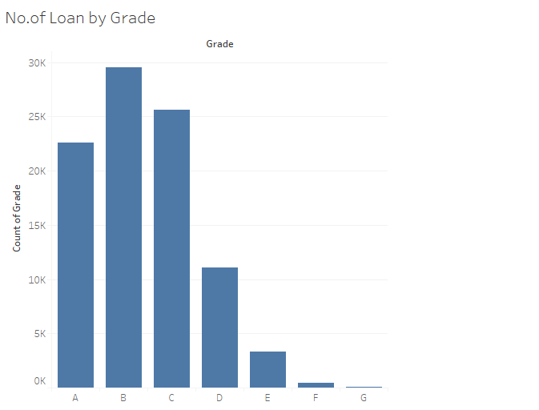
Maximum loans is observed to be falling under the category of B and C.

Slide 4
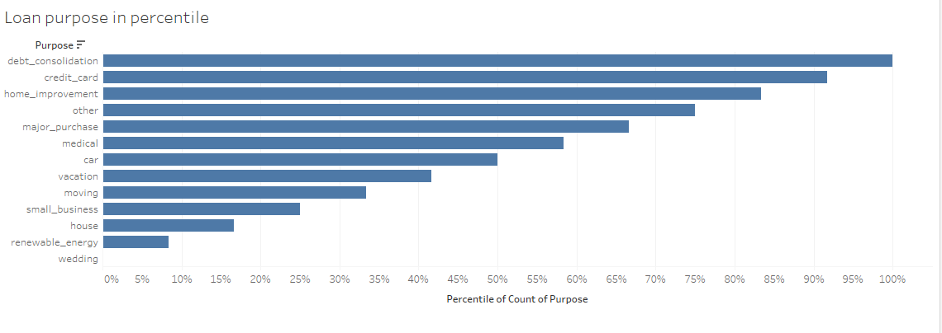
Major categories of loan purpose

Slide 5
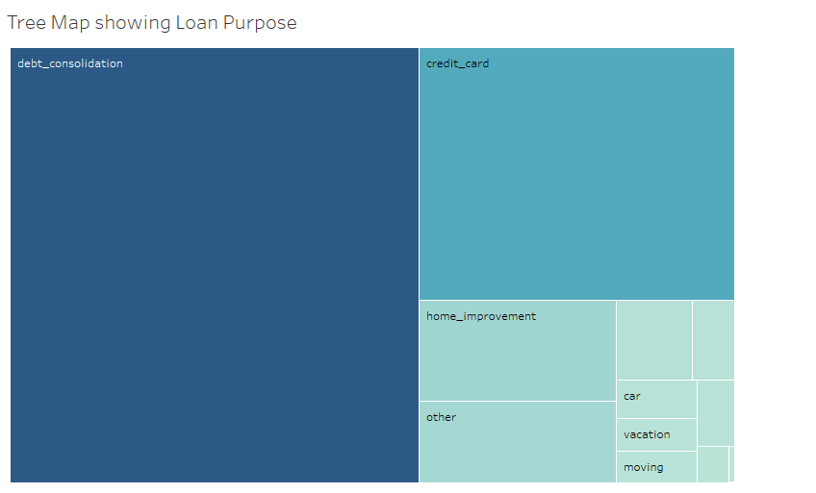

Slide 6
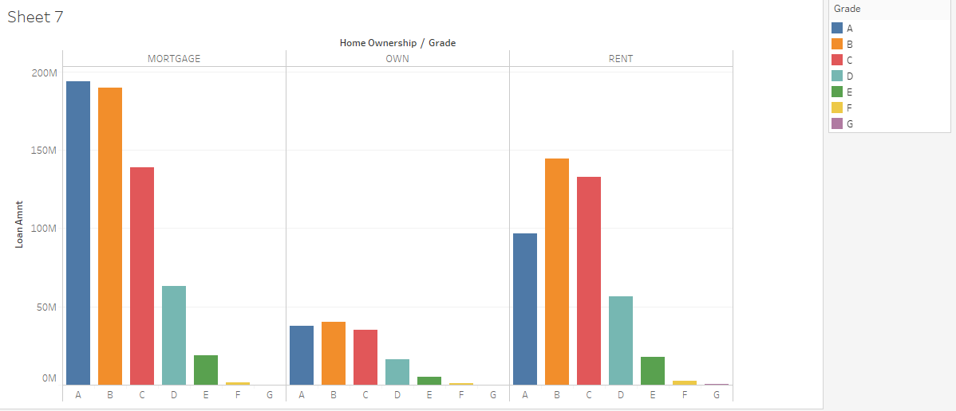
Distribution of loans based on Homeownership

Slide 7
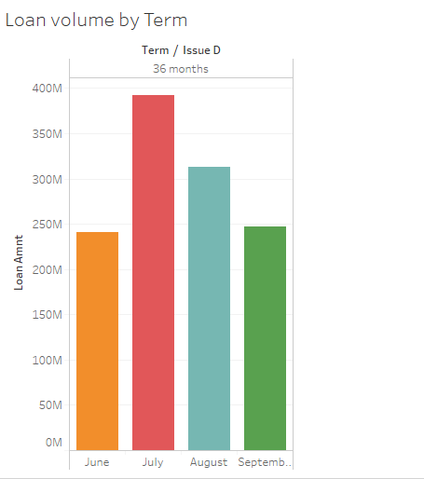
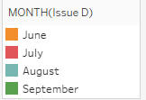
Overall loan monthly wise

Slide 8
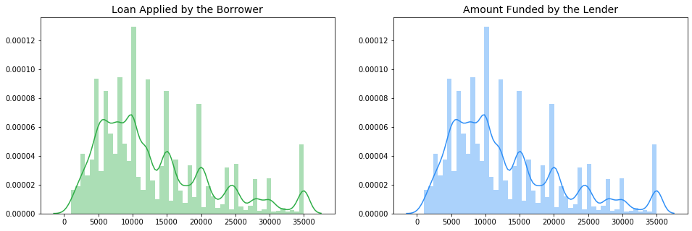
Proportion of Supply and Demand

Slide 9
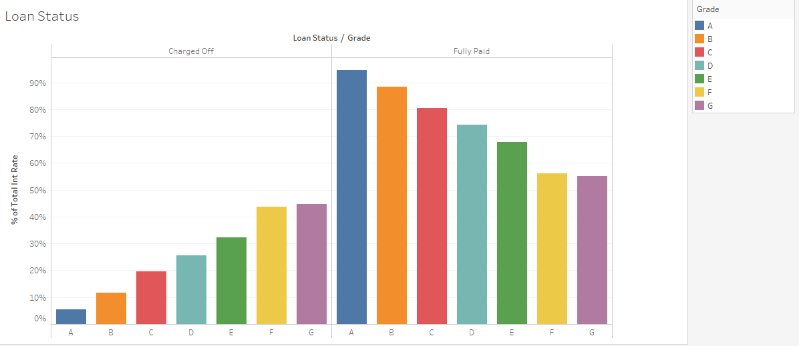
Loan Status categorised as Fully Paid and Charged off loan
Based on Grade
Based on interest Rate

Slide 10
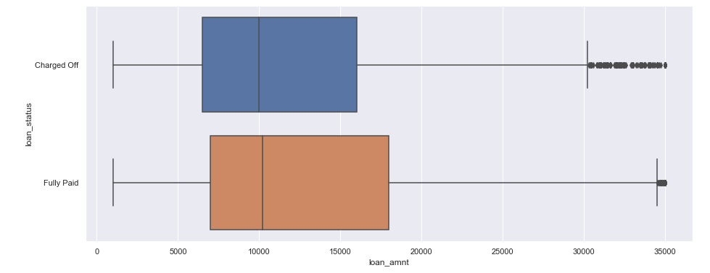

Slide 11
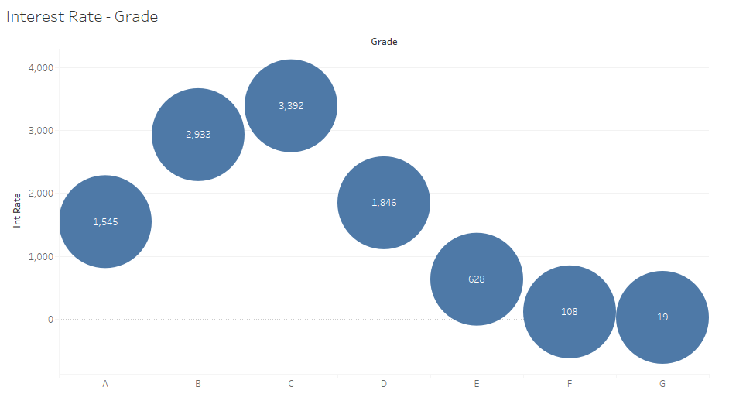
Interest rate distribution over Grade

Slide 12
Problem Statement
The task is the development of the appropriate ML model which can be used to predict ‘Fully Paid” vs “ Charged Off” loans in the Lending Club platform. In this task, you need to develop models to predict which loans are likely to be paid off and which will default. You also have to judge the interrelationship among the variables and determine an effective investment decisions based on your predictive models – we need examine this in details here. You need to focus on parameter tuning, and reliable performance estimates through resampling and cross-validation.

Slide 13
Data Cleaning
Deleting columns with no values
Excluding Univariate columns
Removal of attributes such as url ,zipcode etc based on description
Data consists of 92624 rows and 79 attributes.
Tools Used : Tableau
Programming language : Python
Models are based on Machine Learning Algorithms.

Slide 14
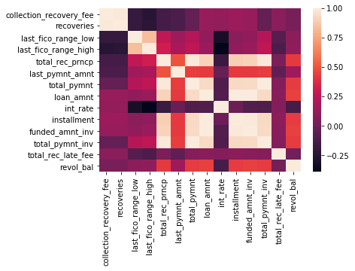

Slide 15
Numerical variable Feature Selection
13 attributes were extracted after decision tree modelling
Model | Random Forest | Decision Tree
Accuracy Score | 96.53 | 96.56
Categorical variable
Pi-square test has been applied on all varaibles and accordingly , attributes of importance is sorted out

Slide 16
Overall Performance of Models on Loan Status
Models were applied on data obtained after cleaning
MODEL | DECISION TREE | BAGGING | RANDOM FOREST | ADA BOOSTING | GRADIENT BOOSTING
ACCURACY SCORE | 95.99% | 99.62% | 99.48% | 99.28% | 99.26%

Slide 17
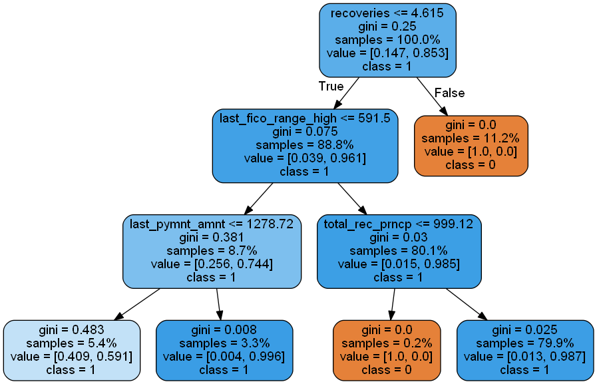
Loan Status interpretation
Given post charge off gross recovery less than 4.6 with last_fico_range_high greater than 591.5 and Principal received to date greater than approximately 1000 has 79.9% chances of paying fully.

Slide 18
Factors affecting loan_status
Loan amount :The listed amount of the loan applied for by the borrower. If at some point in time, the credit department reduces the loan amount, then it will be reflected in this value.
Funded_amnt_inv : The total amount committed by investors for that loan at that point in time.
Purpose_credit_card : A category provided by the borrower for the loan request.
Home_ownership : The home ownership status provided by the borrower during registration. Our values are: RENT, OWN, MORTGAGE, OTHER.
Total_rec_prncp : Principal received to date
Int_rate : Interest Rate on the loan
Total_pymnt : Payments received to date for total amount funded
Title_Debt consolidation :The loan title provided by the borrower
Emp_length_10+ years : Employment length in years.

Slide 19
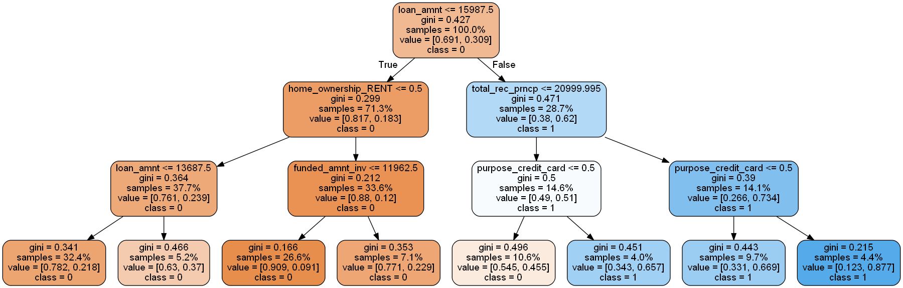
The returns is estimated based on Revolving Balance for given data
For a loan amount greater than 16,000INR with principal received to
date greater than 20,000INR and all purpose except for credit card
make upto 66.9% chances of having a high Revolving Balance.

Slide 20
THANK YOU

