Slide 1
Assesing Superstore Performance
Tool: Tableau

Slide 2
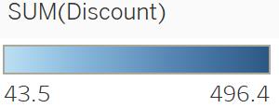
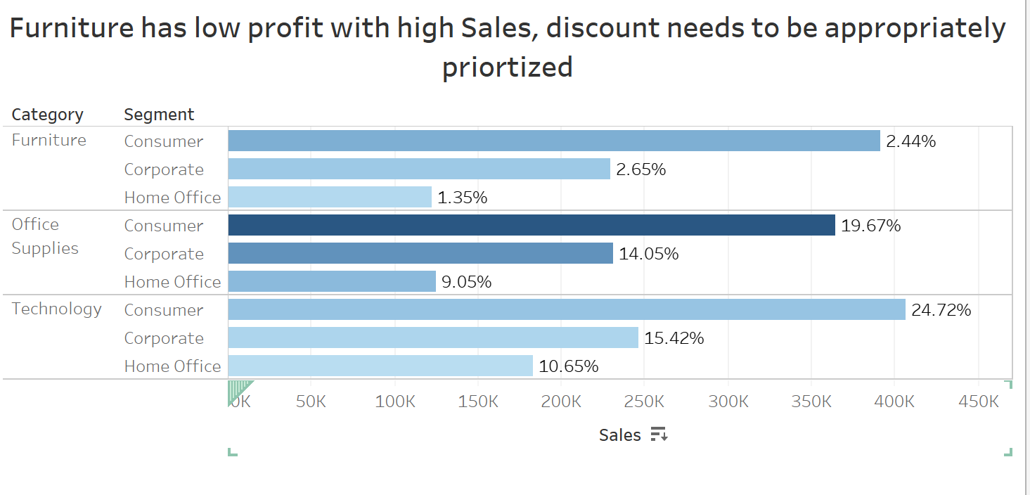
Discount Sales and Profit

Slide 3
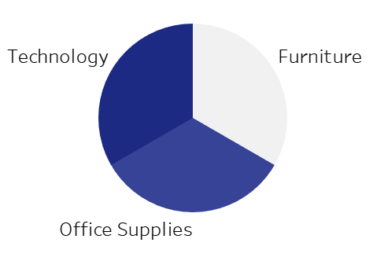
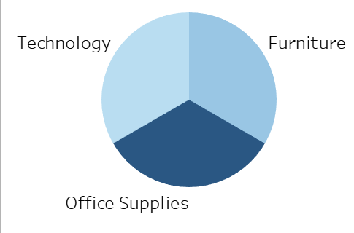
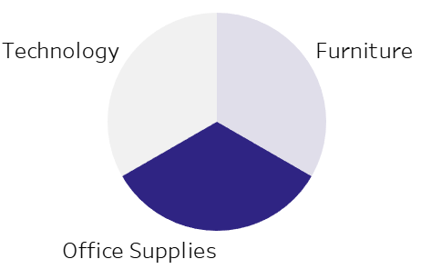
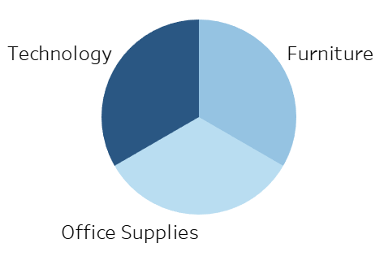
Profit
Discount
Quantity
Sales

Slide 4
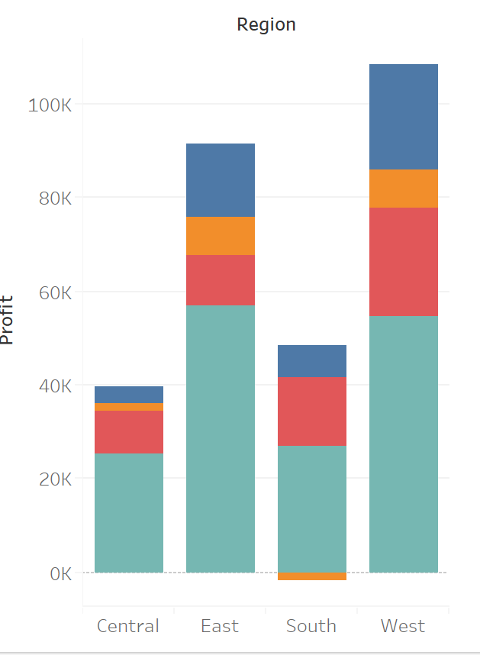
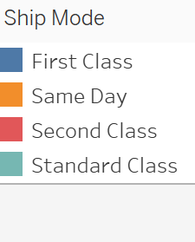
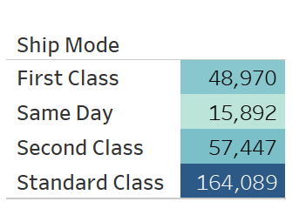
Ship Mode Vs Region
Central Region is a weak area that need to be checked for further changes and improving the profit

Slide 5
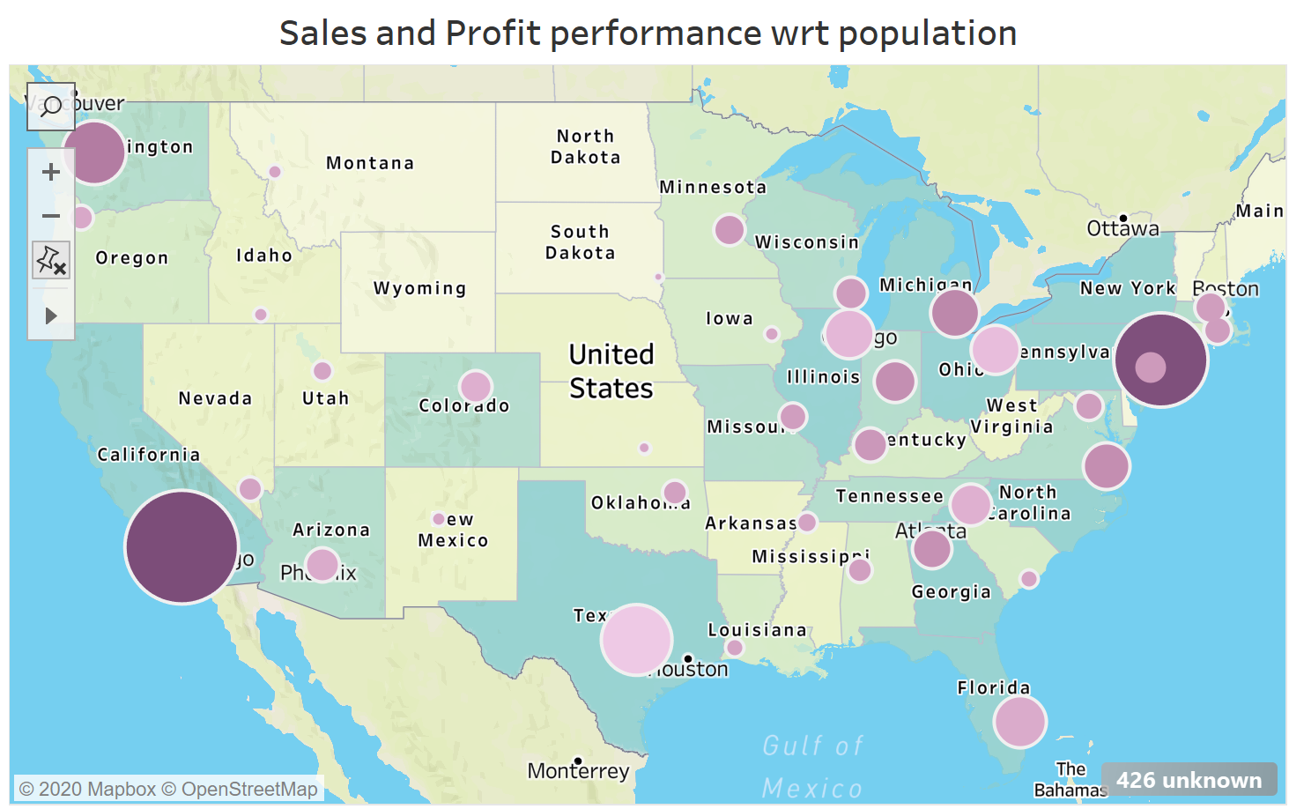
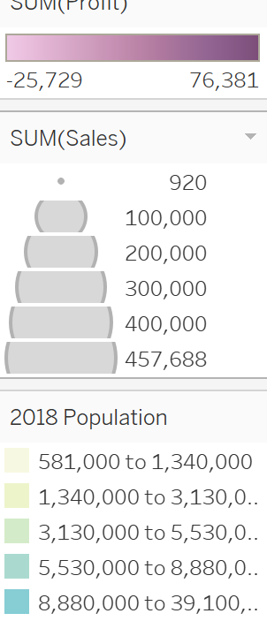

Slide 6
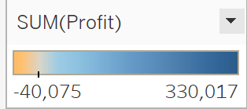
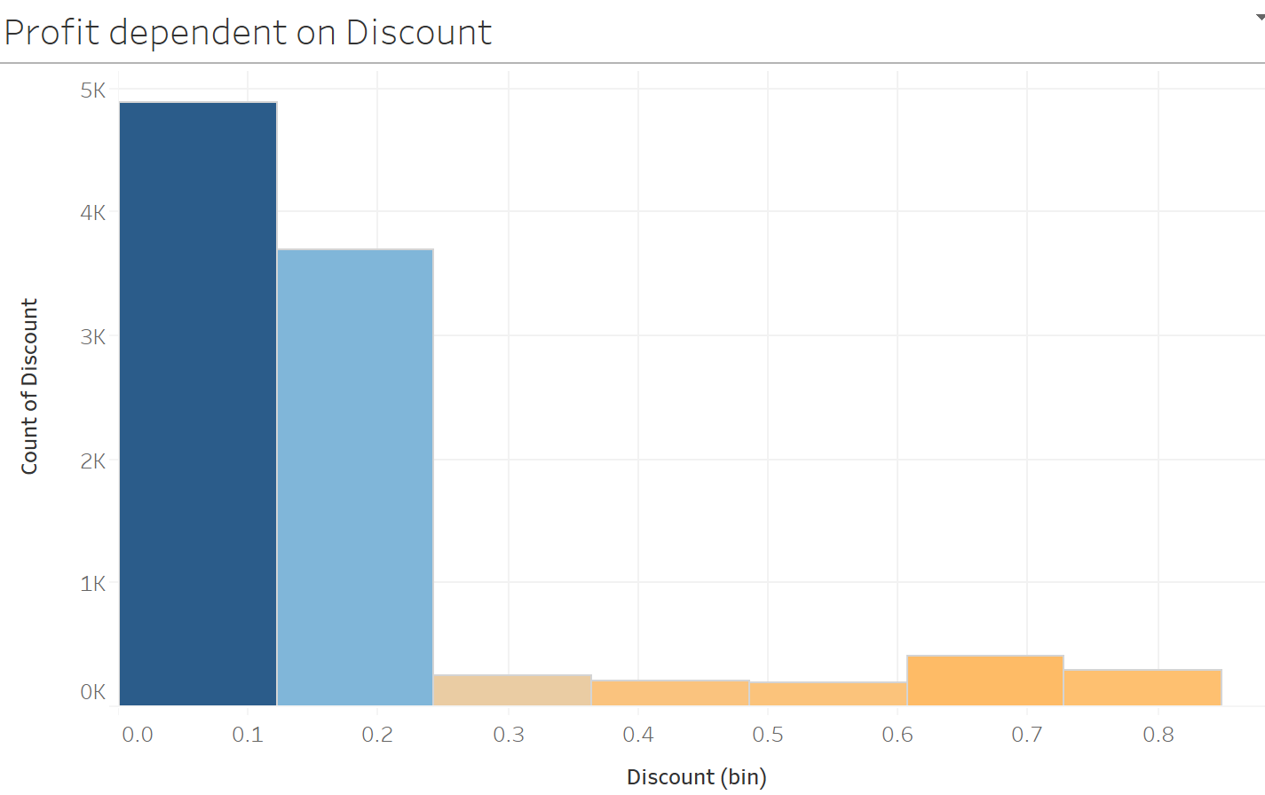

Slide 7
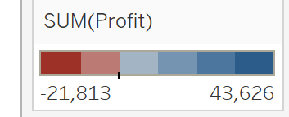
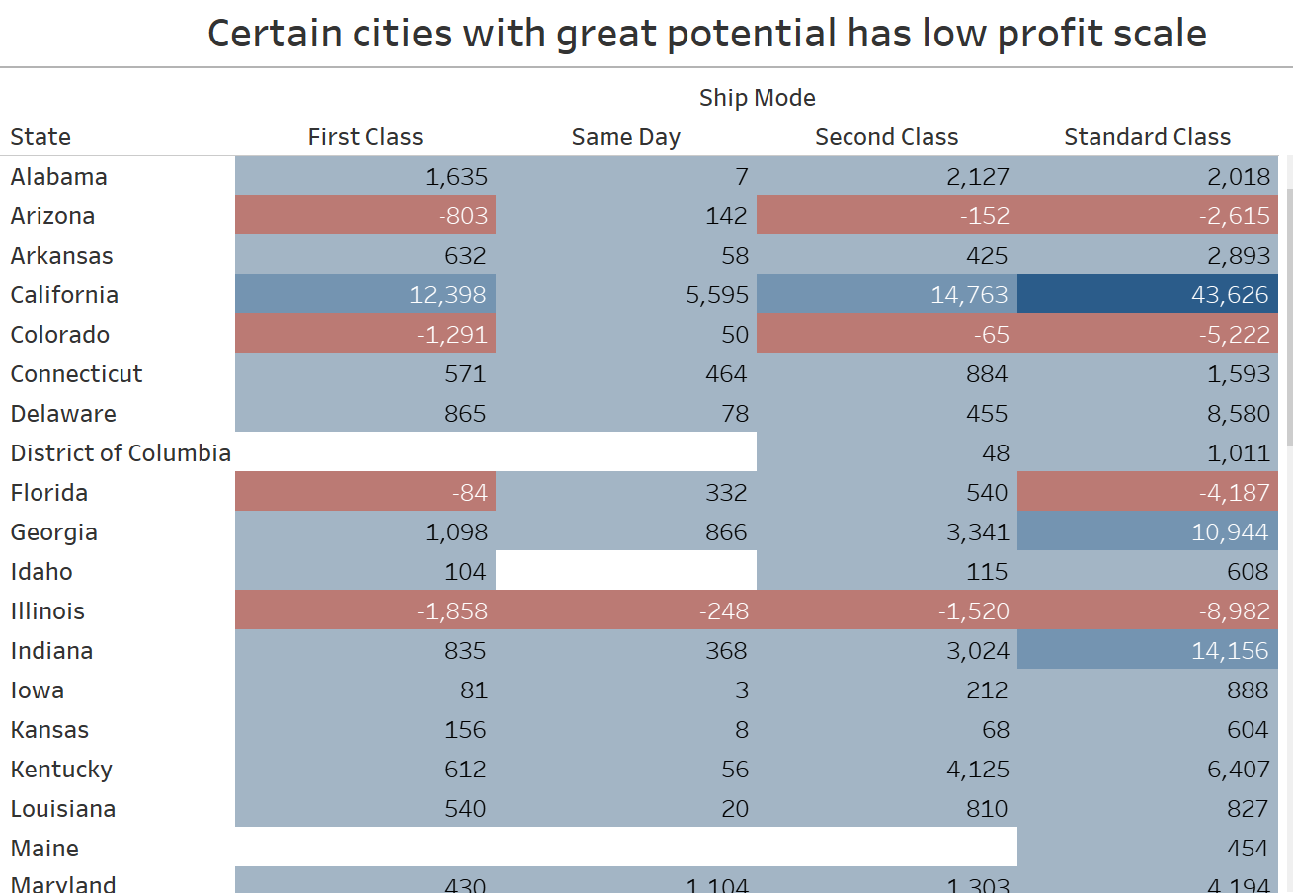

Slide 8
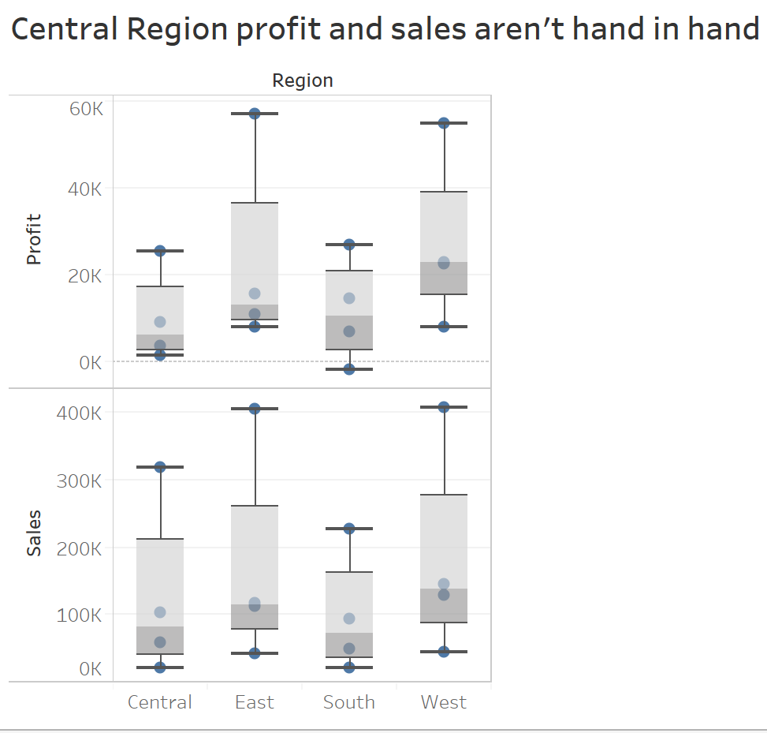

Slide 9
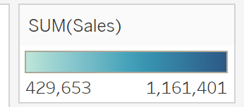
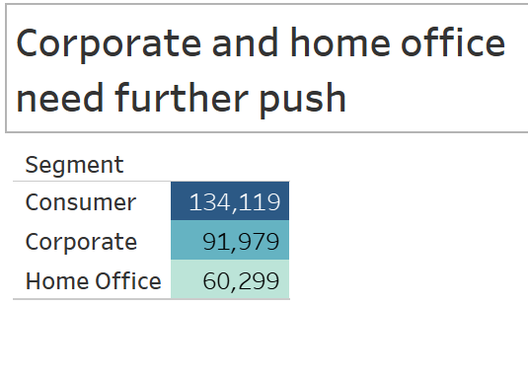
Corporate has scope in improving the revenue

Slide 10
Overall better performing attributes
Technology segment effectively have higher Profit-Sales ratio over the other segments.
East and West are the best with performance keeping revenue as metric.
Consumer category contributed to a good proportion towards company’s growth.
Standard class is twice the first and second class in Ship Mode.

Slide 11
Overall weaker sections leading to business problems
Furniture section has showed has shown least performance.
Central Region contribution can be improved.
Corporate and Home office categories have potential in the growth of the company.
Same day has shown less than average performance.

Slide 12
What can we do to increase the contributions !!
Improve stationary supplies and products that are required for periods of time for Corporate sector by approaching them ourselves , similar to a tie-up.
Same day delivery with extra charges to those customers with immediate requirements in populated areas will be helpful.
Furniture has low Sales-quantity ratio , according to the location of the retail ,new ideas can be incorporated .

