Slide 1
Pruning Neural Networks with Matrix Methods
Yajvan Ravan, Ben Ebanks
May 9, 2024

Slide 2
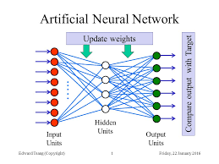
Background
Neural Networks are the state-of-the-art models for tasks such as classification, regression, generative modeling, etc
Most networks are very large
AlexNet (240Mb, 21 M parameters)
ChatGPT (500Gb, 175 B parameters)
Cons: High Inference Time, Need lots of compute, Limited applications in edge computing
Pruning aims to reduce redundant parameters

Slide 3
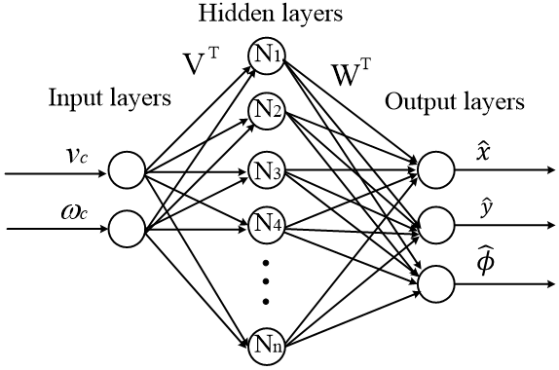
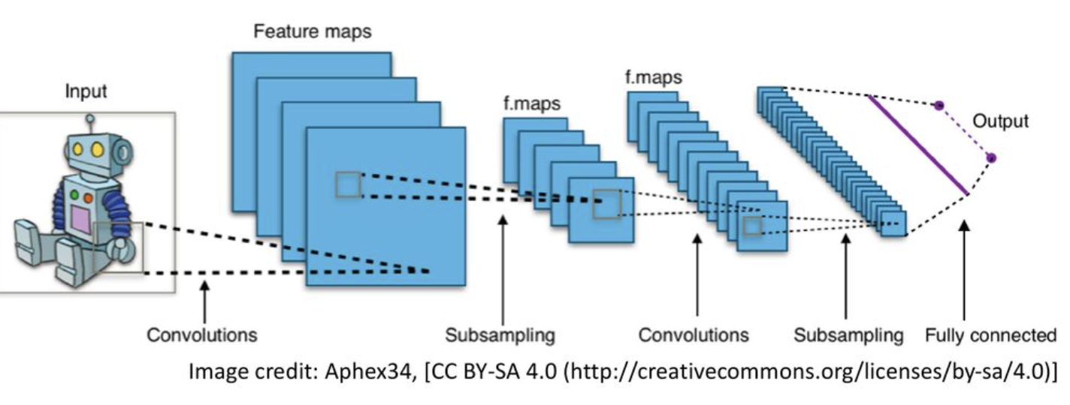
Methods
Fast Post-training Pruning
Linear layer == Matrix Multiplication,
Convolutional Layer ~ Matrix Multiplication
Not quite the same but it is a linear operation
We can approximate each operation with techniques from this class
PCA for dimension reduction
Low-rank approximation for fast multiplication
Randomized linear algebra for fast multiplication
Linear Layer
Convolutional Layer

Slide 4
PCA For Dimension Reduction
W1 (784 x 120)
W2 (120 x 84)
Goal: Reduce the dimensionality of intermediate features
Expected Result:
Applicable for taking high dimensional input to low dimensional output
Ex. Image Encoders, Image/Text Classification
Reduce the Size & Inference Time of the network
Procedure:
PCA to reproject W1 to a smaller output feature space
Preserve most of the variance between the rows of W1
Projection matrix: PCA(W1) => P (120 x 80)
Reproject
W1* = W1 * P (784 x 80)
W2* = P^{T} * W2 (80 x 74)
Essentially, we have reprojected y1* = y1 * P
y1 (1 x 120)
x (1 x 784)
Neural Network
Input: x
Layer 1 output: y1
Layer 1 Weight: W1
Layer 2 Weight: W2
y1 = x * W1

Slide 5
Low-Rank Approximation
W1 (784 x 120)
W2 (120 x 84)
Goal: Make Matrix Multiplication Faster
Expected Result:
Inference time should be drastically reduced for networks with many redundant parameters
Procedure:
Use SVD to compute a low rank approximation of W1
W1 = U * V where U (784 x k) & V (k x 120), k << 120
y1 = x * W1 ===> y1 = x * U * V
Computation time: 784 * 120 ===> 884 * k
y1 (1 x 120)
x (1 x 784)
Neural Network
Input: x
Layer 1 output: y1
Layer 1 Weight: W1
Layer 2 Weight: W2
y1 = x * W1

Slide 6
Randomized Linear Algebra
W1 (784 x 120)
W2 (120 x 84)
Goal: Make Matrix Multiplication Faster
Expected Result:
Inference time should be drastically reduced for networks with many equivalent parameters
Procedure:
Use Random Matrix Multiplication to do multiplication
y1 = x * W1
Computation: 784 * 120 ===> 120 * num_samples
y1 (1 x 120)
x (1 x 784)
Neural Network
Input: x
Layer 1 output: y1
Layer 1 Weight: W1
Layer 2 Weight: W2
y1 = x * W1

Slide 7
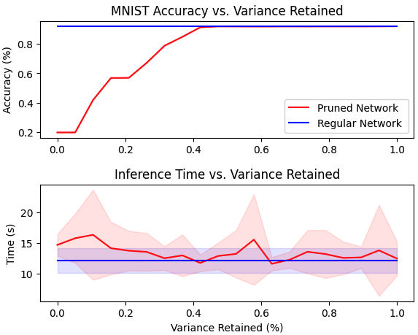
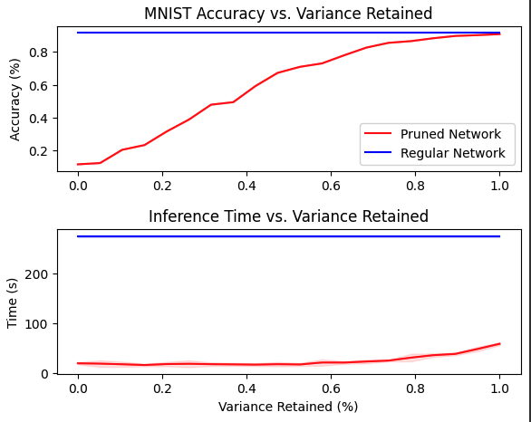
Preliminary Results
Large Linear Network:
PCA:
Small Linear Network
Hidden Units: 120, 84
Hidden Units: 128, 512, 2048, 8192, 2048, 512, 128

Slide 8
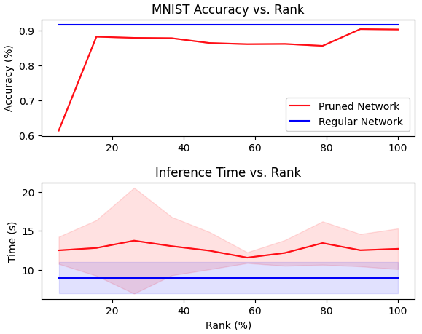
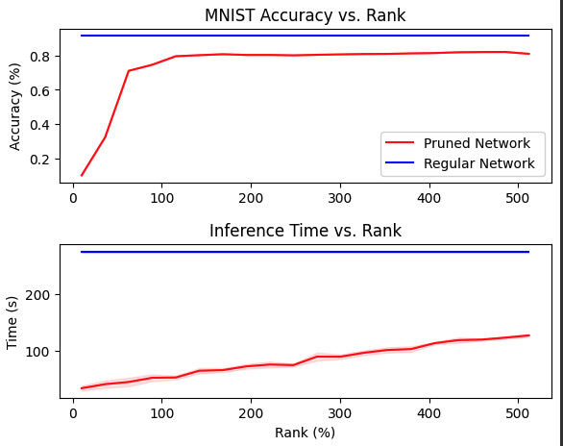
Preliminary Results
Large Linear Network:
Low-Rank Approximation:
Small Linear Network
Hidden Units: 120, 84
Hidden Units: 128, 512, 2048, 8192, 2048, 512, 128

Slide 9
References
Emily Denton, Wojciech Zaremba, Joan Bruna, Yann LeCun, and Rob Fergus. 2014. Exploiting linear structure within convolutional networks for efficient evaluation. In Proceedings of the 27th International Conference on Neural Information Processing Systems - Volume 1 (NIPS'14). MIT Press, Cambridge, MA, USA, 1269–1277.
Garg, I., Panda, P. and Roy, K. (2020) ‘A low effort approach to structured CNN design using PCA’, IEEE Access, 8, pp. 1347–1360. doi:10.1109/access.2019.2961960.
Jaderberg, M., Vedaldi, A. and Zisserman, A. (2014) ‘Speeding up convolutional neural networks with low rank expansions’, Proceedings of the British Machine Vision Conference 2014 [Preprint]. doi:10.5244/c.28.88.
Levin, Asriel, Todd Leen, and John Moody. "Fast pruning using principal components." Advances in neural information processing systems 6 (1993).

