Slide 1

Notes:
Baseball is a bat-and-ball sport played between two teams, each consisting of nine players. It is widely regarded as America's pastime and has gained popularity worldwide. The game is divided into two main phases: offense and defense. The offensive team, or batting team, takes turns sending a batter to the plate to face pitches from the opposing team's pitcher. The defensive team, or fielding team, aims to prevent runs by fielding the ball and making strategic plays.

Slide 2

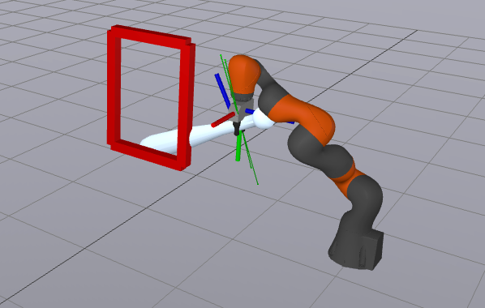
BatterBot: A Case Study in Trajectory Optimization for Nonprehensile Manipulation
6.4210 Robotic Manipulation Final Project
Felix Huang, Stephen Hong, Yajvan Ravan

Slide 3
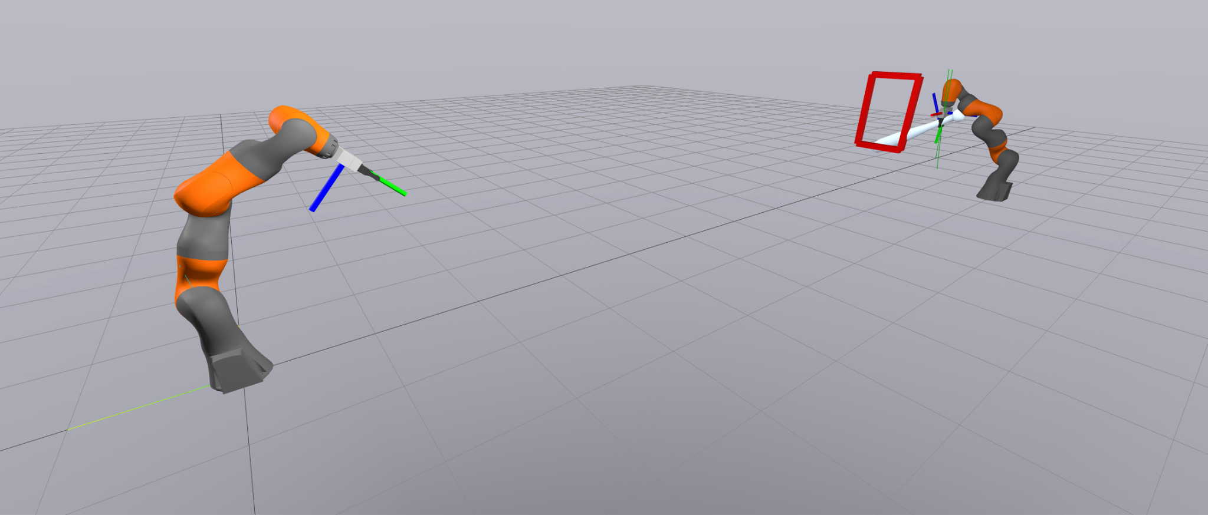
Why Baseball?
Classic (& Favorite) Sport
Interesting Manipulation Tasks
Pitching
Batting
Limited literature on nonprehensile manipulation for dynamic aerial objects
Nonprehensile = when an object is not in grasp for entirely of the task

Slide 4
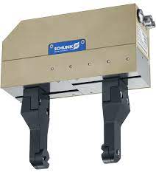
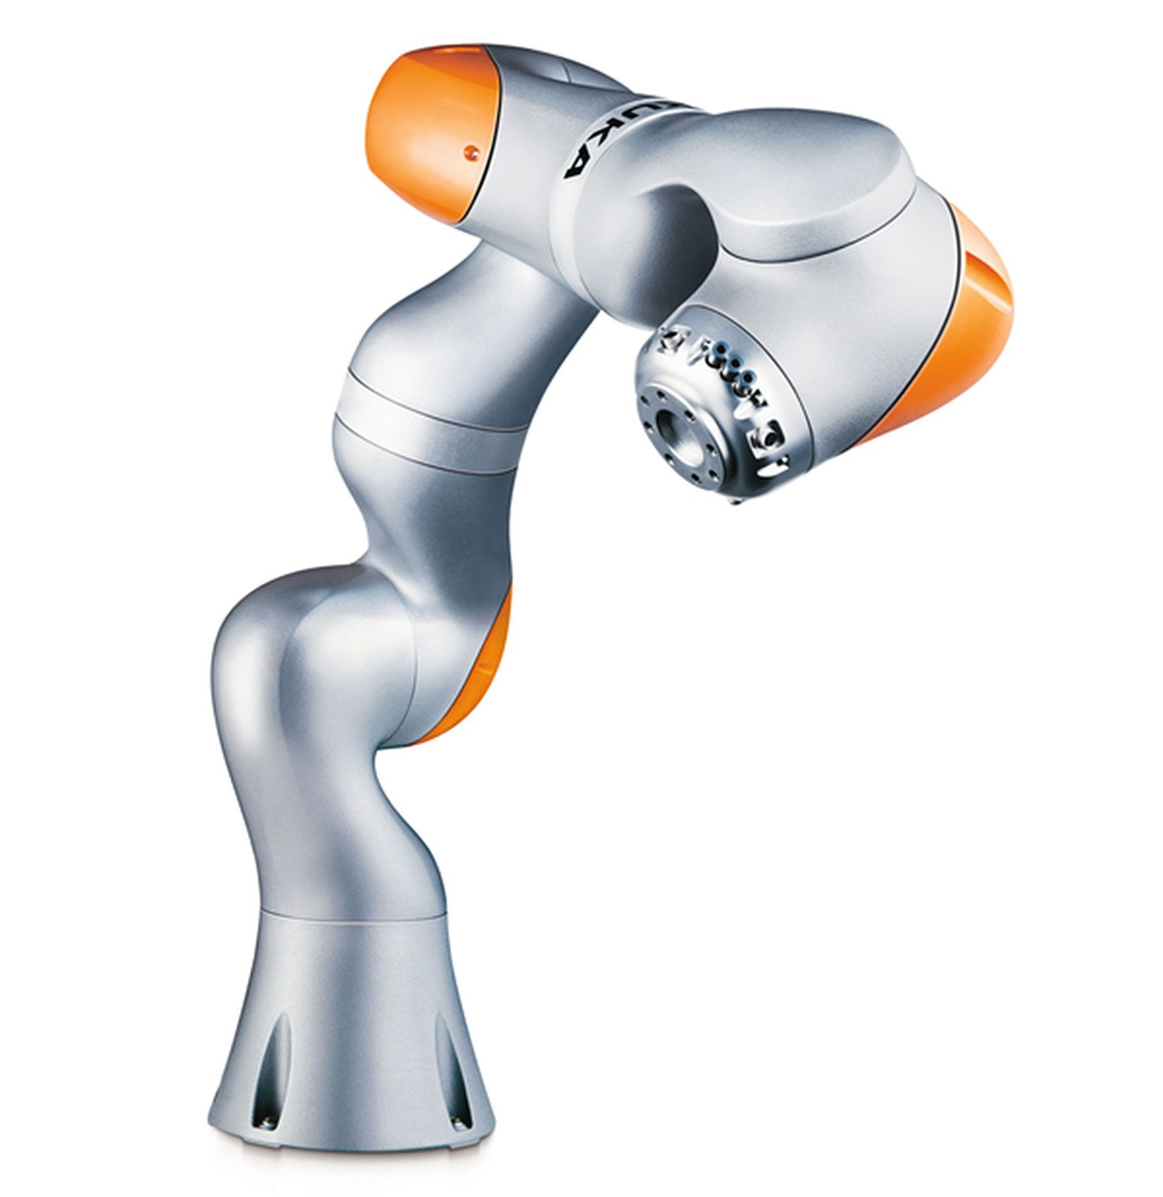
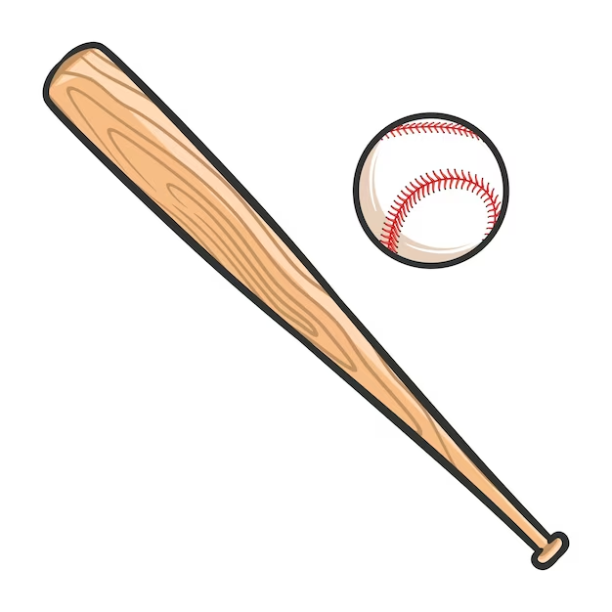
Simulation Setup
Models from Drake and TurboSquid
Notes:
Set up sim with drake /deepnote for development pipeline
Two Kuka iiwa robot arms, each equipped with a Schunk WSG two finger gripper
The models for theses and the ball are provided by drake
Import bat from turbosquid and changed its inertial/geometric properties to fit into the simulation

Slide 5
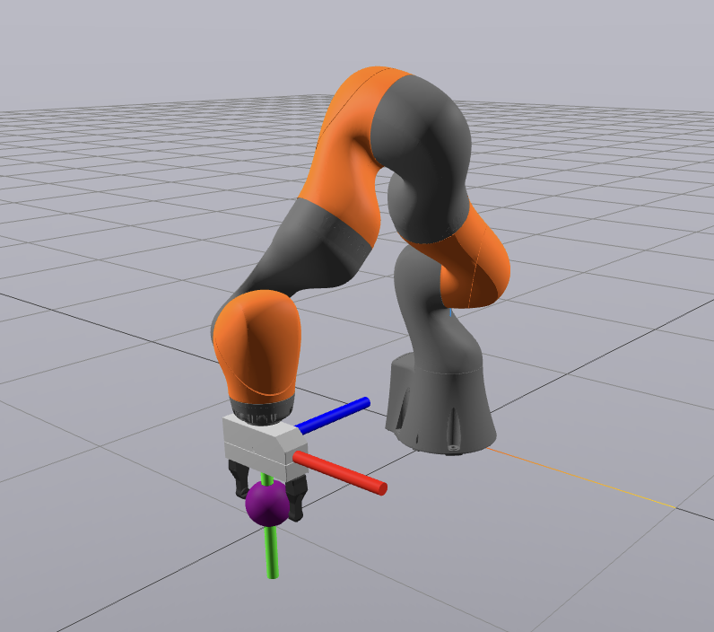
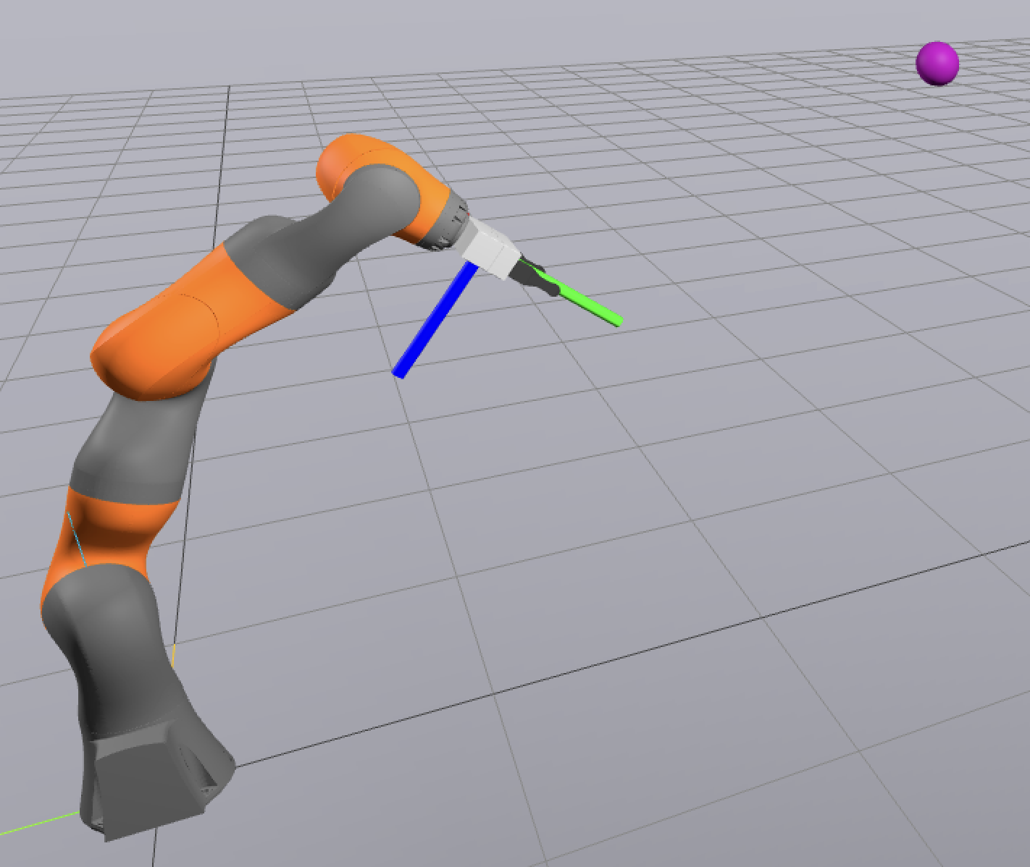
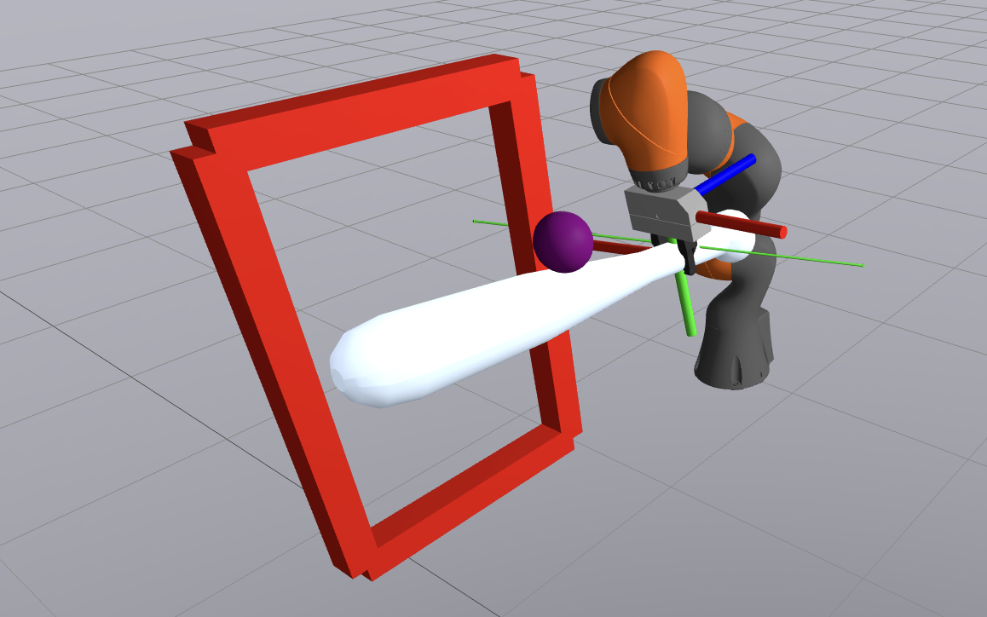
System Design
Grasp
Pitch
HIT!
Notes:
Our system, BatterBot, simulates a simplified game of
baseball in which one robot arm pitches the ball and another
robot bats the ball. To pick up the baseball, the pitcher bot uses a antipodal grasp
to maximize the contact area between the ball and gripper which allows for a
more secure hold. To pitch the baseball, the pitcher robot
chooses a randomly desired position within the ”strike zone”
and calculates and executes a trajectory that can be generated,
within robot constraints, to aim for that position. To bat the
ball, the batter robot uses knowledge of the initial position
and velocity of the ball and determines a trajectory to meet
the ball at a desired position with the desired velocity.

Slide 6
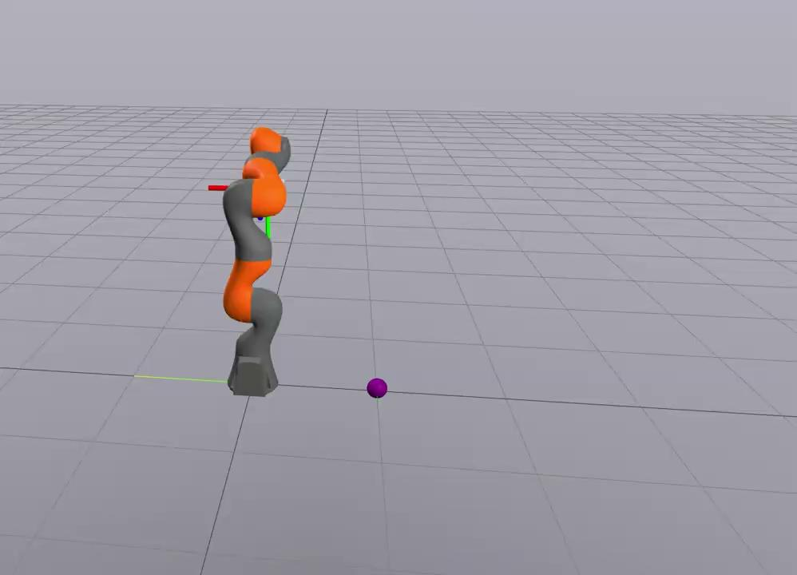
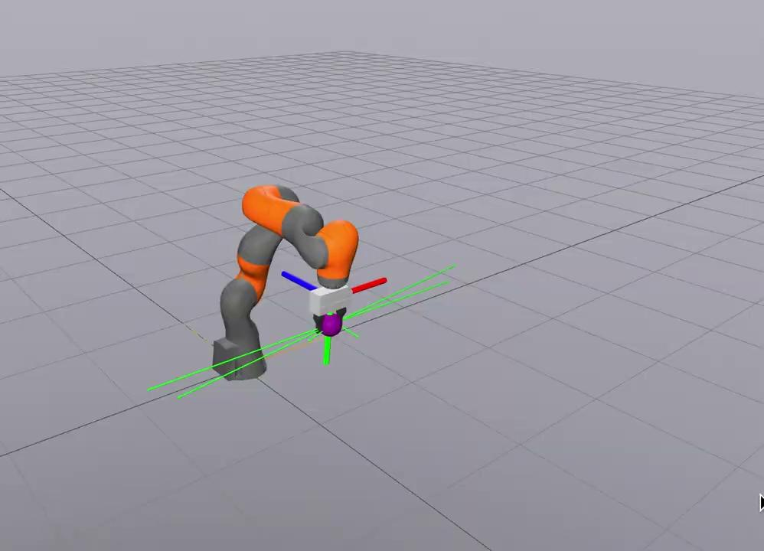
Pitching
Picking
Throwing
Notes:
We split the pitching motion into a pick and
then throw.
Picking:
Our first method of picking involved generating a trajectory
of poses using linear interpolation between the key frames.
While this generates a smooth trajectory, adding
In a second iiwa and free bodies made it significantly more
computationally expensive, slowing down the simulation.
Our second method of picking involved optimization-based inverse kine-
matics. In this iteration, we used the 5 key gripper frames and
performed inverse kinematics (IK) for all the poses. This method ended up
Being more computationally efficient, which is why we chose this approach.
Throwing:

Slide 7
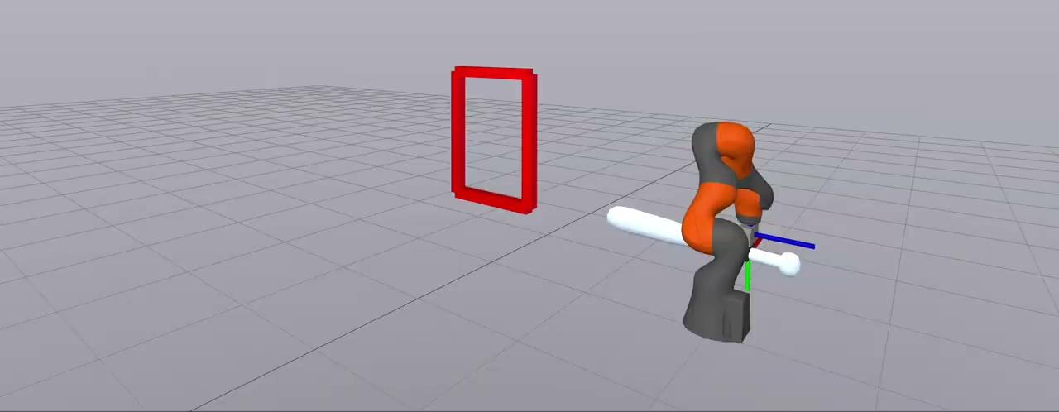
Batting
Hitting
Example of a bunt
Notes:
For the batting robot, we use the same optimization methods
as for pitching.
To swing the
bat, we define a desired swing position and velocity.
Given the pitch position and velocity, the batter
computes the trajectory of the ball’s path. It then picks the position
where the trajectory intersects its ”strike zone” (as defined
by the rules of baseball) and computes a desired velocity
in a direction opposite of the ball’s velocity and twice the
magnitude.
Then using that it computes a trajectory for itself to hit the ball

Slide 8
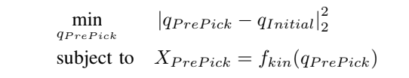
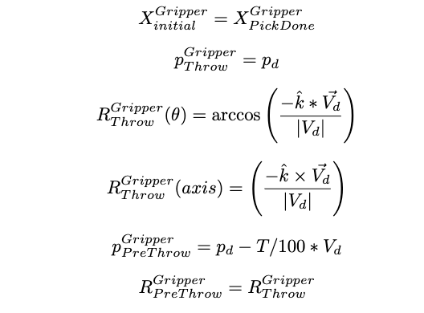

Trajectory Optimization
Inverse Kinematics:
Kinematic Trajectory Optimization:
Position Constraints
Velocity Constraints

Slide 9
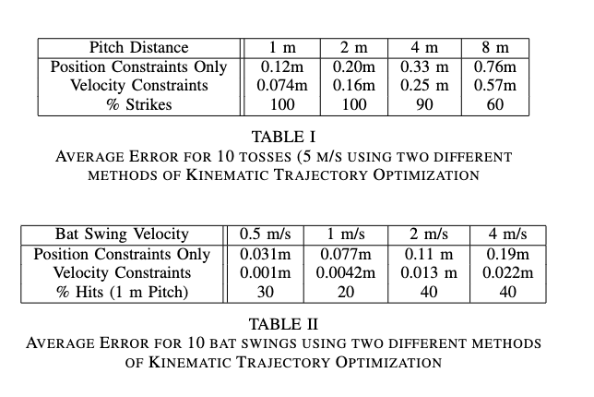
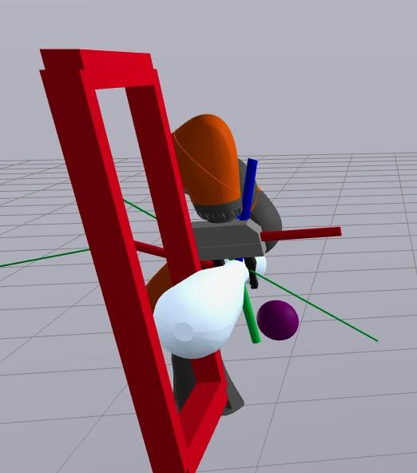
Results
*As of this morning, Hit/Strike rate (up to 4m) is now 100%
Notes:
Table 1 is number of pitches that enter the strikebox
Table 2 is the percent of hits given diff bat swing velocities
The faster you swing less variance in the final position of the bat

Slide 10
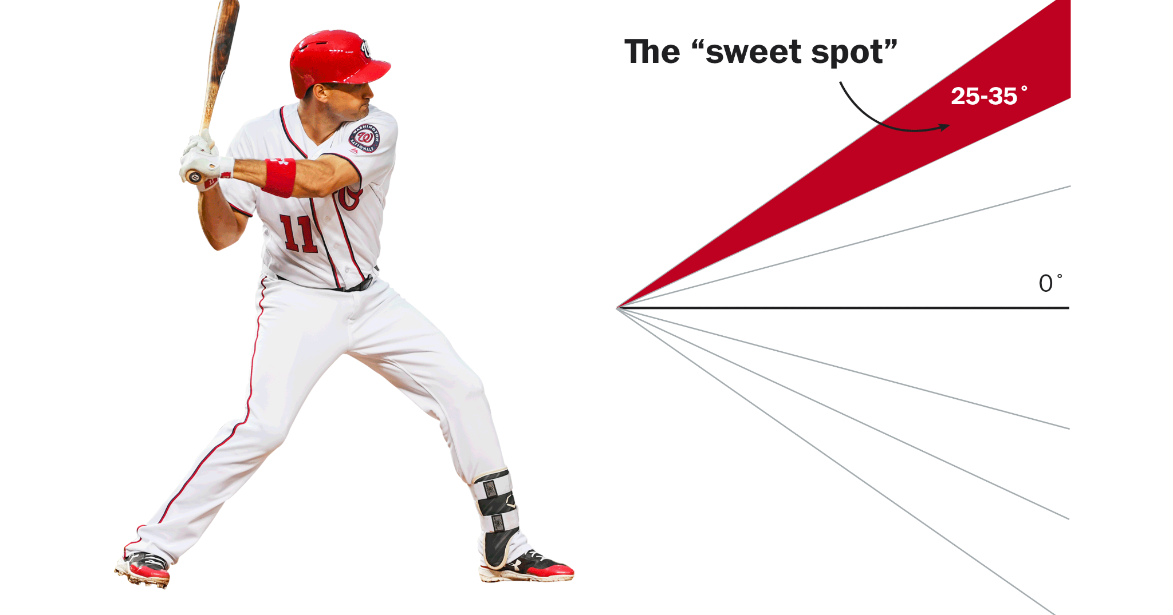
Limitations
Use of privileged information
Awareness of pitch trajectory
Implement perception algorithm
Physics Modeling
Notes:
The design assumes batter robot is aware of the pitch trajectory. In the real world, such information is not available. It will have to be estimated by the robot, which we can do using a perception alg
Dont apply air resistance drakes hydroelastic contact modeling, which would makes the physics of the simulation more realistic

Slide 11
Future Work
Visual pose estimation
Explore dynamics of friction
Test trajectory optimization framework for other tasks
Notes:
Need to estimate path trajectory visually; can use an RGBD camera to generate a 3D point cloud
Model gripper friction and release dynamics can improve accuracy
See if traj opt framework as effective in other non prehensile scenarios; push chair, roll ball

Slide 12
Thank You!

