Slide 1
MMM
Marketing Mix Model
Data-Driven Budget Optimization
Omar Oudrari
March 2026
Executive Leadership Team
CONFIDENTIAL | FOR INTERNAL USE ONLY

Slide 2



THE PROBLEM
We Spend $4.5M/Year Across 5 Channels —
But Don't Know What's Working
No Attribution
Budget Waste
Missed Revenue
Cannot determine which channels actually drive revenue vs. merely correlate with it.
TV gets 44% of spend but delivers the lowest ROI at 0.55x. Estimated misallocation costs $635K+/year.
Under-investment in high-ROI channels (Email at 7.48x, Display at 2.34x) leaves money on the table.
Bottom Line: Without a model, budget decisions rely on intuition — not evidence.
2 / 10

Slide 3
METHODOLOGY
A Rigorous 5-Step Modeling Pipeline
01
02
03
04
05
Raw Spend
Data
Adstock
Transform
Saturation
(Hill Fn)
OLS
Regression
Decompose
& Optimize
Weekly channel
investment data
Geometric decay
for carryover
Diminishing returns
curve fitting
With seasonality,
holiday, competitor
Attribution +
budget allocation
Key Assumptions
Adstock captures carryover effects (e.g., TV ad seen this week drives purchase next week). Saturation via Hill function models the point of diminishing returns per dollar spent. Together they remove bias that would distort a naive regression. Controls for seasonality, holidays, and competitor promotions isolate the true marketing effect.
3 / 10

Slide 4
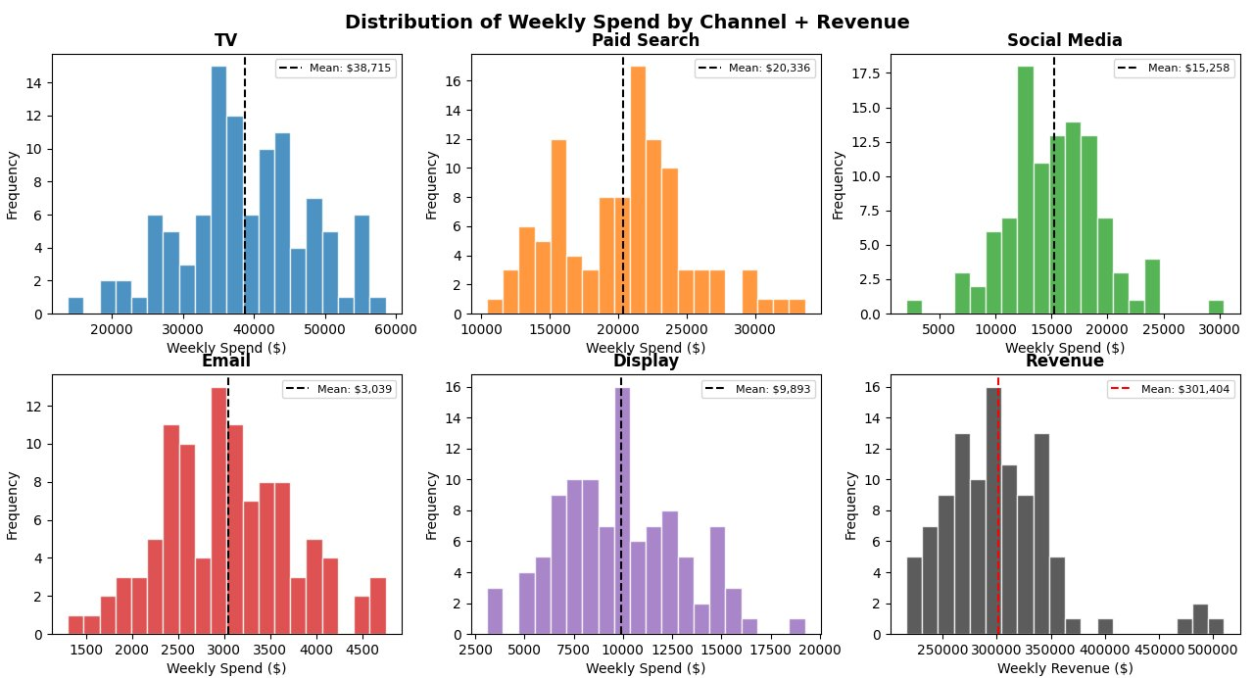
DATA
2 Years of Weekly Data Across 5 Paid Channels
104
5
3
Weeks of data (2 yrs)
Marketing channels
Control variables
Channel | Avg Weekly Spend | Spend Range | % of Budget
TV | $38,715 | $14K – $59K | 44%
Paid Search | $20,336 | $10K – $34K | 23%
Social Media | $15,258 | $2K – $30K | 17%
Display | $9,893 | $3K – $19K | 11%
Email / CRM | $3,039 | $1K – $5K | 3%
Mean Weekly Revenue: $301,404
Total Weekly Budget: $87,240
Controls: seasonality index, holiday flags (Black Friday +75%, Christmas +60%), competitor promo (−8%)
4 / 10

Slide 5
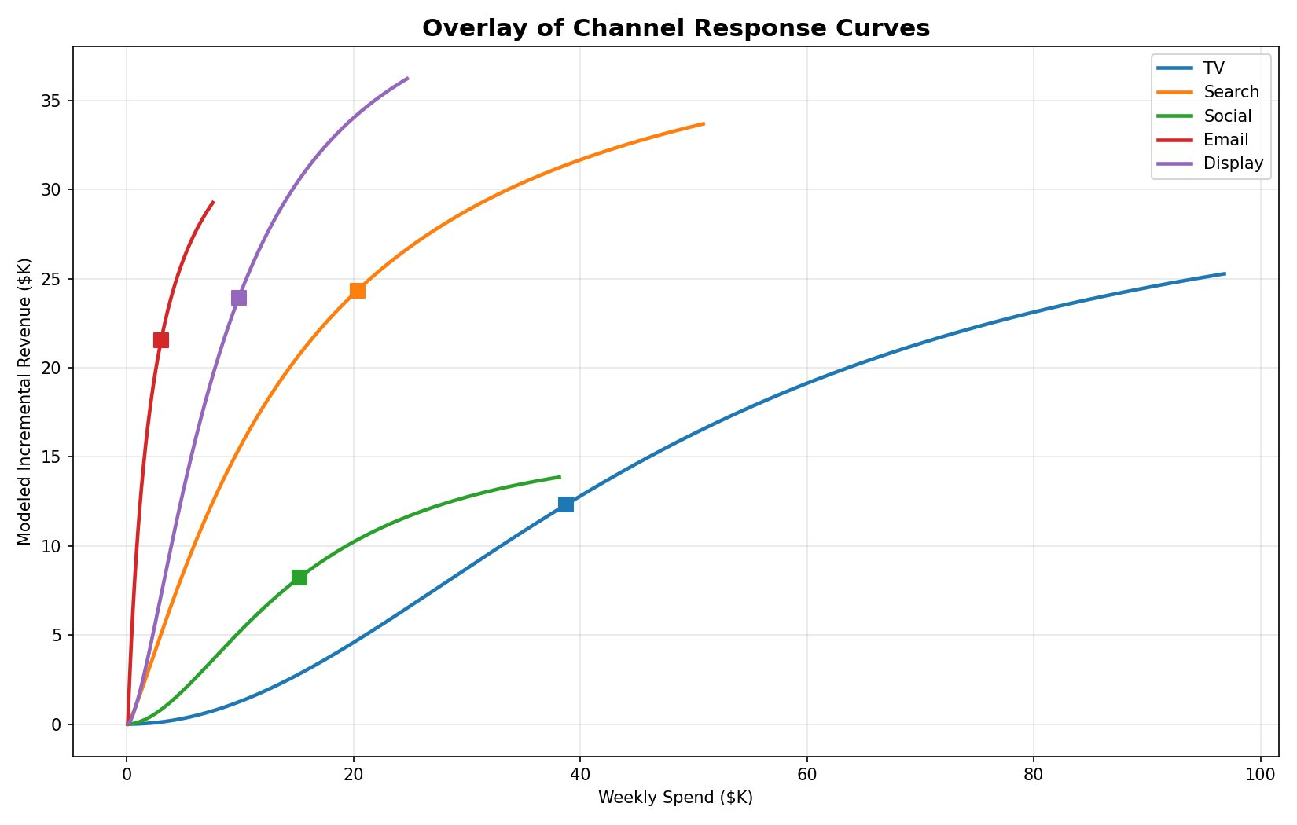
FINDINGS
Every Channel Shows Diminishing Returns — But at Different Rates
Email
Highest ROI at 7.48x — saturates fast due to small list size, but every dollar works hard.
Display
Strong 2.34x ROI — currently underfunded at 11% of budget. Room to scale.
Search
Moderate 1.15x ROI — solid performance channel with concave returns.
TV
Lowest ROI at 0.55x — gets 44% of budget but is deep in diminishing returns.
5 / 10

Slide 6
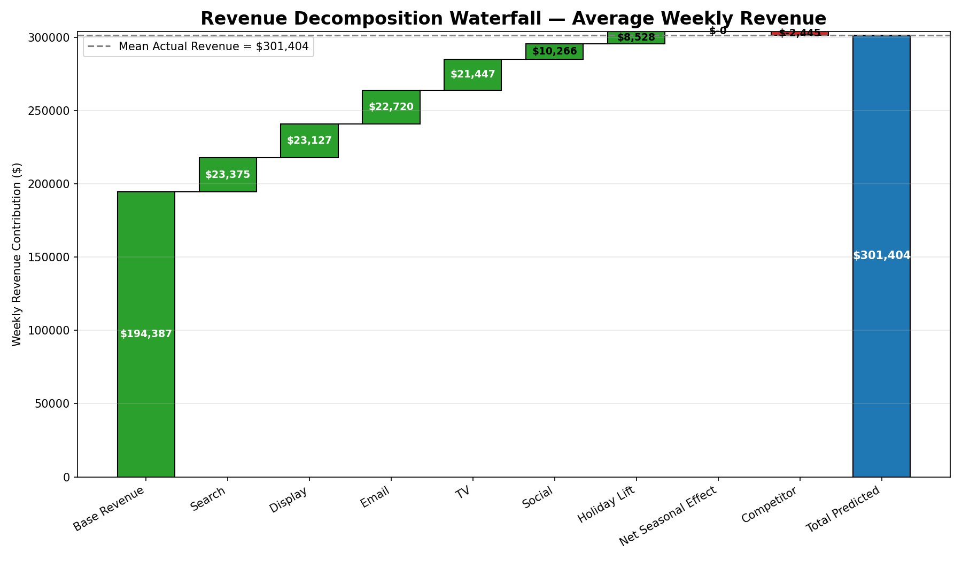
FINDINGS
Revenue Decomposition: What's Actually Driving Sales?
Contribution Breakdown
64%
Base revenue (organic / brand)
8%
Paid Search — top paid driver
8%
Display — strong efficiency
8%
Email — highest per-dollar impact
7%
TV — large spend, modest lift
3%
Social + Holiday + Other
6 / 10

Slide 7
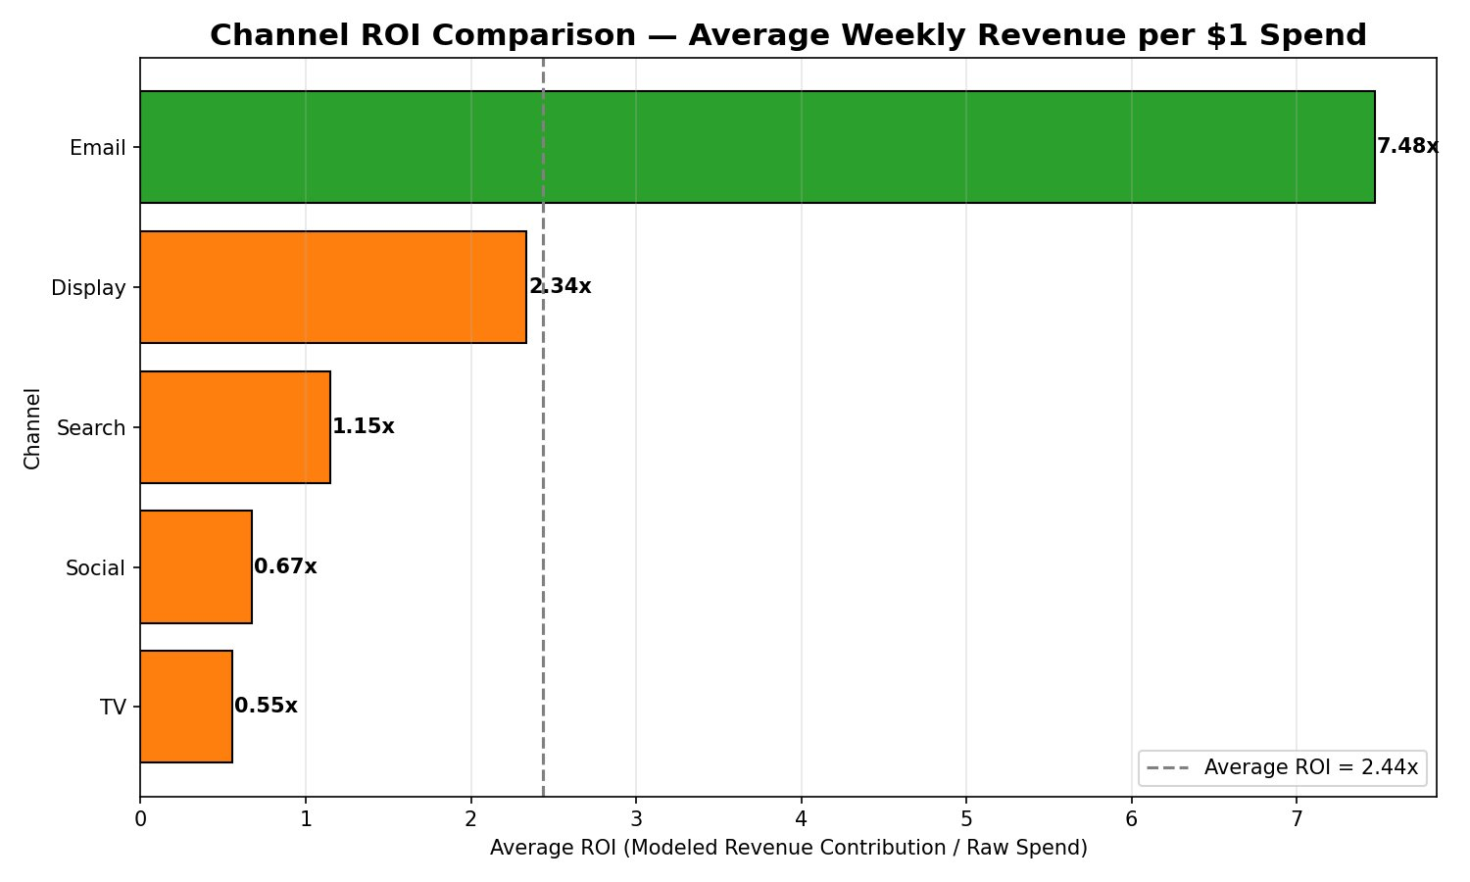
FINDINGS
Not All Channels Are Equal: ROI Varies 14x Across Channels
MOST EFFICIENT
Email / CRM
$7.48 return per $1 spent
Smallest budget, highest leverage. Constrained by list size, not spend ceiling.
LEAST EFFICIENT
TV
$0.55 return per $1 spent
Commands 44% of budget but delivers the lowest marginal return of all channels.
7 / 10

Slide 8
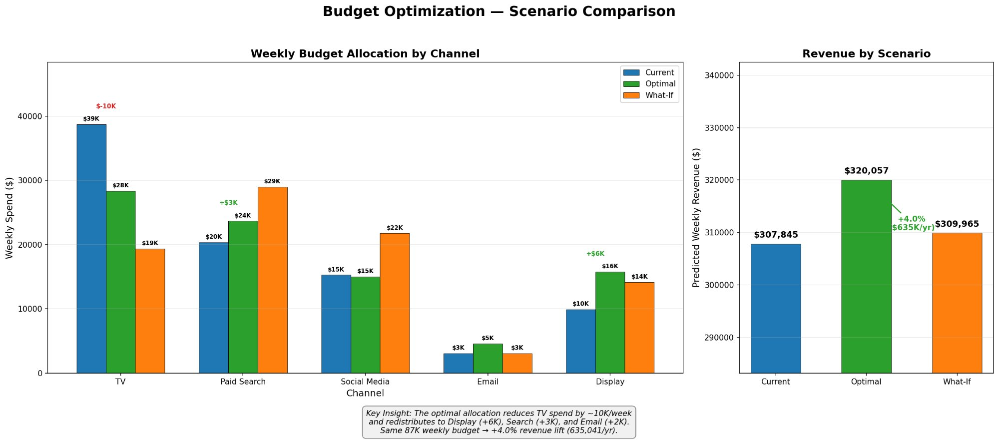
OPTIMIZATION
Reallocation Could Generate +4% More Revenue — Same Budget
8 / 10

Slide 9
RECOMMENDATIONS
Reallocating Budget Could Unlock $635K in Incremental Annual Revenue
01
Cut TV from $39K to $28K/week
02
Scale Display from $10K to $16K/week
−$10.4K/wk redeployed
+$5.8K/wk invested
TV consumes 44% of budget at a 0.55x ROI. The model shows it is deep into diminishing returns. Redirect to higher-ROI channels.
Second-highest ROI at 2.34x and still in the steep part of its response curve. Room to scale before hitting saturation.
03
Increase Paid Search to $24K/week
04
Grow Email from $3K to $5K/week
+$3.3K/wk invested
+$1.5K/wk invested
Moderate 1.15x ROI with solid performance. Response curve shows it can absorb incremental spend efficiently up to ~$28K.
Highest marginal ROI at 7.48x. Constraint is list quality, not budget. Invest in CRM hygiene and list growth to unlock ceiling.
9 / 10

Slide 10
Next Steps
From Model to Impact — a 90-Day Roadmap
Days 1–30
Days 31–60
Days 61–90
Validate with Real Data
A/B Test Budget Shift
Build Monitoring Dashboard
Integrate actual revenue and spend feeds
Re-run model on production data
Audit adstock / saturation parameters with media team
Pilot Display + Email increase in 2 test markets
Reduce TV spend in test cohort by $10K/wk
Measure lift against holdout group
Weekly ROI tracker per channel
Alert when spend crosses saturation threshold
Monthly model refresh pipeline
Questions? | Omar Oudrari | oudraroa@dukes.jmu.edu

