Slide 1
AVANT-GARDE
THE DURABILITY
MAINSTREAM LUXURY
FAST FASHION
PARADOX
How Avant-Garde Fashion Brands Outlast the Brands That Outspend Them
Omar Oudrari · JMU College of Business
Dataset: 12 brands · 18 variables · Sources: OTB Group, Owenscorp, LVMH, Kering, Business of Fashion, Fashion Revolution FTI, Vestiaire Collective, Grailed
Rick Owens
Maison Margiela
Comme des Garçons
Yohji Yamamoto
Ann Demeulemeester
Helmut Lang

Slide 2
CONTENTS
01
Thesis & Argument
The core claim and why it matters
02
Industry Context
Three-tier landscape: avant-garde, mainstream luxury, fast fashion
03
The Anti-Virality Paradox
Revenue vs. social media scale
04
The Resale Signal
Secondary market as brand durability proxy
05
Revenue & Business Model
Growth, DTC strategy, and ownership structure
06
Ethics, Transparency & The Regulatory Illusion
Why disclosure scores don't measure ethics
07
The Archive Premium
When a brand's past is worth more than its present
08
Synthesis & Implications
What the data proves about scarcity as strategy

Slide 3
01 · THESIS & ARGUMENT
Scarcity, mystique, and designer authorship create brand moats that volume-dependent luxury and trend-dependent fast fashion structurally cannot replicate — making avant-garde brands some of the most durable businesses in fashion despite never chasing scale.
SCARCITY
MYSTIQUE
AUTHORSHIP
Scarcity by Design
Mystique as Moat
Authorship as Durability
Limited distribution, no licensing, no diffusion lines that dilute the brand. Rick Owens refuses department store placement. Comme des Garçons sells primarily through Dover Street Market — its own retail.
The designer is the brand. Martin Margiela never showed his face. Rei Kawakubo rarely speaks. Yohji Yamamoto gives almost no interviews. This opacity creates irreplaceable identity.
These brands aren't run by committees or trend forecasters. They're the sustained vision of a single creative mind — which creates collector markets, archive premiums, and cultural permanence.

Slide 4
02 · INDUSTRY CONTEXT
Three distinct business models, three distinct durability profiles
AVANT-GARDE
MAINSTREAM LUXURY
FAST FASHION
Rick Owens · Maison Margiela · Comme des Garçons
Yohji Yamamoto · Ann Demeulemeester · Helmut Lang
Louis Vuitton (LVMH) · Gucci (Kering) · Balenciaga (Kering)
Zara (Inditex) · H&M (H&M Group) · Shein (Private)
Business Model
Business Model
Business Model
Independent or small-group ownership. Intentionally limited distribution. Revenue $35M–$310M. Designer as sole creative authority.
Conglomerate-owned. Global retail networks. Revenue €1.5B–€20B. Creative directors are replaceable employees.
Volume-driven. Trend-reactive. Revenue €20B–€30B. No creative authorship. Competing on price and speed.
Strength
Strength
Strength
Identity moat — impossible to replicate the designer's vision
Scale and capital — can absorb a bad creative director
Mass market reach — billions of customers
Risk
Risk
Risk
Succession risk — what happens when the designer leaves?
Brand dilution — too many product lines, too much accessibility
Zero brand equity — replaceable by the next cheaper competitor

Slide 5
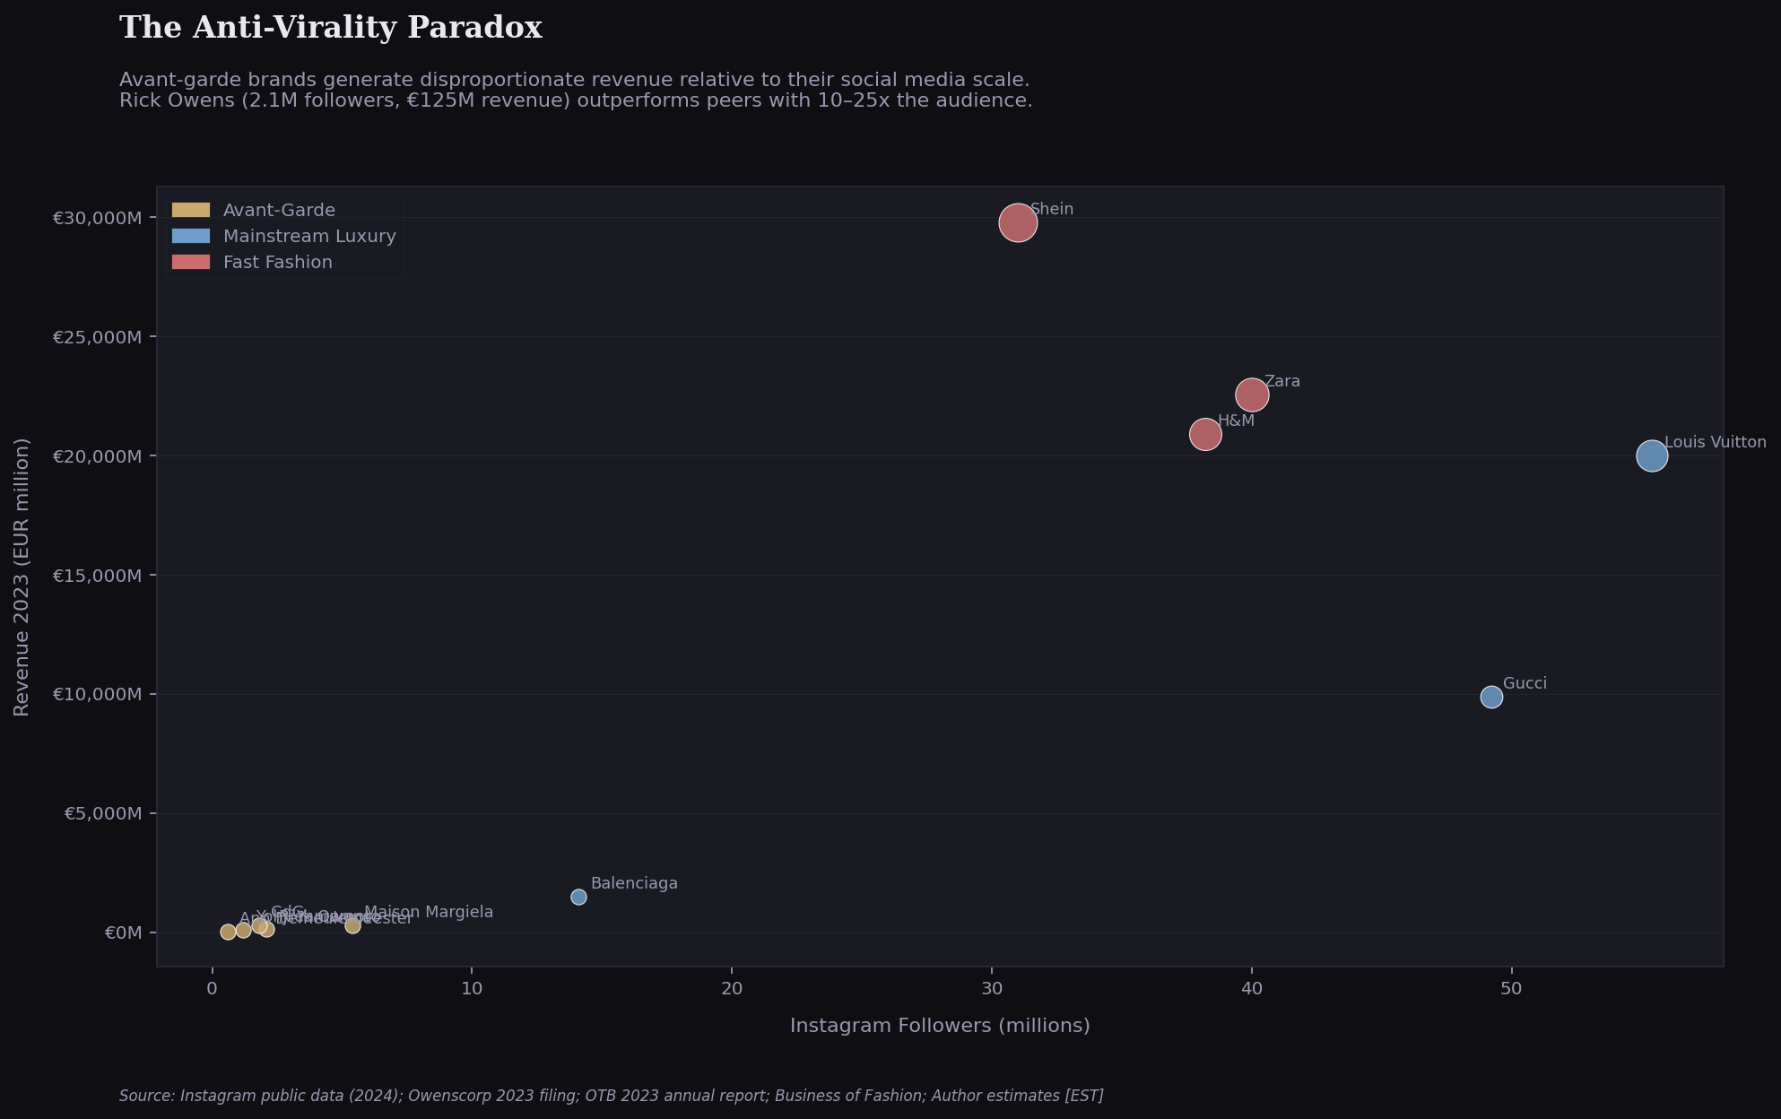
03 · THE ANTI-VIRALITY PARADOX
Revenue vs. Social Media Scale
KEY FINDING
Rick Owens generates €125M in revenue with 2.1M Instagram followers. Shein has 31M followers. The ratio is inverted — and intentional.
WHY IT WORKS
Virality is a liability for luxury brands. Mass exposure erodes the perception of scarcity. Avant-garde brands cultivate deliberate obscurity — making the brand feel like a discovery, not an advertisement.
Source: Instagram public data (2024); Owenscorp 2023 filing; OTB 2023 annual report; Business of Fashion; Author estimates

Slide 6
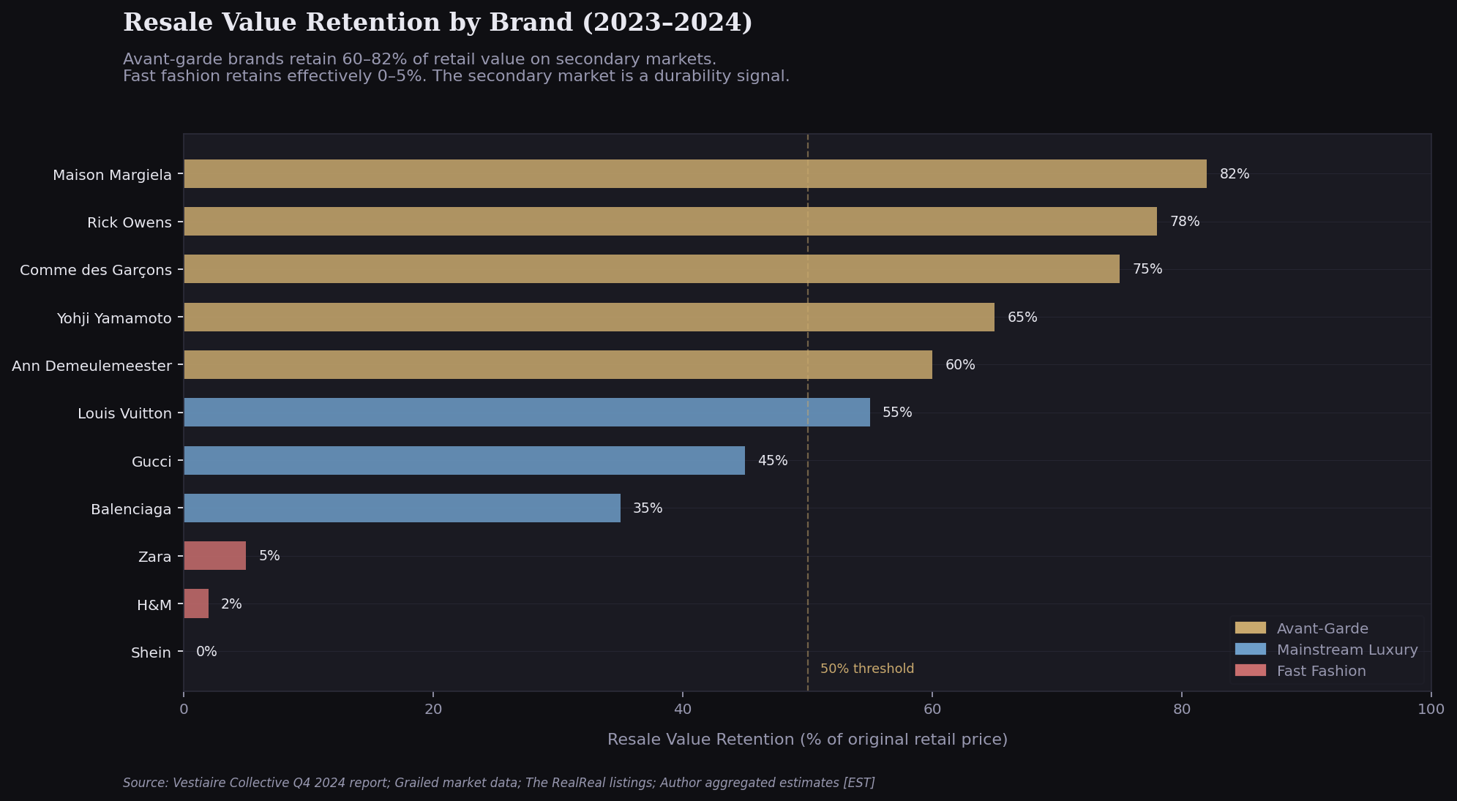
04 · THE RESALE SIGNAL
Secondary Market Performance as a Brand Durability Indicator
82%
Maison Margiela resale retention
300%+
Helmut Lang archive premium
2–5%
Fast fashion resale retention
The secondary market is a leading indicator of brand health. When buyers confidently pay 80%+ of retail for used pieces, it signals that the brand's value proposition transcends the transaction.
Source: Vestiaire Collective Q4 2024; Grailed sold listings; The RealReal; Sotheby's Martin Margiela 2019 sale; Author aggregated estimates

Slide 7
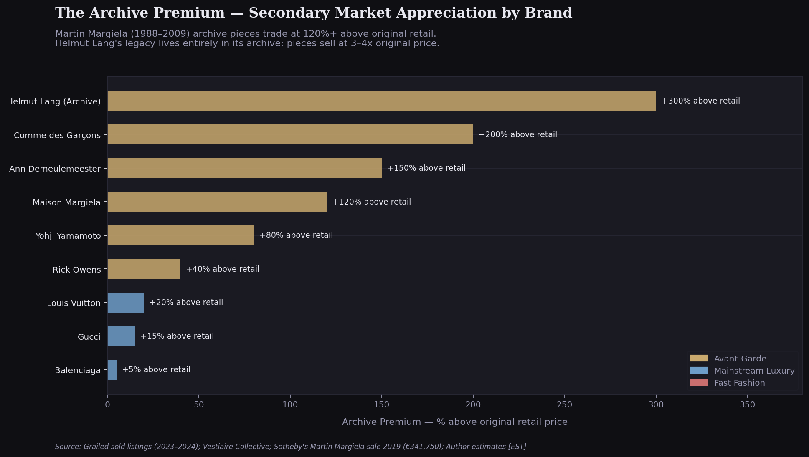
07 · THE ARCHIVE PREMIUM
When a Brand's Past is Worth More Than Its Present
HELMUT LANG
Helmut Lang left fashion in 2005. The brand was sold. The designer became a visual artist. Yet his archive (1986–2004) trades at 300–400% above original retail prices — 20 years after he stopped designing.
WHAT THIS PROVES
Avant-garde brands don't just build loyalty — they build collector ecosystems. The brand's value becomes decoupled from its operational existence. No luxury conglomerate brand has achieved this. No fast fashion brand ever will.
Source: Grailed sold listings (2023–2024); Vestiaire Collective; Sotheby's Martin Margiela sale 2019 (€341,750 realized)

Slide 8
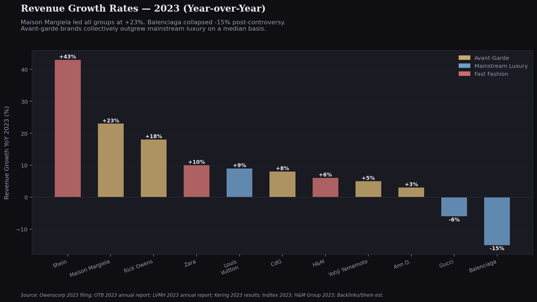
05 · REVENUE & BUSINESS MODEL
2023 Growth Rates — Avant-Garde Outperforms on a Median Basis
+23%
Maison Margiela 2023
+18%
Rick Owens 2023
-15%
Balenciaga 2023
-6%
Gucci 2023
Maison Margiela's 23% growth in 2023 — while Balenciaga contracted 15% following brand controversy — illustrates a core thesis point: avant-garde brands are insulated from cultural backlash by their deliberate distance from mass culture.
Source: OTB Group 2023 Annual Report; Owenscorp 2023 filing; LVMH 2023 Annual Report; Kering 2023 Results; Inditex 2023; H&M Group 2023; Backlinko/Shein estimates

Slide 9
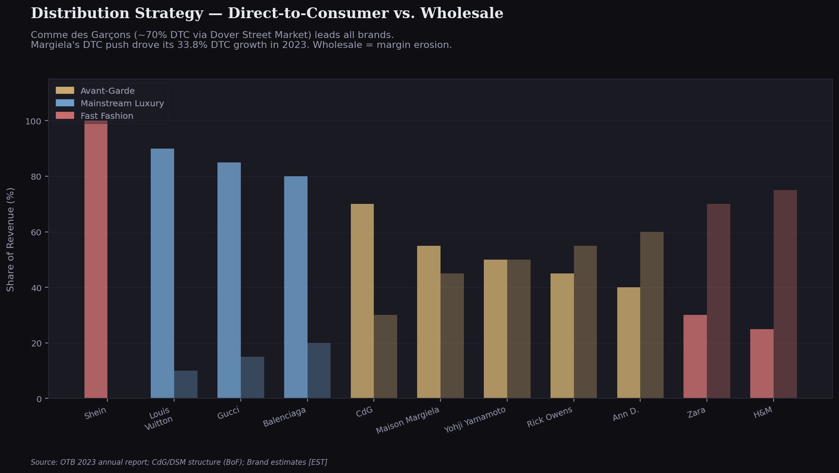
05 · DISTRIBUTION STRATEGY
Direct-to-Consumer as a Scarcity Mechanism
DTC AS CONTROL
Comme des Garçons (~70% DTC via Dover Street Market) owns the entire customer relationship. No department store markup. No promotional discounting. No brand dilution through adjacent product placement.
MARGIELA'S SHIFT
OTB Group reported Maison Margiela's DTC channel grew 33.8% in 2023 — the fastest growth segment across the entire group. Wholesale is a margin-erosion mechanism. DTC is a brand-control mechanism.
Source: OTB Group 2023 Annual Report; Comme des Garçons / DSM structure (Business of Fashion, Adrian Joffe profile); Brand estimates

Slide 10
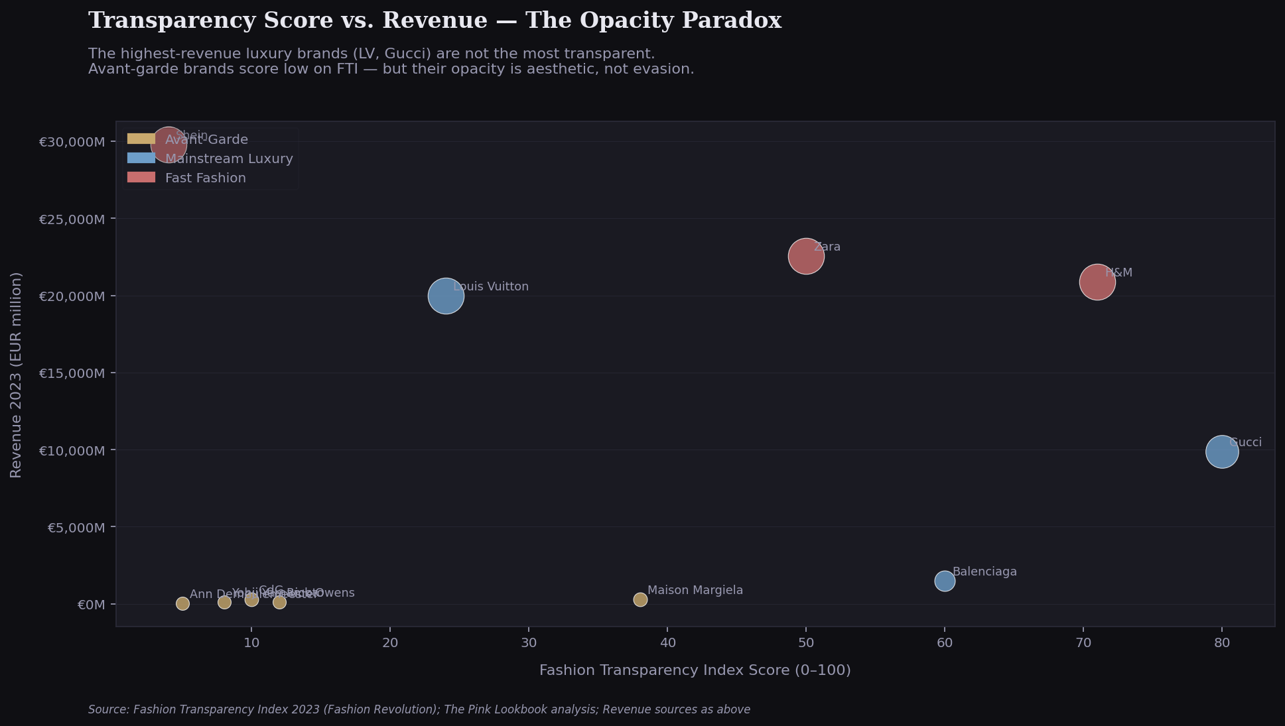
06 · ETHICS, TRANSPARENCY & THE REGULATORY ILLUSION
High Transparency Scores Reflect Regulatory Pressure — Not Superior Ethics
The EU Fashion Strategy
The European Commission's 2022 EU Strategy for Sustainable and Circular Textiles mandates supply chain disclosure for brands selling in the EU. Compliance is mandatory for large brands — not optional ethics.
LVMH & Kering Lobbying
Both conglomerates have active EU lobbying operations. Kering's 2023 sustainability report was produced partly in response to the EU Corporate Sustainability Reporting Directive (CSRD) — a legal obligation, not a moral choice.
The Avant-Garde Exception
Rick Owens, Comme des Garçons, and Yohji Yamamoto are not in the Fashion Transparency Index's 250-brand sample — they're too small. Their low scores reflect absence from the reporting infrastructure, not ethical failure.
What Low Scores Actually Mean
A small Parisian atelier with 350 employees producing limited runs in Italy is structurally less harmful than a brand producing 600,000 SKUs per month in unaudited Chinese factories — regardless of their FTI scores.
Source: Fashion Transparency Index 2023 (Fashion Revolution); EU Strategy for Sustainable and Circular Textiles (2022); EU CSRD; Kering 2023 Sustainability Report; LVMH 2023 Annual Report

Slide 11
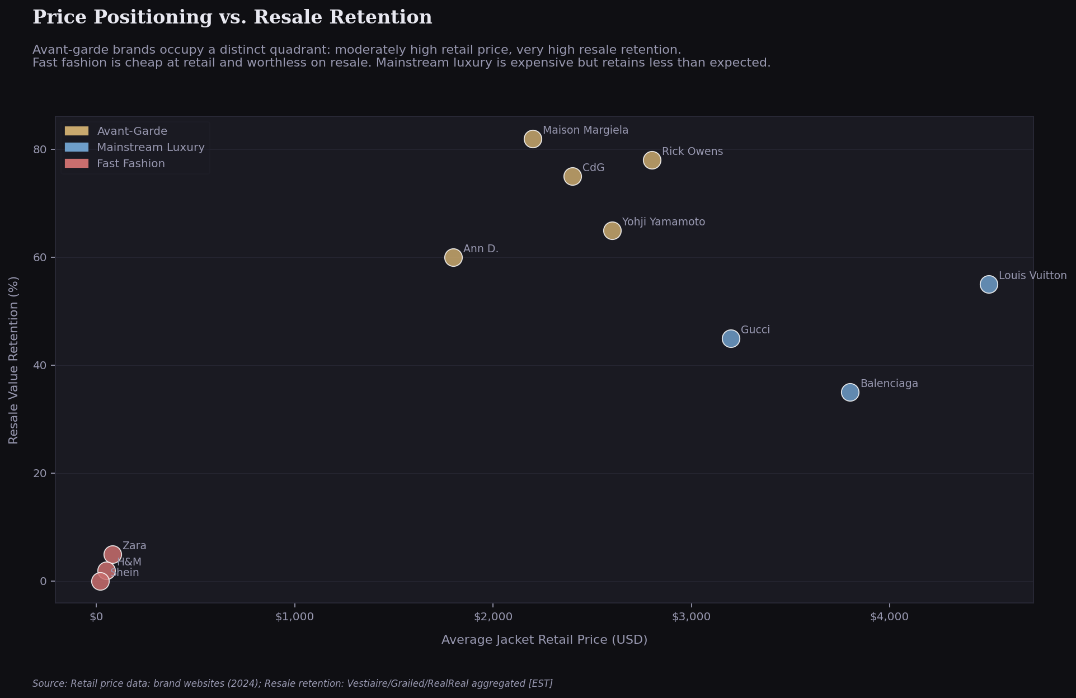
05 · PRICE POSITIONING
The Distinct Quadrant — Moderate Price, Maximum Retention
THE QUADRANT
Avant-garde brands occupy a unique quadrant: moderate retail price with very high resale retention.
Fast fashion is cheap at retail and worthless on resale.
Mainstream luxury is expensive at retail but retains less value than expected — because their pieces are not scarce enough to appreciate.
Avant-garde pieces are priced at a premium but retain most of that value — because the market correctly identifies them as collectible objects, not consumer goods.

Slide 12
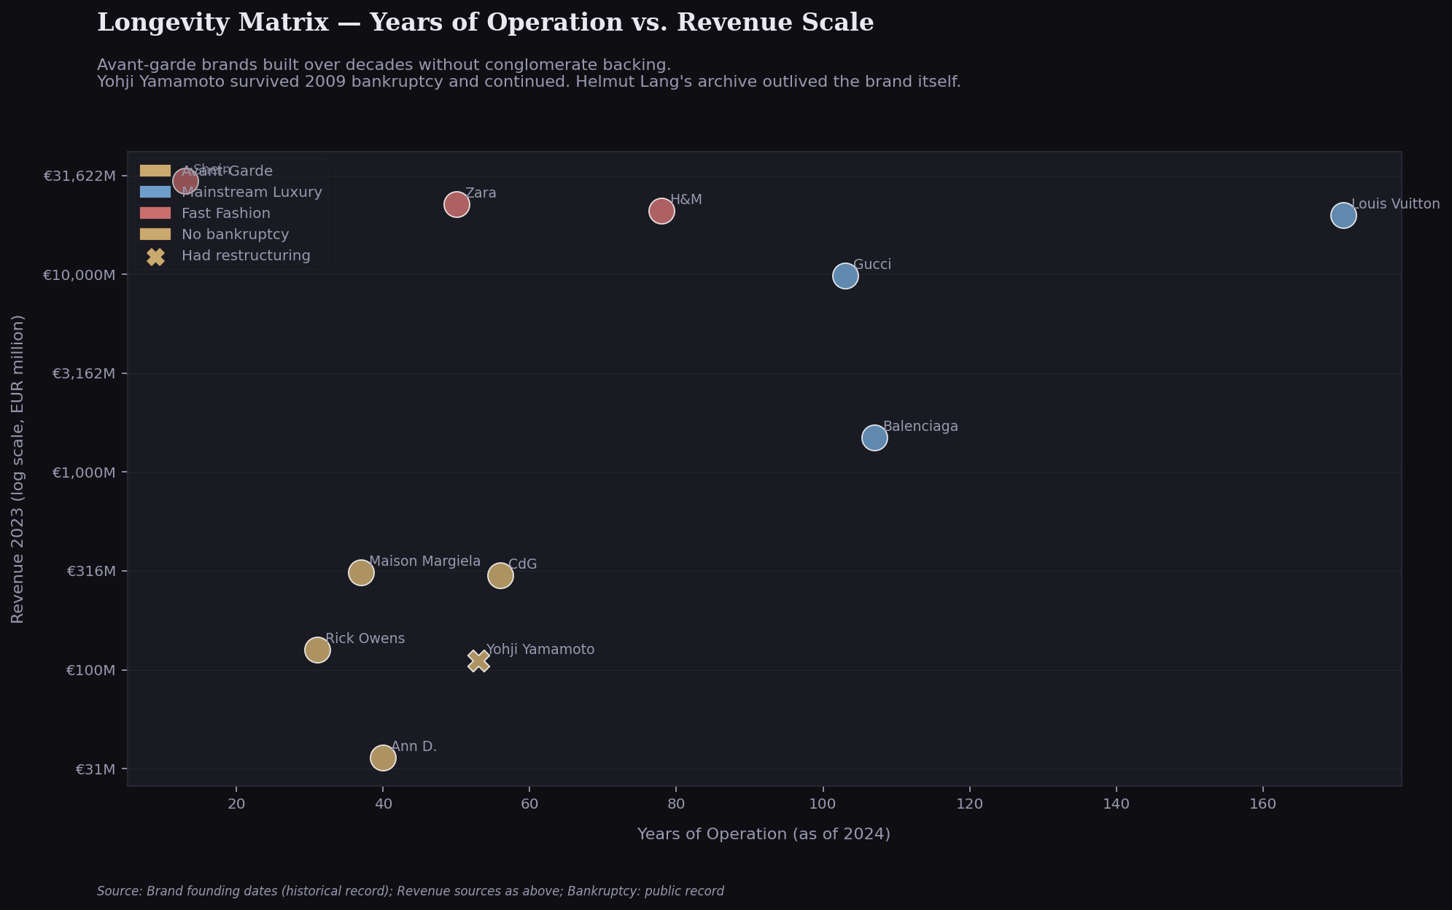
08 · LONGEVITY
Years of Operation vs. Revenue Scale
YOHJI YAMAMOTO
Went bankrupt in 2009 with debts over $65M USD. Restructured under Integral Corp. Continued producing collections. The brand survived because its identity was irreplaceable — collectors didn't stop buying.
COMME DES GARÇONS
Founded 1969. Still owned and controlled by Rei Kawakubo. 56 years of operation without conglomerate acquisition, without bankruptcy, and without compromising the brand's creative direction. The definition of durability.

Slide 13
08 · SYNTHESIS & IMPLICATIONS
What the Data Proves
01
04
The scarcity model is financially viable
Transparency scores measure regulation compliance, not ethics
Rick Owens generates €125M in revenue with no advertising spend, no celebrity endorsements, and 10 flagship stores globally. The model works.
The avant-garde sector's low FTI scores reflect structural exclusion from a reporting framework built for conglomerates — not evidence of unethical practices.
02
05
Social media reach is inversely correlated with brand durability
The designer-as-auteur model creates irreplaceable brand moats
The brands with the highest resale retention and archive premiums have the smallest social media presences. This is not coincidence — it is strategy.
You cannot hire a replacement, Rei Kawakubo. You cannot acquire the cultural capital that Helmut Lang built in 18 years of designing. This is the most durable competitive advantage in fashion.
03
The secondary market is the real revenue signal
When a brand's pieces appreciate on resale, it means the market believes in the brand's permanence. No fast fashion brand has ever achieved this. Several avant-garde brands have sustained it for decades.

Slide 14
APPENDIX · METHODOLOGY & DATA SOURCES
Dataset: 12 brands · 18 variables · Source Classification: Primary / Archival / Derived / Aggregated
Source
Data Used
Classification
Reference
Owenscorp Italia S.p.A.
2023 revenue (€125M), gross profit (€71.9M)
PRIMARY
fashionbi.com/insights/rick-owens-achieves-record-revenue
OTB Group Annual Report 2023
Maison Margiela +23% growth; group revenue €1.9B
PRIMARY
otb.net/en/news/otb-group-results-2023
OTB Group Annual Report 2024
Margiela +4.6%; group revenue €1.8B
PRIMARY
otb.net/en/news/otb-2024-results
Business of Fashion — Adrian Joffe
Comme des Garçons revenue >$320M
ARCHIVAL
businessoffashion.com/people/adrian-joffe
LVMH 2023 Annual Report
Revenue €86.2B; F&L division €42.2B
PRIMARY
lvmh.com/en/publications/2023-record-year
Kering 2023 Results
Gucci €9.87B; group revenue €17.6B
PRIMARY
kering.com 2023 annual results
Inditex 2023 Annual Report
Total revenue €35.9B; Zara est. 63%
PRIMARY / DERIVED
inditex.com annual report
H&M Group 2023 Annual Report
Revenue SEK 236B (~€20.9B)
PRIMARY
hmgroup.com annual report 2023
Backlinko / Business of Apps
Shein 2023 revenue ~$32.2B
AGGREGATED
backlinko.com/shein-stats
Fashion Revolution FTI 2023
Transparency Index scores (250 largest brands)
PRIMARY
fashionrevolution.org/fashion-transparency-index-2023
Vestiaire Collective Q4 2024
Resale retention and brand rankings
AGGREGATED
vestiairecollective.com/journal/resale-buying-guide
Grailed sold listings 2023–2024
Archive premium estimates
AGGREGATED
grailed.com
Sotheby's Martin Margiela 2019
220 pieces; €341,750 realized
PRIMARY
sothebys.com/en/sell/luxury-collectibles/maison-margiela

Slide 15
THE CONCLUSION
"Mass appeal is not a prerequisite for endurance.
Scarcity is not a constraint… it is the product."
Rick Owens built a €125M business with no advertising. Helmut Lang's archive appreciates 20 years after he stopped designing. Comme des Garçons has operated independently for 56 years without conglomerate acquisition. The data is unambiguous: the scarcity model is not a niche curiosity; it is one of the most durable business models in fashion.
Omar Oudrari · James Madison University
github.com/yrgomar

