Slide 1



Proactive Verification of DNS Configurations
GRoot
Siva Kesava Reddy Kakarla¹
Ryan Beckett²
Behnaz Arzani²
Todd Millstein^{1,3}
George Varghese¹
¹
University of California, Los Angeles
²
Microsoft Research
Intentionet
³

Slide 2
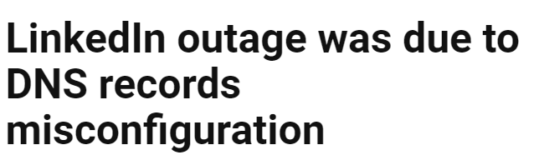

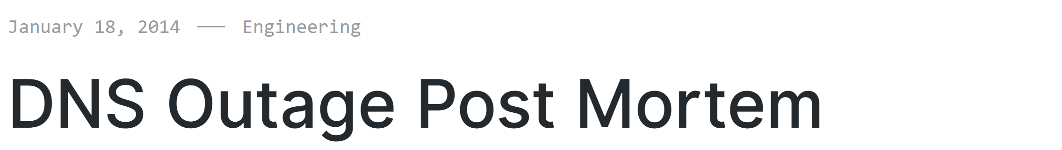
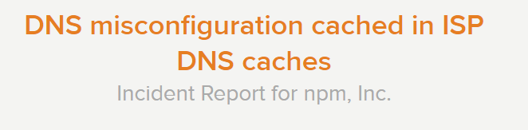
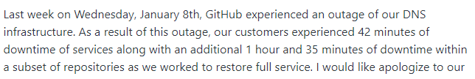


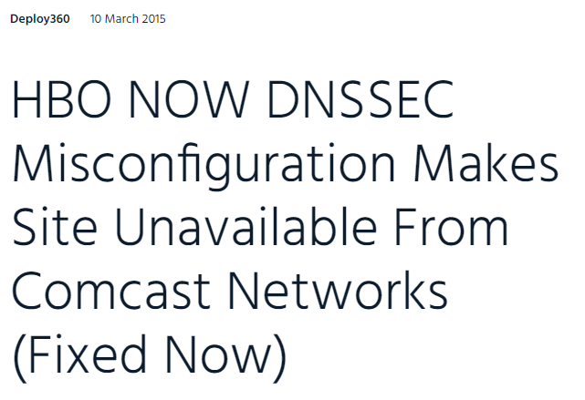
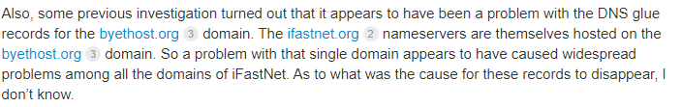
DNS Misconfigurations lead to Service Disruptions

Slide 3












Azure Global Outage, 2019
Storage
BLOB Storage
Azure Files
Premium Storage
20h impact duration
Data
SQL
Database
SQL Data
Warehouse
Redis
Cache
Search
Cause: a one-line incorrect configuration change to a server during migration
DocumentDB
Tables
Key Vault
Many key Azure services were unreachable

Slide 4
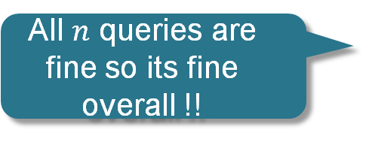


Current DNS Management Practices
Black-box Testing
Only finds errors after they are live
Not exhaustive
All queries under my domain should not be rewritten
All $n$ queries are fine so its fine overall !!
$$q_{1}, q_{2}, q_{3}, …q_{n}$$
DNS
$$a_{1}, a_{2}, a_{3}, …a_{m}$$
DNS Engineer

Slide 5
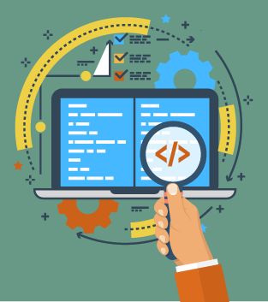


Current DNS Management Practices
Black-box Testing
DNS Config Review
$$q_{1}, q_{2}, q_{3}, …q_{n}$$
DNS
$$a_{1}, a_{2}, a_{3}, …a_{m}$$
DNS Engineer
Only finds errors after they are live
Not exhaustive
Not automated
Error Prone

Slide 6



The Ideal: Verification
Verifier
Configs
Certified
Bug found!
Properties

Slide 7
The Ideal: Verification
Verifier
No Verifier Exists for DNS Configs!
DNS
Configs
Certified
Bug found!
Properties

Slide 8

Our Contribution
GRoot: First Proactive Verification Tool for DNS Configs

Slide 9
End-to-End Design

Slide 10
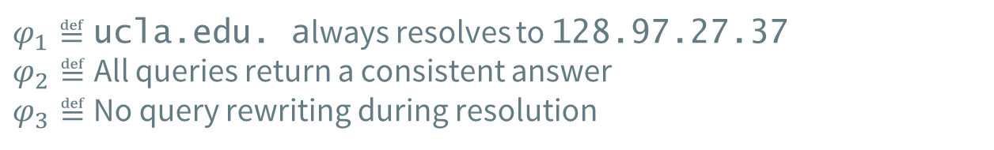
End-to-End Design
Zone Files
Certified
Bug found!
Property 𝜑
$φ_{1}≝$ucla.edu. always resolves to 128.97.27.37
$φ_{2}≝$All queries return a consistent answer
$φ_{3}≝$ No query rewriting during resolution

Slide 11

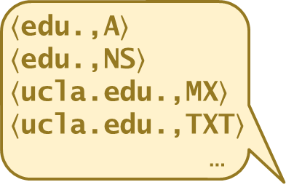
End-to-End Design
Zone Files
Certified
Bug found!
$$≈\sum_{i=0}^{253}{{38}^{i}} ×|T|$$
Too many queries to enumerate!
$$\left\langle \text{edu}\text{.,}\text{A}\right\rangle$$
$$\left\langle \text{edu}\text{.,}\text{NS}\right\rangle$$
$$\left\langle \text{ucla}\text{.}\text{edu}\text{.,}\text{MX}\right\rangle$$
$$\left\langle \text{ucla}\text{.}\text{edu}\text{.,}\text{TXT}\right\rangle$$
…
Property 𝜑
$φ_{1}≝$ucla.edu. always resolves to 128.97.27.37
$φ_{2}≝$All queries return a consistent answer
$φ_{3}≝$ No query rewriting during resolution

Slide 12












GRoot Internals
Zone Files
Label Graph
Query Equivalence Classes
.
$$\{q_{1}, q_{2}, q_{3},…\}$$
$$α$$
edu
Equivalence Class – A set of queries that are treated similarly at each server
$$\{q_{x}\}$$
ucla
ns1
ns2
$$α$$
$$α$$
$$\{q_{a}, q_{b}, q_{c},…\}$$
bio
www
*
$$α$$
$$α$$
$$α$$
$$\{q_{y}\}$$
$$\{q_{β}\}$$

Slide 13









GRoot Internals
Zone Files
Label Graph
Query Equivalence Classes
.
Symbolic Query
$$\left\{q_{1}, q_{2}, q_{3},…\right\}≡q_{s1}$$
$$α$$
edu
$$\left\{q_{x}\right\}≡q_{s2}$$
ucla
ns1
ns2
$$α$$
$$α$$
$$\left\{q_{a}, q_{b}, q_{c},…\right\} ≡q_{s3}$$
bio
www
*
$$α$$
$$α$$
$$α$$
$$\left\{q_{y}\right\} ≡q_{s4}$$
$$\left\{q_{β}\right\} ≡q_{s5}$$

Slide 14
GRoot Internals
Zone Files
Label Graph
Query Equivalence Classes
Interpretation Graphs
.
$$\left\{q_{1}, q_{2}, q_{3},…\right\}≡q_{s1}$$
$$α$$
edu
Symbolic
Execution
$$\left\{q_{x}\right\}≡q_{s2}$$
ucla
ns1
ns2
$$α$$
All nondeterministic execution traces using our formal semantics
$$α$$
$$\left\{q_{a}, q_{b}, q_{c},…\right\} ≡q_{s3}$$
bio
www
*
$$α$$
$$α$$
$$α$$
$$\left\{q_{y}\right\} ≡q_{s4}$$
$$\left\{q_{β}\right\} ≡q_{s5}$$

Slide 15
GRoot Internals
Zone Files
Property
Checking
Label Graph
Query Equivalence Classes
Interpretation Graphs
.
$$\left\{q_{1}, q_{2}, q_{3},…\right\}≡q_{s1}$$
$$α$$
edu
Symbolic
Execution
$$\left\{q_{x}\right\}≡q_{s2}$$
ucla
ns1
ns2
$$α$$
$$α$$
$$\left\{q_{a}, q_{b}, q_{c},…\right\} ≡q_{s3}$$
bio
www
*
$$α$$
$$α$$
$$α$$
$$\left\{q_{y}\right\} ≡q_{s4}$$
$$\left\{q_{β}\right\} ≡q_{s5}$$

Slide 16
GRoot Internals
Zone Files
Property
Checking
Label Graph
Query Equivalence Classes
Interpretation Graphs
.
$$\left\{q_{1}, q_{2}, q_{3},…\right\}≡q_{s1}$$
𝜑 holds if it holds on all graphs
$$α$$
edu
Symbolic
Execution
$$\left\{q_{x}\right\}≡q_{s2}$$
ucla
ns1
ns2
$$α$$
$$α$$
$$\left\{q_{a}, q_{b}, q_{c},…\right\} ≡q_{s3}$$
bio
www
*
$$α$$
$$α$$
$$α$$
$$\left\{q_{y}\right\} ≡q_{s4}$$
$$\left\{q_{β}\right\} ≡q_{s5}$$

Slide 17
Our Contributions
GRoot – First verification tool for DNS zone files to verify if a property of interest holds for all possible DNS queries
Algorithm to generate equivalence classes of DNS queries to cover all possible queries for scalable analysis
First formal model of DNS resolution (RFC 6672) for automating zone file review
Symbolic execution over equivalence classes with the help of formal model
GRoot revealed 109 bugs on a large campus network zone files and 160k blackholing issues on zone files of a large infrastructure service provider

Slide 18
Label Graph Construction
Domain Name | Type | Data
edu. | SOA | a.edu.net. …
ucla.edu. | NS | ns1.edu.
ucla.edu. | NS | ns2.edu.
ns1.edu. | A | 192.35.255.7
ns2.edu. | A | 54.201.38.106
.
edu
ucla
ns1
ns2

Slide 19

Label Graph Construction
Domain Name | Type | Data
edu. | SOA | a.edu.net. …
ucla.edu. | NS | ns1.edu.
ucla.edu. | NS | ns2.edu.
ns1.edu. | A | 192.35.255.7
ns2.edu. | A | 54.201.38.106
.
edu
Domain Name | Type | Data
ucla.edu. | SOA | sb1.ucla.edu. …
bio.ucla.edu. | A | 192.35.255.7
www.ucla.edu. | A | 128.97.27.37
*.ucla.edu. | CNAME | www.ucla.edu.
ucla
ns1
ns2
bio
www
*
$$α$$
Wildcard
www
bio
apps.bio
...
Arbitrary sequence with the end label unique from its siblings
ee
alumni.chem
www.apps.ee
...

Slide 20
Label Graph Construction
Domain Name | Type | Data
edu. | SOA | a.edu.net. …
ucla.edu. | NS | ns1.edu.
ucla.edu. | NS | ns2.edu.
ns1.edu. | A | 192.35.255.7
ns2.edu. | A | 54.201.38.106
.
edu
Domain Name | Type | Data
ucla.edu. | SOA | sb1.ucla.edu. …
bio.ucla.edu. | A | 192.35.255.7
www.ucla.edu. | A | 128.97.27.37
*.ucla.edu. | CNAME | www.ucla.edu.
ucla
ns1
ns2
bio
www
*
$$α$$
Complete Query Rewrite
apps.ee.ucla.edu → www.ucla.edu

Slide 21
Label Graph Construction
Domain Name | Type | Data
edu. | SOA | a.edu.net. …
ucla.edu. | NS | ns1.edu.
ucla.edu. | NS | ns2.edu.
ns1.edu. | A | 192.35.255.7
ns2.edu. | A | 54.201.38.106
.
edu
Domain Name | Type | Data
ucla.edu. | SOA | sb1.ucla.edu. …
bio.ucla.edu. | A | 192.35.255.7
www.ucla.edu. | A | 128.97.27.37
*.ucla.edu. | CNAME | www.ucla.edu.
ucla
ns1
ns2
bio
www
*
$$α$$
See our paper for details on challenges with rewrites (CNAMEs and DNAMEs)

Slide 22
Label Graph Construction
Domain Name | Type | Data
edu. | SOA | a.edu.net. …
ucla.edu. | NS | ns1.edu.
ucla.edu. | NS | ns2.edu.
ns1.edu. | A | 192.35.255.7
ns2.edu. | A | 54.201.38.106
.
edu
Domain Name | Type | Data
ucla.edu. | SOA | sb1.ucla.edu. …
bio.ucla.edu. | A | 192.35.255.7
www.ucla.edu. | A | 128.97.27.37
*.ucla.edu. | CNAME | www.ucla.edu.
ucla
ns1
ns2
bio
www
*
$$α$$
Domain Name | Type | Data
ucla.edu. | SOA | sb1.ucla.edu. …
ucla.edu. | A | 128.97.27.37

Slide 23





Label Graph Construction
Domain Name | Type | Data
edu. | SOA | a.edu.net. …
ucla.edu. | NS | ns1.edu.
ucla.edu. | NS | ns2.edu.
ns1.edu. | A | 192.35.255.7
ns2.edu. | A | 54.201.38.106
.
$$α$$
edu
Domain Name | Type | Data
ucla.edu. | SOA | sb1.ucla.edu. …
bio.ucla.edu. | A | 192.35.255.7
www.ucla.edu. | A | 128.97.27.37
*.ucla.edu. | CNAME | www.ucla.edu.
ucla
ns1
ns2
$$α$$
bio
www
*
$$α$$
Domain Name | Type | Data
ucla.edu. | SOA | sb1.ucla.edu. …
ucla.edu. | A | 128.97.27.37
$$α$$
$$α$$
$$α$$

Slide 24



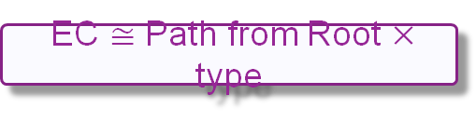
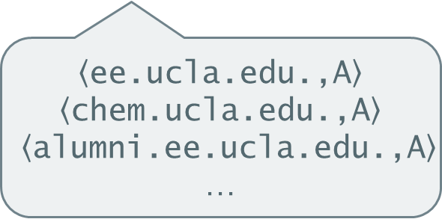
Equivalence Classes Generation
.
EC $≅$ Path from Root $×$ type
$$⟨\text{ucla}\text{.}\text{edu}\text{.,}\text{A}⟩$$
$$α$$
edu
$$⟨\text{ucla}\text{.}\text{edu}\text{.,}\text{TXT}⟩$$
ucla
ns1
ns2
$$α$$
A symbolic query
$$\left\langle α\text{.}\text{ucla}\text{.}\text{edu}\text{.,}\text{A}\right\rangle$$
An equivalence class
$$\left\langle \text{ee}\text{.}\text{ucla}\text{.}\text{edu}\text{.,}\text{A}\right\rangle$$
$$\left\langle \text{chem}\text{.}\text{ucla}\text{.}\text{edu}\text{.,}\text{A}\right\rangle$$
$$\left\langle \text{alumni}\text{.}\text{ee}\text{.}\text{ucla}\text{.}\text{edu}\text{.,}\text{A}\right\rangle$$
…
bio
www
*
$$α$$
$$α$$
$$α$$
$$α$$

Slide 25




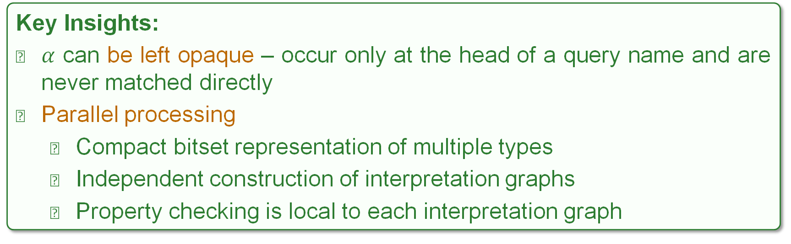
Symbolic Execution
$$\left\langle α\text{.}\text{ucla}\text{.}\text{edu}\text{.,}\text{A}\right\rangle$$
$$\left\langle α\text{.}\text{ucla}\text{.}\text{edu}\text{.,}\text{NS}\right\rangle$$
$$\left\langle α\text{.}\text{ucla}\text{.}\text{edu}\text{.,}\text{TXT}\right\rangle$$
$$⟨ α\text{.}\text{ucla}\text{.}\text{edu}\text{.,\{}\text{A}\text{,}\text{NS}\text{,}\text{TXT}\text{\}}〉$$
Key Insights:
$α$ can be left opaque – occur only at the head of a query name and are never matched directly
Parallel processing
Compact bitset representation of multiple types
Independent construction of interpretation graphs
Property checking is local to each interpretation graph

Slide 26
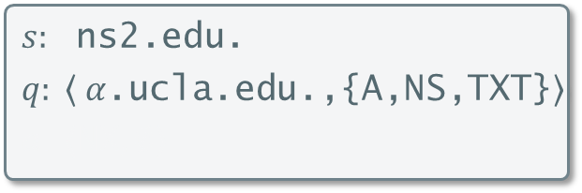
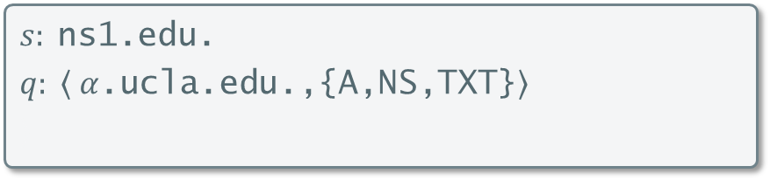
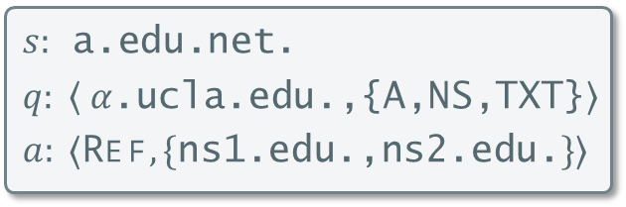
Interpretation Graph Example
Domain Name | Type | Data
edu. | SOA | a.edu.net. …
ucla.edu. | NS | ns1.edu.
ucla.edu. | NS | ns2.edu.
ns1.edu. | A | 192.35.255.7
ns2.edu. | A | 54.201.38.106
$s:$ $\text{a}\text{.}\text{edu}\text{.}\text{net}$.
$$q: ⟨ α\text{.}\text{ucla}\text{.}\text{edu}\text{.,\{}\text{A}\text{,}\text{NS}\text{,}\text{TXT}\text{\}}〉$$
$$a: ⟨\text{Ref}, \{\text{ns}\text{1.}\text{edu}\text{.,}\text{ns}\text{2.}\text{edu}\text{.}\}⟩$$
$$s: \text{ns}\text{1.}\text{edu}\text{.}$$
$$q: ⟨ α\text{.}\text{ucla}\text{.}\text{edu}\text{.,\{}\text{A}\text{,}\text{NS}\text{,}\text{TXT}\text{\}}〉$$
$$⟩$$
$s:$ $\text{ns}\text{2}\text{.}\text{edu}\text{.}$
$$q: ⟨ α\text{.}\text{ucla}\text{.}\text{edu}\text{.,\{}\text{A}\text{,}\text{NS}\text{,}\text{TXT}\text{\}}〉$$
$$a: ⟨\text{NX}, ∅⟩$$

Slide 27
Interpretation Graph Example
Domain Name | Type | Data
ucla.edu. | SOA | sb1.ucla.edu. …
ucla.edu. | A | 128.97.27.37
$s:$ $\text{a}\text{.}\text{edu}\text{.}\text{net}$.
$$q: ⟨ α\text{.}\text{ucla}\text{.}\text{edu}\text{.,\{}\text{A}\text{,}\text{NS}\text{,}\text{TXT}\text{\}}〉$$
$$a: ⟨\text{Ref}, \{\text{ns}\text{1.}\text{edu}\text{.,}\text{ns}\text{2.}\text{edu}\text{.}\}⟩$$
$$s: \text{ns}\text{1.}\text{edu}\text{.}$$
$$q: ⟨ α\text{.}\text{ucla}\text{.}\text{edu}\text{.,\{}\text{A}\text{,}\text{NS}\text{,}\text{TXT}\text{\}}〉$$
$$⟩$$
$s:$ $\text{ns}\text{2}\text{.}\text{edu}\text{.}$
$$q: ⟨ α\text{.}\text{ucla}\text{.}\text{edu}\text{.,\{}\text{A}\text{,}\text{NS}\text{,}\text{TXT}\text{\}}〉$$
$$a: ⟨\text{NX}, ∅⟩$$

Slide 28
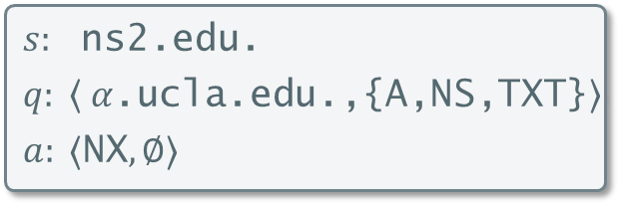
Interpretation Graph Example
Domain Name | Type | Data
ucla.edu. | SOA | sb1.ucla.edu. …
ucla.edu. | A | 128.97.27.37
$s:$ $\text{a}\text{.}\text{edu}\text{.}\text{net}$.
$$q: ⟨ α\text{.}\text{ucla}\text{.}\text{edu}\text{.,\{}\text{A}\text{,}\text{NS}\text{,}\text{TXT}\text{\}}〉$$
$$a: ⟨\text{Ref}, \{\text{ns}\text{1.}\text{edu}\text{.,}\text{ns}\text{2.}\text{edu}\text{.}\}⟩$$
$$s: \text{ns}\text{1.}\text{edu}\text{.}$$
$$q: ⟨ α\text{.}\text{ucla}\text{.}\text{edu}\text{.,\{}\text{A}\text{,}\text{NS}\text{,}\text{TXT}\text{\}}〉$$
$$⟩$$
$s:$ $\text{ns}\text{2}\text{.}\text{edu}\text{.}$
$$q: ⟨ α\text{.}\text{ucla}\text{.}\text{edu}\text{.,\{}\text{A}\text{,}\text{NS}\text{,}\text{TXT}\text{\}}〉$$
$$a: ⟨\text{NX}, ∅⟩a: ⟨\text{NX}, ∅⟩$$

Slide 29
Interpretation Graph Example
Domain Name | Type | Data
ucla.edu. | SOA | sb1.ucla.edu. …
bio.ucla.edu. | A | 192.35.255.7
www.ucla.edu. | A | 128.97.27.37
*.ucla.edu. | CNAME | www.ucla.edu.
$s:$ $\text{a}\text{.}\text{edu}\text{.}\text{net}$.
$$q: ⟨ α\text{.}\text{ucla}\text{.}\text{edu}\text{.,\{}\text{A}\text{,}\text{NS}\text{,}\text{TXT}\text{\}}〉$$
$$a: ⟨\text{Ref}, \{\text{ns}\text{1.}\text{edu}\text{.,}\text{ns}\text{2.}\text{edu}\text{.}\}⟩$$
$$s: \text{ns}\text{1.}\text{edu}\text{.}$$
$$q: ⟨ α\text{.}\text{ucla}\text{.}\text{edu}\text{.,\{}\text{A}\text{,}\text{NS}\text{,}\text{TXT}\text{\}}〉$$
$$⟩$$
$s:$ $\text{ns}\text{2}\text{.}\text{edu}\text{.}$
$$q: ⟨ α\text{.}\text{ucla}\text{.}\text{edu}\text{.,\{}\text{A}\text{,}\text{NS}\text{,}\text{TXT}\text{\}}〉$$
$$a: ⟨\text{NX}, ∅⟩a: ⟨\text{NX}, ∅⟩$$

Slide 30
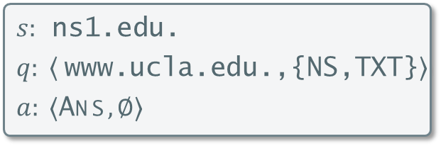
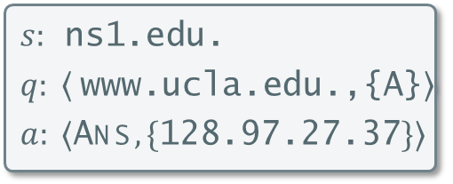
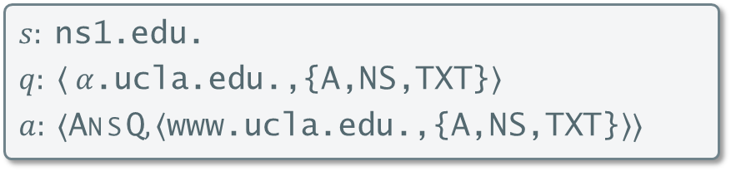
Interpretation Graph Example
Domain Name | Type | Data
ucla.edu. | SOA | sb1.ucla.edu. …
bio.ucla.edu. | A | 192.35.255.7
www.ucla.edu. | A | 128.97.27.37
*.ucla.edu. | CNAME | www.ucla.edu.
$s:$ $\text{a}\text{.}\text{edu}\text{.}\text{net}$.
$$q: ⟨ α\text{.}\text{ucla}\text{.}\text{edu}\text{.,\{}\text{A}\text{,}\text{NS}\text{,}\text{TXT}\text{\}}〉$$
$$a: ⟨\text{Ref}, \{\text{ns}\text{1.}\text{edu}\text{.,}\text{ns}\text{2.}\text{edu}\text{.}\}⟩$$
$$s: \text{ns}\text{1.}\text{edu}\text{.}$$
$$q: ⟨ α\text{.}\text{ucla}\text{.}\text{edu}\text{.,\{}\text{A}\text{,}\text{NS}\text{,}\text{TXT}\text{\}}〉$$
$$a: ⟨\text{AnsQ}, ⟨\text{www}\text{.}\text{ucla}\text{.}\text{edu}\text{.,\{}\text{A}\text{,}\text{NS}\text{,}\text{TXT}\text{\}}〉⟩$$
$s:$ $\text{ns}\text{2}\text{.}\text{edu}\text{.}$
$$q: ⟨ α\text{.}\text{ucla}\text{.}\text{edu}\text{.,\{}\text{A}\text{,}\text{NS}\text{,}\text{TXT}\text{\}}〉$$
$$a: ⟨\text{NX}, ∅⟩a: ⟨\text{NX}, ∅⟩$$
$s:$ $\text{ns}\text{1.}\text{edu}\text{.}$
$$q: ⟨ \text{www}\text{.}\text{ucla}\text{.}\text{edu}\text{.,\{}\text{A}\text{\}}〉$$
$$a: ⟨\text{Ans}, \{\text{128.97.27.37}\}⟩$$
$s:$ $\text{ns}\text{1.}\text{edu}\text{.}$
$$q: ⟨ \text{www}\text{.}\text{ucla}\text{.}\text{edu}\text{.,\{}\text{NS}\text{,}\text{TXT}\text{\}}〉$$
$$a: ⟨\text{Ans}, ∅⟩$$

Slide 31
Property Checking
Answer Consistency
Different sink nodes must return same answer
$s:$ $\text{a}\text{.}\text{edu}\text{.}\text{net}$.
$$q: ⟨ α\text{.}\text{ucla}\text{.}\text{edu}\text{.,\{}\text{A}\text{,}\text{NS}\text{,}\text{TXT}\text{\}}〉$$
$$a: ⟨\text{Ref}, \{\text{ns}\text{1.}\text{edu}\text{.,}\text{ns}\text{2.}\text{edu}\text{.}\}⟩$$
$$s: \text{ns}\text{1.}\text{edu}\text{.}$$
$$q: ⟨ α\text{.}\text{ucla}\text{.}\text{edu}\text{.,\{}\text{A}\text{,}\text{NS}\text{,}\text{TXT}\text{\}}〉$$
$$a: ⟨\text{AnsQ}, ⟨\text{www}\text{.}\text{ucla}\text{.}\text{edu}\text{.,\{}\text{A}\text{,}\text{NS}\text{,}\text{TXT}\text{\}}〉⟩$$
$s:$ $\text{ns}\text{2}\text{.}\text{edu}\text{.}$
$$q: ⟨ α\text{.}\text{ucla}\text{.}\text{edu}\text{.,\{}\text{A}\text{,}\text{NS}\text{,}\text{TXT}\text{\}}〉$$
$$a: ⟨\text{NX}, ∅⟩a: ⟨\text{NX}, ∅⟩$$
$s:$ $\text{ns}\text{1.}\text{edu}\text{.}$
$$q: ⟨ \text{www}\text{.}\text{ucla}\text{.}\text{edu}\text{.,\{}\text{A}\text{\}}〉$$
$$a: ⟨\text{Ans}, \{\text{128.97.27.37}\}⟩$$
$s:$ $\text{ns}\text{1.}\text{edu}\text{.}$
$$q: ⟨ \text{www}\text{.}\text{ucla}\text{.}\text{edu}\text{.,\{}\text{NS}\text{,}\text{TXT}\text{\}}〉$$
$$a: ⟨\text{Ans}, ∅⟩$$

Slide 32
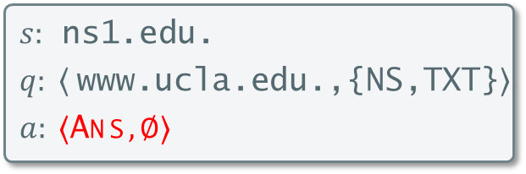
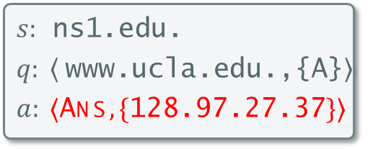
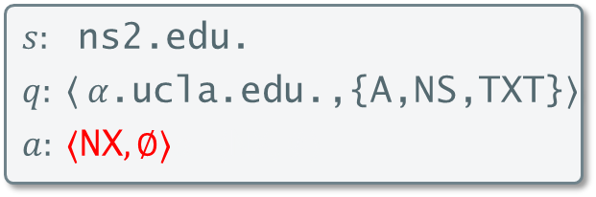
Property Checking
Answer Consistency
Different sink nodes must return same answer
No Rewrite Blackholing
No path from root to a leaf can have a rewrite and end with NX
$s:$ $\text{a}\text{.}\text{edu}\text{.}\text{net}$.
$$q: ⟨ α\text{.}\text{ucla}\text{.}\text{edu}\text{.,\{}\text{A}\text{,}\text{NS}\text{,}\text{TXT}\text{\}}〉$$
$$a: ⟨\text{Ref}, \{\text{ns}\text{1.}\text{edu}\text{.,}\text{ns}\text{2.}\text{edu}\text{.}\}⟩$$
$$s: \text{ns}\text{1.}\text{edu}\text{.}$$
$$q: ⟨ α\text{.}\text{ucla}\text{.}\text{edu}\text{.,\{}\text{A}\text{,}\text{NS}\text{,}\text{TXT}\text{\}}〉$$
$$a: ⟨\text{AnsQ}, ⟨\text{www}\text{.}\text{ucla}\text{.}\text{edu}\text{.,\{}\text{A}\text{,}\text{NS}\text{,}\text{TXT}\text{\}}〉⟩$$
$s:$ $\text{ns}\text{2}\text{.}\text{edu}\text{.}$
$$q: ⟨ α\text{.}\text{ucla}\text{.}\text{edu}\text{.,\{}\text{A}\text{,}\text{NS}\text{,}\text{TXT}\text{\}}〉$$
$$a: ⟨\text{NX}, ∅⟩a: ⟨\text{NX}, ∅⟩$$
$s:$ $\text{ns}\text{1.}\text{edu}\text{.}$
$$q: ⟨ \text{www}\text{.}\text{ucla}\text{.}\text{edu}\text{.,\{}\text{A}\text{\}}〉$$
$$a: ⟨\text{Ans}, \{\text{128.97.27.37}\}⟩$$
$s:$ $\text{ns}\text{1.}\text{edu}\text{.}$
$$q: ⟨ \text{www}\text{.}\text{ucla}\text{.}\text{edu}\text{.,\{}\text{NS}\text{,}\text{TXT}\text{\}}〉$$
$$a: ⟨\text{Ans}, ∅⟩$$

Slide 33
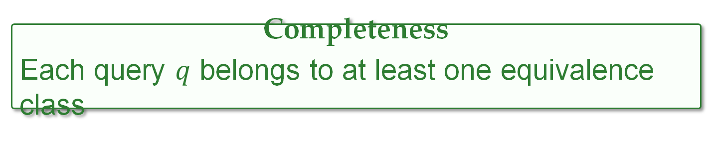
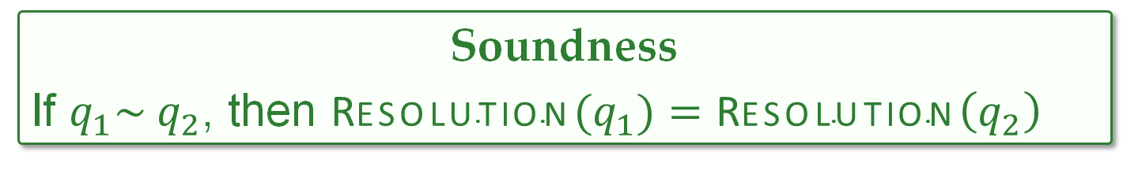
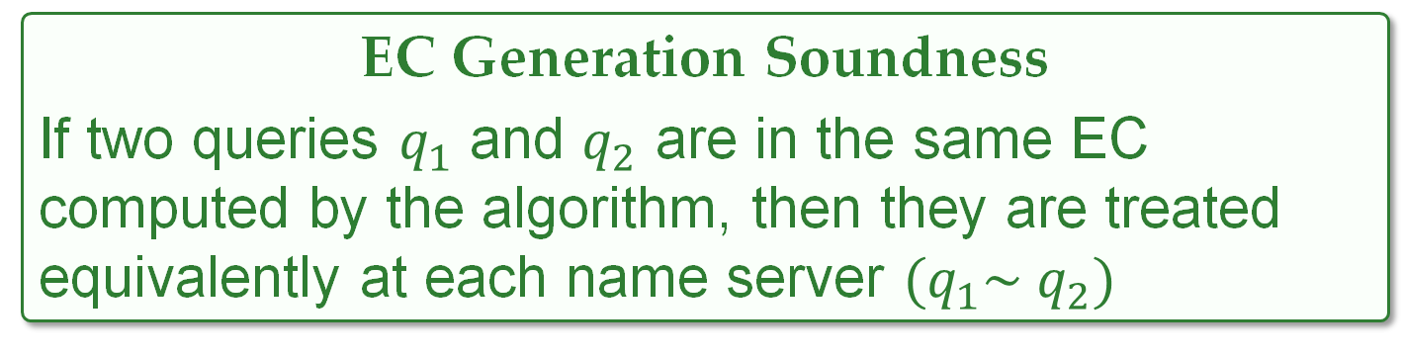
Correctness Theorems
EC Generation Soundness
If two queries $q_{1}$ and $q_{2}$ are in the same EC computed by the algorithm, then they are treated equivalently at each name server ${(q}_{1}\sim q_{2})$
Soundness
If $q_{1}\sim q_{2}$, then ${\text{Resolution}(q}_{1})=\text{Resol}\text{ution}\left(q_{2}\right)$
Completeness
Each query $q$ belongs to at least one equivalence class

Slide 34
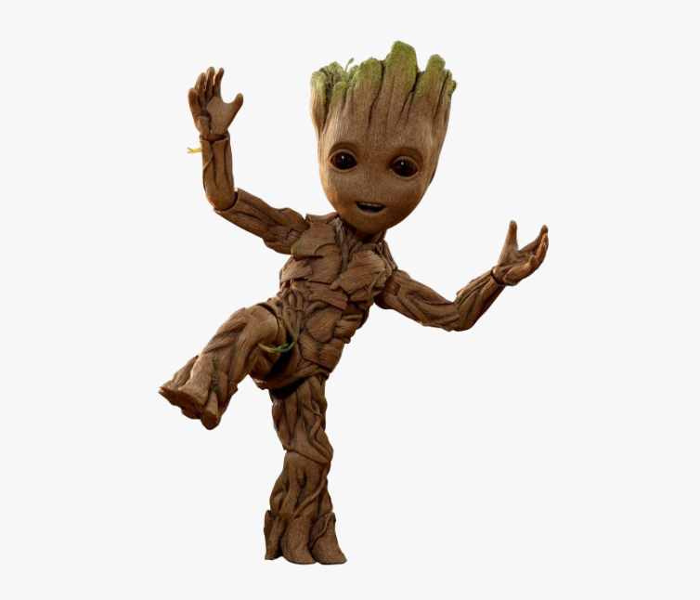
University Results
Property | Number of bugs
Delegation Consistency | 49
No lame delegation | 9
No rewrite loops | 2
No missing glue records | 1
No rewrite blackholing | 48
No zero TTL records | 0
Decentralized management – Central (campus.edu.) and departmental (dept.campus.edu.)
Zone files of campus.edu. and 895 subdomains
120k resource records
4,259 CNAME records
63 wildcard records
Property | Number of warnings
No rewrite to outside domain | 378
No resolution at an external NS | 324
Number of rewrites ≤ 2 | 24
7 sec

Slide 35
University Results
Property | Number of bugs
Delegation Consistency | 49
No lame delegation | 9
No rewrite loops | 2
No missing glue records | 1
No rewrite blackholing | 48
No zero TTL records | 0
NS records mismatch and some servers incorrectly pointed to web server
Affects response time and redundancy
We haven’t noticed this discrepancy because we almost never use DNS names for DNS servers, we use IPs
Campus
DNS Engineer

Slide 36
University Results
Property | Number of bugs
Delegation Consistency | 49
No lame delegation | 9
No rewrite loops | 2
No missing glue records | 1
No rewrite blackholing | 48
No zero TTL records | 0
CNAME rewrite to itself !!
The short answer is negligence
Campus
DNS Engineer

Slide 37
University Results
Property | Number of bugs
Delegation Consistency | 49
No lame delegation | 9
No rewrite loops | 2
No missing glue records | 1
No rewrite blackholing | 48
No zero TTL records | 0
48 cases returning NXDOMAIN after a rewrite
CNAME entries missed during prior retirement
Campus
DNS Engineer
Entries orphaned accidentally when the source server was removed a few years back
Campus DNS Engineer

Slide 38
University Results
Property | Number of warnings
No rewrite to outside domain | 378
No resolution at an external NS | 324
Number of rewrites ≤ 2 | 24
GRoot guarantees that only 24 cases under campus.edu. are rewritten more than twice

Slide 39

Infrastructure Service Provider Results
1241 internal zone files
3.6 million resource records
3.4 milion CNAME records
2059 wildcard records
160k rewrite blackholing cases
Incomplete decommissioning of host names that are no longer in use
DNS Engineer

Slide 40
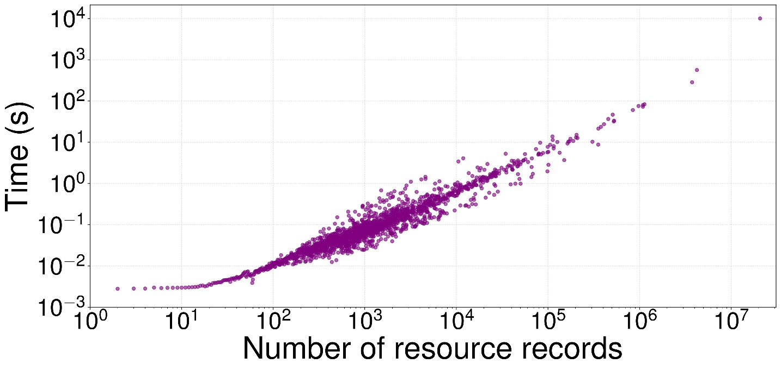
GRoot Performance
DNS Census – Publicly available DNS records
Created Zone files from CSV files
1,368,523 second-level domains (e.g., co.uk.)
65 million resource records
3.4 million CNAME records
218 DNAME records
GRoot can scale linearly to tens of millions of records

Slide 41
Related Work
DNS Testing and Linting:
ThousandEyes [M.Lad and R.Oliveira], Distributed DNS Troubleshooting [SIGCOMM ‘04 V.Pappas et al]
Live testing from multiple vantage points
Network Verification Equivalence Class Techniques:
Veriflow [NSDI ‘13, A.Khurshid et al.]
Trie-based approach for PECs
Atomic Predicates [IEEE ‘17, H Yang and SS Lam]
Predicate (BDDs) abstraction for PECs
Key Limitations
Incomplete
Not exhaustive
Key Limitations
Veriflow – No support for rewrites
AP – Expensive with quadratic number of predicate intersections

Slide 42
Conclusion
GRoot – Our tool for verification of DNS zone files
First formal model of DNS
Provides all queries that violate a property
Found 109 bugs in the live DNS zone files of a large campus
Found 160k blackholing issues on a large infrastructure service provider zone files
https://github.com/dns-groot/groot
Reach me at: sivakesava@cs.ucla.edu

