Slide 1
Formal Analysis of Host Network Performance
Rulan Yang

Slide 2
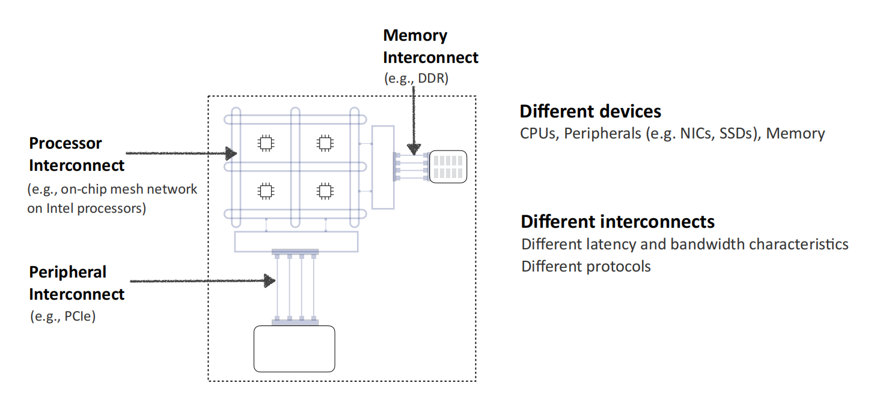
The host network: Network within a single host
Traditional network
Host network
S1
S2
S3
H1
H2
H3
H4
Notes:
distinct from more commonly discussed networks like the Internet or datacenter, today we will talk about the host network, the host network is an inter-network within a single host

Slide 3
Background: Performance bottlenecks shift from the traditional networks to the host networks
Traditional network
Host network
S1
S2
S3
H1
H2
H3
H4
Past: Links and switches are bottlenecks
Present: Host interconnects are bottlenecks
Notes:
直接说Host也可以看作是一个网络，运行着各式各样的服务（网络服务，计算服务），存在资源争用，可能产生性能瓶颈

Slide 4
Related Works: Empirical analysis of host network performance
Understanding the Host Network [sigcomm’24]
Host Congestion Control [sigcomm’23]
Understanding Host Interconnect Congestion [hotnets’22]
Understanding the Host Stack Overheads [sigcomm’21]
Understanding PCIe Performance for End Host [sigcomm’18]
....
From real-world observations of performance degradation to the empirical validation of degradation causes under specific workload scenarios

Slide 5
Related Works: Formal analysis of network performance
A Performance Verification Methodology for Resource Allocation Heuristics [arxiv’24]
Formal Methods for Network Performance Analysis [nsdi’23]
Toward Formally Verifying Congestion Control Behavior [sigcomm’21]
…
From formal models of network behavior to the automated verification of performance degradation across diverse workload scenarios

Slide 6
Motivation
Can we leverage formal methods to proactively analyze whether the host network performance will degrade across diverse workload scenarios?
 | Accuracy | Coverage
Empirical Analysis (Reactive) | High | Low
Formal Analysis (Proactive) | Relatively low | High
Notes:
formal verification techniques to analyze or predict the performance characteristics (e.g., bottlenecks, contention) of a host network

Slide 7
Proposal: Formal analysis of host network performance
Create a formal model for the host network
Automatically analyze the host network
①
③
④
Specify the desired performance property
Prove or disprove the property
②

Slide 8
Formal model of the host network
L1/L2/LLC: Level 1/Level 2/ Last Level Cache
CHA: Caching home agent (ingress request queue)
MC: Memory controller (request pending queue)
IIO: Integrated IO controller
LFB: Line fill buffer
CPU
CPU
L1
L1
LFB
L2
L2
IIO
RNIC
CHA
MC
Host Mem
RNIC
LLC

Slide 9
Analysis and Design of Host Networks via Formal Methods: Possibilities, Opportunities and Challenges
Open Questions:
Supporting failure analysis：在总线/内存/cpu/gpu等有一定概率会发生故障的场景下，分析主机性能的下降情况
Differential analysis of the host network performance: 比较主机网络的拓扑或配置变化后，性能会受到怎样的影响。比如调度策略从 RR 改为优先级调度是否可以提高吞吐量？某个队列的长度减少后导致平均延迟发生怎样的变化？
Performance-driven design automation for host networks: 给定性能要求（例如请求平均时延<5个时间步长），自动设计主机架构和调度策略（相当于synthesis）

Slide 10
Formal model of the host network
Processing components source data requests to the storage components, forming different data paths
CPU to Mem data path
① Upon an L1 cache miss, the request is added to the LFB and is sent to the L2 cache
② Once an L2 cache hits, the request in the LFB is freed. Otherwise, the request is sent to the CHA, where it is queued in the IRQ
③ Once a last-level cache hits, the request in the LFB is freed. Otherwise, the request is sent to the MC, where it is queued in the RPQ
④ The MC serves the request in a FIFO manner, then returns the data to the CPU core and frees the request in both CHA and LFB
CPU
CPU
Queue
Storage component
L1
L1
①
Processing component
LFB
②
L2
L2
IIO
③
RNIC
CHA
MC
Host Mem
④
③
RNIC
LLC
①
②

Slide 11
Formal model of the host network
Processing components source data requests to the storage components, forming different data paths
RNIC to Mem data path
① The request is initiated at IIO and is sent to the CHA, where it is queued in the IRQ
② Once a last-level cache hits, the request in the IIO is freed. Otherwise, the request is sent to the MC, where it is queued in the RPQ
③ The MC serves the request in a FIFO manner, then returns the data to the RNIC and frees the request in the IIO
CPU
CPU
Queue
Storage component
L1
L1
①
Processing component
LFB
②
L2
L2
IIO
③
RNIC
CHA
MC
Host Mem
④
③
RNIC
LLC
①
②

Slide 12
Formal model of the host network
Modeling the time
The time is discretized at each enqueue and dequeue event
Modeling the queue
Queued
In INQ(q, t)[1:S]
ENQ(q, t)[1:K]: The requests are sent to queue q at time t, K is the maximum number of incoming requests
INQ(q, t)[1:S]: The requests are inside queue q at time t, S is the queue size
DEQ(q, t): The number of dequeue requests at time t
Enqueue
ENQ(q, t)[1:K]
Dequeue
DEQ(q, t)
queue q
DEQ(q1, t) is determined by queue q2
ENQ(q2, t)[1:K] = INQ(q1, t)[1:K], indicating that the first K elements in q1 are sent to q2 at time t
queue q1
queue q2
Notes:
The cache/memory access latency is a constant

Slide 13
Formal analysis of the host network
Notes:
The cache/memory access latency is a constant

Slide 14
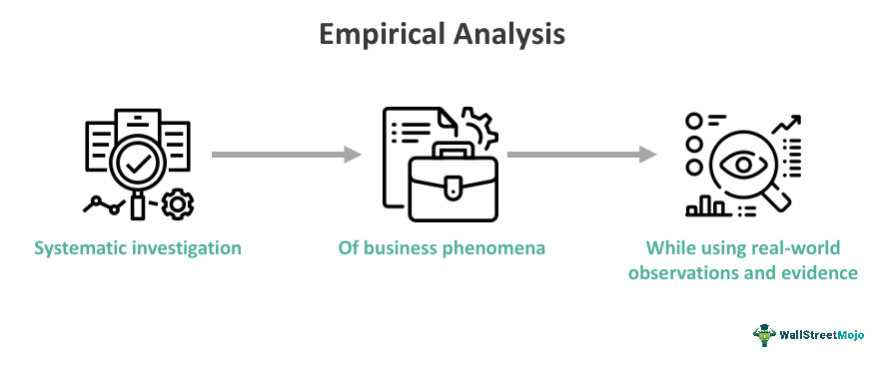

Based on prior experience:
The system is expected to perform well/bad under typical workloads
The system performs well under all workloads.
trace
Real/Sim System
Performance Query
selected workload
Analyzer
Formal Model
all possible workloads
The system performs badly under specific workloads.

Slide 15
selected workload
The system is expected to perform well/poorly under typical workloads
Real/Sim System
Experienced observation
trace
Performance Query
Empirical analysis process
The system will perform well/poorly under all/specific workloads
all possible workloads
Formal Model
Analyzer
Formal proof
or Counterexample
Formal analysis process

Slide 16
Analysis and Design of Host Networks via Formal Methods: Possibilities, Opportunities and Challenges
Motivation
Performance query
Will the CPU and RNIC share the same memory bandwidth if 50% of the CPU's requests are cache hits?
Will the average latency of C2M be twice that of R2M when the total number of requests for C2M and R2M is equal?
CPU
Cache
Host Mem
RNIC

Slide 17
Analysis and Design of Host Networks via Formal Methods: Possibilities, Opportunities and Challenges
Proposal: Using formal methods to automatically analyze the host network, to explore the overlooked corner cases that caused poor performance
Key Insight: Abstracting the host network in terms of queuing nodes and request endpoints — including both request initiators (e.g., CPUs, RNICs) and targets (e.g., memory) — enables systematic analysis of performance-critical behaviors using formal methods.

Slide 18
Host network performance analysis
Consider the host network as an event-driven model, time advances when a new event happens (e.g., dequeue, cache replacement)
Model the performance query as the SMT formula:
workload /\ model /\ query
Check the satisfiability of this formula to find whether there is a trace that complies with this query

Slide 19
Analysis and Design of Host Networks via Formal Methods: Possibilities, Opportunities and Challenges
Queue
Destination
LFB
Source
CPU
CPU
Cache
Host Mem
Cache
Host Mem
RNIC
RNIC
CHA
MC
IIO
Compared to FPerf, we support extra features in the host:
Credit-based flow control
Cache

Slide 20
Formal model of the host network
Modeling the queue
n
…
2
1
deq_cnt(1:T)
q(1:T)[1:L]
The state of a queue q at time t is represented as q(1:T)[1:L], where L is the length of q, T is the total timestep we try to model
The dequeue number of a queue q at time t is q_deq_cnt(1:T)
Each element q(t)[i] in the queue consists of:
isValid: Bool whether the element exist at time t
source: Enum the source of this request, e.g., CPU or IO
reqLoc: Int the memory location required by this request
startTime: Int the start time of this request
To ensure the model is compliant with the reality:
There is no holes in each queue (suppose the queue has an element at index i, i.e., isValid is true, and no elements at index i+1, i.e., isValid is false, . Then, there is an element at any index j ≤ i queue)
The elements in the queue are ordered (preserving the order in which they were inserted)
Notes:
The cache/memory access latency is a constant

Slide 21
Formal model of the host network
Modeling the queue scheduling
FIFO
We use two auxiliary variables q_remain_cnt(1:T) and q_val_cnt(1:T) to track how many elements persist in a queue q across adjacent time steps, i.e., not dequeued between t – 1 and t. For example, for the queue q1:
q1_remain_cnt(t) == q1_val_cnt(t-1) + q1_deq_cnt(t-1)
q1_val_cnt(t-1) == Sum([If(q1(t-1)[i], 1, 0) for i in m)
q1_cap_cnt(t) == q1.size – q1_remain_cnt(t)
n
…
2
1
m
…
2
1
q2(1:T)[1:n]
q1(1:T)[1:m]
Suppose q1 dequeues k element at time t-1, where k = q1_deq_cnt(t-1), then the i^{th} element of q1 at time t (q1(t)[i]) would be:
① For 1 <= i <= q1_remain_cnt(t):
q1(t)[i] == q1(t-1)[i+k]
② For q1_remain_cnt(t) < i <= q1_remain_cnt(t) + q2_deq_cnt(t-1):
q1(t)[i] == q2(t-1)[j], where j = i – q1_remain_cnt(t)
② For q1_remain_cnt(t) + q2_deq_cnt(t-1) < i <= m:
q1(t)[i].isValid == false
The dequeue number of a queue is determined by its upstream queue. For example, The dequeue of q2 is determined by q1, such that:
tmp = q1_cap_cnt(t) – q2_val_cnt(t-1)
If tmp < 0:
q2_deq_cnt(t-1) == q1_cap _cnt(t)
else:
q2_deq_cnt(t-1) == q2_val_cnt(t-1)
If(q1_cap > q2_val_t_1, q2_deq_t_1 == q2_val_t_1, q2_deq_t_1 == q1_cap)
Notes:
The cache/memory access latency is a constant

Slide 22
Formal model of the host network
Compute the dequeue number of each downstream queue according to the scheduling algorithm:
tmp = m – q1_remain_cnt(t)
If q2_val_cnt(t-1) + q3_val_cnt(t-1) <= tmp:
q2_deq_cnt(t-1) == q2_val_cnt(t-1)
q3_deq_cnt(t-1) == q3_val_cnt(t-1)
else:
If q2_val_cnt(t-1) <= tmp/2: // and q3_val_cnt(t-1) > tmp/2
q2_deq_cnt(t-1) == q2_val_cnt(t-1)
q3_deq_cnt(t-1) == tmp – q3_val_cnt(t-1)
else If q3_val_cnt(t-1) <= tmp/2: // and q2_val_cnt(t-1) > tmp/2
q3_deq_cnt(t-1) == q3_val_cnt(t-1)
q2_deq_cnt(t-1) == tmp – q3_val_cnt(t-1)
else: // q2_val_cnt(t-1) > tmp/2 and q3_val_cnt(t-1) > tmp/2
If tmp % 2 != 0:
q2_deq_cnt(t-1) == tmp/2 + 1
q3_deq_cnt(t-1) == tmp/2
else:
q2_deq_cnt(t-1) == tmp/2
q3_deq_cnt(t-1) == tmp/2
Modeling the queue scheduling
Round-Robin
q2(1:T)[1:n]
n
…
2
1
m
…
2
1
p
…
2
q1(1:T)[1:m]
1
q3(1:T)[1:p]
Notes:
The cache/memory access latency is a constant

Slide 23
Formal model of the host network
q2(1:T)[1:n]
n
…
2
1
Modeling the queue scheduling
Round-Robin
m
…
2
1
p
…
2
q1(1:T)[1:m]
1
q3(1:T)[1:p]
Suppose q1 dequeues k element at time t, where k = q1_deq_cnt(t-1), then the i^{th} element of q1 at time t (q1(t)[i]) would be:
① For 1 <= i <= q1_remain_cnt(t):
q1(t)[i] == q1(t-1)[i+k]
② For q1_remain_cnt(t) < i <= q1_remain_cnt(t) + q2_deq_cnt(t-1) + q3_deq_cnt(t-1):
j = i - q1_remain_cnt(t)
If j <= 2*min(q2_deq_cnt(t-1), q3_deq_cnt(t-1)):
If j % 2 == 1:
q1(t)[i] == q2(t-1)[j/2]
else:
q1(t)[i] == q3(t-1)[j/2]
else:
If q2_deq_cnt(t-1) < q3_deq_cnt(t-1):
q1(t)[j] == q3(t-1)[j-q2_deq_cnt(t-1)]
else:
q1(t)[j] == q2(t-1)[j-q3_deq_cnt(t-1)]
③ For q1_remain_cnt(t) + q2_deq_cnt(t-1) + q3_deq_cnt(t-1) < i <= m:
q1(t)[i].isValid == false
Suppose q1 remains q1_remain_cnt elements, q2/q3 dequeues q2_deq_cnt/q3_deq_cnt elements, then the i^{th} element of q1 at time t (q1[i]) would be:
For q1_remain_cnt < i <= q1_remain_cnt + q2_deq_cnt + q3_deq_cnt:
j = i - q1_remain_cnt
If j <= 2*min(q2_deq_cnt, q3_deq_cnt):
If j % 2 == 1:
q1[i] == q2[j/2]
else:
q1[i] == q3[j/2]
else:
If q2_deq_cnt < q3_deq_cnt:
q1[j] == q3[j-q2_deq_cnt]
else:
q1[j] == q2[j-q3_deq_cnt]
Notes:
The cache/memory access latency is a constant

Slide 24
Formal model of the host network
m
…
2
1
q1(1:T)[1:m]
Modeling the credit-based flow control
n
…
2
1
q(1:T)[1:n]
The state of a queue q at time t is represented as q(1:T)[1:L], where L is the length of q, T is the total timestep we try to model
The dequeue number of a queue q at time t is q_deq_cnt(1:T)
Each element q(t)[i] in the queue consists of:
isValid: Bool whether the element exists at time t
source: Enum the source of this request, e.g., CPU or IO
reqLoc: Int the memory location required by this request
startTime: Int the start time of this request
Notes:
The cache/memory access latency is a constant

Slide 25
Formal model of the host network
Modeling the cache hit
n
…
2
1
Cache
…
q(1:T)[1:n]
c(1:T)[1:S]
The state of a cache c at time t is represented as c(1:T)[1:S], where S is the size of the cache, T is the total timestep we try to model
Each cacheline c(t)[i] in the cache consists of:
isValid: Bool whether the cacheline exists at time t
loc: Int the memory location of the current cacheline
lastAcc: Int the last time the current cacheline was accessed
hitCnt: Int the hit count of the current cacheline
If there are multiple-level cache, we assume the cache state is fixed within each timestep

Slide 26
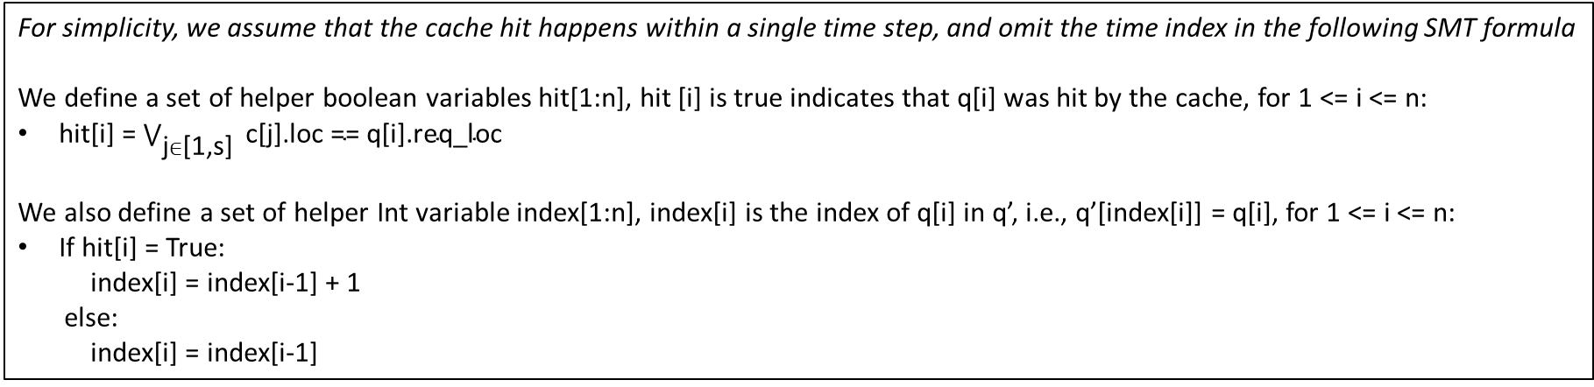
Formal model of the host network
Modeling the cache hit
Add a shadow queue q’ to store the elements that are not hit by the cache
n
…
2
1
Cache
n
…
2
1
…
q(1:T)[1:n]
q’(1:T)[1:n]
c(1:T)[1:s]
For simplicity, we assume that the cache hit happens within a single time step, and omit the time index in the following SMT formula
We define a set of helper boolean variables hit[1:n], hit [i] is true indicates that q[i] was hit by the cache, for 1 <= i <= n:
hit[i] = $\bigvee_{\text{j}∈\text{[1,}\text{s}\text{] }}{\text{c}\text{[}\text{j}\text{].}\text{loc}\text{ == }\text{q}\text{[}\text{i}\text{].}\text{req}\text{_}\text{loc} }$
We also define a set of helper Int variable index[1:n], index[i] is the index of q[i] in q’, i.e., q’[index[i]] = q[i], for 1 <= i <= n:
If hit[i] = True:
index[i] = index[i-1] + 1
else:
index[i] = index[i-1]

Slide 27
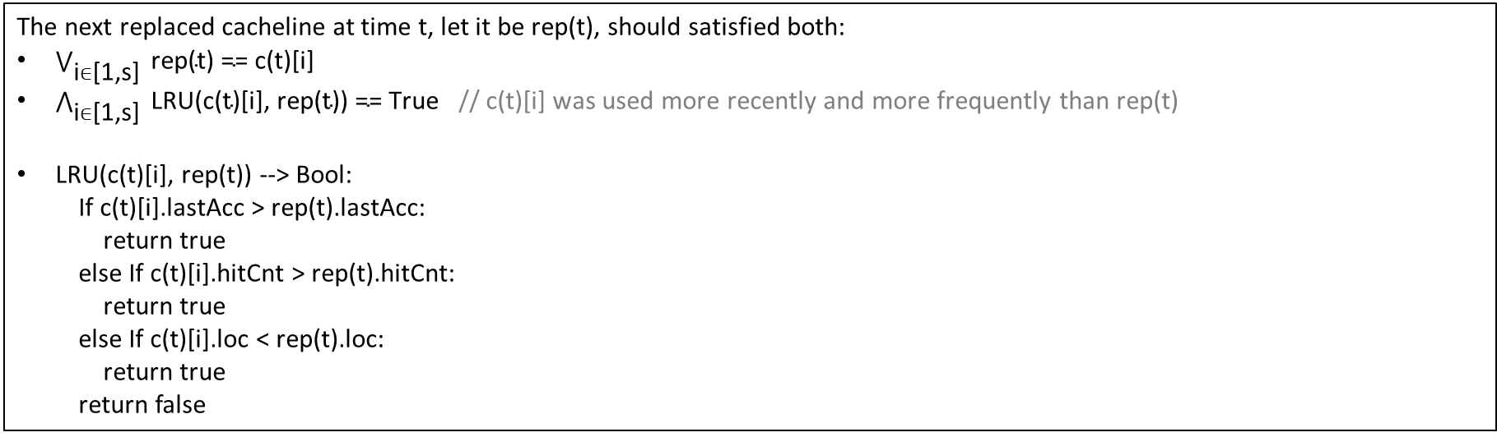
Formal model of the host network
Modeling the cache replacement (simplified)
The next replaced cacheline at time t, let it be rep(t), should satisfied both:
$\bigvee_{\text{i}∈\text{[1,}\text{s}\text{] }}{\text{rep}\text{(}\text{t}\text{) == }\text{c}\text{(}\text{t}\text{)[}\text{i}\text{] }}$
$\bigwedge_{\text{i}∈\text{[1,}\text{s}\text{]}}{ \text{LRU}\text{(}\text{c}\text{(}\text{t}\text{)[}\text{i}\text{]}\text{, }\text{rep}\text{(}\text{t}\text{)) == }\text{True} }$ // c(t)[i] was used more recently and more frequently than rep(t)
LRU(c(t)[i], rep(t)) --> Bool:
If c(t)[i].lastAcc > rep(t).lastAcc:
return true
else If c(t)[i].hitCnt > rep(t).hitCnt:
return true
else If c(t)[i].loc < rep(t).loc:
return true
return false

Slide 28
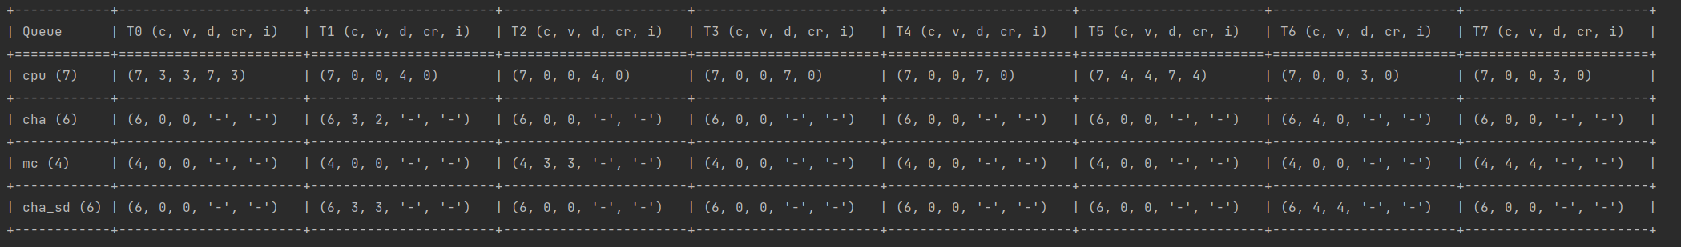
Performance analysis results
A concrete trace that shows the states of each queues at each time steps

Slide 29
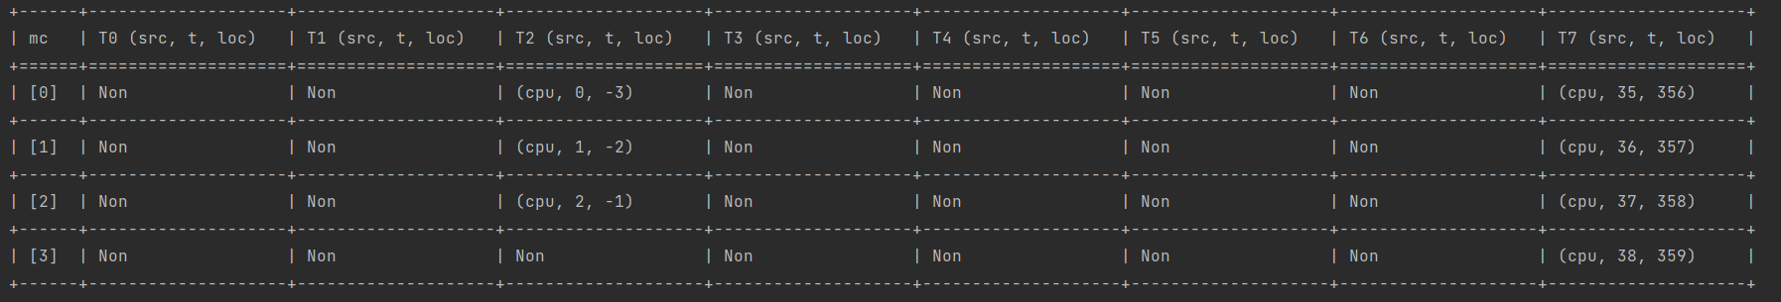
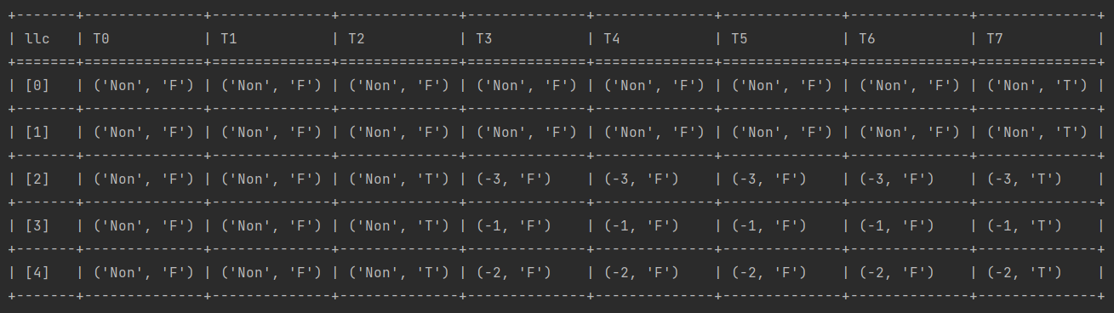
Performance analysis results
A concrete trace that shows the states of each queues at each time steps

Slide 30
Analysis and Design of Host Networks via Formal Methods: Possibilities, Opportunities and Challenges
Open Questions:
Scaling to larger networks: e.g., tens of cores or I/O devices
Supporting new architectures: NUMA, CXL memory, Huawei UB-mesh
Unifying the model of host network and traditional network for end-to-end performance reasoning: 统一主机内部状态模型与网络侧路径模型，实现端到端的性能验证
From verification counter-example to real-world workload/traces: 把验证得到的反例转化成真实的workloads/trace（比如可以直接作为类似ns3那种的simulator的输入）
Toward automated formalization of arbitrary host-network configurations：给定任意主机网络的拓扑&配置（调度算法，传输协议），自动化建模以及生成SMT约束
Supporting failure analysis：在总线/内存/cpu/gpu等有一定概率会发生故障的场景下，分析主机性能的下降情况
Differential analysis of the host network performance: 比较主机网络的拓扑或配置变化后，性能会受到怎样的影响。比如调度策略从 RR 改为优先级调度是否可以提高吞吐量？某个队列的长度减少后导致平均延迟发生怎样的变化？
Performance-driven design automation for host networks: 给定性能要求（例如请求平均时延<5个时间步长），自动设计主机架构和调度策略（相当于synthesis）

Slide 31
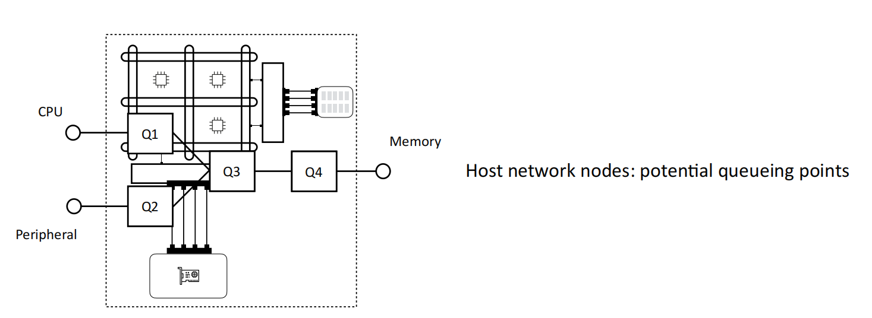
Formal Verification for Host Network Performance
Create a formal model for the host network
Automatically analyze the entire input space
LFB
CHA
MC
IIO
Host network node:
potential queuing point
Specify the desired performance property
Prove or disprove the property
Model the queue node, scheduling, and read/write requests in the host network using first-order logic:
i.e., model d requests dequeue at time t:
dequeue_cnt[t] = d -> tmp_valid[t][i] = inqueue_valid[t][i+d]
Notes:
We also define a set of helper boolean variables val_elem[t][i].
val_elem[t][i] is true if there is a packet in elems[t][1 : S] and is
false if elems[t][i] is empty. val_enq[t][1 : K] is defined similarly.
Our queues can have up to K enqueues and up to S dequeues
in every time step. To model that, we take care of the dequeues
first. We define an extra set of helper variables tmp_val[t][1 : S]
to denote which indexes in the queue would still have packets
and which ones would become empty at t +1 if we were to
only do deq_cnt(t) number of dequeues and not any enqueues.
Specifically, tmp_val[t][i] is true if the ith element of the queue
will still contain a packet after the dequeues in that time step
assuming no enqueues happen

Slide 32
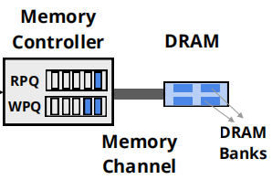
Formal Verification for Host Network Performance
Create a formal model for the host network
Automatically analyze the entire input space
Properties are performance metrics we intend to verify:
Will the P2M throughput degradation > 1.5x when collocated with C2M?
Will the write pending queue be full at some point in time?
e.g., ∀t∈[1,T]: lfb_enq(Q,t) ≥ 2R·t /\ iio_enq(Q,t) ≥ R·t
→ ∃t∈[1,T]: mc_wpq_enqueue(t) > mc_wpq_size
Specify the desired performance property
Prove or disprove the property

Slide 33

Formal Verification for Host Network Performance
Create a formal model for the host network
Automatically analyze the entire input space
We model the performance query as the SMT formula:
workload /\ model -> property
We use SMT solver Z3 to analyze its satisfiability:
i.e., whether all input workloads hold the property:
workload /\ model /\ $¬$property
Specify the desired performance property
Prove or disprove the property

Slide 34


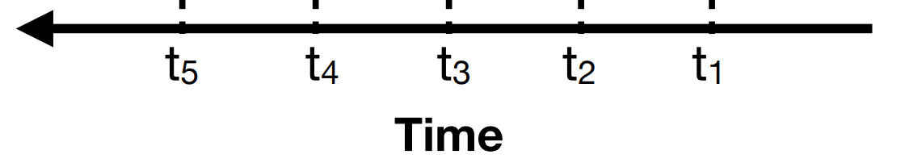
Formal Verification for Host Network Performance
✔ Property always holds
× An example input for that does not hold
Create a formal model for the host network
Automatically analyze the entire input space
LFB
Memory
CHA
MC
IIO
A counter-example trace
Specify the desired performance property
Prove or disprove the property

Slide 35
The host network overview
CPU
CPU
Storage components
L1
L1
RNIC
GPU
L2
L2
CHA
RC
RP
RP
LLC
Host Mem
CXL Mem

Slide 36


Proposal: Formal analysis of host network performance
LFB
CHA
MC
IIO
L1
L1
L2
L2
CHA
RC
LLC
LLC
RPQ
CXL Mem
WPQ
Host Mem

Slide 37
The host network overview
CPU
CPU
L1
L1
RNIC
RNIC
L2
L2
CHA
RC
LLC
RPQ
WPQ
Host Mem

Slide 38
The host network overview
CPU
L1
RNIC
RNIC
L2
CHA
I/O Controller
LLC
Host Mem
CXL Mem

Slide 39
Proposal: Formal analysis of host network performance
LFB
CHA
MC
IIO
L1
L1
L2
L2
CHA
RC
LLC
LLC
RPQ
CXL Mem
WPQ
Host Mem

Slide 40
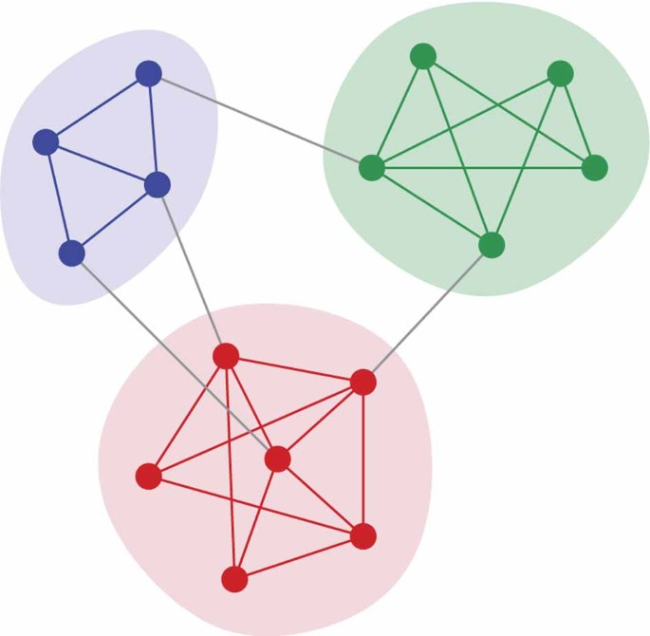
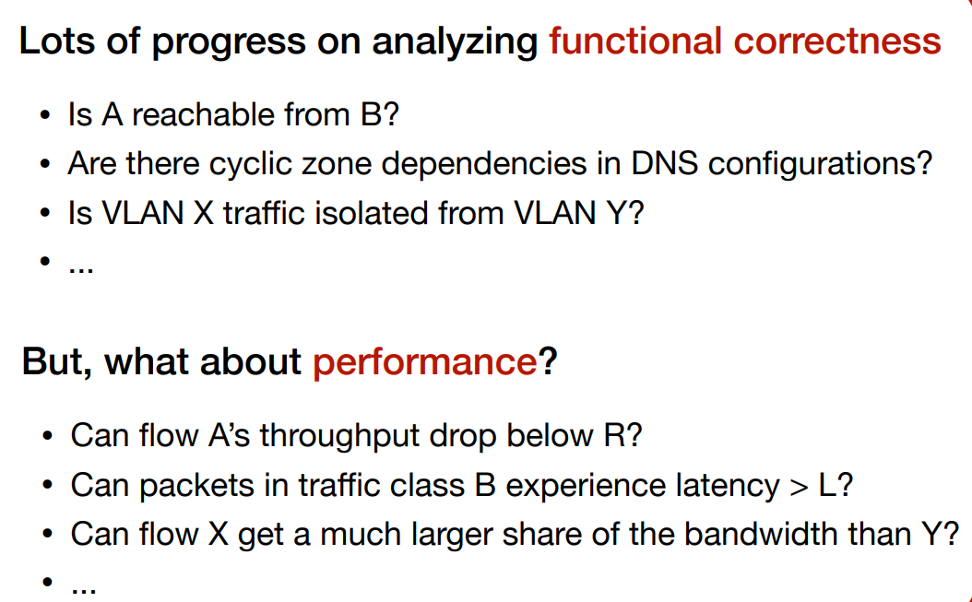
Network verification
Automatically verifying whether the network conforms to certain properties
Is A reachable from B?
Are there cyclic zone dependencies in DNS configurations?
Is VLAN X traffic isolated from VLAN Y?
From 2012 to 2024, > 40 sigcomm, nsdi, sosp, … papers

Slide 41
Network verification
Automatically verifying whether the network conforms to certain properties
Is A reachable from B?
Are there cyclic zone dependencies in DNS configurations?
Is VLAN X traffic isolated from VLAN Y?
Functional Correctness
From 2012 to 2024, > 40 sigcomm, nsdi, sosp, … papers

Slide 42
From correctness to performance verification
Verify the congestion control algorithm’s performance (CCAC [sigcomm’21])
Can AIMD’s cwnd reduce to 1 BDP even when buffer size is 2BDP, whereas in a fluid model, it never goes below 1.5 BDP?
Can BBR achieve less than 𝑥% utilization?
Will one queue take more than its share of the bandwidth?
Will a queue transmit fewer than K packets during T time steps?
Verify the scheduling algorithm’s performance (FPerf [nsdi’23])
Performance metrics:
Efficiency, Fairness, Starvation, Latency, …

Slide 43
Can we verify the host network performance?
Host network as a standalone network

Slide 44
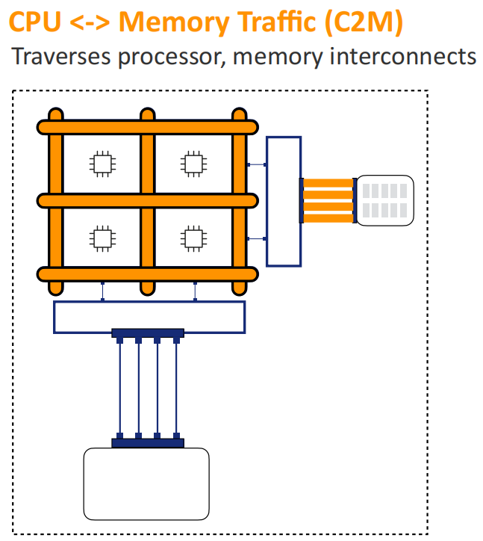
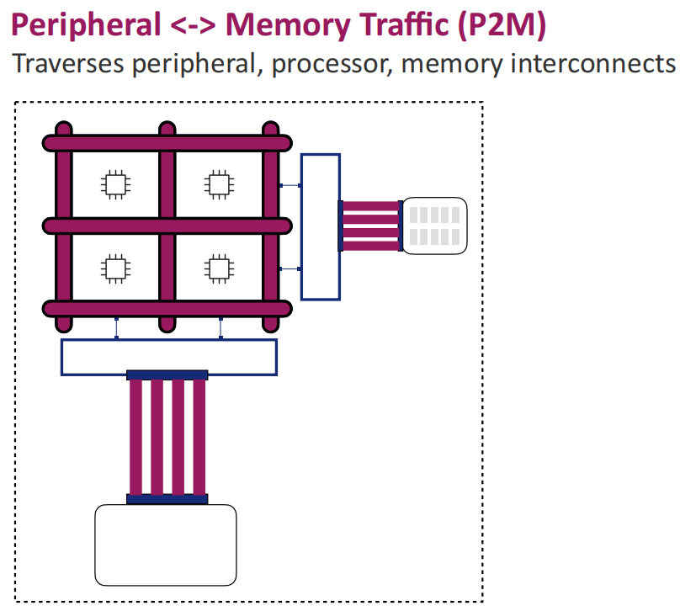

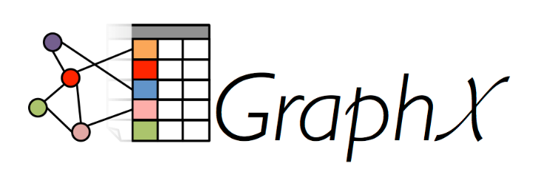


Data transfers in the host network
Notes:
There are types of traffic in the host,
one is CPU-2-Mem traffic, which traverses processor, mem interconnects, generated from apps such as Redis and GraphX
another is peripheral-2-Mem traffic, which traverses peripheral, mem interconnects, generated from networked and storage apps such as Spark and Mapreduce

Slide 45

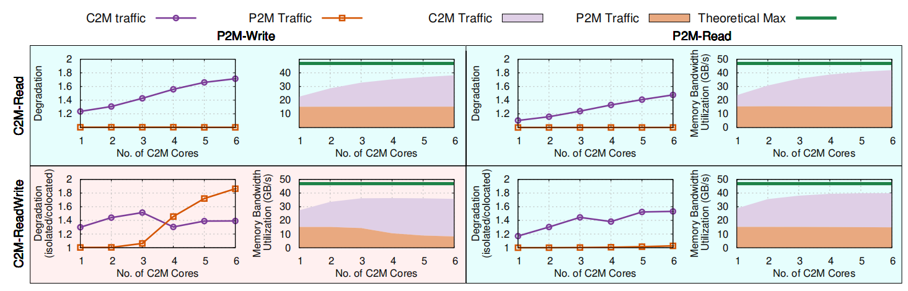

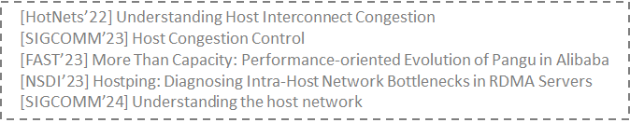
Contention in the host network has an impact on C2M/P2M application performance
Contention regimes ([sigcomm’24])
Blue regime: C2M throughput degrades while P2M throughput does not.
Red regime: Both C2M and P2M throughput degrade ([HotNets’22], [sigcomm’23, fast’23, nsdi’23]).

