Slide 1
Daniel Battle.
Hi my name is Daniel and I am 9 years old my school is Dudley academy

Slide 2
My toy is narto
I like cupter

Slide 3
My favorite food is hot dogs
My favorite game is minecraft because I like the graphic

Slide 4
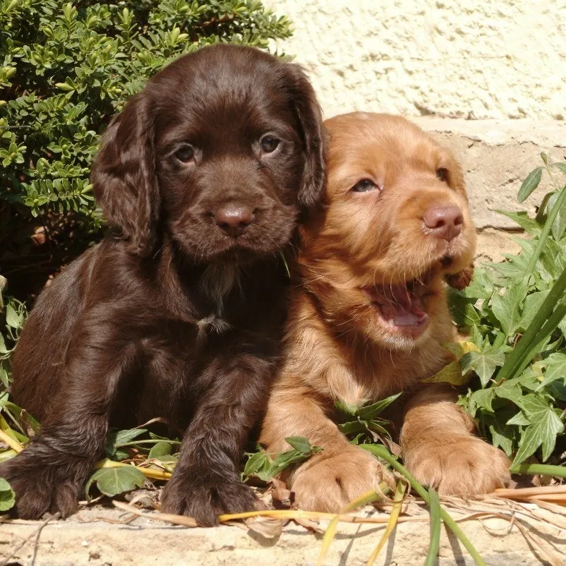
My favorite animal is dog

Slide 5
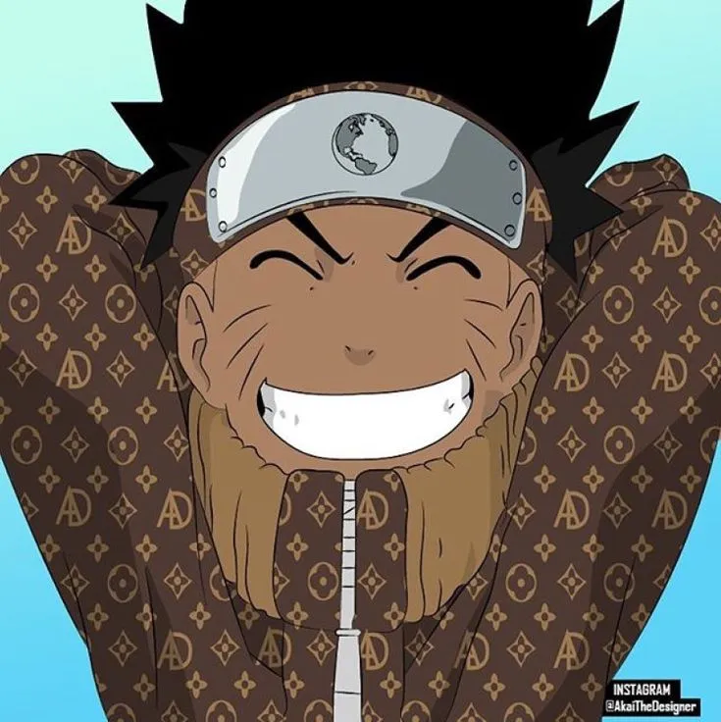
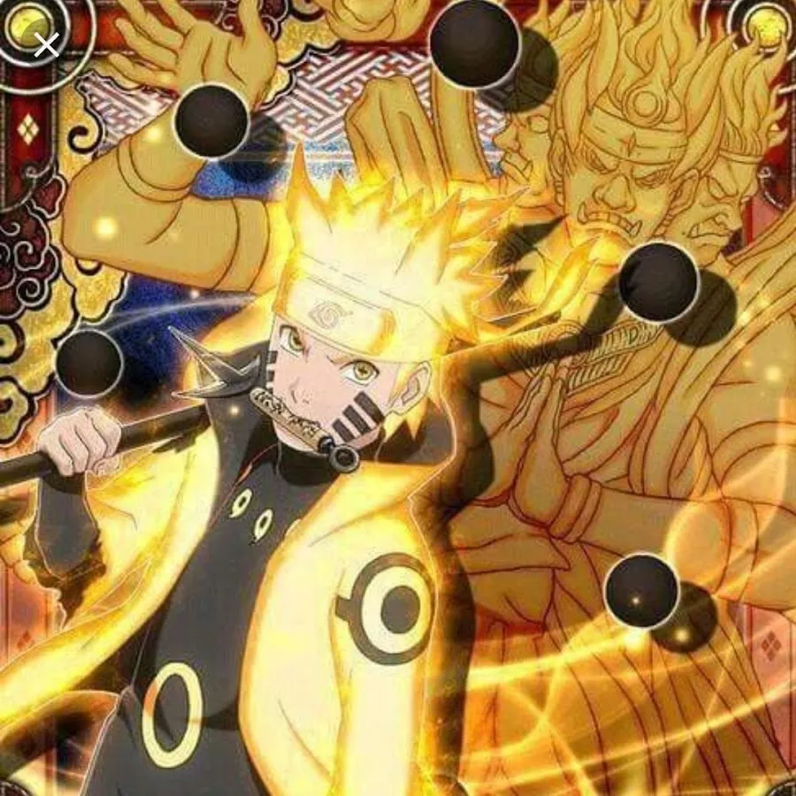
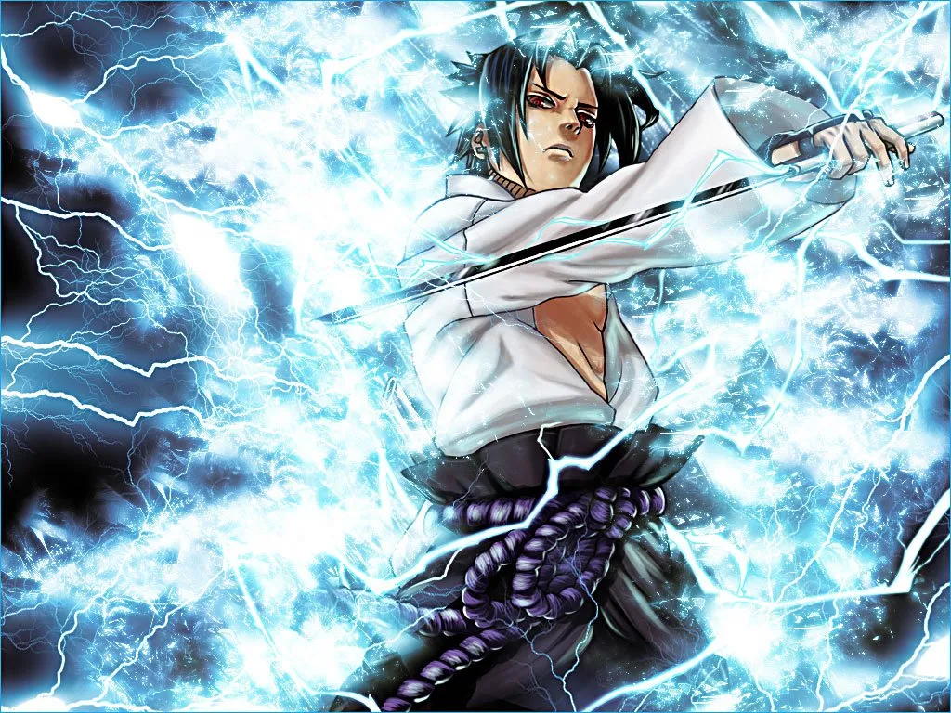
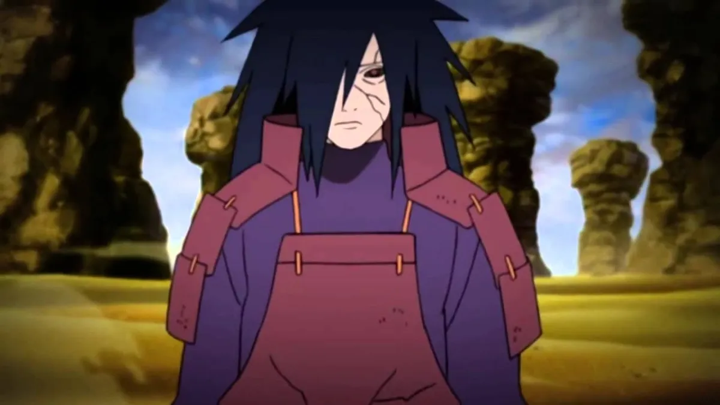
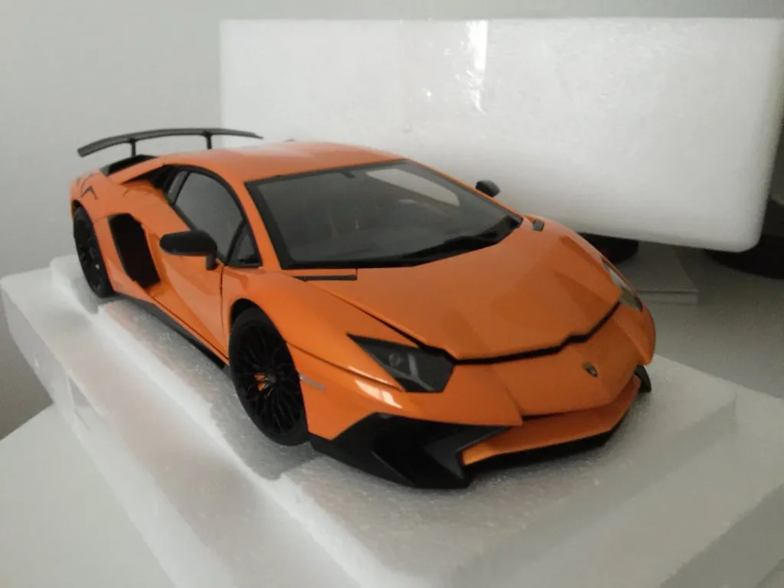
This is all

