Slide 1
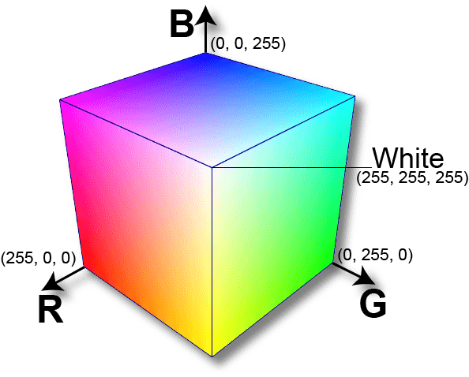

Slide 2
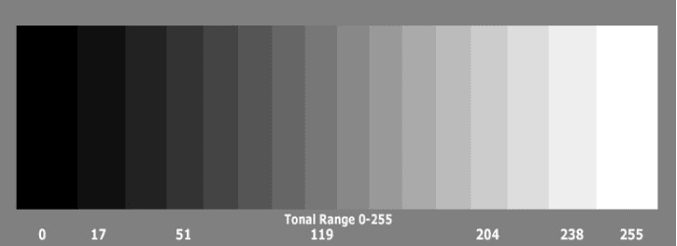

Slide 3
How to Convert an RGB Image to a Grayscale
Predefined Function
cv.cvtColor( img, cv.COLOR_BGR2GRAY )

Slide 4

Lightness Method
A very simple method is to take the average value of the components with the highest and lowest value:
We can easily see that this method presents a very serious weakness since one RGB component is not used. This is definitely a problem because the amount of lightness that our eye perceives depends on all three basic colors.

Slide 5

Average Method
Another method is to take the average value of the three components (red, green, and blue) as the grayscale value:
Although we now take into account all components, the average method is also problematic since it assigns the same weight to each component.
Based on research on human vision, we know that our eyes react to each color in a different manner.
Specifically, our eyes are more sensitive to green, then to red, and finally to blue. Therefore, the weights in the above equation should change.

Slide 6
Luminosity Method
The best method is the luminosity method that successfully solves the problems of previous methods.
Based on the aforementioned observations, we should take a weighted average of the components. The contribution of blue to the final value should decrease, and the contribution of green should increase. After some experiments and more in-depth analysis, researchers have concluded in the equation below:

