Slide 1
Histogram

Slide 2
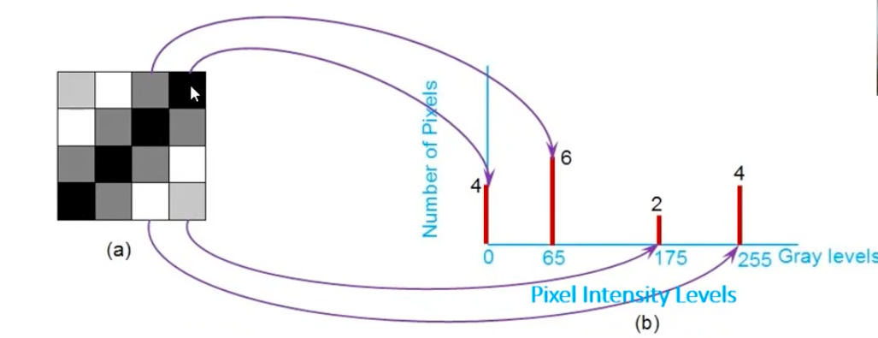
Histogram: An image histogram is a graph that shows the distribution of pixel values in a digital image

Slide 3
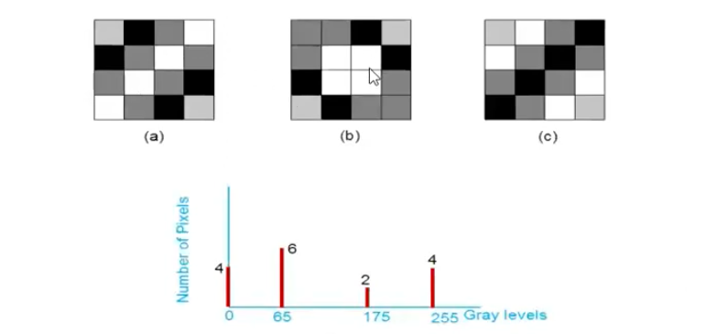

Slide 4
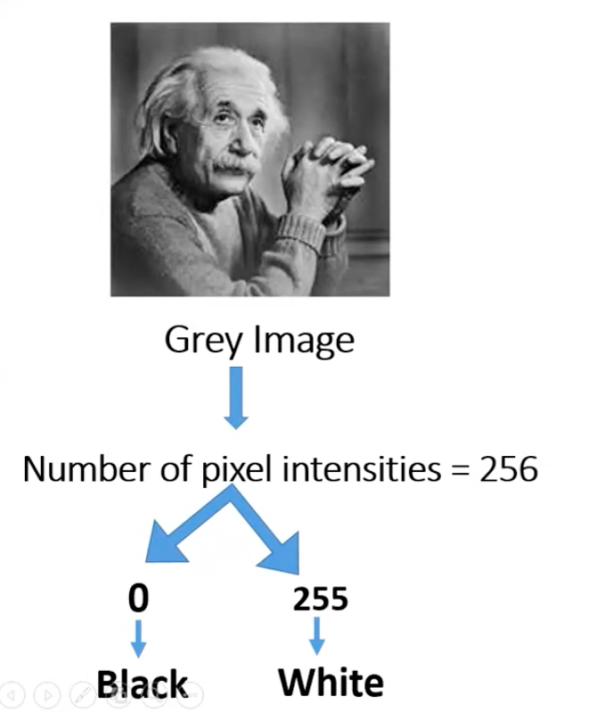

Slide 5
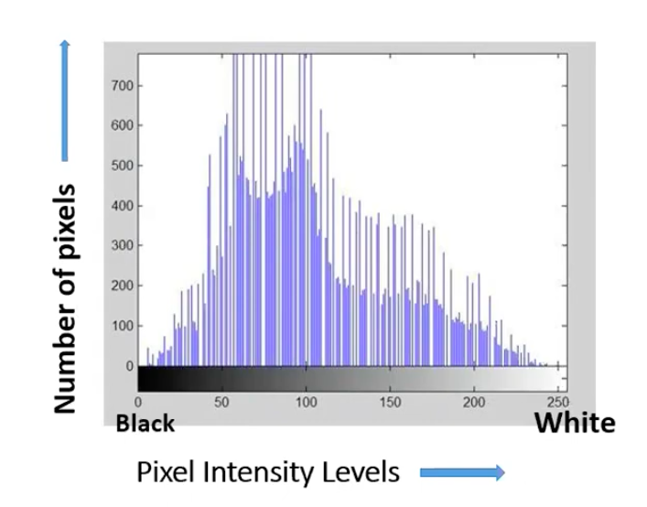

Slide 6
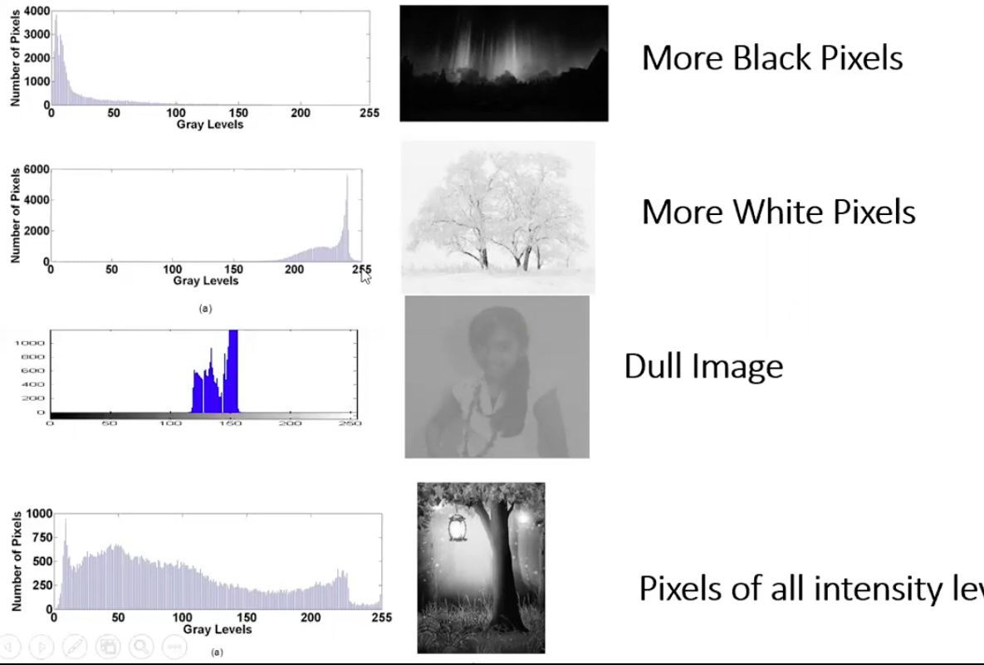

Slide 7
Histogram equalization
Histogram equalization is an image processing technique that adjusts the pixel values of an image based on its intensity histogram
Or
Histogram equalization is a method to process images in order to adjust the contrast of an image by modifying the intensity distribution of the histogram

Slide 8
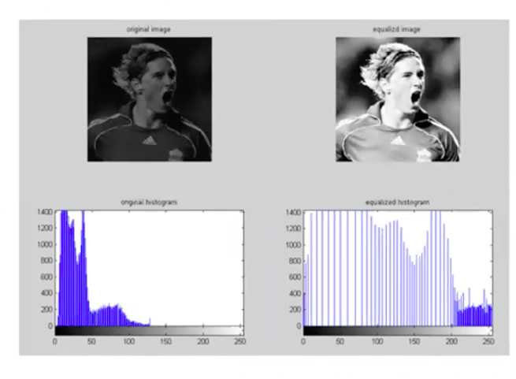

Slide 9
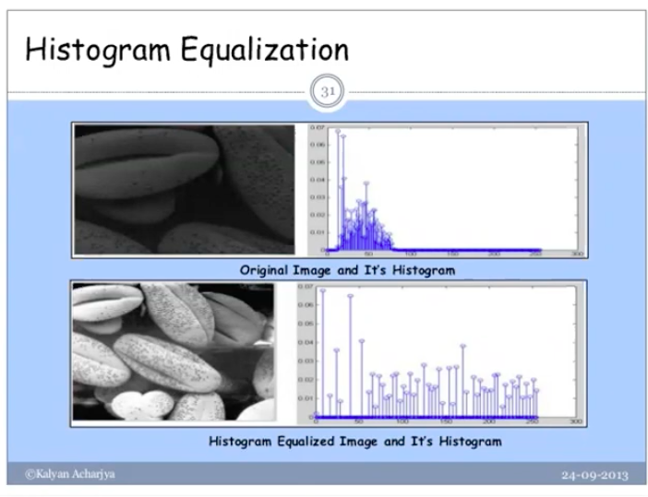

Slide 10
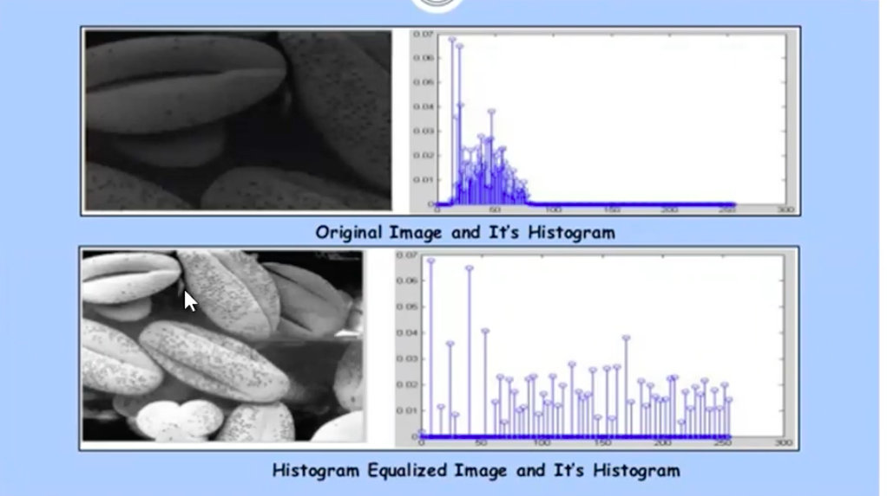

Slide 11
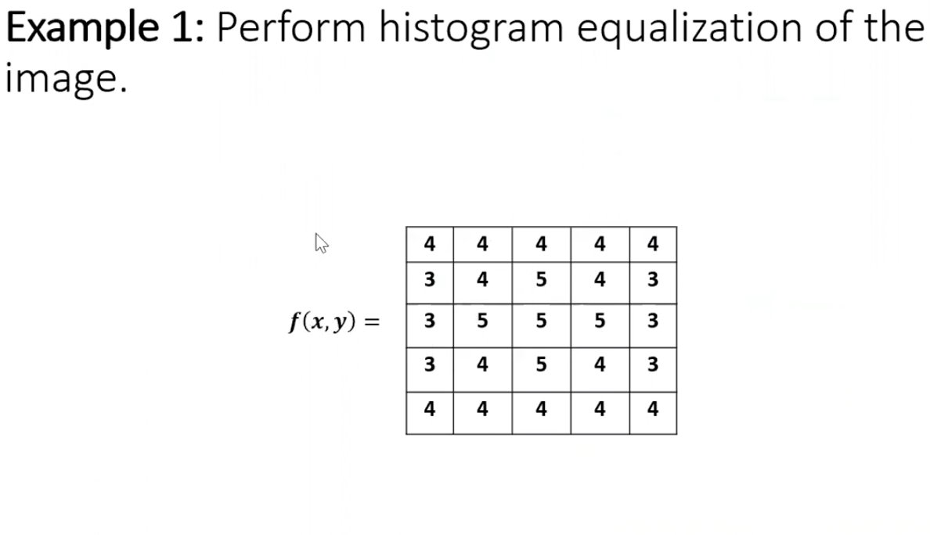

Slide 12
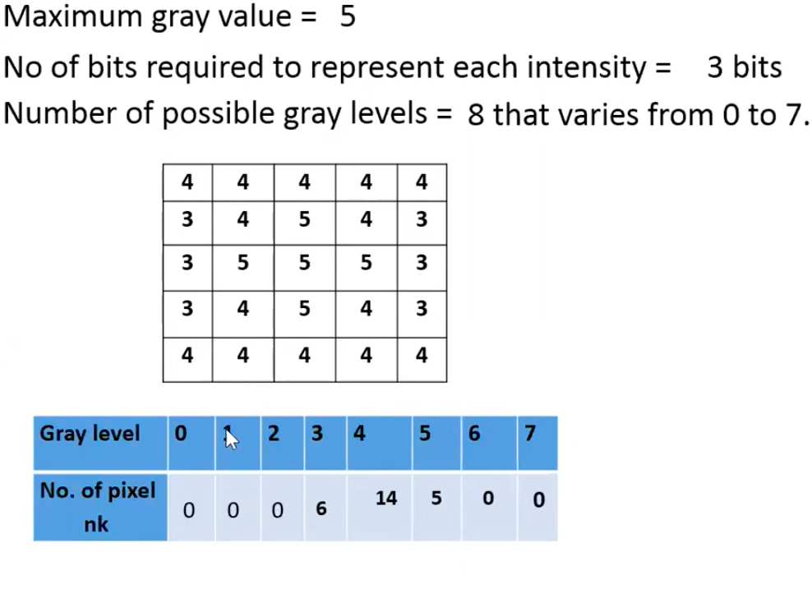

Slide 13
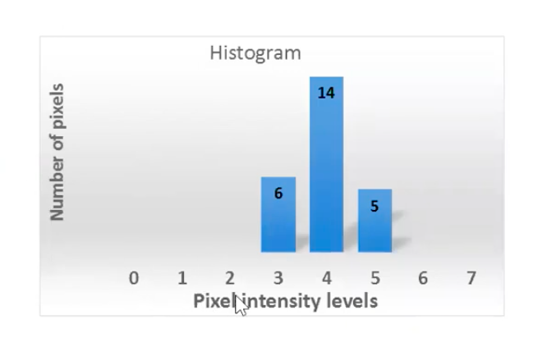

Slide 14
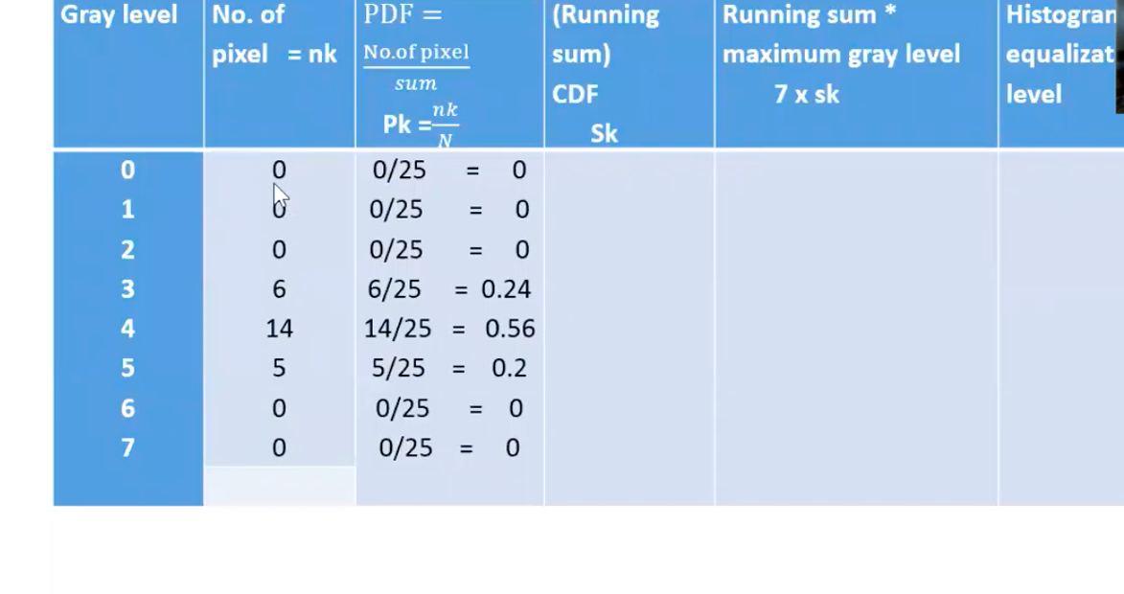

Slide 15
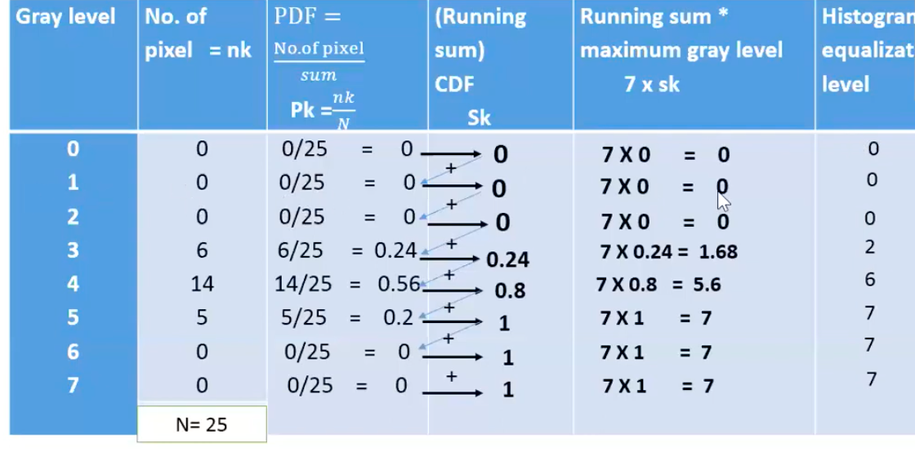

Slide 16
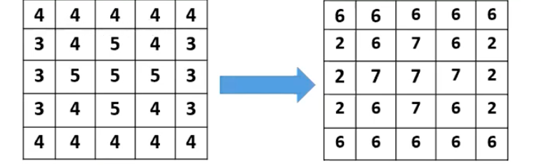

Slide 17
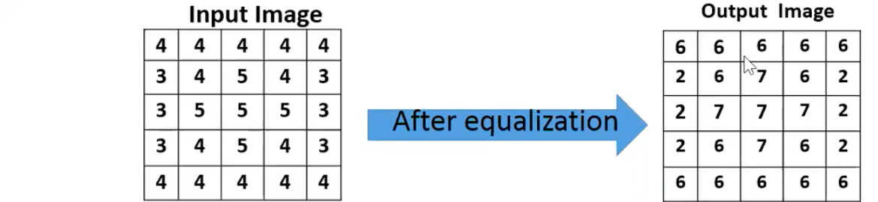
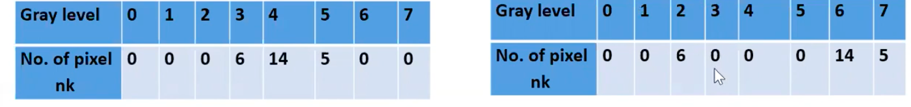

Slide 18
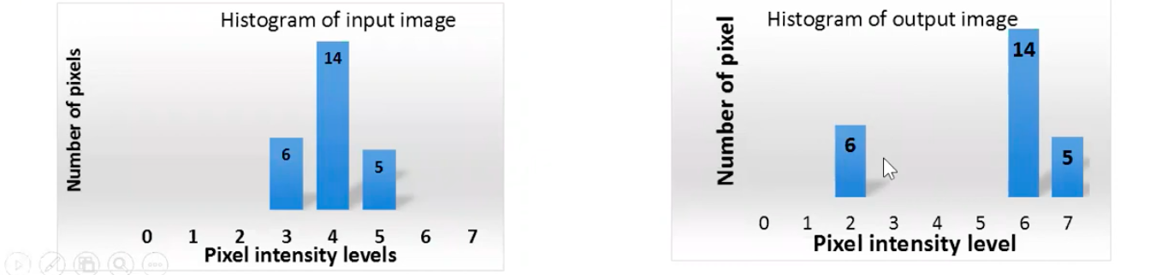

Slide 19
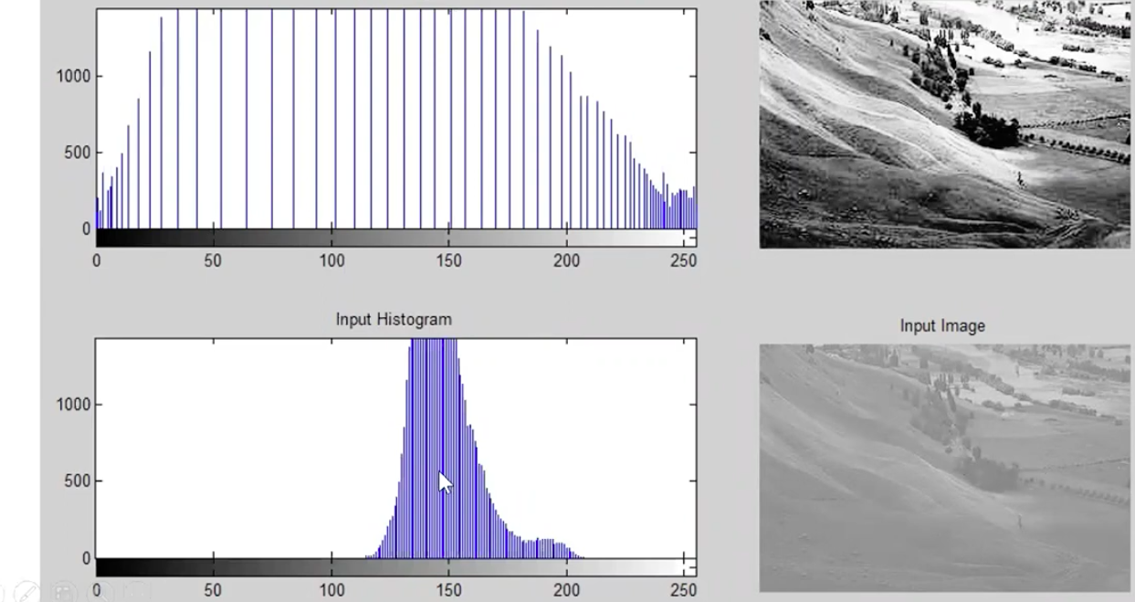

Slide 20
Exercise: Histogram Equalizer
4 | 1 | 3 | 2
3 | 1 | 1 | 1
0 | 1 | 5 | 2
1 | 1 | 5 | 2

Slide 21
4 | 1 | 3 | 2
3 | 1 | 1 | 1
0 | 1 | 5 | 2
1 | 1 | 5 | 2
5 | 3 | 4 | 4
4 | 3 | 3 | 3
1 | 3 | 5 | 4
3 | 3 | 4 | 4

Slide 22
Histogram Calculation in OpenCV
cv.calcHist(images, channels, mask, histSize, ranges[, hist[, accumulate]])
images : it is the source image of type uint8 or float32. it should be given in square brackets, ie, "[img]".
channels : it is also given in square brackets. It is the index of channel for which we calculate histogram. For example, if input is grayscale image, its value is [0]. For color image, you can pass [0], [1] or [2] to calculate histogram of blue, green or red channel respectively.
mask : mask image. To find histogram of full image, it is given as "None". But if you want to find histogram of particular region of image, you have to create a mask image for that and give it as mask. (I will show an example later.)
histSize : this represents our BIN count. Need to be given in square brackets. For full scale, we pass [256].
ranges : this is our RANGE. Normally, it is [0,256].

Slide 23
Histogram Calculation in OpenCV
cv.calcHist(images, channels, mask, histSize, ranges[, hist[, accumulate]])
img = cv.imread('home.jpg', cv.IMREAD_GRAYSCALE)
hist = cv.calcHist([img],[0],None,[256],[0,256])

