Slide 1
Perform Walsh Transform
1 2 1
2 3 2
3 4 3
1 2 3 2

Slide 2
Noise Models

Slide 3
Introduction to Noise in Image Processing
Content:
Noise is random variation in pixel intensity and occurs due to various external factors.
Noise is usually unwanted and distorts the original signal or image.
Understanding noise models is critical in designing algorithms for filtering, detection, and image reconstruction.

Slide 4
Noise Models Overview
A noise model characterizes the statistical properties of noise.
Different types of noise impact images and signals in various ways.
Common noise models: Gaussian, Rayleigh, Erlang, Exponential, Uniform, Salt & Pepper.

Slide 5
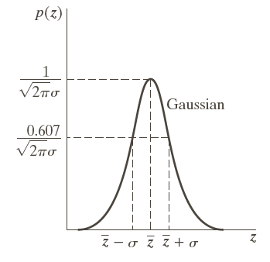
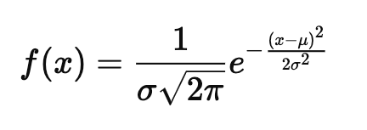
Gaussian Noise
Description:Gaussian noise (also called normal noise) follows a normal distribution.
Characterized by its mean (μ) and standard deviation (σ).
Most common type of noise in image processing, caused by thermal noise or sensor noise.
Formula:Probability density function (PDF):
Why Use:Represents typical noise in natural imaging systems, such as cameras and sensors.

Slide 6
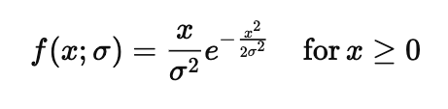
Rayleigh Noise
Description:Rayleigh noise follows a Rayleigh distribution.
Applicable when the magnitude of a signal has two independent Gaussian components.
Formula:PDF:
Use Cases:Often found in radar, communication systems, or imaging involving coherent light (e.g., lasers).
Why Use:Models noise in applications where phase and magnitude are independent.

Slide 7
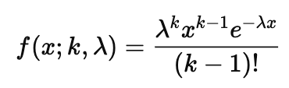
Erlang Noise (Gamma Noise)
Description:Erlang (or Gamma) noise is based on the Erlang distribution.
Describes the waiting time between multiple Poisson-distributed events.
Formula:PDF:
Use Cases:Useful in modeling traffic in telecommunications or biological systems.
Why Use:Suitable for scenarios where noise is derived from the sum of independent, exponentially distributed random variables.

Slide 8

Exponential Noise
Description:Exponential noise follows an exponential distribution.
Often used to model time between events in a Poisson process.
Formula:PDF:
Use Cases:Common in queuing theory and some communication systems.
Why Use:Represents noise in processes where the likelihood of an event decreases exponentially over time.

Slide 9

Uniform Noise
Description:
Uniform noise is characterized by a constant probability density within a specific range.
All values within the range are equally likely.
Formula:
PDF:
Use Cases:
Used when there’s equal uncertainty over a defined range of values.
Why Use:
Simulates random noise where no particular value is more likely than another within the noise range.

Slide 10
Salt & Pepper Noise
Description:Salt & Pepper noise (impulse noise) consists of randomly occurring white and black pixels.
Appears as black (salt) and white (pepper) dots over an image.
Characteristics:Typically caused by malfunctioning pixels in camera sensors or transmission errors.
Use Cases:Simulates sudden disturbances, such as dead pixels or corrupted data transmission.
Why Use:Helps in designing filters (like median filters) that specifically target impulse noise.

Slide 11
Why Use Different Noise Models?
Different noise models are required because:
Each model simulates a different real-world phenomenon (thermal noise, transmission errors, atmospheric disturbances, etc.).
Testing algorithms across various noise models ensures robustness in practical applications.
Some noise types (like Gaussian) are more prevalent in real-world systems, while others (Salt & Pepper) simulate specific hardware errors.

Slide 12
Comparison of Noise Models
Gaussian: Used for general noise; affects all pixels.
Rayleigh: Phase-independent magnitude disturbances.
Erlang: Suitable for traffic or biological models.
Exponential: Models time between random events.
Uniform: Simulates equal probability noise.
Salt & Pepper: Models impulse noise for hardware malfunctions.

