Slide 1
Jester-Gesture Dataset Training & Testing Environment
By Dmitry Zimin

Slide 2
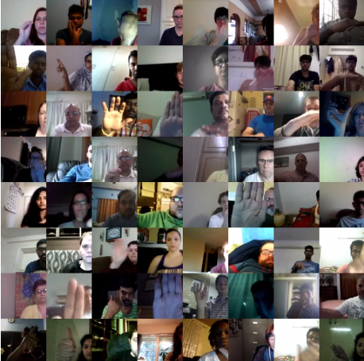
Jester v1 Dataset
27 different Gesture labels
148,092 videos
RGB frames
~54GB of data

Slide 3
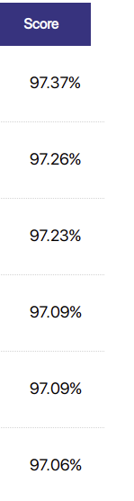
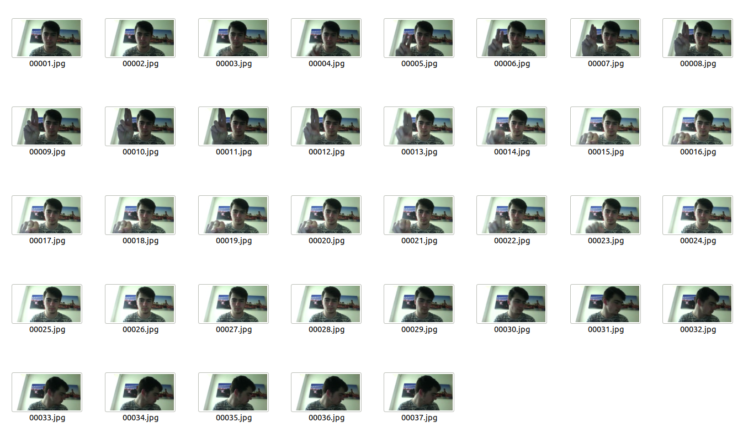
Jester v1 Dataset
Competitive Leaderboard
Free Use
97.37% accuracy

Slide 4
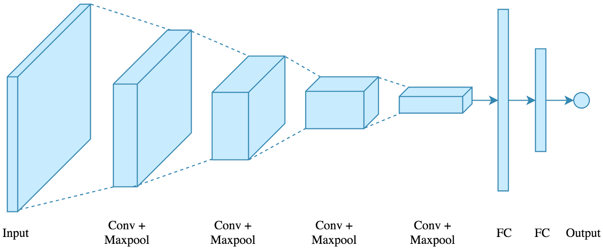
3D CNN
Simple
4 Conv Layers
2 Fully Connected
1 ELU fc

Slide 5
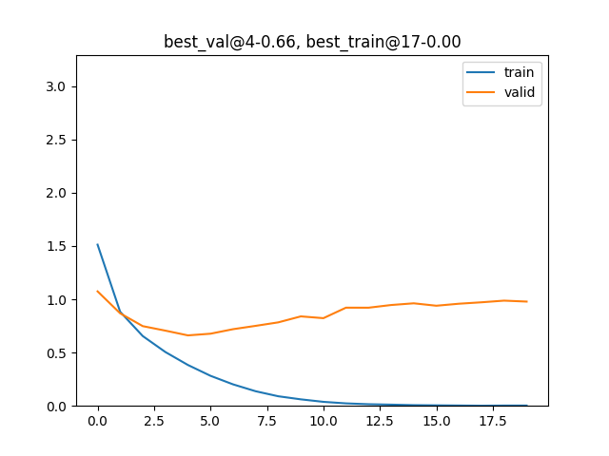
Loss
Best at Epoch 4
Overfitting
Simple

Slide 6
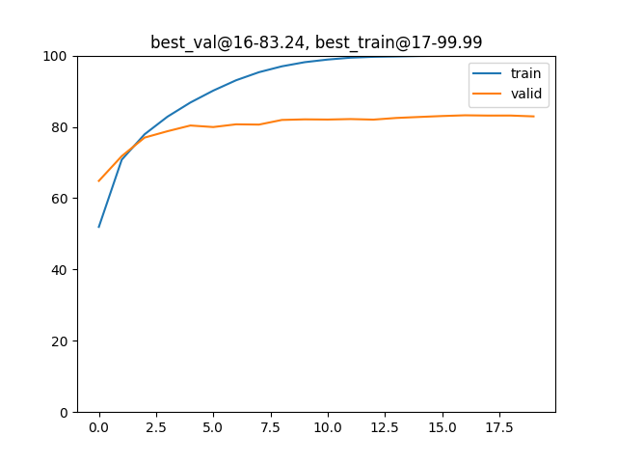
Accuracy
Same as before
Overfitting
Highest accuracy is 83.24%

Slide 7
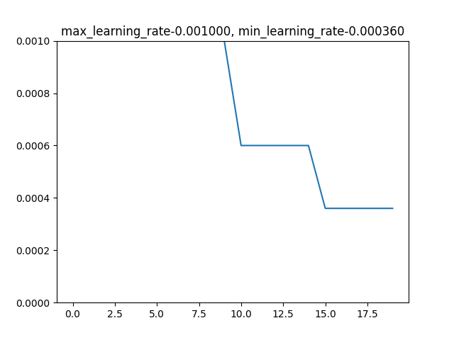
Learning Rate
Allows more granular Learning
Negligent increase in accuracy
Ineffective on the current model

Slide 8
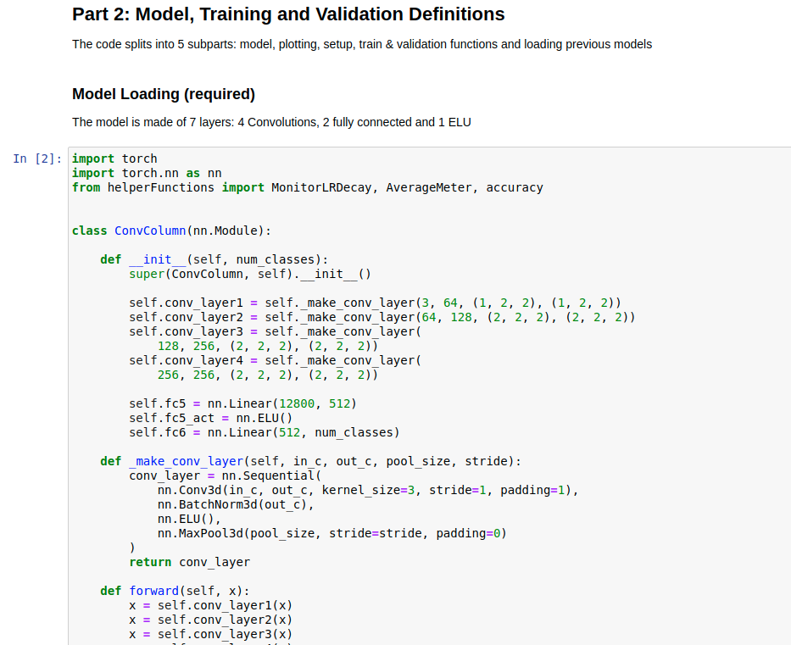
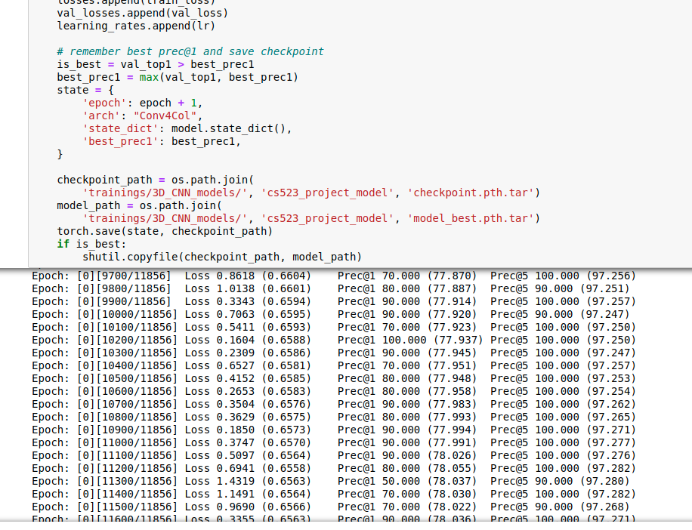
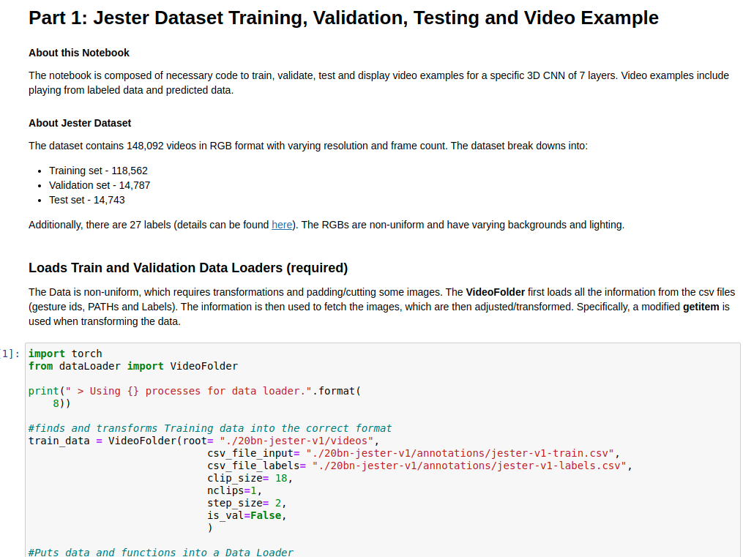
Notebook
Training, Validation + Testing
Display data and labeling
Loss & Accuracy Plotting

Slide 9
Video Examples

Slide 10
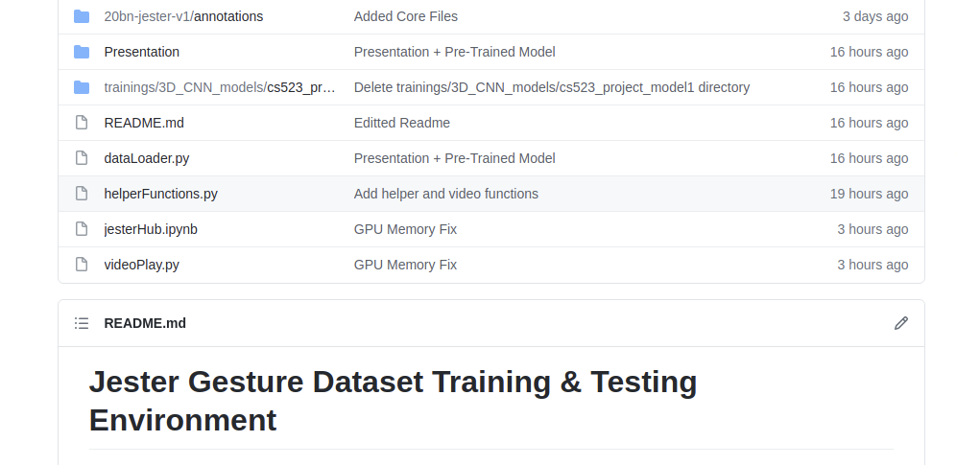
Github Link
https://github.com/yrtimd/Jester-Gesture-3D-CNN

Slide 11
References
Zhu, G., Zhang, L., Mei, L., Shen, P., Shah, S.A.A. and Bennamoun, M. (2018) _Attention in Convolutional LSTM for Gesture Recognition._ In: 32nd Conference on Neural Information Processing Systems (NIPS) 2018, 3 - 8 December 2018, Montreal, Canada
J. Materzynska, G. Berger, I. Bax and R. Memisevic, "The Jester Dataset: A Large-Scale Video Dataset of Human Gestures," 2019 IEEE/CVF International Conference on Computer Vision Workshop (ICCVW)
L. Shi, Y. Zhang, J. Hu, J. Cheng and H. Lu, "Gesture Recognition Using Spatiotemporal Deformable Convolutional Representation," _2019 IEEE International Conference on Image Processing (ICIP)

