Slide 1
Jester-Gesture 3D CNN Training Environment
By Dmitry Zimin

Slide 2
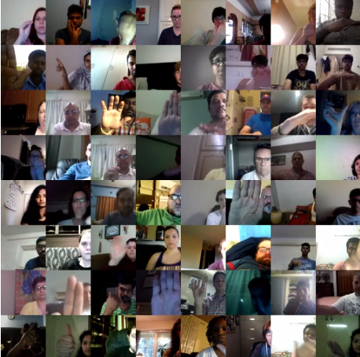
Jester Dataset
27 different Gesture labels
148,092 videos
RGB frames
~35GB of data
Competitive Leaderboard
Free Use

Slide 3
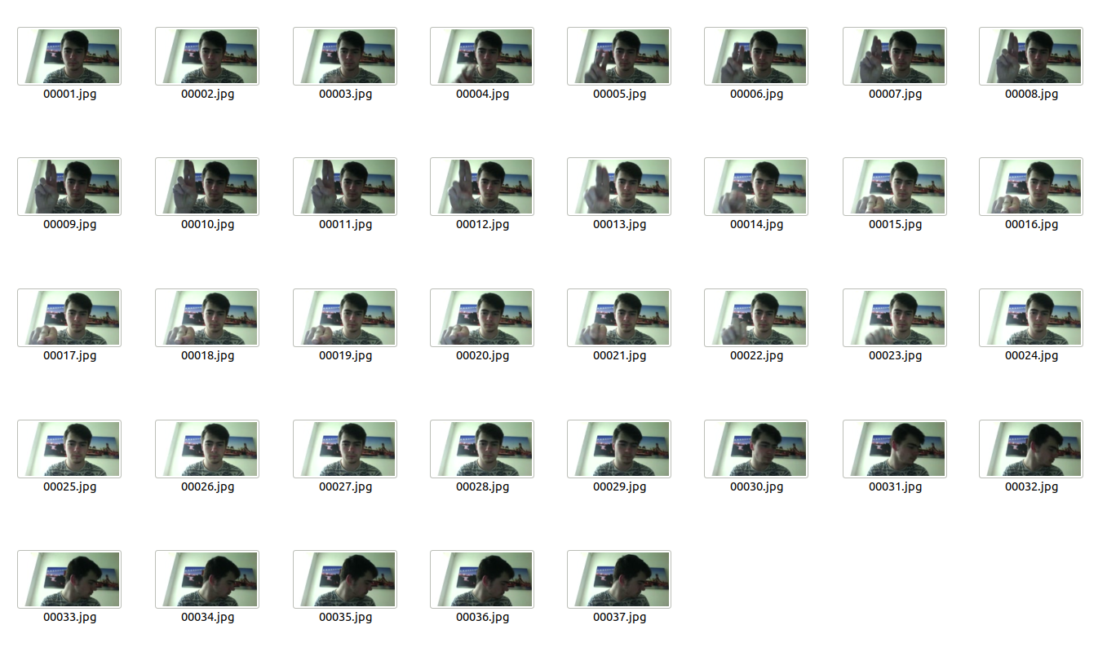
Jester Dataset Example

Slide 4
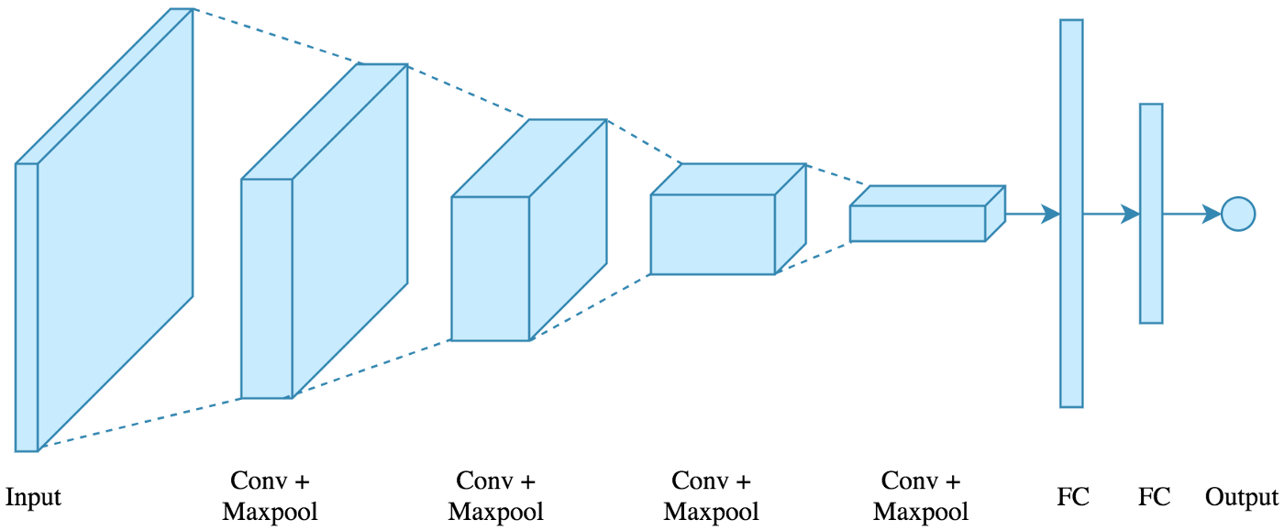
3D CNN
Simple
4 Conv Layers
2 Fully Connected
1 ELU fc

Slide 5
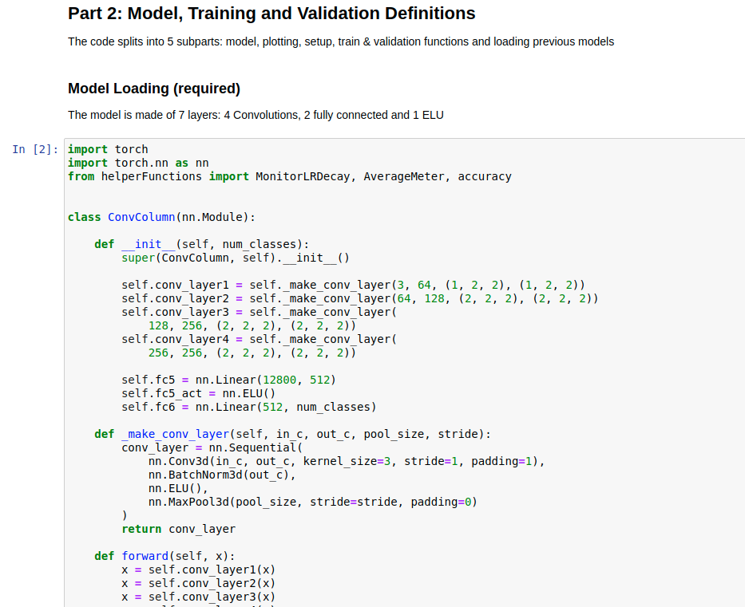
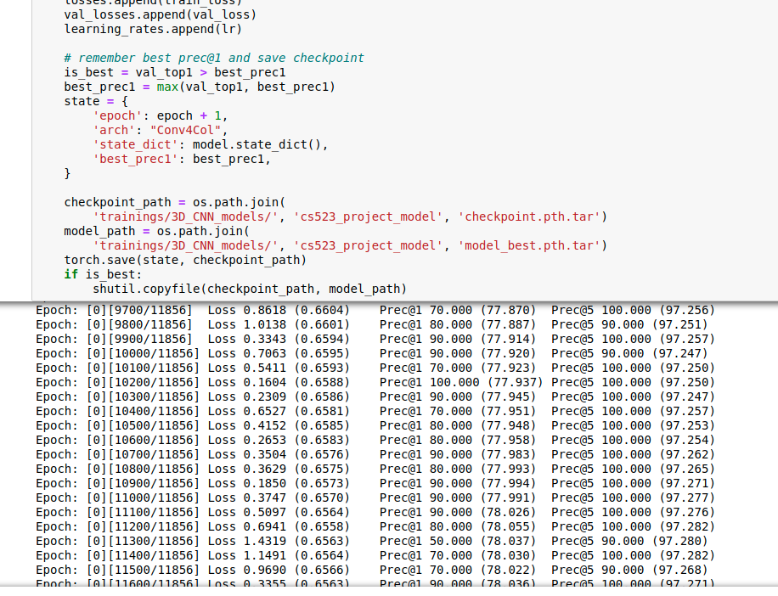
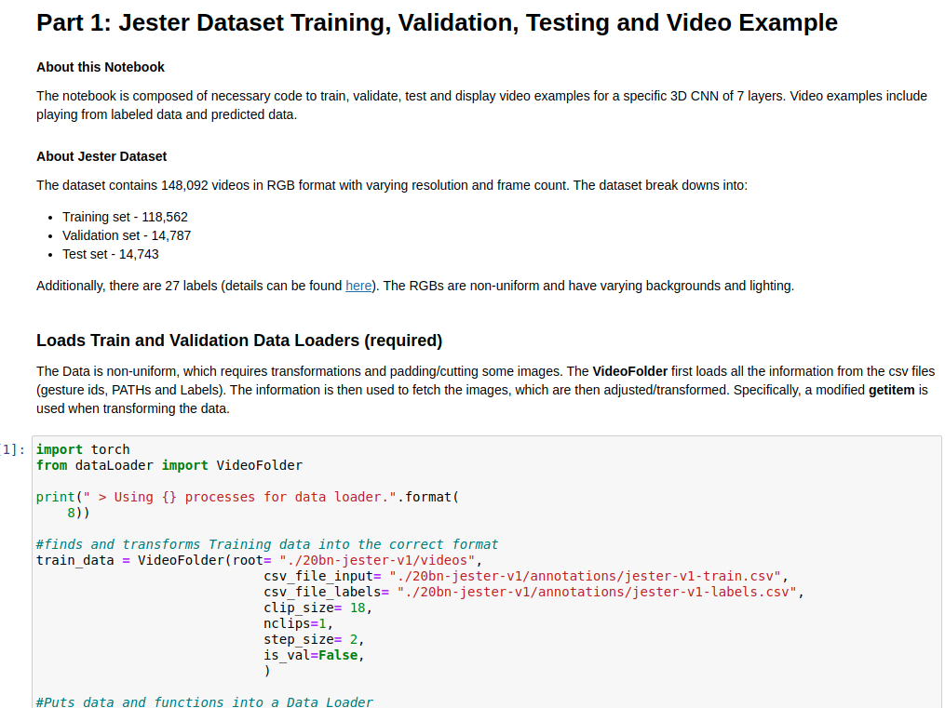
Notebook
Training, Validation + Testing
Display data and labeling
Loss & Accuracy Plotting

Slide 6
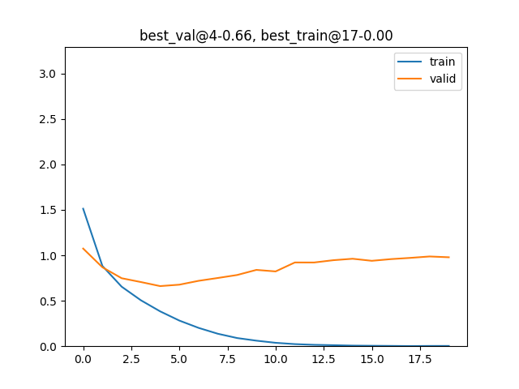
Loss
Best at Epoch 4
Overfitting
Simple

Slide 7
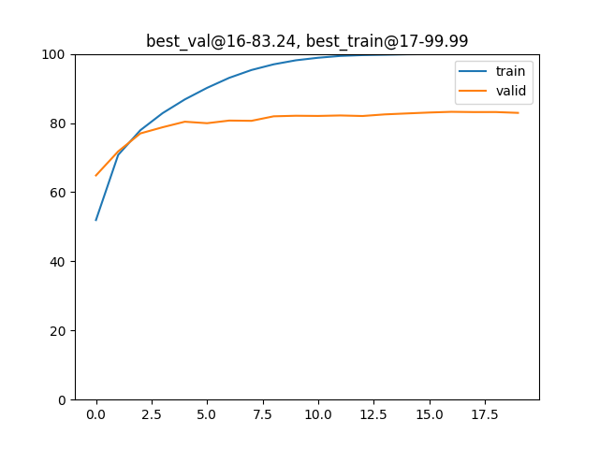
Accuracy
Same as before
Overfitting
Highest accuracy is 83.24%

Slide 8
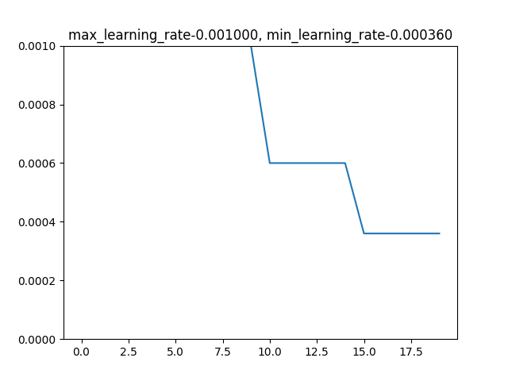
Learning Rate
Allows more granular Learning
Negligent increase in accuracy
Ineffective on the current model

Slide 9
Video Examples

Slide 10
Live Example

