Slide 1
Image restoration and synthesis via Learned Gradient Descent
Koshelev Iaroslav,
Bayesian ML, 2020
https://github.com/ys-koshelev/lgd

Slide 2
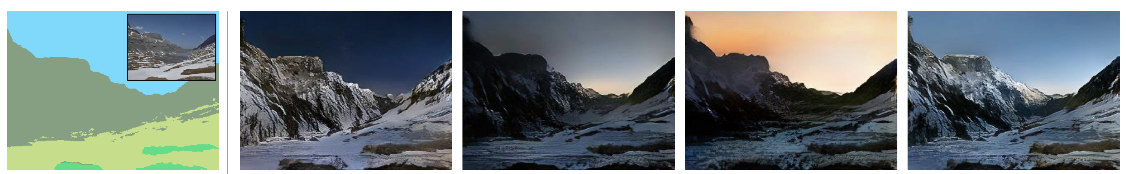
Theoretical background
Degradation model:
Example for Semantic Image Synthesis problem:
y
x₁
x₂
x₃
x₄
Image credit: https://arxiv.org/pdf/1903.07291.pdf

Slide 3
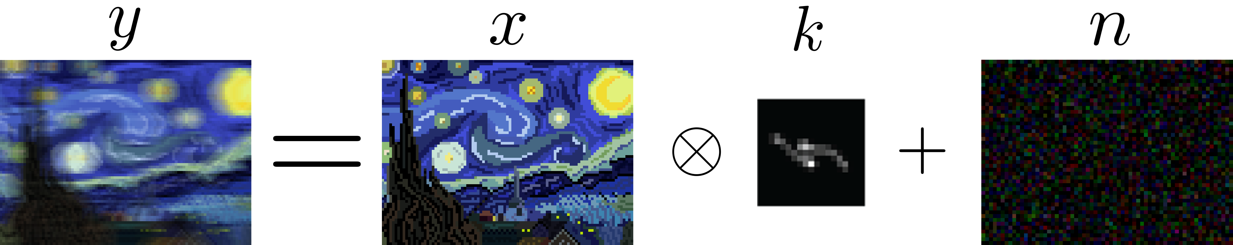
Theoretical background
Linear degradation model + i.i.d. Gaussian noise => classical image restoration problem
Example for deblurring problem:

Slide 4
Theoretical background
Degradation model:
Reasonable solutin - MAP (mode of negative log-posterior) => variational problem:
Probabilistic framework
Variational framework

Slide 5
Theoretical background
Degradation model:
Reasonable solutin - MAP (mode of negative log-posterior) => variational problem:
Solution via gradient-based optimization (gradient descent):

Slide 6
Theoretical background
Degradation model:
Reasonable solutin - MAP (mode of negative log-posterior) => variational problem:
Solution via gradient-based optimization (gradient descent):
No knowledge about prior - ?

Slide 7
Theoretical background
Degradation model:
Reasonable solutin - mode of posterior (negative log-posterior), variational problem:
Solution via gradient-based optimization (gradient descent):
No knowledge about prior - ?
Learn it from data!

Slide 8
Theoretical background
Degradation model:
Reasonable solutin - mode of posterior (negative log-posterior), variational problem:
Calculations of step size, step direction and gradient of prior are alltogether embedded in CNN architecture, which can be learned from data through backpropagation!
Solution via learned gradient-based optimization: meet the learned gradient descent:

Slide 9
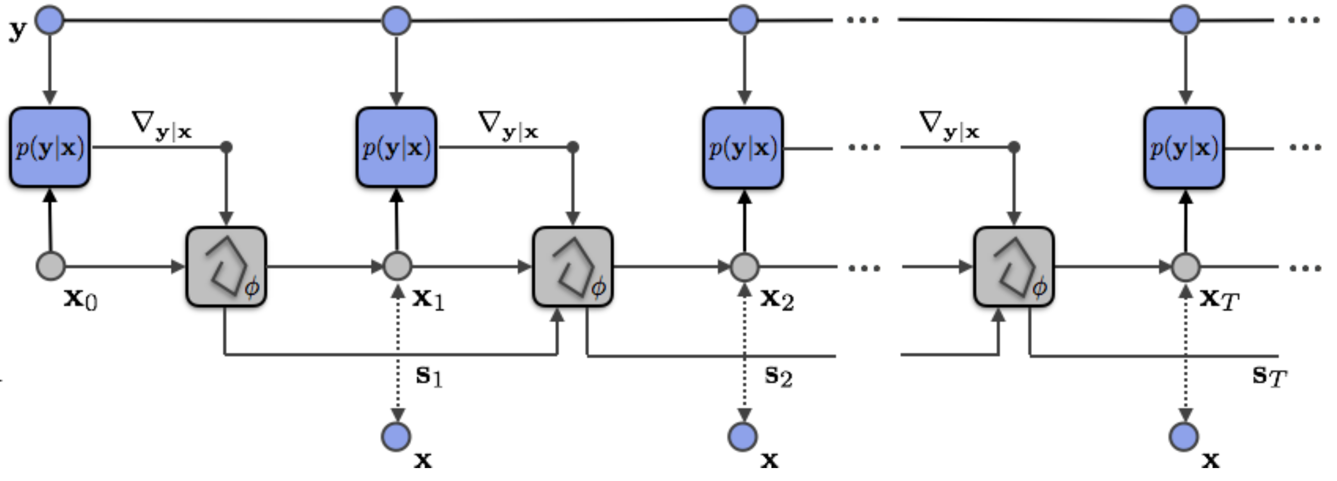
Theoretical background
Learned learned gradient descent:
Is a Recurrent Neural Network (RNN) with additional input of likelihood gradient:
Image credit: https://arxiv.org/pdf/1706.04008.pdf

Slide 10
Who cares?

Slide 11


Implementation details
Denoisig | Deblurring | Super Resolution | Semantic Synthesis
y = x + n | y = Kx + n | y = DKx + n | y = s(x)
n ~ N(0, σ²I) | K – valid convolution matrix; n ~ N(0, σ²I) | K – valid convolution matrix; D – decimation operator; n ~ N(0, σ²I) | s – trained semantic segmentation CNN
L(x, y) = ||y - x||₂² | L(x, y) = ||y - Kx||₂² | L(x, y) = ||y - DKx||₂² | L(x, y) = CrossEntropy(y, x)
Repo available at https://github.com/ys-koshelev/lgd

Slide 12


Datasets
Images:
Berkley Segmentation datasets (BSD500) – 200 images, took random crops
ADE20K – 20 000+ images with segmentation masks
Kernels:
Camera Shake Blur kernels for deblurring (21x21): random sampling, using brownian motion simulation
Downscale kernels for super-resolution (13x13): random sampling of multivariate Gaussian kernels

Slide 13
Training detais
Training loss: L1
Batch size:
64 for linear problems
8 for semantis synthesis
Validation metrics:
PSNR
SSIM
Datasets:
BSD500 for linear problems
ADE20K for semantic image synthesis
Network details:
Architecture: 4 Residual Blocks
64 features inside
Hidden state network: 2 Residual Blocks, 16 features inside
Up to 50 number of epoch, 200 batches per epoch
WarmUp + Step learning rate scheduling

Slide 14
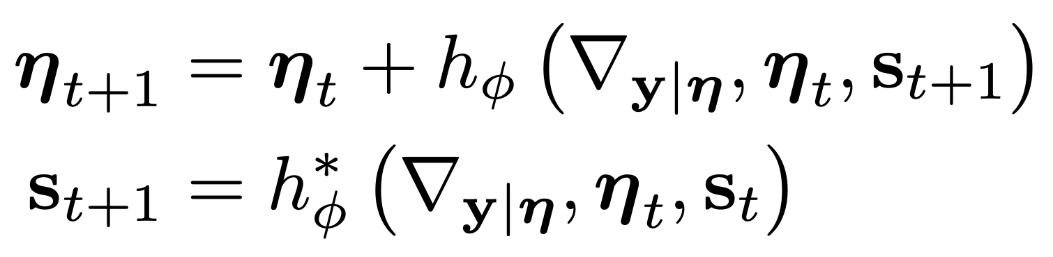
Models details
Hidden state:
With hidden state (no-hidden), without backprop through likelihood grads
Without hidden state (no-hidden), without backprop through likelihood grads
Without hidden state (no-hidden), with backprop through likelihood grads (bgl)

Slide 15
Additional experiments: baseline
Non-learned optimization: LBFGS with Total Variation (TV) prior:
Grid search to find optimal regularization weight
Liu, D.C., Nocedal, J. On the limited memory BFGS method for large scale optimization. Mathematical Programming 45, 503–528 (1989). https://doi.org/10.1007/BF01589116

Slide 16
Results

