Slide 1

ASSIGNMENT SUMMARY FOR DATA SCIENCE INTERN POSITION SUBMITTED BY YASHWI V SHAH MOB: 7898556656 EMAIL-ID: iamyashwi@gmail.com

Slide 2
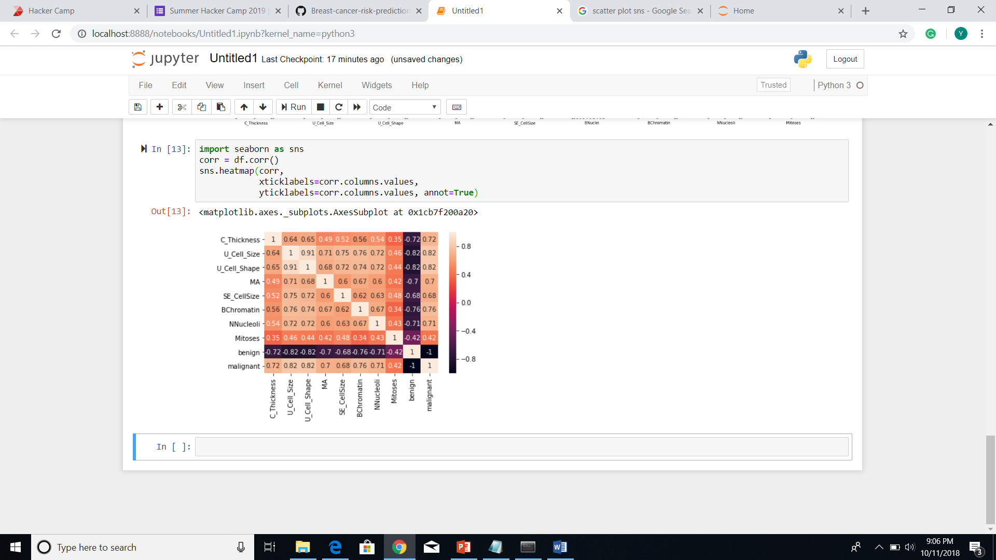
Tripadvisor dataset Aim: Build a classification/regression model to predict scores for any new reviewer.
1) The dataset was a mixture of categorical and continuous features. Analyzed the features columns to find if they had any correlation with the label and detect the duplicates. 2)All the categorical features were converted into dummy columns(one-hot encoding) 3)The most important observation was that the data was in order with the hotel names. Therefore, shuffling was done before training the data. 4) Models that were expected to give better results were taken into account. 5)The splitting of data into train-test data was repeated 5 times(since data was not completely random even after shuffling) and the mean of their mean absolute percentage error was taken to identify the best classifier.
While performing cross validation mean absolute error(MAE) metrics and mean absolute percentage error(MAPE) metrics while testing the model was taken into account.
Random Forests classifier had the mean absolute percentage error of 27.68% which was better than other models.

Slide 3
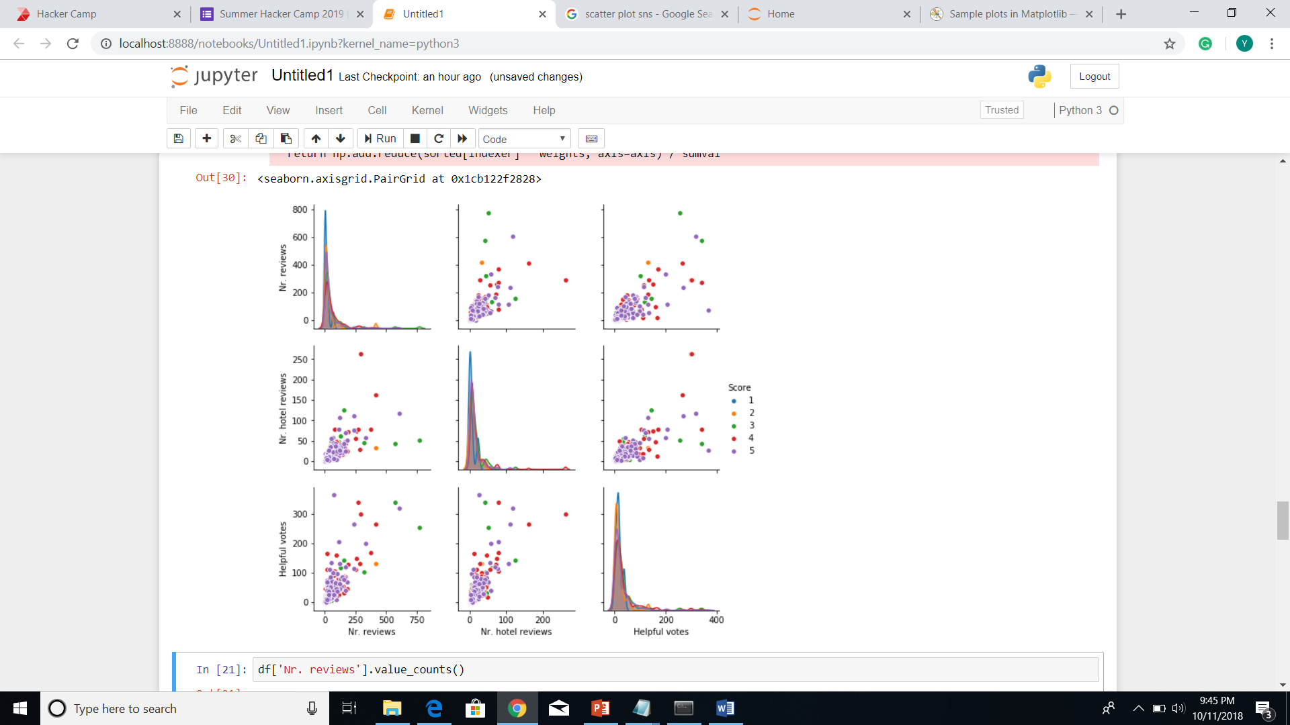
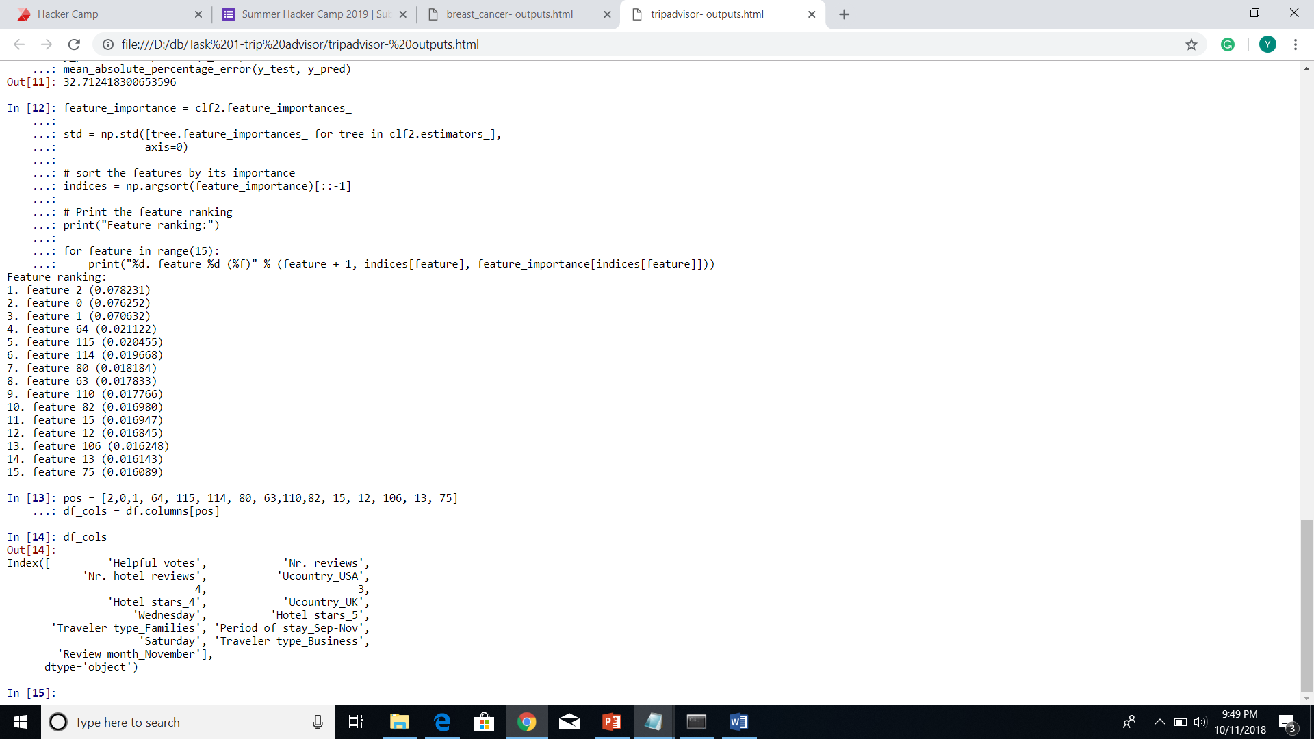
Q. Identify features that are most relevant in the model. Since random forests classifier had better mean percentage error than others so the features that were most relevant according to the model are displayed in bottom-right corner.
1)Nr. Reviews, Nr. Hotel reviews and Helpful votes are relevant as shown in scatter plot.
2)4, 3 indicate the member years. Maybe due to some Membership advantages.
3)Hotel stars is the feature that is kept in mind while reviewing so it should be relevant.
4)Review weekday Saturday might be due to weekends.
5)Labor day and Thanksgiving day is celebrated by most US citizens which calls for vacation justifying Period of stay and review month.

Slide 4
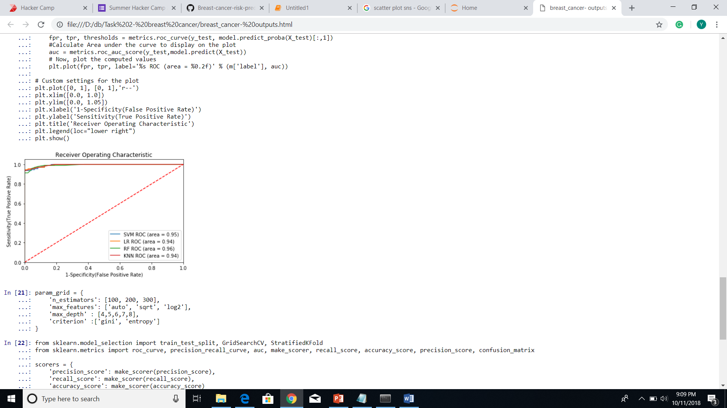
Breast cancer dataset Aim: Build a classification/regression model to predict scores for any new reviewer.
Procedure:
1) The dataset was a classification problem with binary label values. Analyzed the features columns to find if they had any correlation with the label and detected the duplicates. 2)Data cleaning was done and missing values were handled. Dummy columns for benign and malignant was created. 3)The features were normalized. 4)The models that were expected to give better results were taken into account. 5)ROC AUC metric was used for determining performance. 5)Random Forest proved to be best classifier with 0.96 value and 95.71% accuracy on test data.

Slide 5
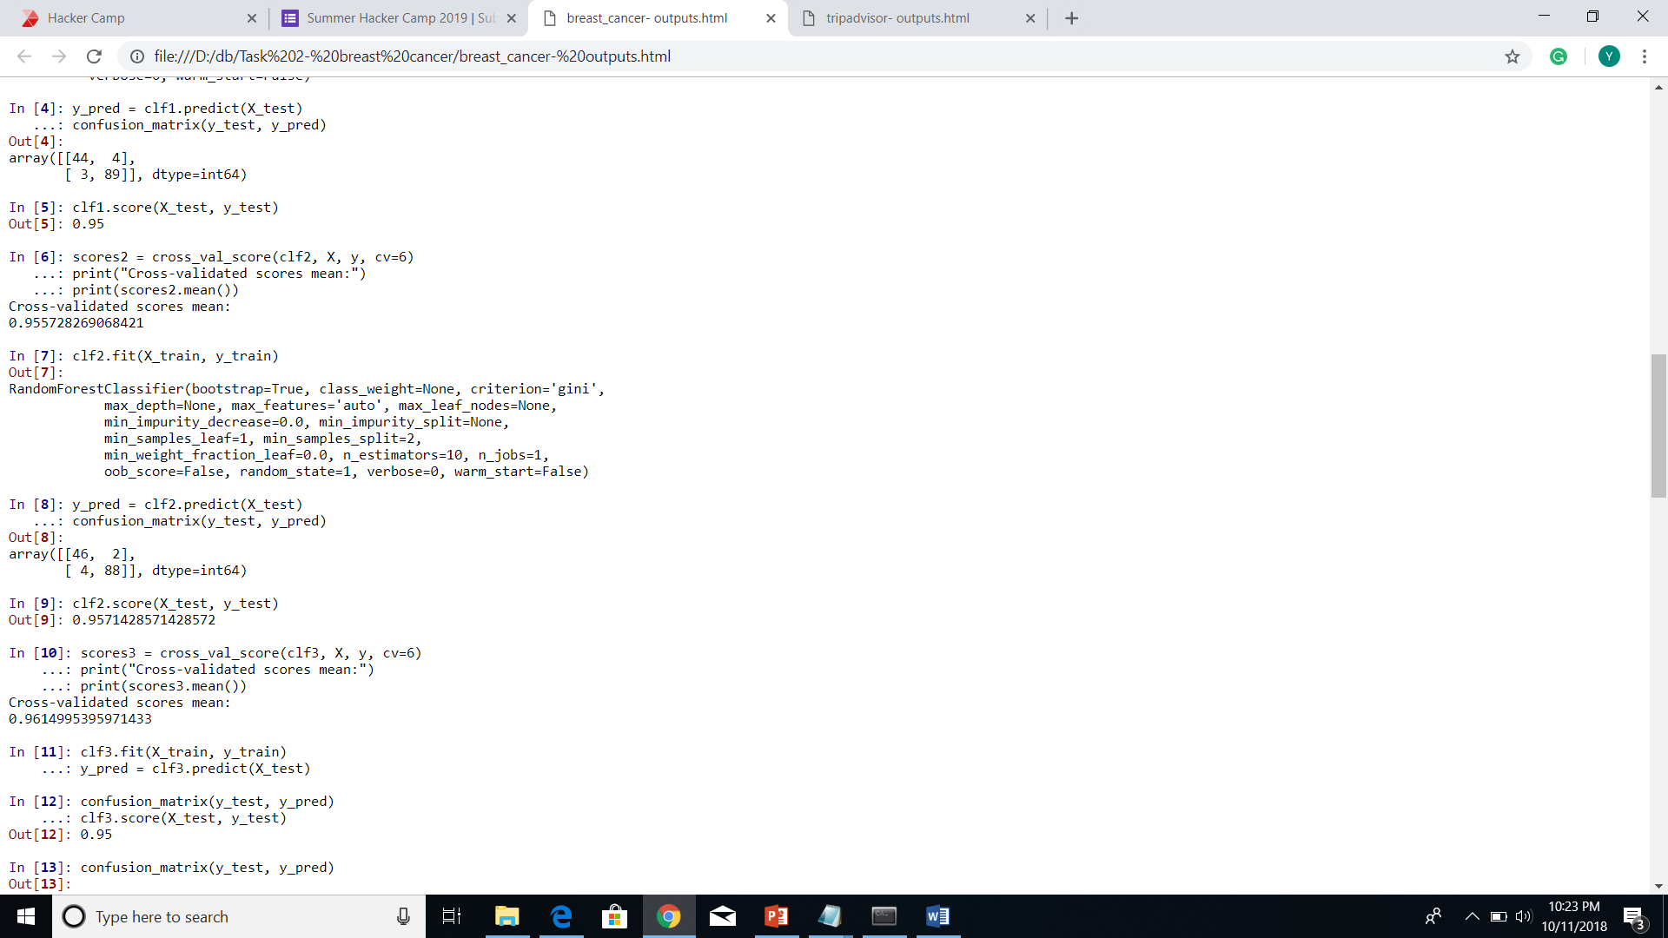
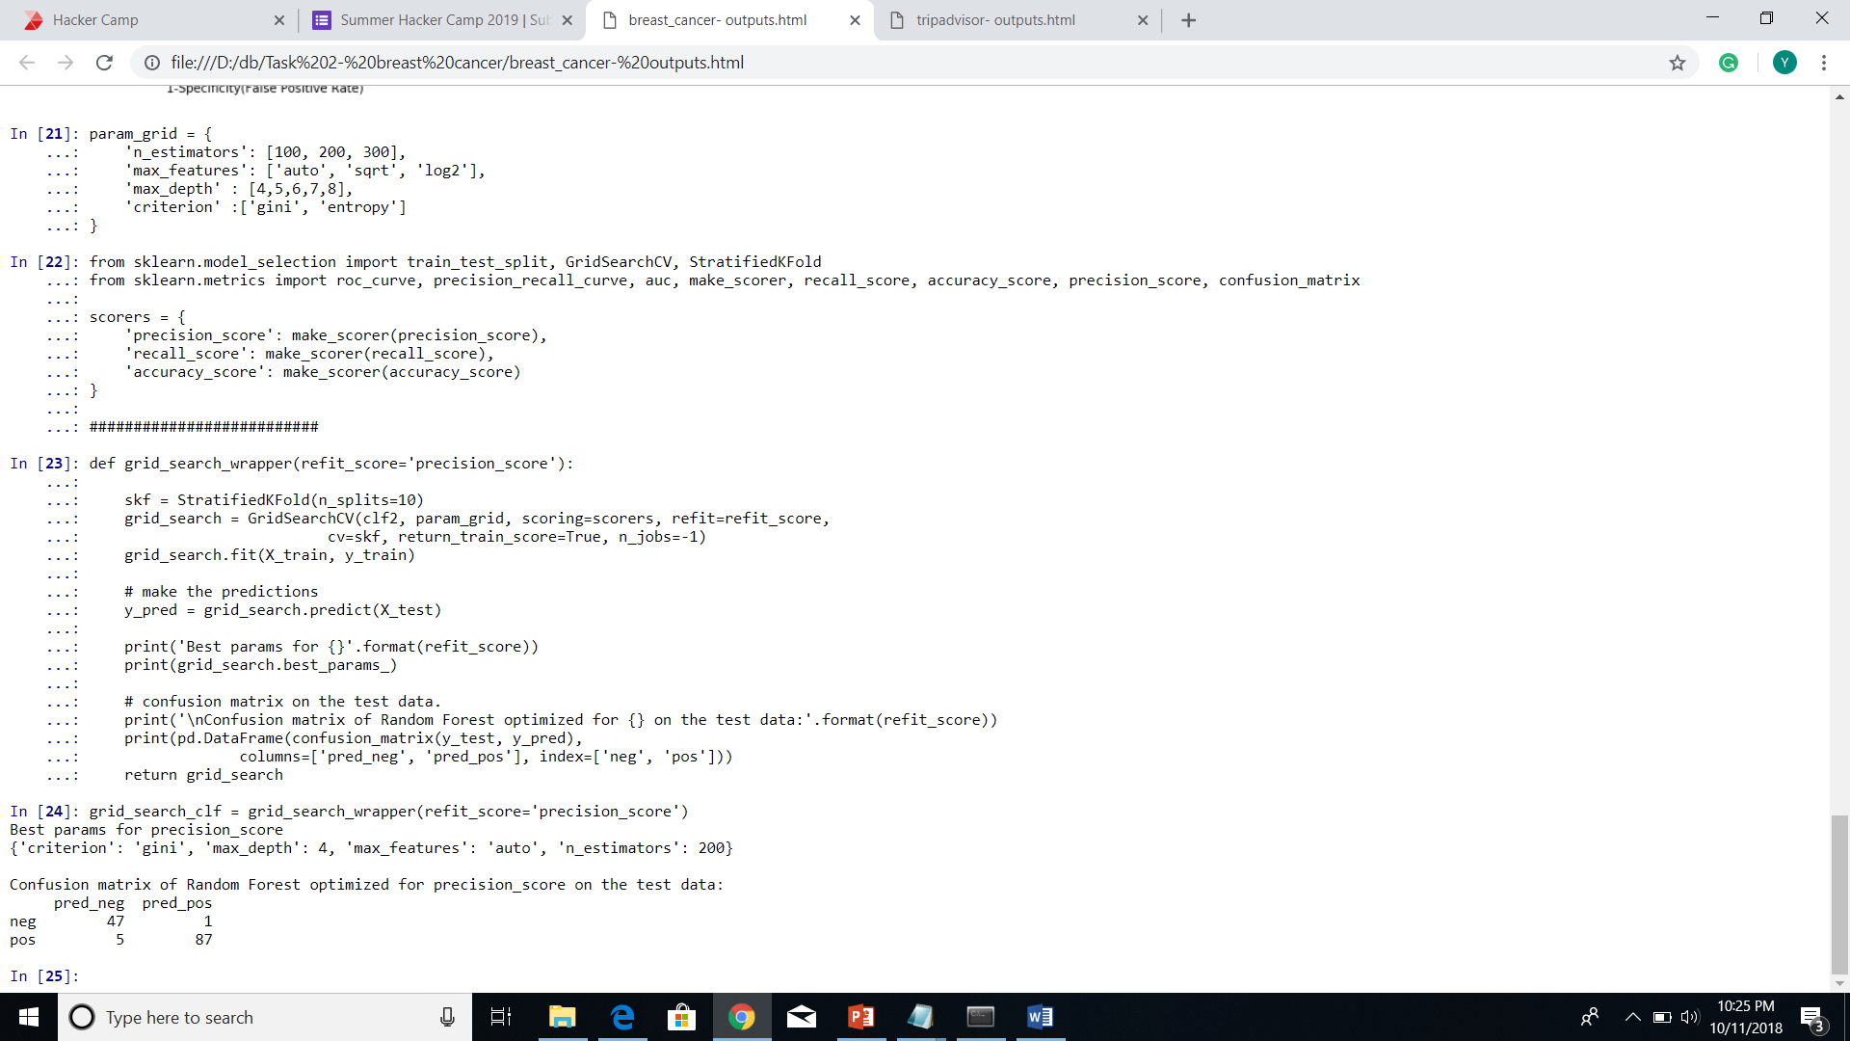
a. Identify the number of false positive and false negatives b. Improve your classification model to reduce patients who are being predicted as having benign tumor but actually have malignant tumor
Ans.
a)The values of false positives and false negatives were 2 and 4 respectively.
b) In my model, I have excluded malignant column after one hot encoding and kept benign as label column.
Therefore, we need to reduce our false positives. GridSearchCV was used and since false positives are inversely proportional to precision score. Therefore the scoring parameter was kept precision and the best learning parameters for maximum precision were returned which reduced the false positive as expected.
False positives became 1 and false negatives became 5.

