Slide 1
P&G annual report analysis
Yifan Song
ys3250@olumbia.edu
508-717-1889

Slide 2
First glimpse at the introduction and 10-k form
Intro
10-k

Slide 3
Core focus
Growth
Consumer
Market
Share
Value
Sales

Slide 4
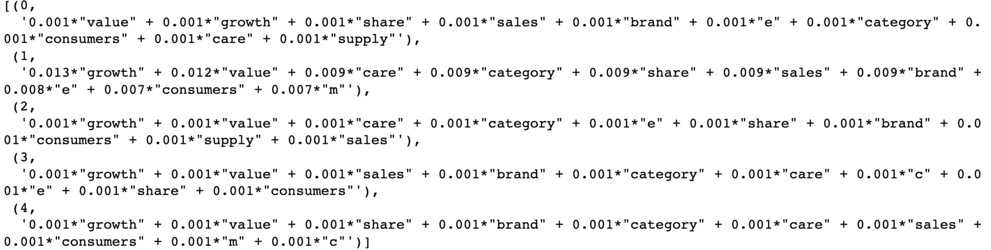
LDA shows similar topics what the word cloud generates

Slide 5
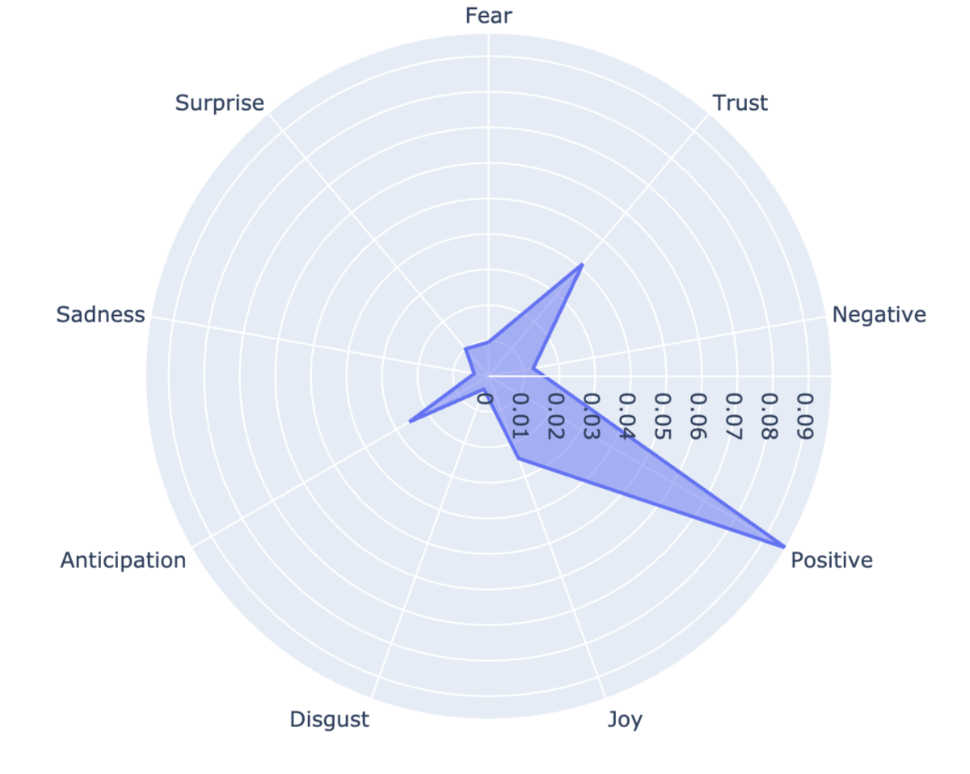
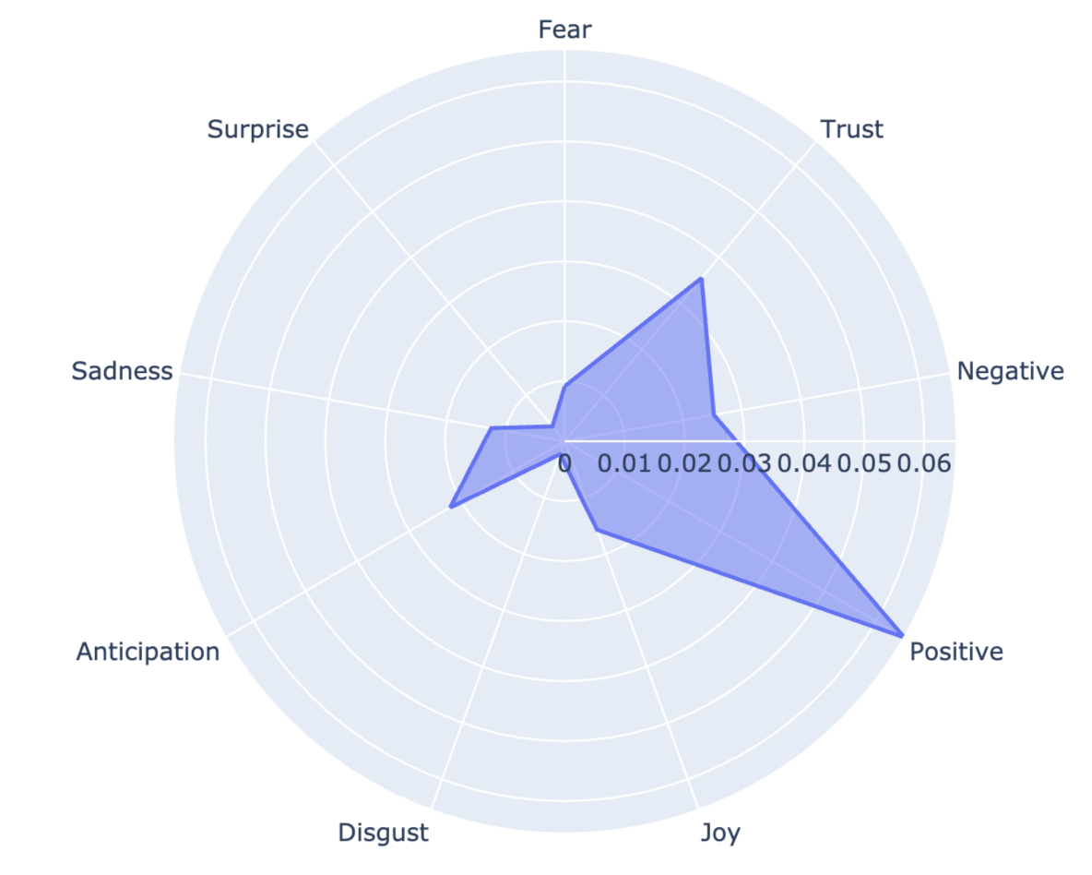
Emotions of intro and 10-k using NRC lexicon
intro
10-k
Both introduction and the 10-k form follow a similar pattern of emotion. 10-k form has higher negative and sadness scores possibly due to the nature of 10-k form.

Slide 6
Word2vec model
As we find that the emotions of introduction generally conforms to that of 10-k form, we combined the texts for word2vec model training.
Longer string tend to generate better model.
Generated a 128-dimension model
We can get a closer look at what do they mean when they say about a specific word.

Slide 7
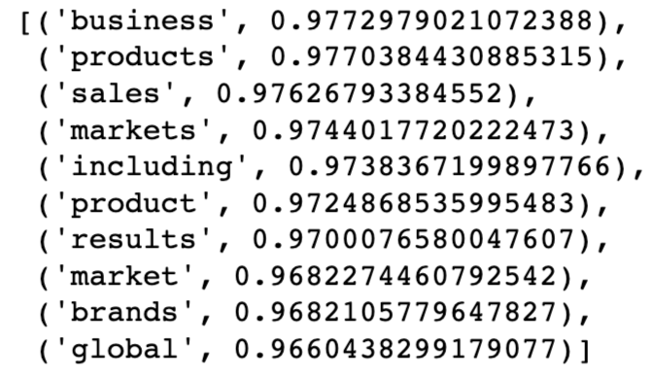
Growth
The model indicates that growth has strong relationship with business, products, sales, etc…
Not reflected in LDA model, growth is strongly related to global as well.
This might indicate P&G’s interest in expanding global market

Slide 8
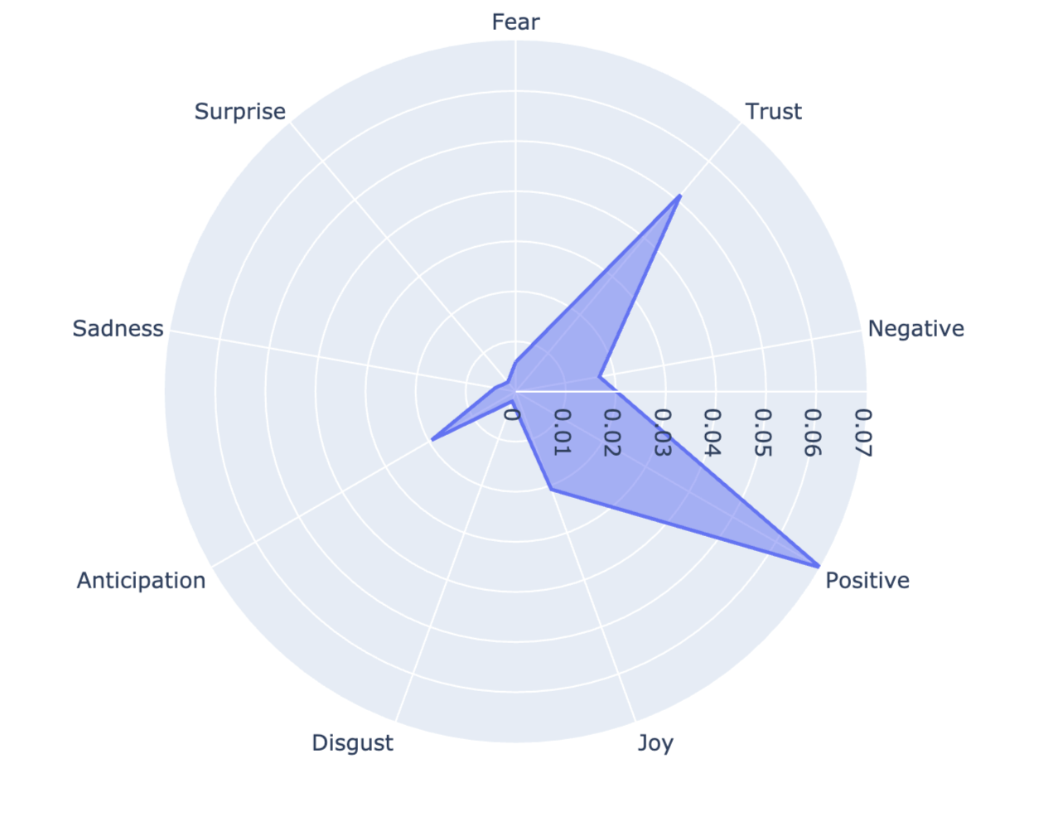
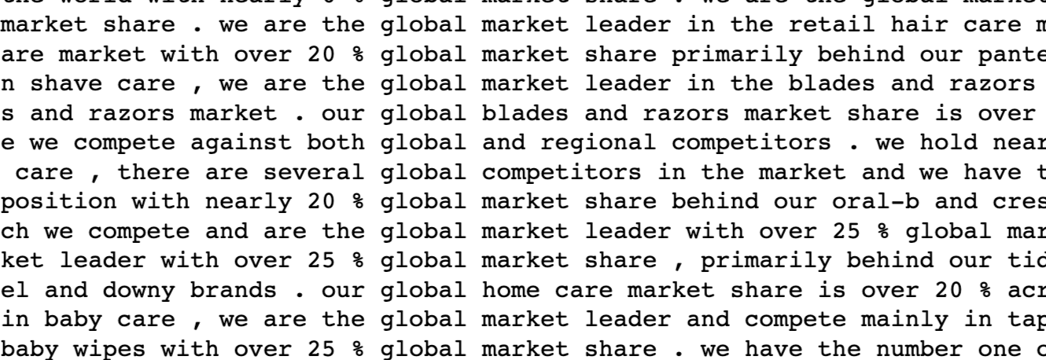
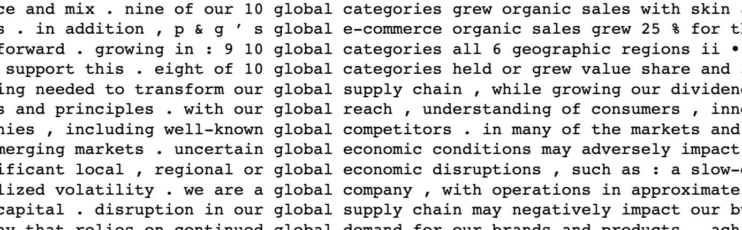
Global
Shows mostly sense of positive and trust when mentioning global
Global e-commerce
Uncertain global economic condition
Global market share

Slide 9
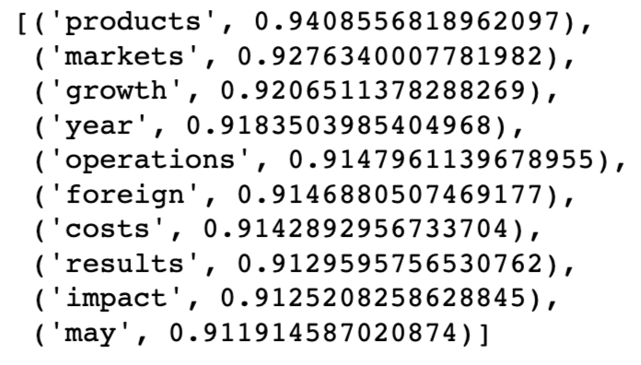
Earnings
The model indicates that earnings has strong products, markets, growth, operations, foreign and etc.

Slide 10
Earnings
Global e-commerce
Uncertain global economic condition
Global market share

